Slide 1
Visitation of Mary to Elizabeth
Year C
1 Samuel 2:1-10
Psalm 113
Romans 12:9-16b
Luke 1:39-57

Slide 2
He raises the poor from the dust, and lifts the needy from the ash heap, to make them sit with princes, with the princes of his people.
Psalm 113:7-8

Slide 3
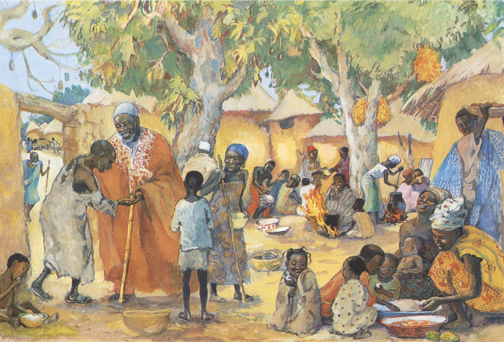
The Poor Invited to the Feast -- JESUS MAFA, Cameroon

Slide 4
Rejoice with those who rejoice, weep with those who weep.
Romans 12:9-16b

Slide 5
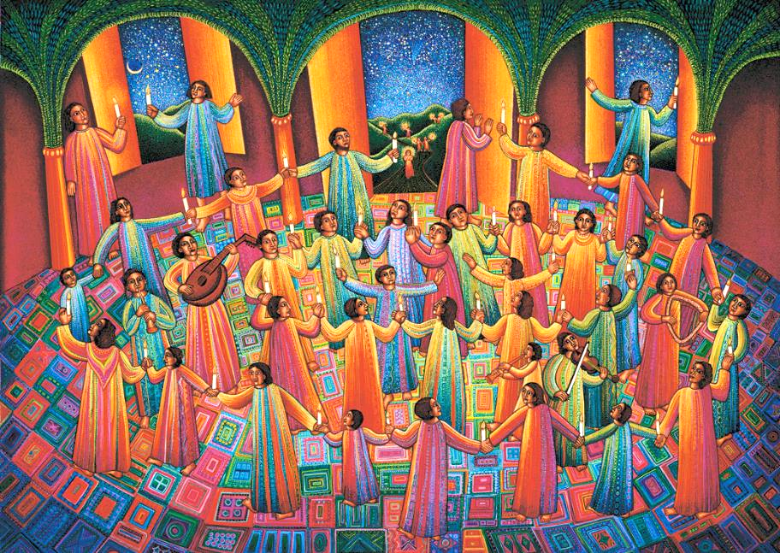
A Celebration -- John August Swanson

Slide 6
When Elizabeth heard Mary's greeting, the child leaped in her womb. And Elizabeth was filled with the Holy Spirit ....
Luke 1:41

Slide 7
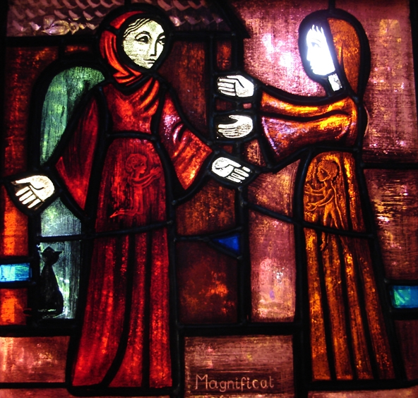
Magnificat -- Brother Eric, Church of Reconciliation, Taize, France

Slide 8
and exclaimed with a loud cry, "Blessed are you among women, and blessed is the fruit of your womb.
Luke 1:42

Slide 9
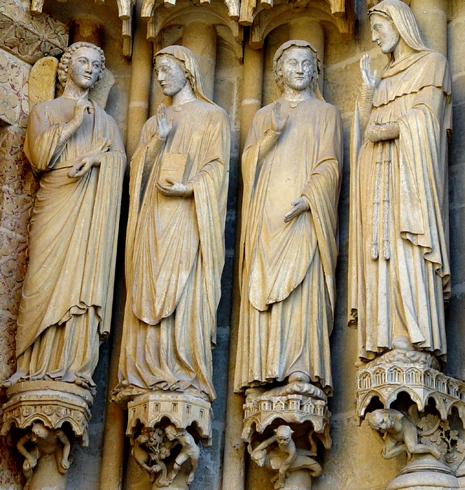
Annunciation and Visitation
Amiens Cathedral
Amiens, France

Slide 10
And why has this happened to me, that the mother of my Lord comes to me?
Luke 1:43

Slide 11
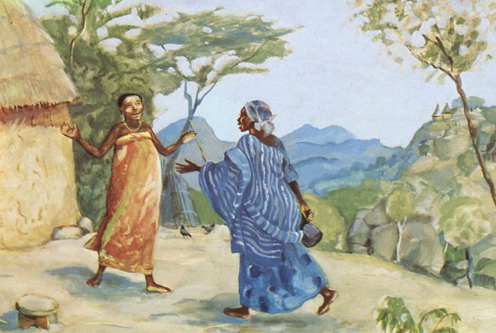
The Visitation -- JESUS MAFA, Cameroon

Slide 12
For as soon as I heard the sound of your greeting, the child in my womb leaped for joy.
Luke 1:44

Slide 13
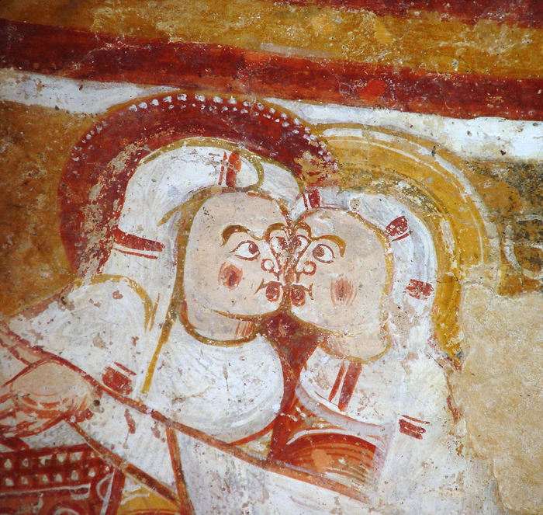
The Visitation
Church of St. Martin
Nohant-Vicq, France

Slide 14
And blessed is she who believed that there would be a fulfillment of what was spoken to her by the Lord."
Luke 1:45

Slide 15
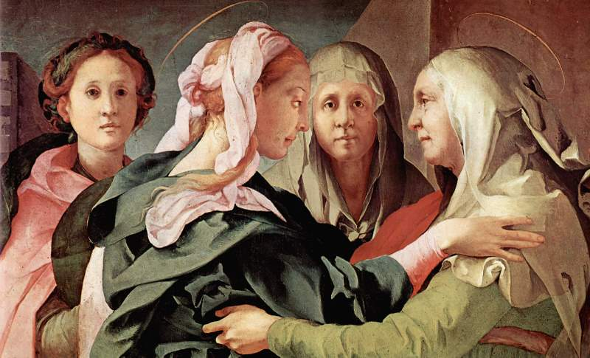
Visitation of Mary -- Jacopo da Pontormo, Parish Church, Carmignano, Italy

Slide 16
And Mary said, "My soul magnifies the Lord, and my spirit rejoices in God my Savior,
Luke 1:46-47

Slide 17
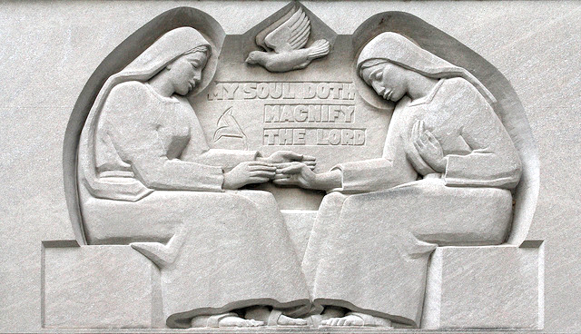
The Magnificat -- Baltimore Cathedral, Baltimore, MD

Slide 18
for he has looked with favor on the lowliness of his servant. Surely, from now on all generations will call me blessed;
Luke 1:48

Slide 19
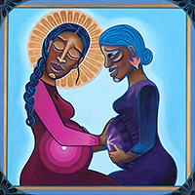
The Magnificat
Mary and Elizabeth
Lauren Wright Pittman
Liturgical artist

Slide 20
for the Mighty One has done great things for me, and holy is his name.
Luke 1:49

Slide 21
The Red Magnificat
Frank Wesley

Slide 22
His mercy is for those who fear him from generation to generation.
Luke 1:50

Slide 23
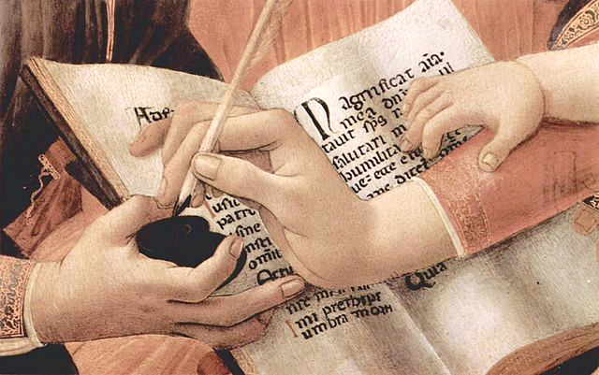
Madonna of the Magnificat (detail) -- Sandro Botticelli, Uffizi Gallery, Florence, Italy

Slide 24
He has shown strength with his arm; he has scattered the proud in the thoughts of their hearts.
Luke 1:51

Slide 25
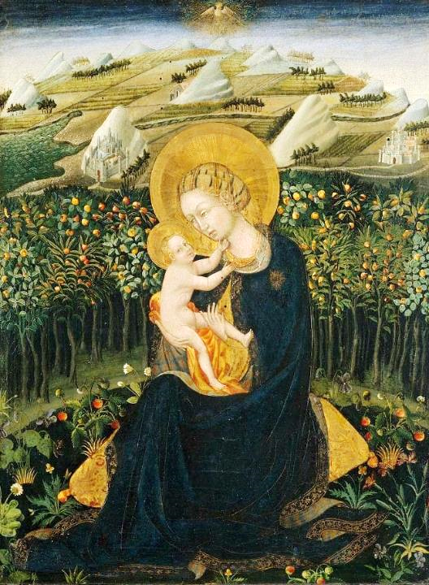
Madonna of Humility
Giovanni di Paolo
Museum of Fine Arts
Boston, MA

Slide 26
He has brought down the powerful from their thrones, and lifted up the lowly;
Luke 1:52

Slide 27
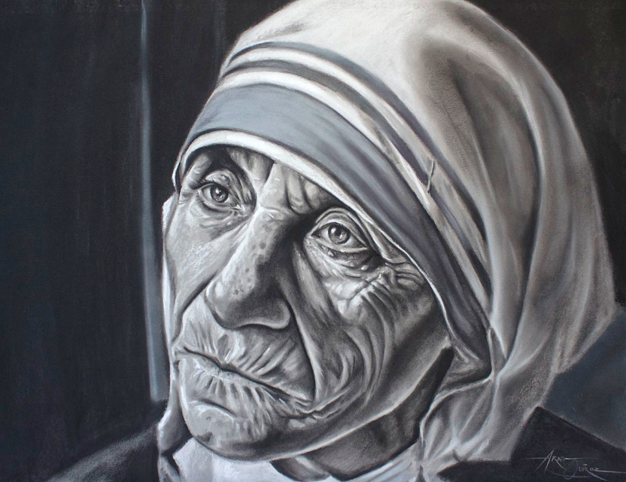
Mother Teresa -- Ariel Quiroz

Slide 28
he has filled the hungry with good things, and sent the rich away empty.
Luke 1:53

Slide 29
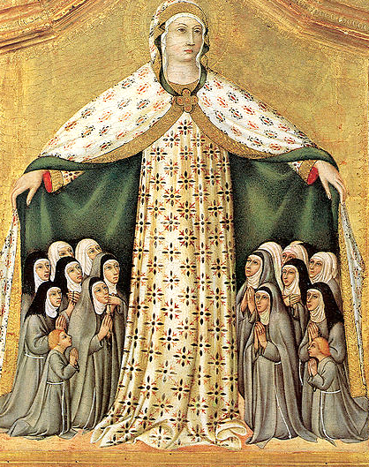
Madonna of Mercy
Sano di Pietro

Slide 30
He has helped his servant Israel, in remembrance of his mercy,
Luke 1:54

Slide 31
The Visitation -- Keur Moussa Abbey, Senegal

Slide 32
according to the promise he made to our ancestors, to Abraham and to his descendants forever."
Luke 1:55

Slide 33
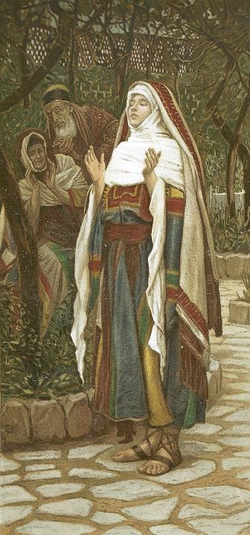
Magnificat
James Tissot
Brooklyn Museum
New York City

Slide 34
Credits
New Revised Standard Version Bible, copyright 1989, Division of Christian Education of the National Council of the Churches of Christ in the United States of America. Used by permission. All rights reserved.
http://diglib.library.vanderbilt.edu/act-imagelink.pl?RC=48397
Estate of John August Swanson, https://www.johnaugustswanson.com/
http://www.flickr.com/photos/swperman/221074981/
http://diglib.library.vanderbilt.edu/act-imagelink.pl?RC=29442
http://diglib.library.vanderbilt.edu/act-imagelink.pl?RC=48279
http://diglib.library.vanderbilt.edu/act-imagelink.pl?RC=42422
www.yorckproject.de
https://www.flickr.com/photos/paullew/23612984750
http://www.lewpstudio.com - copyright by Lauren Wright Pittman
Estate of Frank Wesley, http://www.frankwesleyart.com/main_page.htm
https://commons.wikimedia.org/wiki/File:Sandro_Botticelli_057.jpg
https://commons.wikimedia.org/wiki/File:Madonna_of_Humility.Giovanni_di_Paolo._Boston_MFA.jpg
https://commons.wikimedia.org/wiki/File:Mother_Teresa_flickr.jpg
https://commons.wikimedia.org/wiki/File:Sano_di_Pietro._Madonna_of_Mercy.1440s_Private_coll..jpg
https://commons.wikimedia.org/wiki/File:KeurMoussaAutel.jpg
https://commons.wikimedia.org/wiki/File:Brooklyn_Museum_-_The_Magnificat_(Le_magnificat)_-_James_Tissot_-_ov Erall_.jpg
Additional descriptions can be found at the Art in the Christian Tradition image library, a service of the Vanderbilt Divinity Library, http://diglib.library.vanderbilt.edu/. All images available via Creative Commons 3.0 License.

