Slide 1
THIRD SUNDAY AFTER THE EPIPHANY
Year C
Nehemiah 8:1-3, 5-6, 8-10 Psalm 19 • 1 Corinthians 12:12-31a • Luke 4:14-21

Slide 2
So they read from the book, from the law of God, with interpretation. They gave the sense, so that the people understood the reading.
Nehemiah 8:8

Slide 3
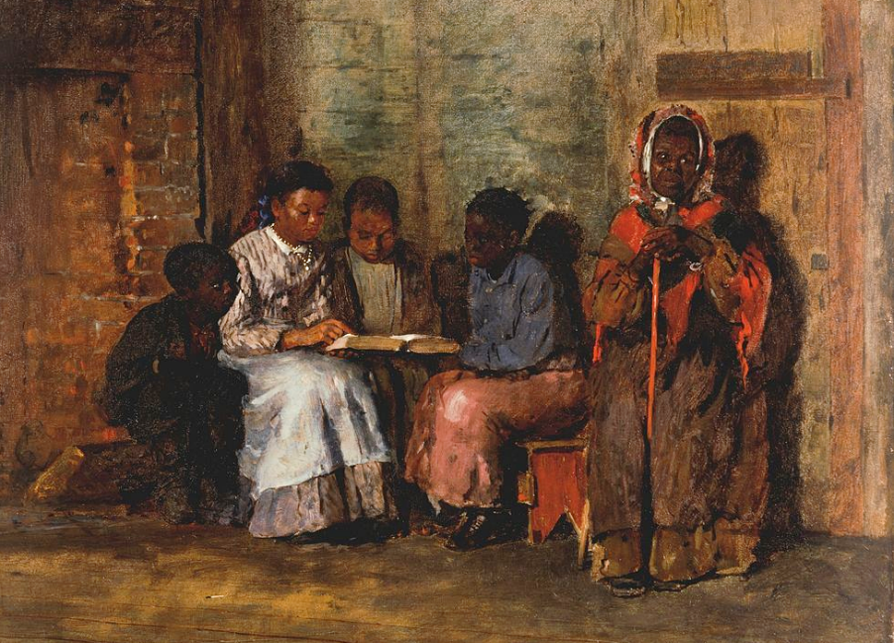
Sunday Morning in Virginia -- Winslow Homer, Cincinnati Art Museum, Cincinnati, Ohio

Slide 4
Let the words of my mouth and the meditation of my heart be acceptable to you, O LORD, my rock and my redeemer.
Psalm 19:14

Slide 5
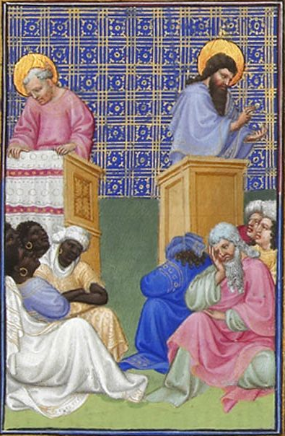
The Preaching of the Apostles
Les Très Riches Heures du duc de Berry
Musée Condé
Chantilly, France

Slide 6
On the contrary, the members of the body that seem to be weaker are indispensable,
1 Corinthians 12:22

Slide 7
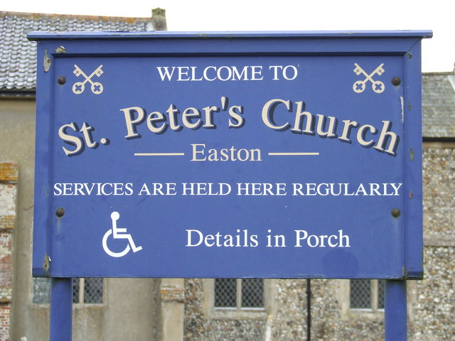
Welcoming Handicapped Information on Church Sign -- St. Peter's, Norfolk, England

Slide 8
Then Jesus, filled with the power of the Spirit, returned to Galilee, and a report about him spread through all the surrounding country.
Luke 4:14

Slide 9
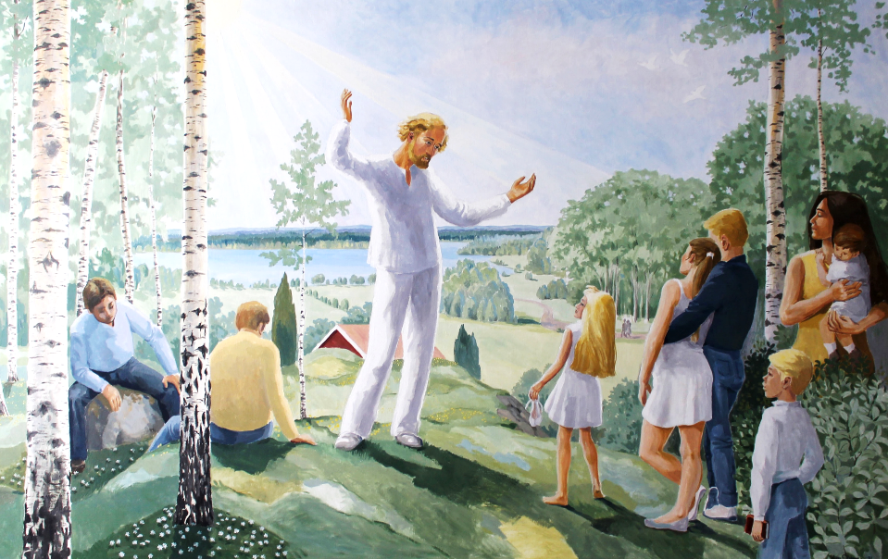
Jesus Preaching in the Present -- Söraby kyrka, Rottne, Sweden

Slide 10
He began to teach in their synagogues and was praised by everyone.
Luke 4:15

Slide 11
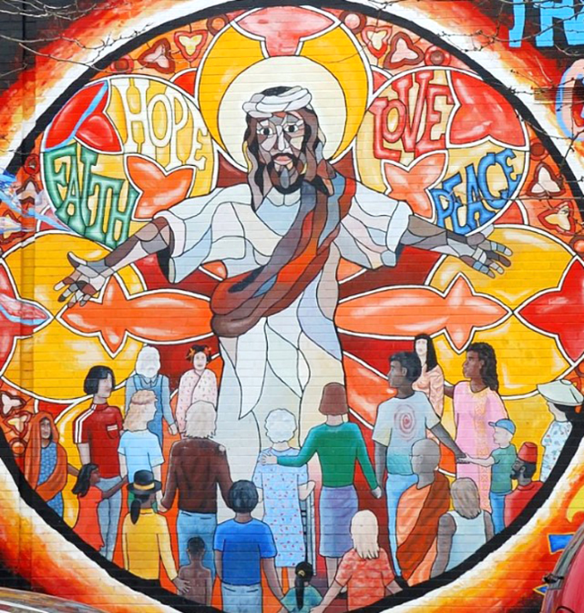
Jesus Mural of Faith, Hope, Love, and Peace

Slide 12
When he came to Nazareth, where he had been brought up, he went to the synagogue on the sabbath day, as was his custom. He stood up to read,
Luke 4:16

Slide 13
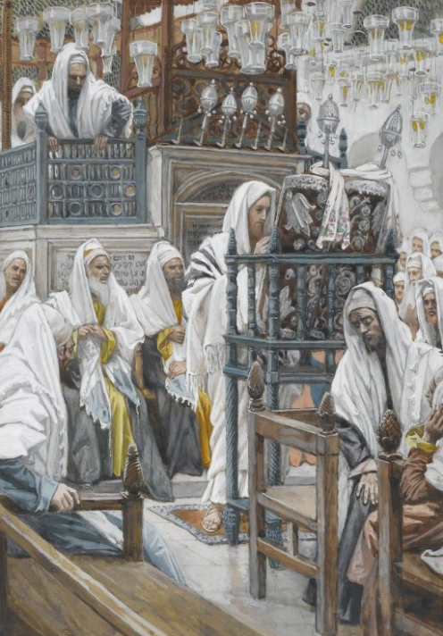
James Tissot: Jesus Unrolls the Book in the Synagogue
James Tissot
Brooklyn Museum
Brooklyn, NY

Slide 14
and the scroll of the prophet Isaiah was given to him. He unrolled the scroll and found the place where it was written:
Luke 4:17

Slide 15
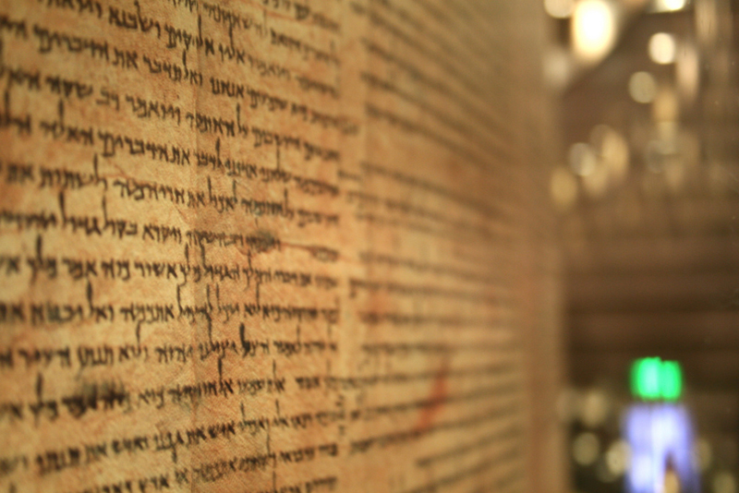
Scroll of Isaiah from Qumran -- Museum of Israel, Jerusalem

Slide 16
"The Spirit of the Lord is upon me, because he has anointed me to bring good news to the poor.
Luke 4:18a

Slide 17
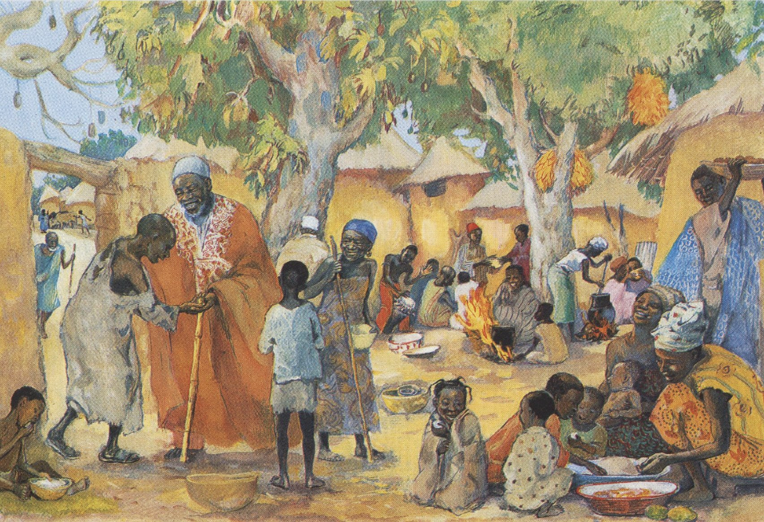
The Poor Invited to the Feast -- JESUS MAFA, Cameroon

Slide 18
He has sent me to proclaim release to the captives and recovery of sight to the blind, to let the oppressed go free,
Luke 4:18b

Slide 19
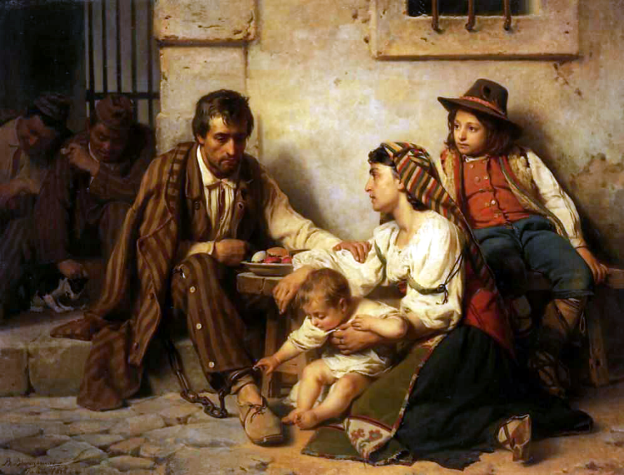
Appointment of a Prisoner with his Family -- V. P. Vereschchagin, Treyakov Gallery, Moscow, Russia

Slide 20
And he rolled up the scroll, gave it back to the attendant, and sat down. The eyes of all in the synagogue were fixed on him.
Luke 4:20

Slide 21
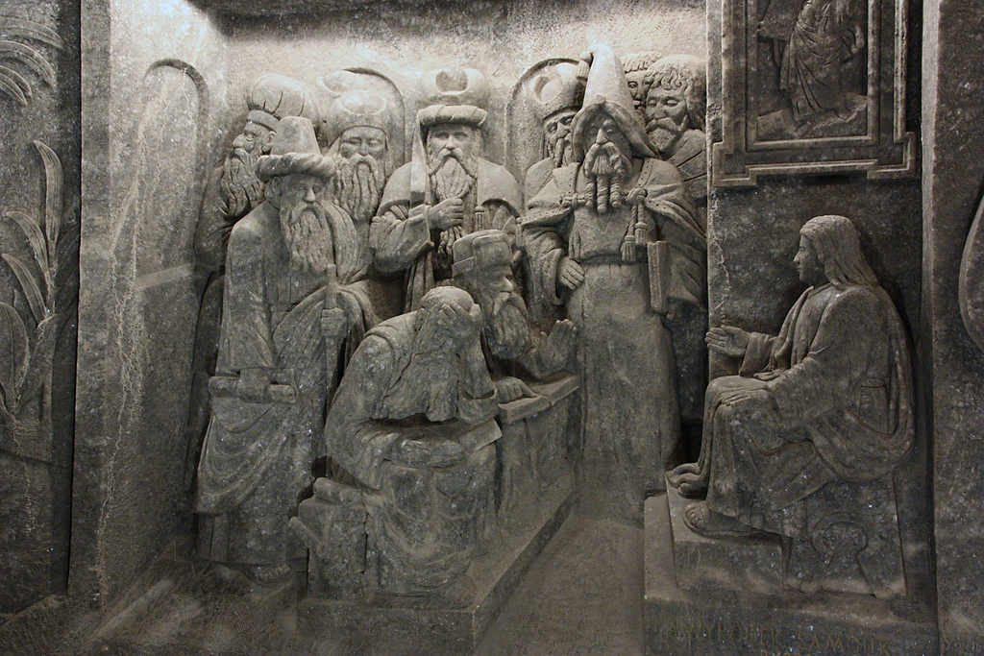
Christ Teaching -- Cathedral of Saint Kinga, in the salt mine of Wieliczka, Poland

Slide 22
Then he began to say to them, "Today this scripture has been fulfilled in your hearing."
Luke 4:21

Slide 23
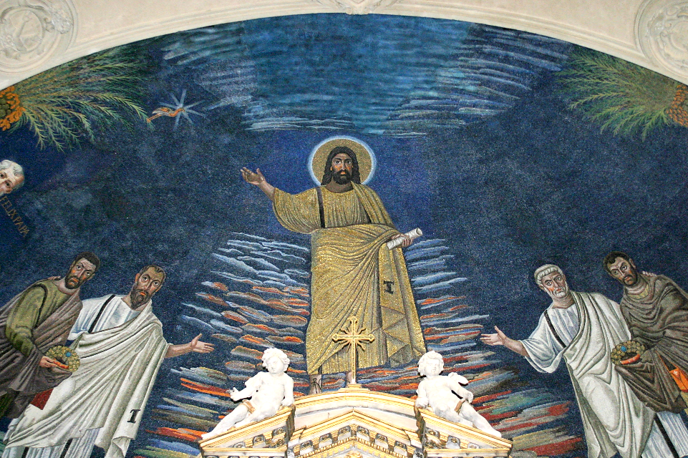
Apse Mosaic -- Basilica of Cosmas and Damien, Rome, Italy

Slide 24
Credits
New Revised Standard Version Bible, copyright 1989, Division of Christian Education of the National Council of the Churches of Christ in the United States of America. Used by permission. All rights reserved.
https://commons.wikimedia.org/wiki/File:Winslow_Homer_-_Sunday_Morning_in_Virginia.jpg
https://commons.wikimedia.org/wiki/File:Folio_28r_-_David_Foresees_the_Preaching_of_the_Apostles.jpg
https://commons.wikimedia.org/wiki/File:Church_Sign_-_geograph.org.uk_-_1188271.jpg
https://commons.wikimedia.org/wiki/File:S%C3%B6raby_kyrka_Tavla_021.JPG
https://www.flickr.com/photos/36847973@N00/3342340183
https://commons.wikimedia.org/wiki/File:Brooklyn_Museum_-_Jesus_Unrolls_the_Book_in_the_Synagogue_(J%C3%A9sus_dans_la_synagogue_d%C3%A9roule_le_livre)_-_James_Tissot_-_overall.jpg
http://www.flickr.com/photos/korephotos/2472547083/
http://diglib.library.vanderbilt.edu/act-imagelink.pl?RC=48397
http://commons.wikimedia.org/wiki/File:Appointment_of_a_prisoner_with_his_family.jpg
https://www.flickr.com/photos/klearchos/3869568394 - Klearchos Kapoutsis
http://diglib.library.vanderbilt.edu/act-imagelink.pl?RC=52452 – Lee Jefferson
Additional descriptions can be found at the Art in the Christian Tradition image library, a service of the Vanderbilt Divinity Library, http://diglib.library.vanderbilt.edu/. All images available via Creative Commons 3.0 License.

