Slide 1
SEVENTH SUNDAY OF EASTER
Year C
Acts 16:16-34 • Psalm 97 Revelation 22:12-14, 16-17, 20-21 • John 17:20-26

Slide 2
"Sirs, what must I do to be saved?" They answered, "Believe on the Lord Jesus" … then he and his entire family were baptized without delay.
Acts 16:30b, 31a, 33b

Slide 3
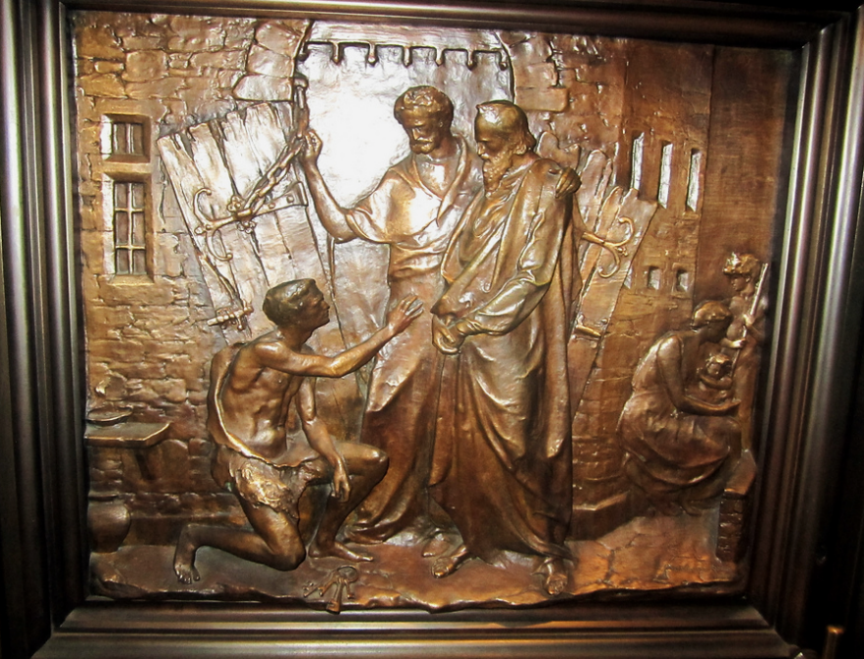
The Jailer, Paul, Silas, and the Jailer's Family -- Bronze doors, Trinity Church, New York, NY

Slide 4
The LORD is king! Let the earth rejoice; let the many coastlands be glad!
Psalm 97:1

Slide 5
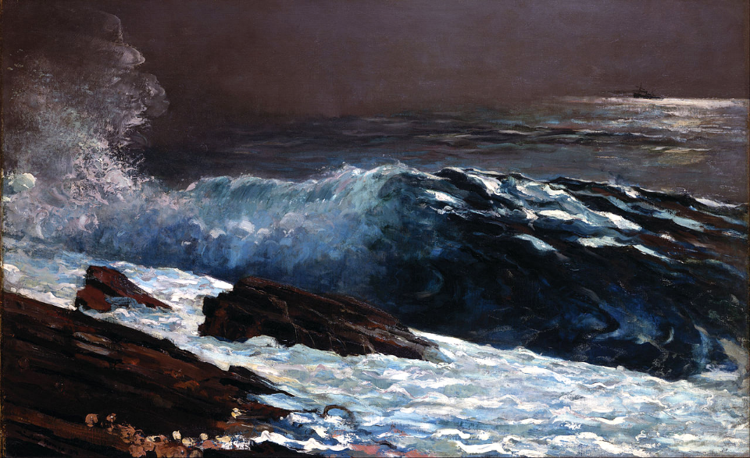
Sunlight Appears on the Coast -- Winslow Homer, Toledo Museum of Art, Toledo, OH

Slide 6
The heavens proclaim his righteousness; and all the peoples behold his glory.
Psalm 97:6

Slide 7
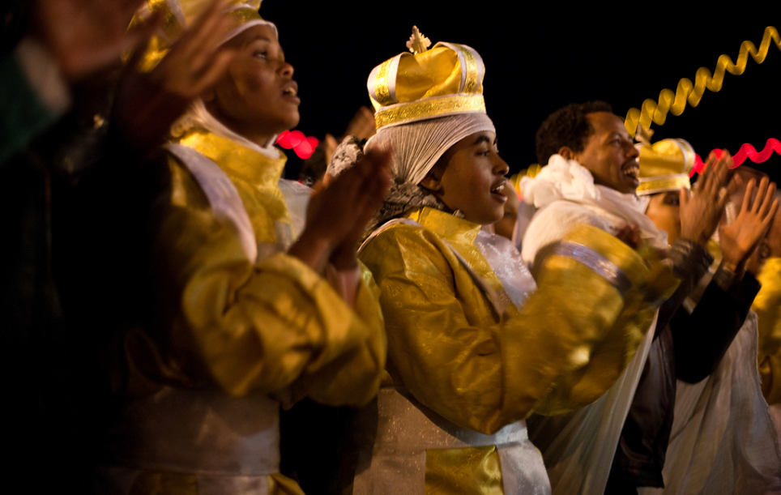
Ethiopian and Eritrean Refugees Celebrate Christmas -- Ridvan Yumlu, Bethlehem, Palestine

Slide 8
I am the Alpha and the Omega, the first and the last, the beginning and the end."
Revelation 22:13

Slide 9
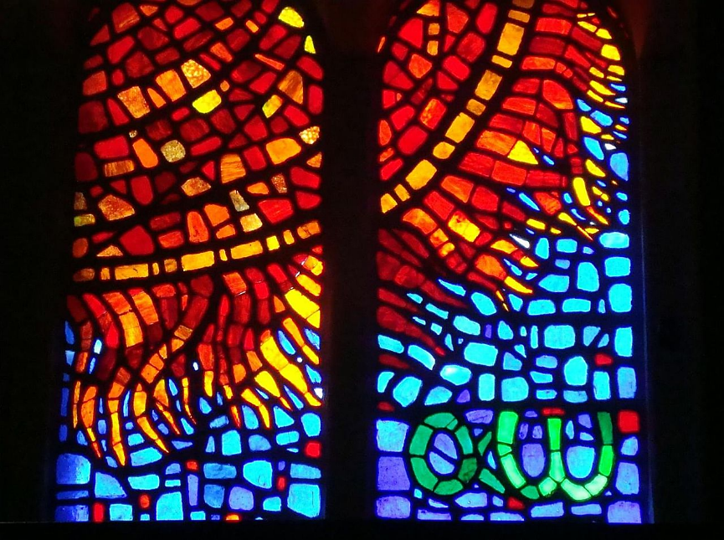
Alpha and Omega -- Saints Kings Church, Mexico City, Mexico

Slide 10
"I am the root and the descendant of David, the bright morning star."
Revelation 22:16b

Slide 11
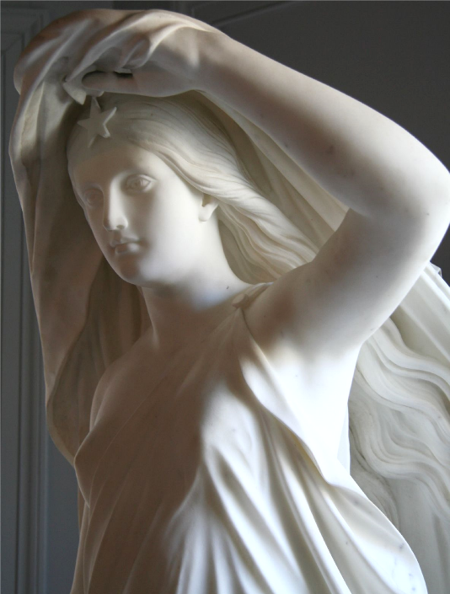
Morning Star
Thomas Crawford
RISD Museum
Providence, RI

Slide 12
… let everyone who is thirsty come. Let anyone who wishes take the water of life as a gift.
Revelation 22:17b

Slide 13
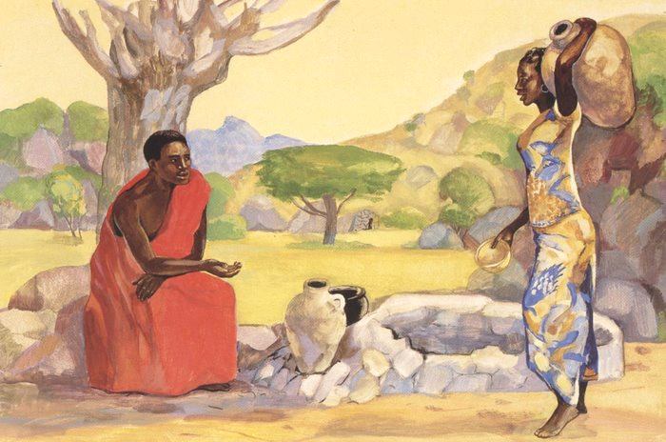
Jesus and the Woman at the Well -- JESUS MAFA, Cameroon

Slide 14
As you, Father, are in me and I am in you, may they also be in us, so that the world may believe that you have sent me.
John 17:21b

Slide 15
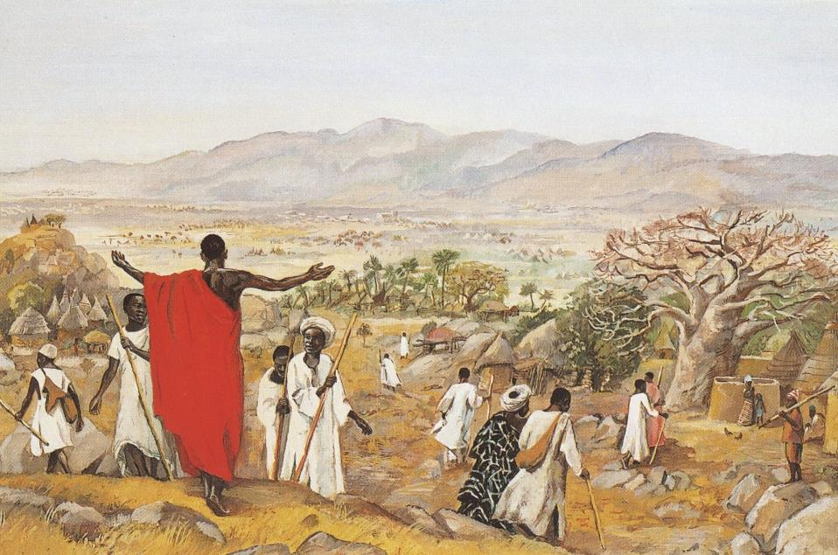
Mission to the World -- JESUS MAFA, Cameroon

Slide 16
"I ask … on behalf of those who will believe in me through their word, that they may all be one."
John 17:20ac, 21a

Slide 17
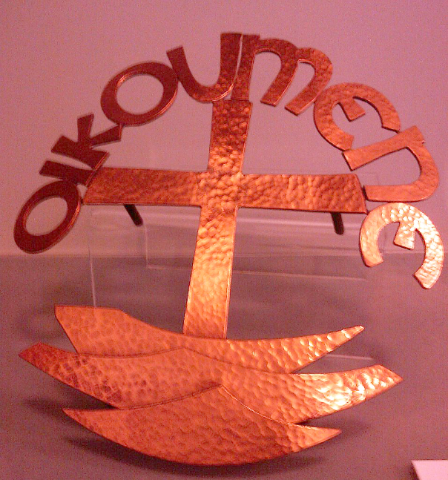
Oikoumene – Symbol of World Council of Churches
Ronald Pope
Derby Museum
Derby, England

Slide 18
Father, I desire that those … whom you have given me, may be with me where I am … because you loved me before the foundation of the world.
John 17:24ac

Slide 19
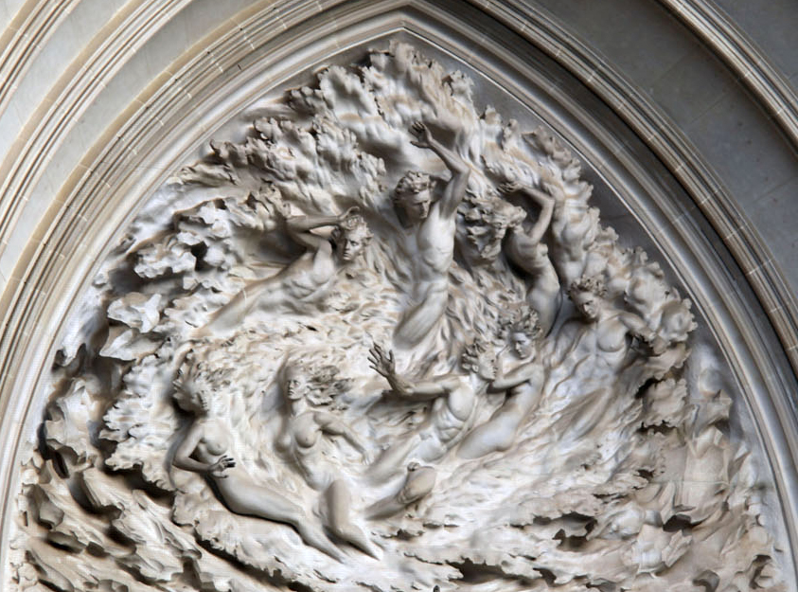
"Out of Nothing" – The Creation of Humankind -- Frederick Hart, Washington National Cathedral, DC

Slide 20
Come, Lord Jesus!
Revelation 22:20b

Slide 21
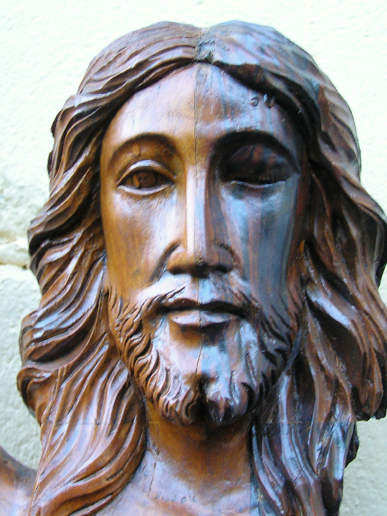
Christ Crucified and Risen
Baguio, Philippines

Slide 22
The grace of the Lord Jesus be with all the saints.
Amen.
Revelation 22:21

Slide 23
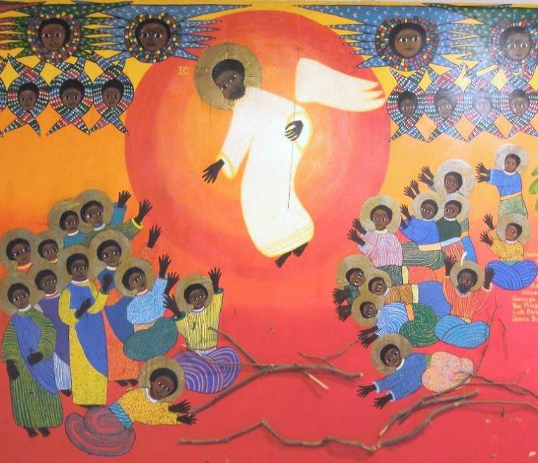
Christ's Ascension -- Emmaus House Martyrs of Uganda, Kamapala, Uganda

Slide 24
Credits
New Revised Standard Version Bible, copyright 1989, Division of Christian Education of the National Council of the Churches of Christ in the United States of America. Used by permission. All rights reserved.
https://www.flickr.com/photos/wallyg/5090420939/ - Wally Gobetz
https://commons.wikimedia.org/wiki/File:Winslow_Homer_-_Sunlight_on_the_Coast_-_Google_Art_Project.jpg
https://www.flickr.com/photos/pal_pics/6713162773 - Ridvan Yumlu
https://commons.wikimedia.org/wiki/File:Saints_Kings_Church,_3000_R%C3%ADo_Consulado_Avenue,_Venustiano_Carranza,_Federal_District,_Mexico07_-_Sun,_Alpha_Omega.jpg - Enrique López-Tamayo Biosca
https://www.flickr.com/photos/skrobola/395962706/ - Mark Skrobola
http://diglib.library.vanderbilt.edu/act-imagelink.pl?RC=48282
http://diglib.library.vanderbilt.edu/act-imagelink.pl?RC=48314
https://commons.wikimedia.org/wiki/File:RonaldPopeInfirmary_(1).jpg – Victuallers
https://www.flickr.com/photos/timevanson/6623043189/
https://www.flickr.com/photos/jardek/804315429/ - Joshua Jardekah Aguilar
https://www.flickr.com/photos/jimforest/5710252358
Additional descriptions can be found at the Art in the Christian Tradition image library, a service of the Vanderbilt Divinity Library, http://diglib.library.vanderbilt.edu/. All images available via Creative Commons 3.0 License.

