Slide 1
REIGN OF CHRIST
Year C
Jeremiah 23:1-6 and Luke 1:68-79 • Jeremiah 23:1-6 and Psalm 46 • Colossians 1:11-20 • Luke 23:33-43

Slide 2
I will raise up for David a righteous Branch, and he shall reign as king and deal wisely, and shall execute justice and righteousness in the land.
Jeremiah 23:5b

Slide 3
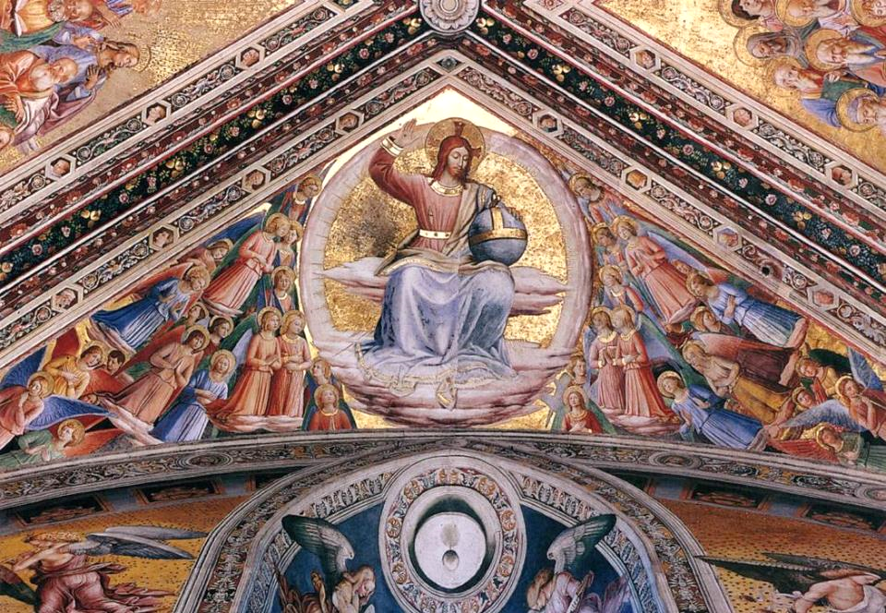
Christ the Judge -- Fra Angelico, Cappella di San Brizio, Orvieto, Italy

Slide 4
"By the tender mercy of our God, the dawn from on high will break upon us,
Luke 1:78

Slide 5
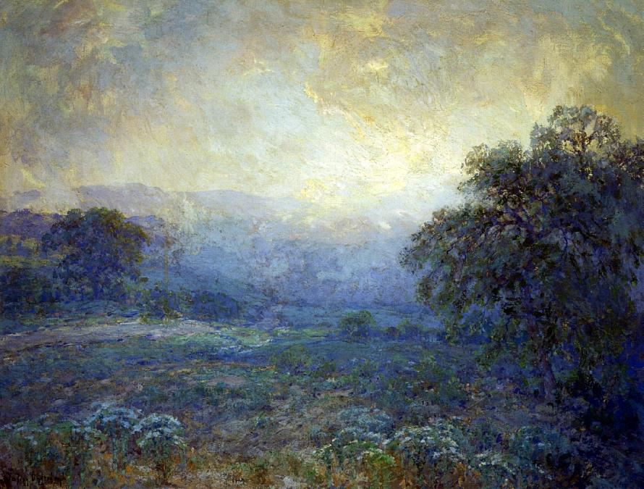
Dawn in the Hills -- Julian Onderdonk, 1922

Slide 6
to give light to those who sit in darkness and in the shadow of death, to guide our feet into the way of peace."
Luke 1:79

Slide 7
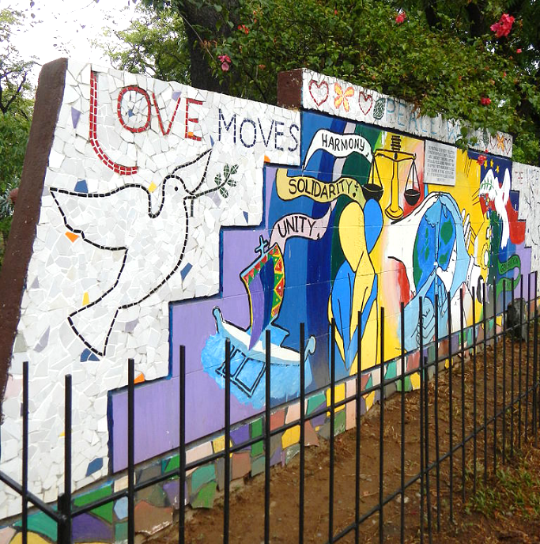
World Peace Wall
World Peace Bell Park
Quezon City, Philippines

Slide 8
He makes wars cease to the end of the earth; he breaks the bow, and shatters the spear; he burns the shields with fire.
Psalm 46:9

Slide 9
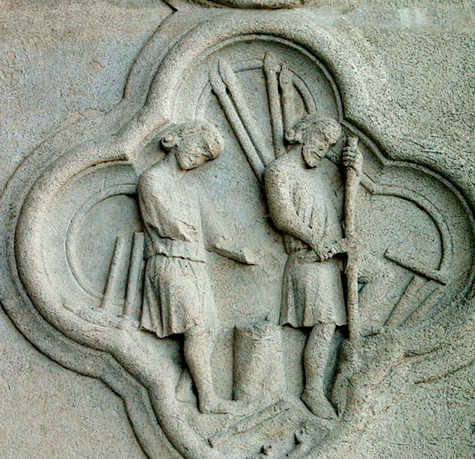
Shattering Spears
Amiens Cathedral
13th century
Amiens, France

Slide 10
"Be still, and know that I am God!"
Psalm 46:10a

Slide 11
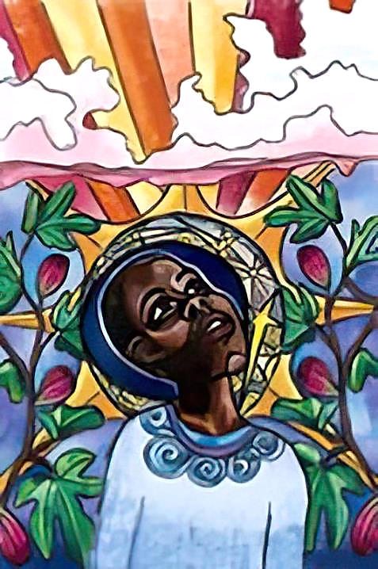
Raise Your Head
Lauren Wright Pittman

Slide 12
He himself is before all things,
and in him all things hold together.
Colossians 1:17

Slide 13
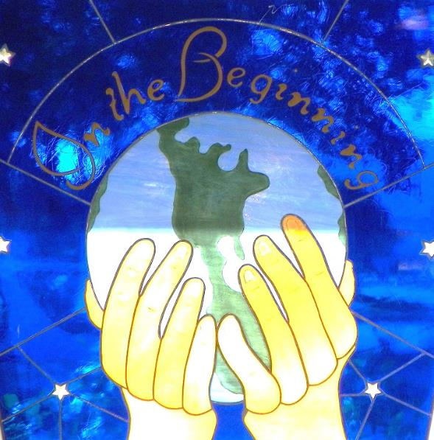
In the Beginning -- Metropolitan Community Church, Boynton Beach, FL

Slide 14
When they came to the place that is called The Skull, they crucified Jesus there with the criminals, one on his right and one on his left.
Luke 23:33

Slide 15
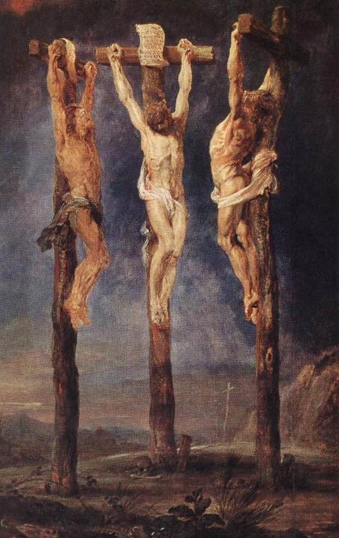
Three Crosses
Peter Paul Rubens
Museum Boijmans Van Beuningen
Rotterdam, Netherlands

Slide 16
Then Jesus said, "Father, forgive them; for they do not know what they are doing."
Luke 23:34a

Slide 17
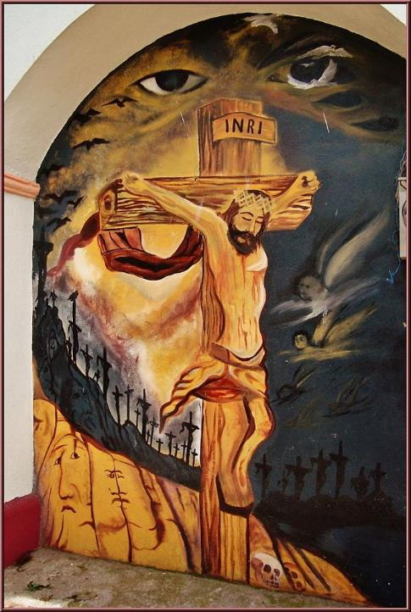
Crucifixion
Parish Church of the Assumption of Mary
Coatepec, Mexico

Slide 18
One of the criminals who were hanged there kept deriding him and saying, "Are you not the Messiah? Save yourself and us!"
Luke 23:39

Slide 19
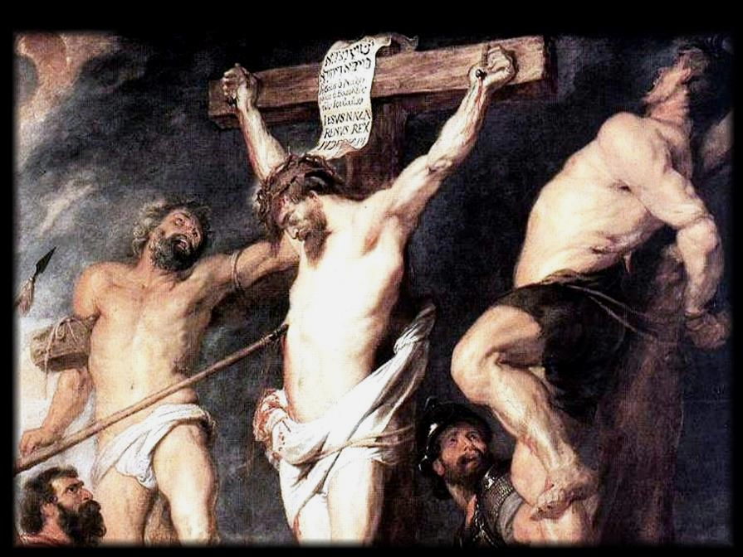
Christ Crucified Between Two Thieves -- Peter Paul Rubens, Royal Museum, Antwerp, Belgium

Slide 20
But the other rebuked him, saying, "Do you not fear God, since you are under the same sentence of condemnation?
Luke 23:40

Slide 21
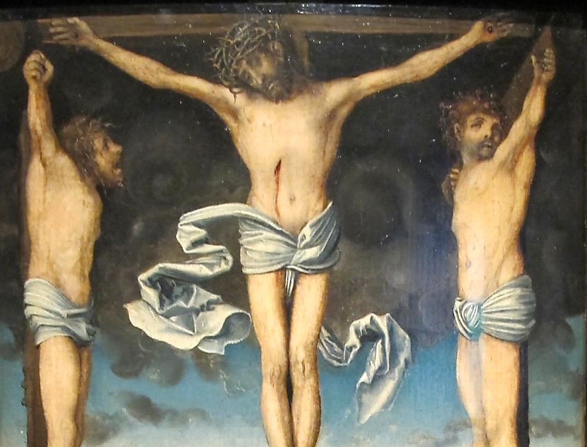
Christ Between Two Thieves -- Lucas Cranach the Elder, Alte Pinakothek, Munich, Germany

Slide 22
And we indeed have been condemned justly, for we are getting what we deserve for our deeds, but this man has done nothing wrong."
Luke 23:41

Slide 23
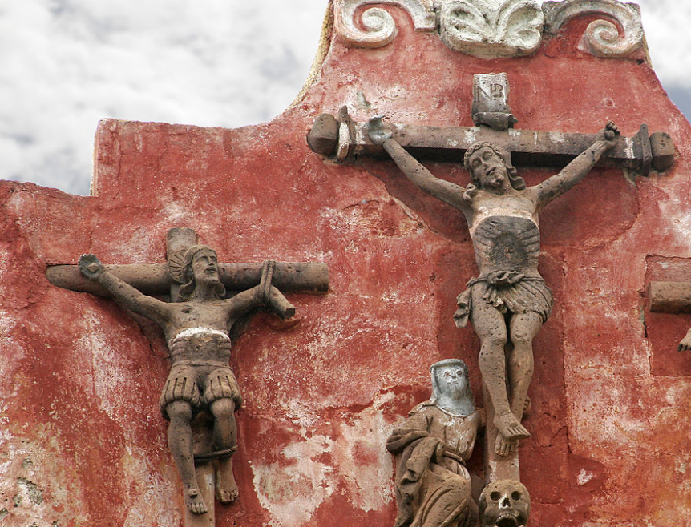
Crucifixion -- Church near Guanajuato, Mexico

Slide 24
Then he said, "Jesus, remember me when you come into your kingdom."
Luke 23:42

Slide 25
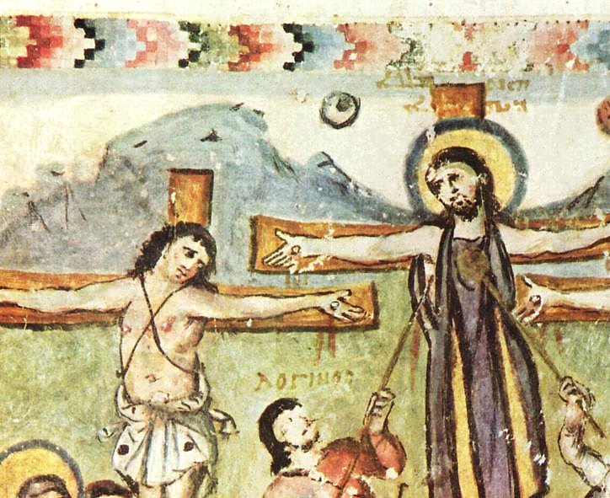
Rabula Gospel -- Manuscript, 586 AD, Laurentian Library, Florence, Italy

Slide 26
He replied, "Truly I tell you, today you will be with me in Paradise."
Luke 23:43

Slide 27
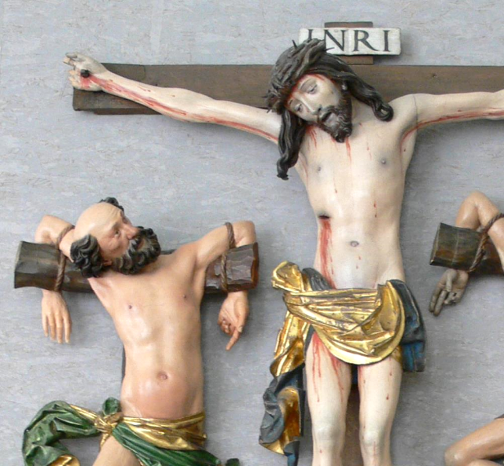
Crucifixion -- Workshop of Niklaus Weckmann, Landesmuseum Wurttemberg, Stuttgart, Germany

Slide 28
Credits
New Revised Standard Version Bible, copyright 1989, Division of Christian Education of the National Council of the Churches of Christ in the United States of America. Used by permission. All rights reserved.
https://commons.wikimedia.org/wiki/File:Fra_Angelico_-_Christ_the_Judge_-_WGA00679.jpg
https://commons.wikimedia.org/wiki/File:Julian_Onderdonk_(1882-1922)_-_Dawn_In_The_Hills_(1922).jpg
https://commons.wikimedia.org/wiki/File:7920jfWorld_Peace_Bell_Quezon_Memorial_Circlefvf_03.JPG
http://diglib.library.vanderbilt.edu/act-imagelink.pl?RC=29241
http://www.lewpstudio.com - copyright by Lauren Wright Pittman
https://commons.wikimedia.org/wiki/File:In_the_Beginning._Stained-glass_window_at_Church_of_Our_Savior,_MCC_(Metropolitan_Community_Church),_2011_South_Federal_Hwy,_Boynton_Beach,_Florida.jpg - Deisenbe
https://commons.wikimedia.org/wiki/File:Peter_Paul_Rubens_The_Three_Crosses.jpg
https://commons.wikimedia.org/wiki/File:Parroquia_de_la_Asunci%C3%B3n_de_Mar%C3%ADa_(Coatepec_Harinas)_Estado_de_M%C3%A9xico,M%C3%A9xico.jpg
https://www.flickr.com/photos/wipipip/16955620456
https://commons.wikimedia.org/wiki/File:Cranach_il_vecchio,_calvario,_1515-20.JPG
https://commons.wikimedia.org/wiki/File:Temple_detail_guanajuato.jpg - Tomas Castelazo
https://commons.wikimedia.org/wiki/File:Meister_des_Rabula-Evangeliums_002.jpg
https://commons.wikimedia.org/wiki/File:Weckmann_(Werkstatt)_Kreuzigung.jpg - Andreas Praefcke
Additional descriptions can be found at the Art in the Christian Tradition image library, a service of the Vanderbilt Divinity Library, http://diglib.library.vanderbilt.edu/. All images available via Creative Commons 3.0 License.

