Slide 1
Twenty-First Sunday after Pentecost
Year C
Habakkuk 1:1-4; 2:1-4 and Psalm 119:137-144 • Isaiah 1:10-18 and Psalm 32:1-7 • 2 Thessalonians 1:1-4, 11-12 Luke 19:1-10

Slide 2
Why do you make me see wrong-doing and look at trouble? Destruction and violence are before me; strife and contention arise.
Habakkuk 1:3

Slide 3
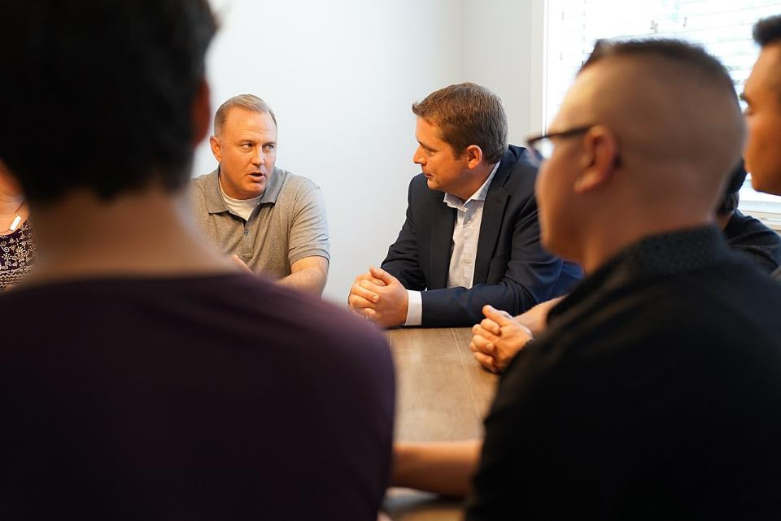
Opioid Abuse Recovery Group -- Cedars Society, Surrey, British Columbia

Slide 4
Your righteousness is an everlasting righteousness, and your law is the truth.
Psalm 119:142

Slide 5
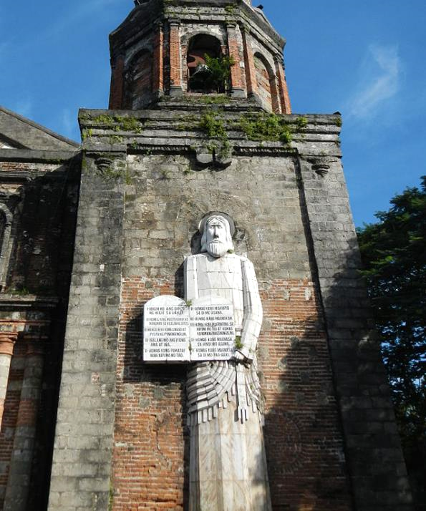
Ten Commandments
St. Augustine of Hippo Parish Church
Baliuag, Philippines

Slide 6
… learn to do good;
seek justice,
rescue the oppressed,
defend the orphan,
plead for the widow.
Isaiah 1:17

Slide 7
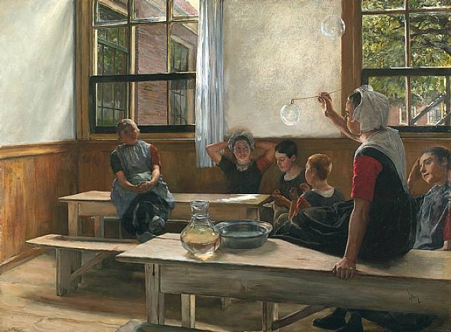
The Waifs (Haarlem, Holland); Children in the Schoolroom -- Charles Ulrich

Slide 8
You are a hiding place for me; you preserve me from trouble; you surround me with glad cries of deliverance.
Psalm 32:7

Slide 9
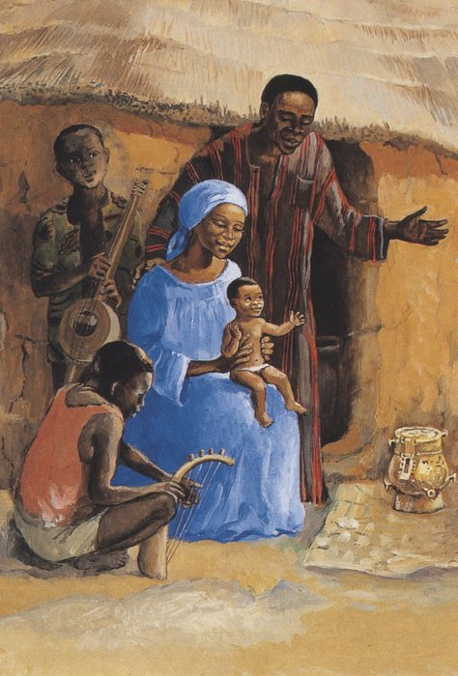
Jesus with his Family
JESUS MAFA
Cameroon

Slide 10
… we always pray for you, asking that our God will make you worthy of his call and will fulfill by his power every good resolve and work of faith …
2 Thessalonians 1:11b

Slide 11
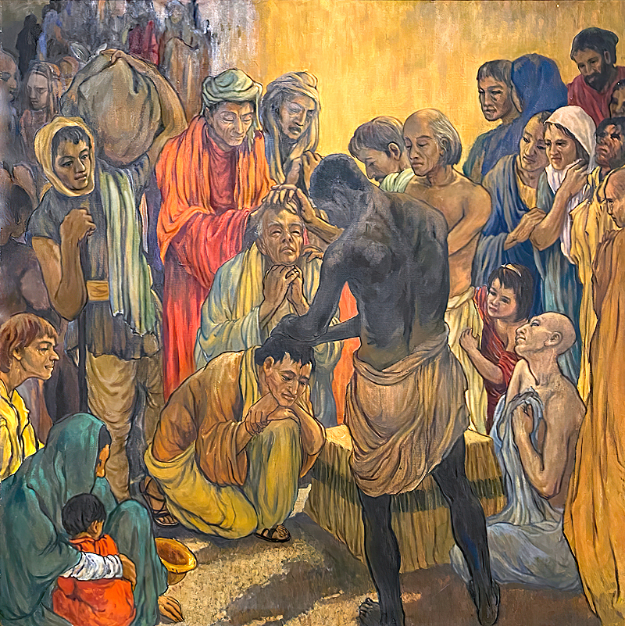
Dedication of Paul and Barnabas
Frank Wesley

Slide 12
A man was there named Zacchaeus; he was a chief tax collector and was rich.
Luke 19:2

Slide 13
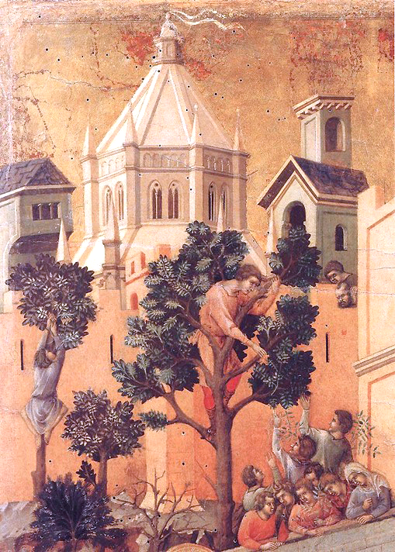
Zacchaeus, detail from Entry into Jerusalem
Duccio
Museo dell'Opera del Duomo
Siena, Italy

Slide 14
He was trying to see who Jesus was, but … because he was short in stature … he ran ahead and climbed a sycamore tree …
Luke 19:3ac, 4a

Slide 15
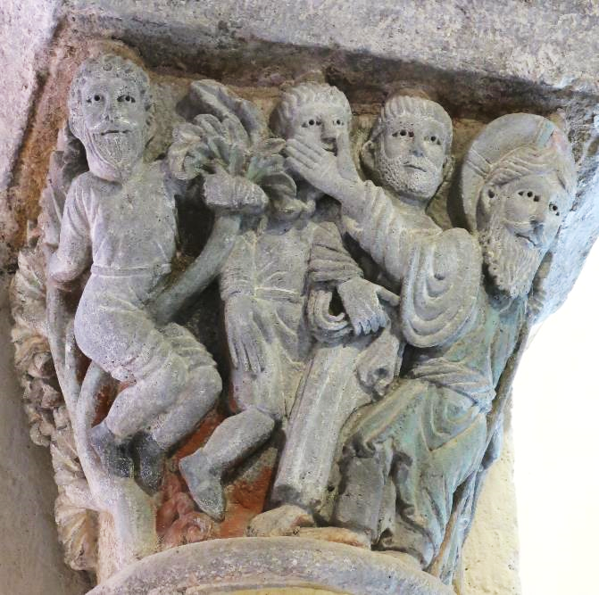
Zacchaeus and Christ -- Capital on column, Church of St. Nectaire, St. Nectaire, France

Slide 16
When Jesus came to the place, he looked up and said to him, "Zacchaeus, hurry and come down; for I must stay at your house today."
Luke 19:5

Slide 17
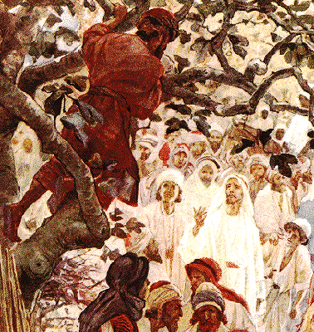
Christ Speaks to Zacchaeus -- William Hole, "Life of Christ", 1908

Slide 18
All who saw it began to grumble and said, "He has gone to be the guest of one who is a sinner."
Luke 19:7

Slide 19
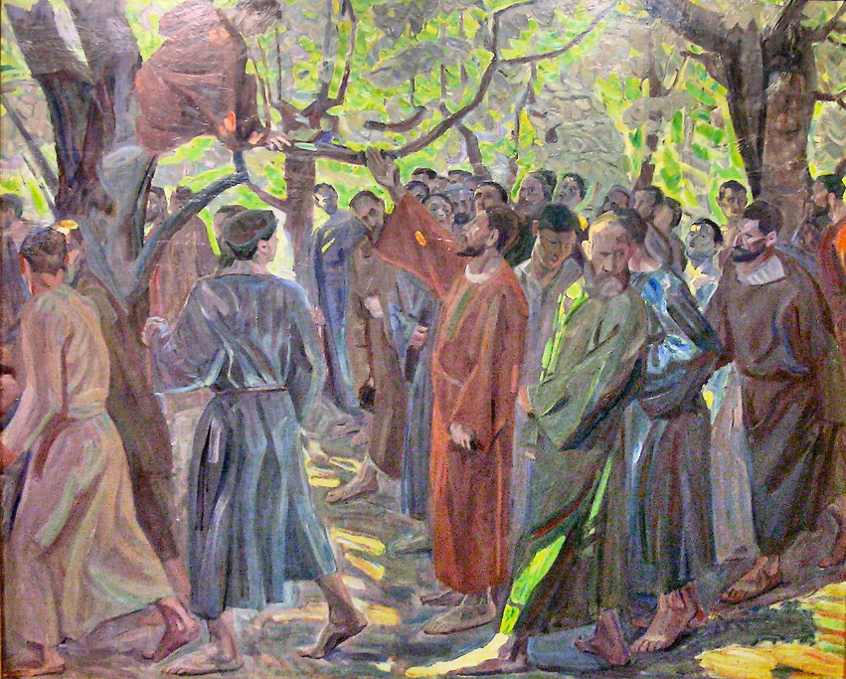
Zacchaeus -- Niels Larsen Stevns, Randers Museum of Art, Randers, Denmark

Slide 20
Zacchaeus … said, "Look, half of my possessions, Lord, I will give to the poor; and if I have defrauded anyone of anything, I will pay back four times as much."
Luke 19:8ac

Slide 21
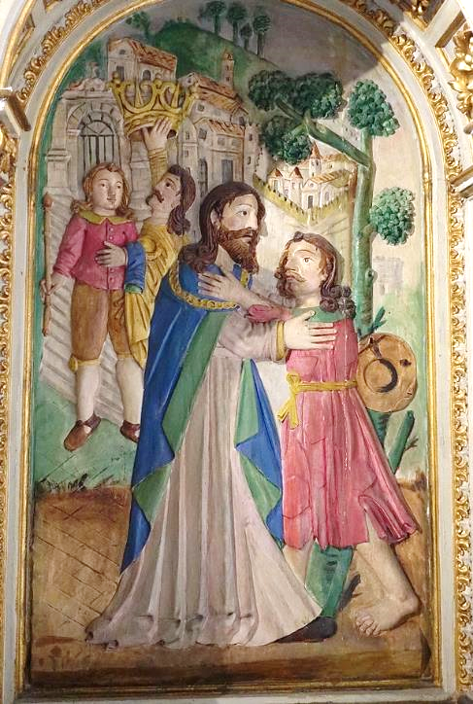
Zacchaeus
Igreja da Misericórdia
Esposende, Portugal

Slide 22
Then Jesus said to him, "Today salvation has come to this house … For the Son of Man came to seek out and to save the lost."
Luke 19:9a, 10

Slide 23
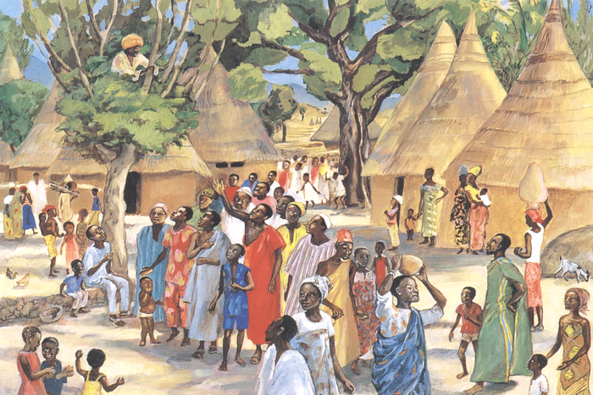
Zacchaeus Meets Jesus -- JESUS MAFA, Cameroon

Slide 24
Credits
New Revised Standard Version Bible, copyright 1989, Division of Christian Education of the National Council of the Churches of Christ in the United States of America. Used by permission. All rights reserved.
https://commons.wikimedia.org/wiki/File:Cedars_Society_(36292296066).jpg
https://commons.wikimedia.org/wiki/File:BaliuagChurchjf9702_02.JPG - Ramon FVelasquez
https://commons.wikimedia.org/wiki/File:Charles_Frederick_Ulrich-waifs_in_Haarlem_weeshuis..jpg
http://diglib.library.vanderbilt.edu/act-imagelink.pl?RC=47583
Estate of Frank Wesley, http://www.frankwesleyart.com/main_page.htm
https://commons.wikimedia.org/wiki/File:Duccio_di_Buoninsegna_-_Entry_into_Jerusalem_(detail)_-_WGA06784.jpg
https://commons.wikimedia.org/wiki/File:Chapiteau_de_St-Nectaire_-_Le_Christ_et_Zach%C3%A9e.jpg - Tangopaso
https://commons.wikimedia.org/wiki/File:Hole_zachaeus_in_tree.gif
https://commons.wikimedia.org/wiki/File:Niels_Larsen_Stevns-_Zak%C3%A6us.jpg
https://commons.wikimedia.org/wiki/File:Interior_of_Igreja_da_Miseric%C3%B3rdia_de_Esposende_(14).jpg - Joseolgon
http://diglib.library.vanderbilt.edu/act-imagelink.pl?RC=48393
Additional descriptions can be found at the Art in the Christian Tradition image library, a service of the Vanderbilt Divinity Library, http://diglib.library.vanderbilt.edu/. All images available via Creative Commons 3.0 License.

