Slide 1
Eighteenth Sunday after Pentecost
Year C
Jeremiah 29:1, 4-7 and Psalm 66:1-12 • 2 Kings 5:1-3, 7-15c and Psalm 111 • 2 Timothy 2:8-15 • Luke 17:11-19

Slide 2
Thus says the LORD … to all the exiles whom I have sent … from Jerusalem to Babylon: Build houses and live in them; plant gardens and eat what they produce.
Jeremiah 29:4ac, 5

Slide 3
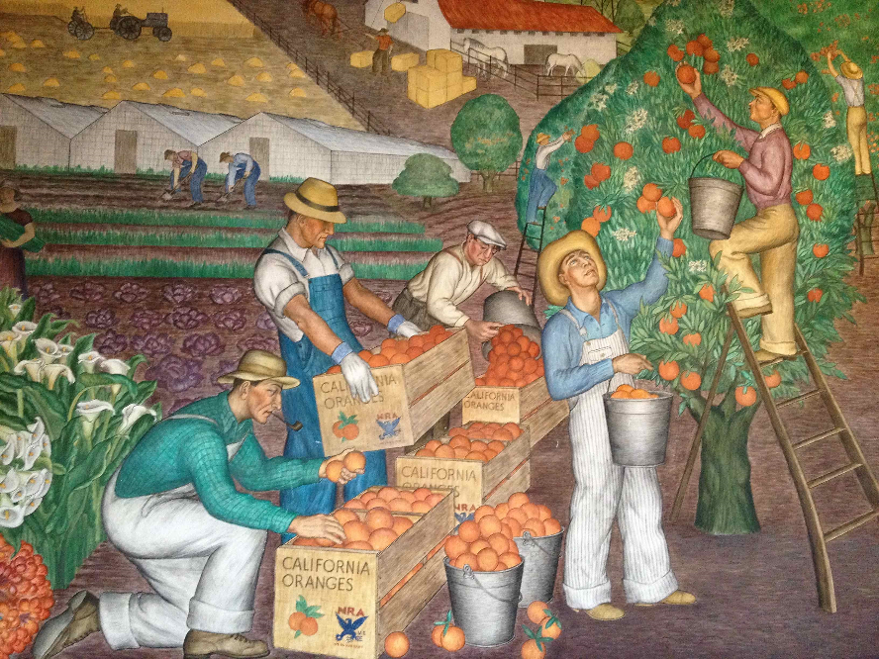
Migrant Farm Workers -- Mural, Coit Tower, San Francisco, CA

Slide 4
Naaman, commander of the army of the king of Aram, … suffered from leprosy.
2 Kings 5:1ac

Slide 5
Elisha sent a messenger to him, saying, "Go, wash in the Jordan seven times, and your flesh shall be restored and you shall be clean."
2 Kings 5:10

Slide 6
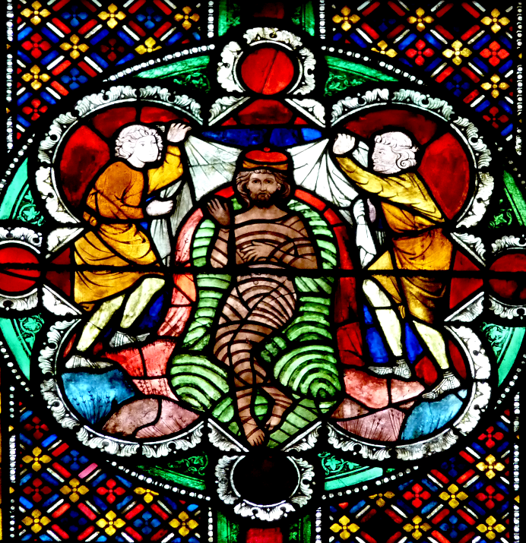
Naaman Bathes in the Jordan
Cologne Cathedral
Cologne, Germany

Slide 7
So he went down and immersed himself seven times in the Jordan, according to the word of the man of God; his flesh was restored … and he was clean.
2 Kings 5:14ac

Slide 8
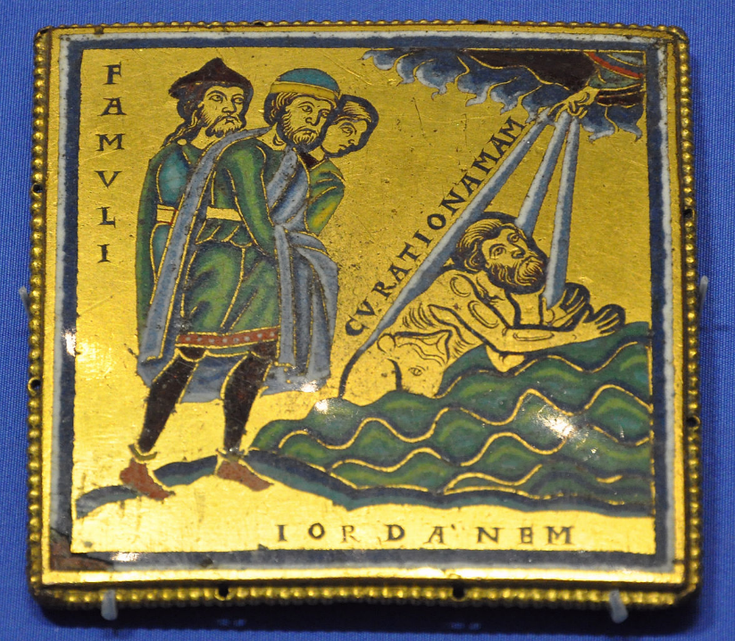
Naaman is Cured of Leprosy
British Museum
London, England

Slide 9
Praise the LORD! I will give thanks to the LORD with my whole heart, in the company of the upright, in the congregation.
Psalm 111:1

Slide 10
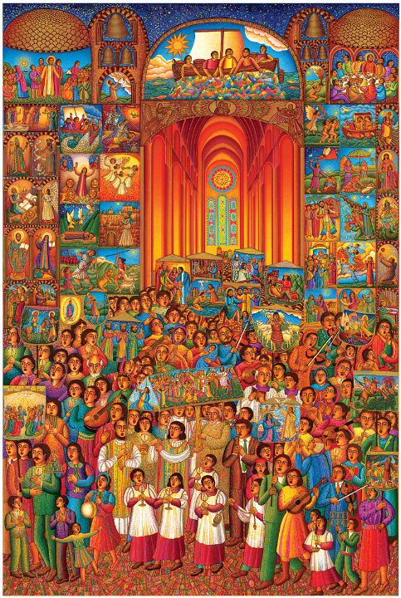
The Procession
John August Swanson
Print, 2007

Slide 11
… warn them before God that they are to avoid wrangling over words, which does no good but only ruins those who are listening.
2 Timothy 2:14b

Slide 12
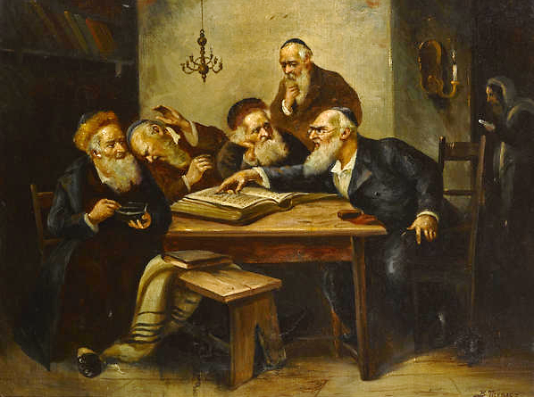
The Scholar's Argument -- Bernard Trębacz, painting, c, 1920

Slide 13
As he entered a village, ten lepers approached him. Keeping their distance, they called out, saying, "Jesus, Master, have mercy on us!"
Luke 17:12-13

Slide 14
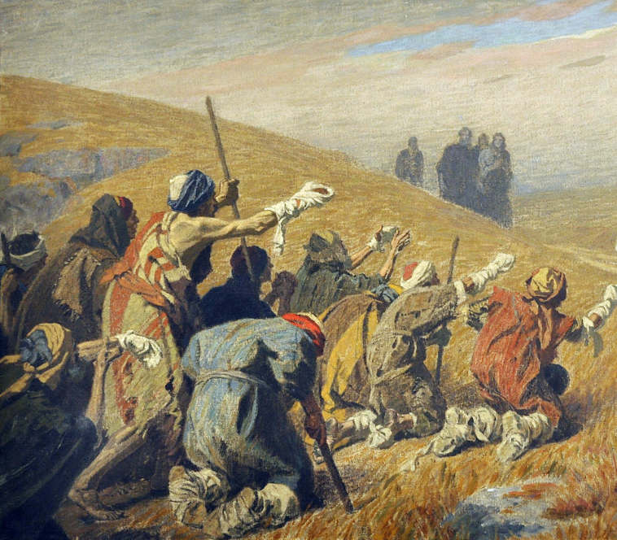
Ten Lepers Call Out to Jesus, detail -- Gebhard Fugel, Diocesan Museum, Freising, Germany

Slide 15
When he saw them, he said to them, "Go and show yourselves to the priests." And as they went, they were made clean.
Luke 17:14

Slide 16
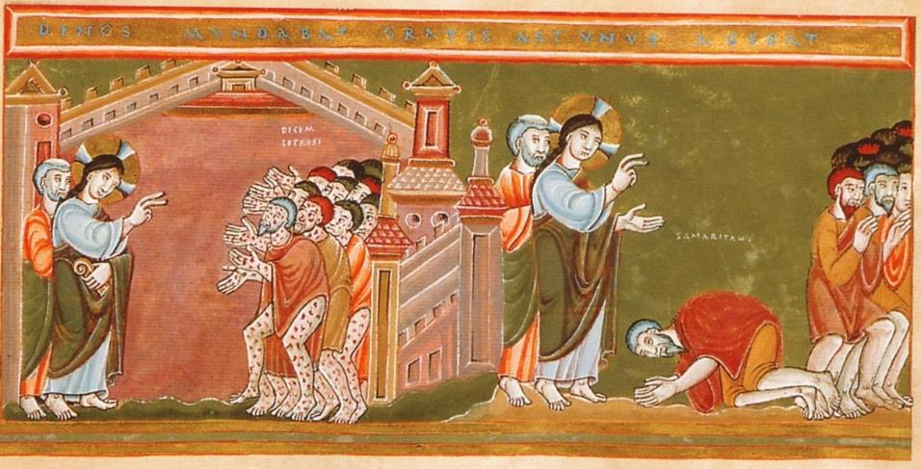
Christ and the Ten Lepers -- Codex Aureus Epternacensis, Freising, Germany

Slide 17
Then one of them, when he saw that he was healed, turned back, praising God with a loud voice.
Luke 17:15

Slide 18
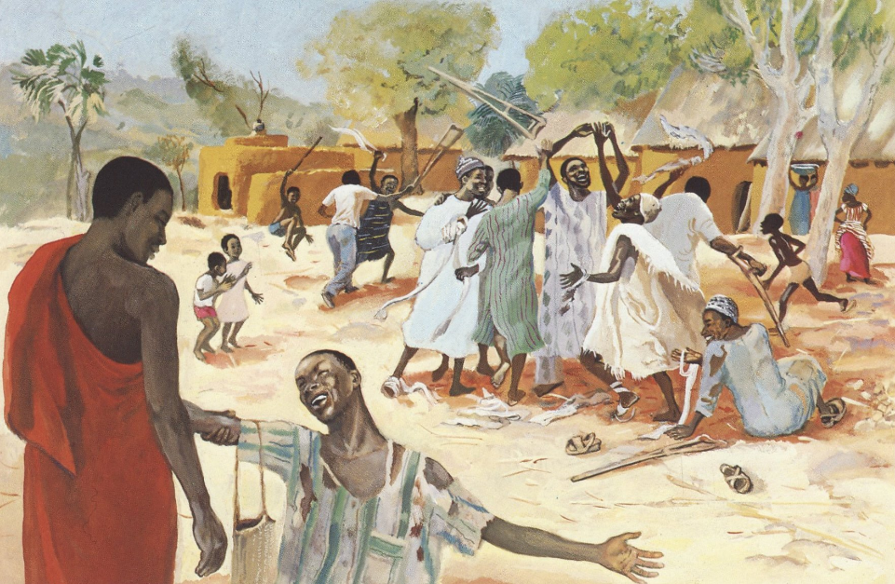
The Grateful Leper -- JESUS MAFA, Cameroon

Slide 19
He prostrated himself at Jesus' feet and thanked him.
And he was a Samaritan.
Luke 17:16

Slide 20
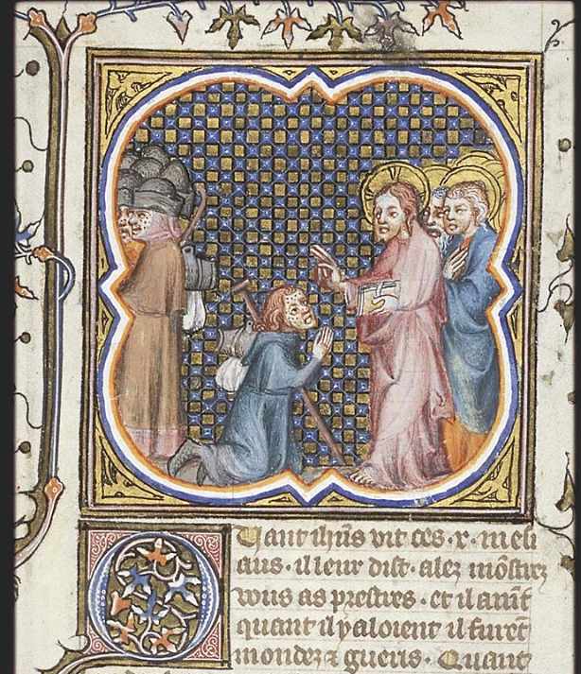
Christ Heals the Ten Lepers
National Library of the Netherlands
Hague, Netherlands
?

Slide 21
Then Jesus asked, "Were not ten made clean? But the other nine, where are they?
Was none of them found to return and give praise to God except this foreigner?"
Luke 17:17-18

Slide 22
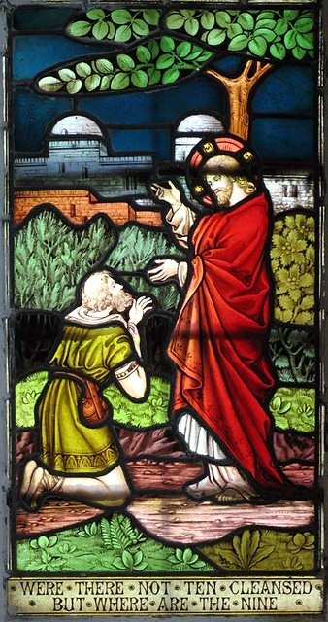
Christ with the Grateful Samaritan Leper
Parish Church of St. Andrew
Buckland,
England

Slide 23
Then he said to him, "Get up and go on your way; your faith has made you well."
Luke 17:19

Slide 24
Credits
New Revised Standard Version Bible, copyright 1989, Division of Christian Education of the National Council of the Churches of Christ in the United States of America. Used by permission. All rights reserved.
https://www.flickr.com/photos/cookwood/6331516045
https://commons.wikimedia.org/wiki/File:K%C3%B6ln_Dom_J%C3%BCngeres_Bibelfenster90.JPG
https://commons.wikimedia.org/wiki/File:Enamel_plaque_Naaman_BM.jpg - Andreas Praefcke
www.JohnAugustSwanson.com - copyright 2007 by John August Swanson
https://commons.wikimedia.org/wiki/File:Bernard_Trebacz_Argument_of_the_scholars.jpeg
https://commons.wikimedia.org/wiki/File:Gebhard_Fugel_Christus_und_die_Auss%C3%A4tzigen_c1920.jpg
http://commons.wikimedia.org/wiki/File:CodexAureus_Cleansing_of_the_ten_lepers.jpg
http://diglib.library.vanderbilt.edu/act-imagelink.pl?RC=48295
https://picryl.com/media/christ-and-the-ten-lepers-one-leper-a-samaritan-sent-to-the-priest-by-christ-370d76
https://commons.wikimedia.org/wiki/File:St_Andrew,_Buckland,_Herts_-_Window_-_geograph.org.uk_-_368076.jpg – John Salmon
Additional descriptions can be found at the Art in the Christian Tradition image library, a service of the Vanderbilt Divinity Library, http://diglib.library.vanderbilt.edu/. All images available via Creative Commons 3.0 License.

