Slide 1
Eleventh Sunday after Pentecost
Year C
Jeremiah 1:4-10 and Psalm 71:1-6 • Isaiah 58:9b-14 and Psalm 103:1-8 • Hebrews 12:18-29 • Luke 13:10-17

Slide 2
Then the LORD put out his hand and touched my mouth; and the LORD said to me, "Now I have put my words in your mouth.
Jeremiah 1:9

Slide 3
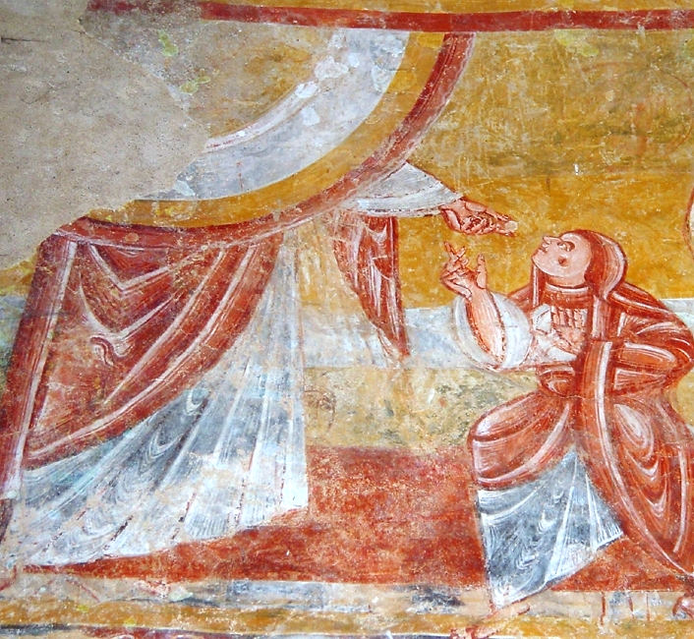
The Lord Gives Jeremiah His Words -- Church of St. Martin, Nohant-Vic, France

Slide 4
Upon you I have leaned from my birth; it was you who took me from my mother's womb. My praise is continually of you.
Psalm 71:6

Slide 5
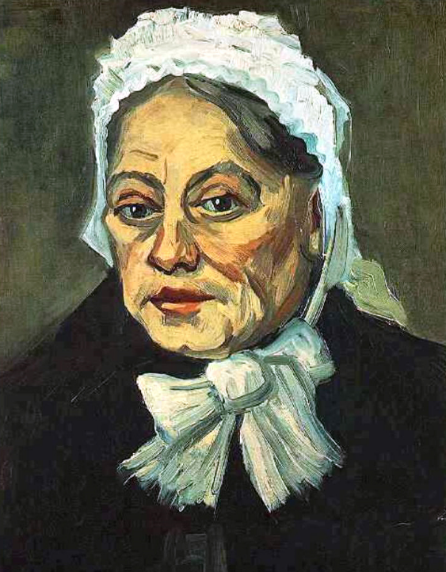
The Midwife
Vincent van Gogh
Van Gogh Museum
Amsterdam, Netherlands

Slide 6
If you remove the yoke from among you, the pointing of the finger, the speaking of evil, ... then your light shall rise in the darkness …
Isaiah 58:9b, 10b

Slide 7
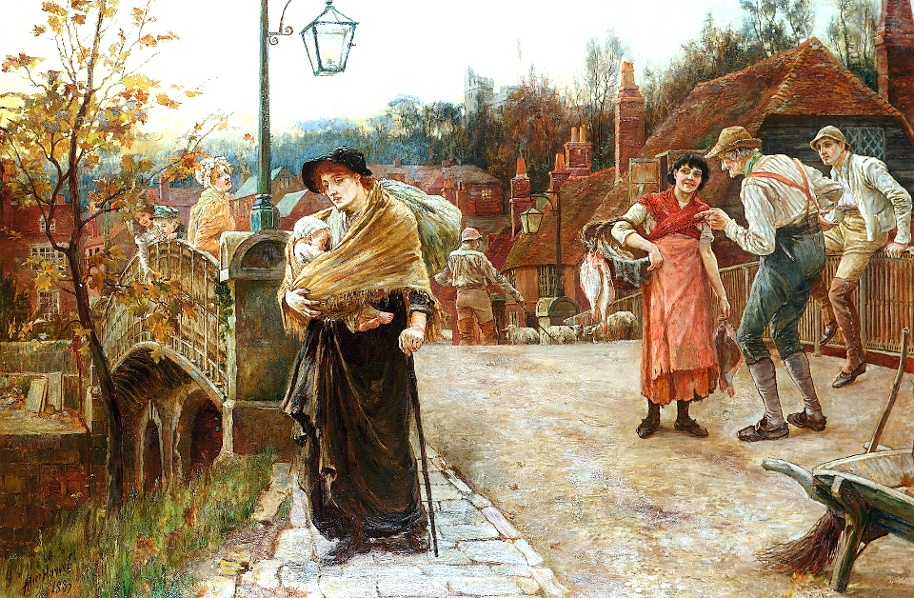
The Belle of the Village -- Mary Alice Havers, 1883

Slide 8
The LORD works vindication and justice for all who are oppressed … The LORD is merciful and gracious, slow to anger and abounding in steadfast love.
Psalm 103:6, 8

Slide 9
Justice Equals Peace -- detail of mural in Christchurch, New Zealand

Slide 10
… since we are receiving a kingdom that cannot be shaken … we offer to God an acceptable worship with reverence and awe;
Hebrews 12:28

Slide 11
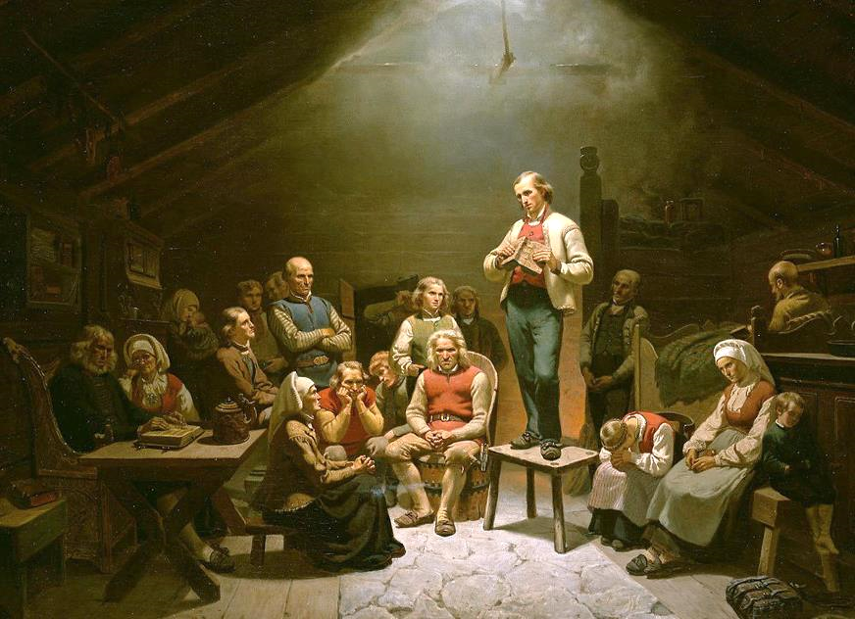
Low Church Devotion -- Adolf Tidemand, National Gallery of Norway, Oslo, Norway

Slide 12
… there appeared a woman with a spirit that had crippled her for eighteen years. She was bent over and was quite unable to stand up straight.
Luke 13:11b

Slide 13
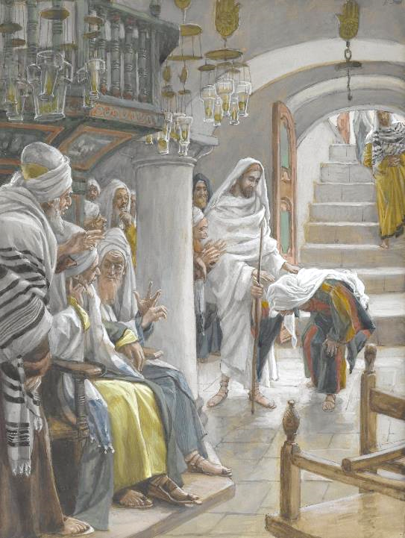
The Woman Bent Over
James Tissot
Brooklyn Museum of Art
New York, NY

Slide 14
When Jesus saw her, he called her over and said, "Woman, you are set free from your ailment."
Luke 13:12

Slide 15
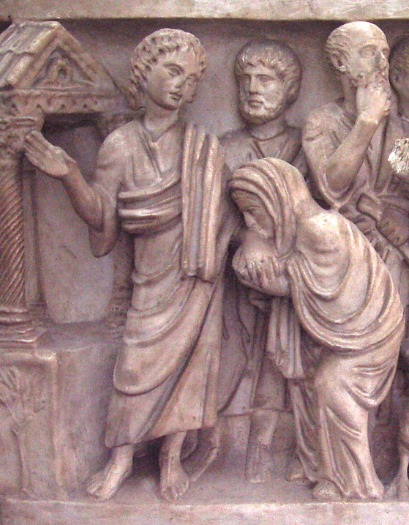
Christ Healing the Woman Bent Over
Two Brothers Sarcophagus
Vatican Museum, Vatican City

Slide 16
When he laid his hands on her, immediately she stood up straight and began praising God.
Luke 13:13

Slide 17
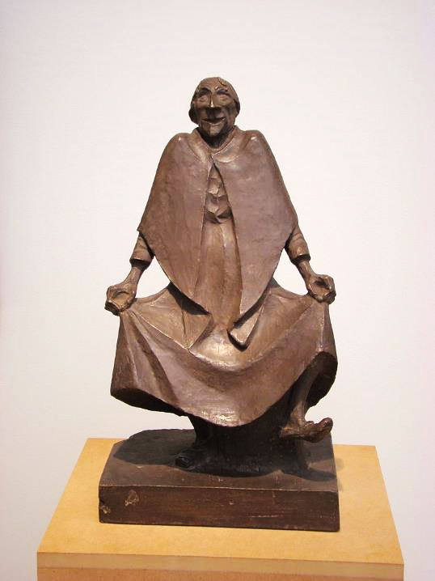
Old Woman Dancing
Ernst Barlach
Museum der bildenden Künste
Leipzig, Austria

Slide 18
But the leader of the synagogue, indignant because Jesus had cured on the sabbath, kept saying to the crowd …
Luke 13:14a

Slide 19
… "There are six days on which work ought to be done; come on those days and be cured, and not on the sabbath day."
Luke 13:14b

Slide 20
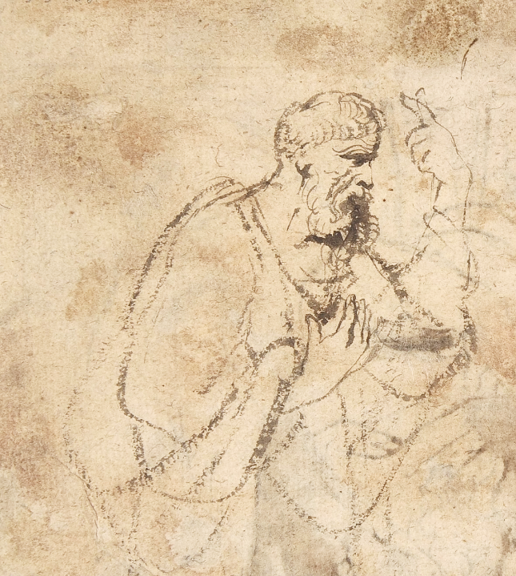
Study for a Pharisee
Anthony van Dyck
Metropolitan Museum of Art
New York, NY

Slide 21
But the Lord answered him and said, "You hypocrites! Does not each of you on the sabbath untie his ox or his donkey from the manger, and lead it away to give it water?
Luke 13:15

Slide 22
And ought not this woman, a daughter of Abraham whom Satan bound for eighteen long years, be set free from this bondage on the sabbath day?"
Luke 13:16

Slide 23
?
?
"Hope" for breast cancer patients at Minot Air Force Base medical services

Slide 24
Getting Ready - Global Race for the Cure Participants
L'Enfant Plaza Metro
Washington, DC

Slide 25
Tree of Hope for Breast Cancer Survivors -- Julie Leuthold

Slide 26
Credits
New Revised Standard Version Bible, copyright 1989, Division of Christian Education of the National Council of the Churches of Christ in the United States of America. Used by permission. All rights reserved.
http://diglib.library.vanderbilt.edu/act-imagelink.pl?RC=42491
https://www.flickr.com/photos/universodarte/3069291609/
http://commons.wikimedia.org/wiki/File:Alice_Mary_Havers_Belle_of_the_village_1883.jpg
https://www.flickr.com/photos/joceykinghorn/12073945554
https://commons.wikimedia.org/wiki/File:Adolph_Tidemand_-_Low_Church_Devotion_-_Google_Art_Project_(9QGXjFzX4Caijw).jpg
https://commons.wikimedia.org/wiki/File:HealWomanSabbath.jpg
http://diglib.library.vanderbilt.edu/act-imagelink.pl?RC=51253 – Burns-Jensen
https://commons.wikimedia.org/wiki/File:Barlach_Tanzende_Alte.JPG
https://commons.wikimedia.org/wiki/File:Christ_and_the_Pharisees;_verso;_Christ_and_a_Pharisee_MET_DP802094.jpg
https://media.defense.gov/2015/Oct/20/2001492734/-1/-1/0/151009-F-JT564-012.jpg
https://www.flickr.com/photos/perspective/14152384141 - Elvert Barnes
https://www.flickr.com/photos/julieleuthold/7521645058 - Julie
Additional descriptions can be found at the Art in the Christian Tradition image library, a service of the Vanderbilt Divinity Library, http://diglib.library.vanderbilt.edu/. All images available via Creative Commons 3.0 License.

