Slide 1
Eighth Sunday after Pentecost
Year C
Hosea 11:1-11 and Psalm 107:1-9, 43 • Ecclesiastes 1:2, 12-14; 2:18-23 and Psalm 49:1-12 • Colossians 3:1-11 Luke 12:13-21

Slide 2
Yet it was I who taught Ephraim to walk, I took them up in my arms …
Hosea 11:3a

Slide 3
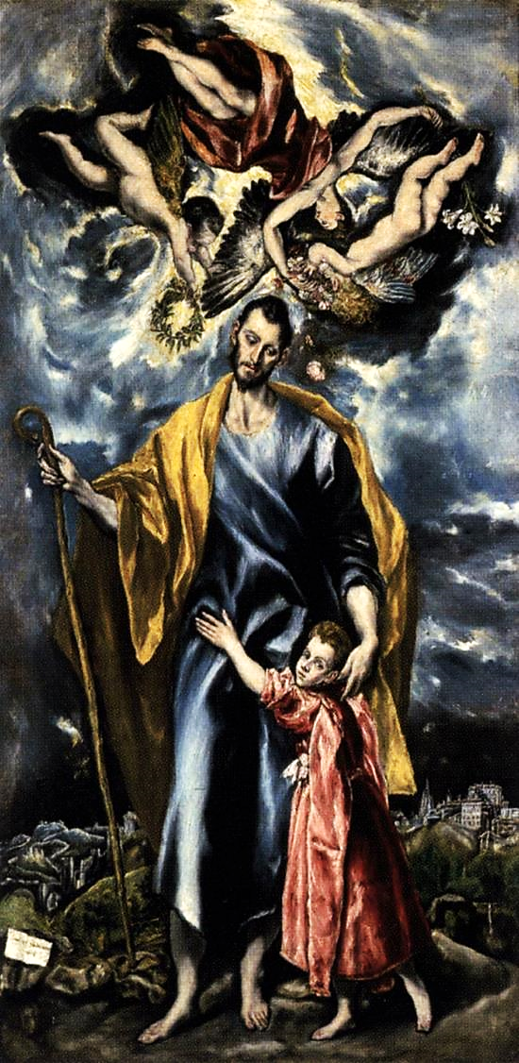
Joseph and the Christ Child
El Greco
Museum of Santa Cruz
Toledo, Spain

Slide 4
I led them with cords of human kindness, with bands of love.
Hosea 11:4a

Slide 5
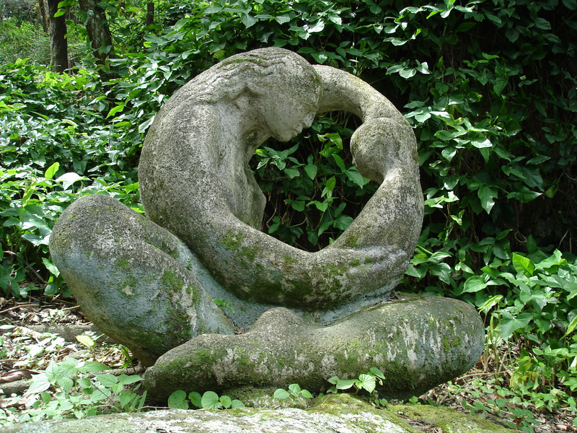
Motherhood -- Nelly Alves, Catacumba Park, Rio de Janiero, Brazil

Slide 6
I was to them like those who lift infants to their cheeks. I bent down to them and fed them.
Hosea 11:4b

Slide 7
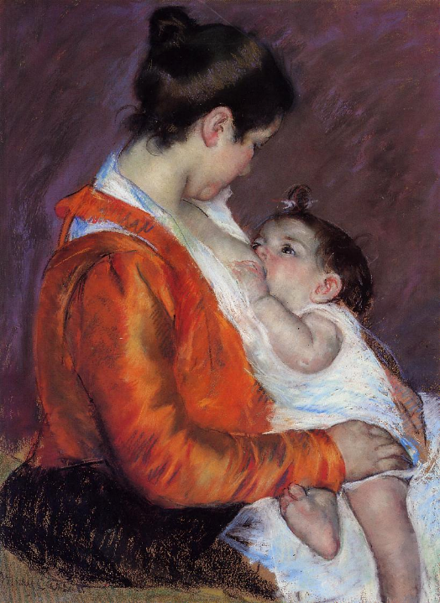
Louise Nursing Her Child
Mary Cassatt
Fondation Rau pour le Tiers-Monde
Zurich, Switzerland

Slide 8
Let them thank the LORD for his steadfast love, for his wonderful works to humankind.
Psalm 107:8

Slide 9
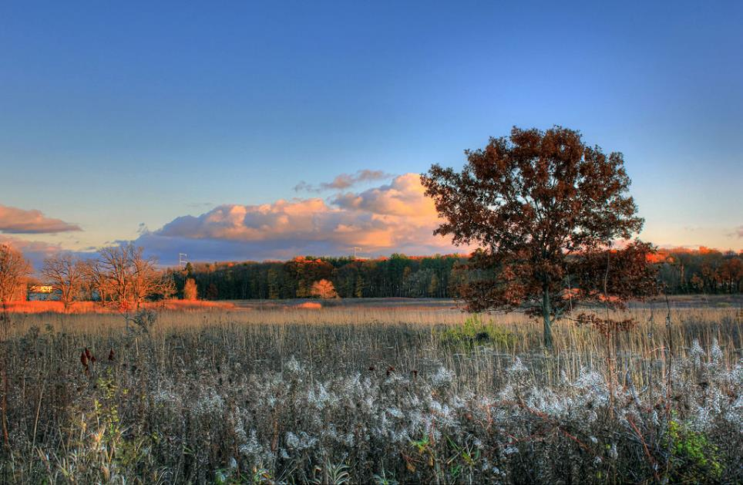
Wisconsin Fields -- Yinan Chen, 2013

Slide 10
I saw all the deeds that are done under the sun; and see, all is vanity and a chasing after wind.
Ecclesiastes 1:14

Slide 11
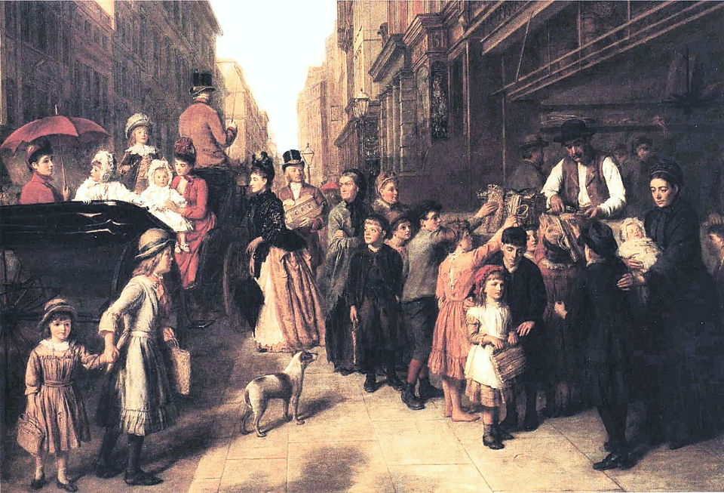
Poverty and Wealth -- William Frith, 1888

Slide 12
Hear this, all you peoples; give ear, all inhabitants of the world, both low and high, rich and poor together.
Psalm 49:1-2

Slide 13
Hands Around the World Mural -- Ballymena, Northern Ireland

Slide 14
In that renewal there is no longer Greek and Jew … barbarian, Scythian, slave and free; but Christ is all and in all!
Colossians 3:11ac

Slide 15
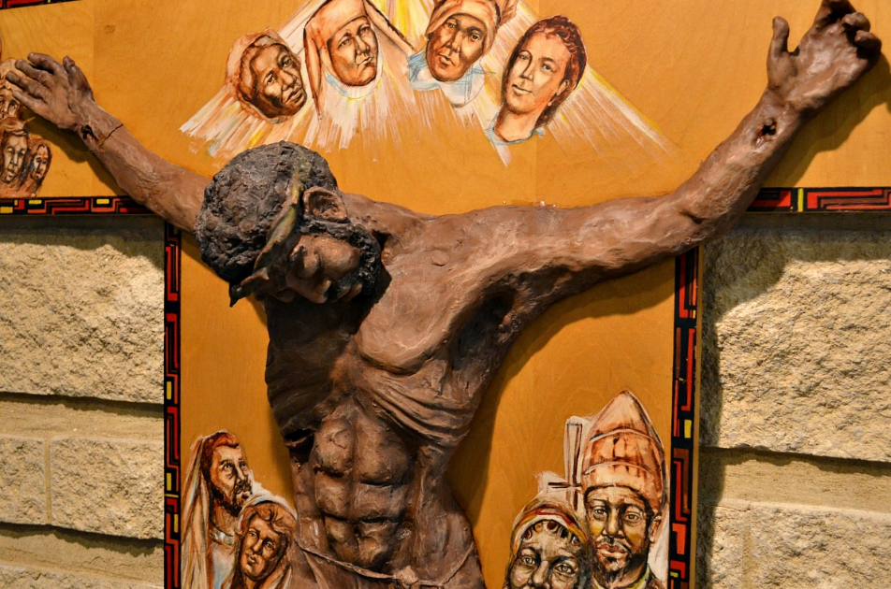
Crucifixion -- St. Benedict the African East, Chicago, IL

Slide 16
Then he told them a parable: "The land of a rich man produced abundantly.
Luke 12:16

Slide 17
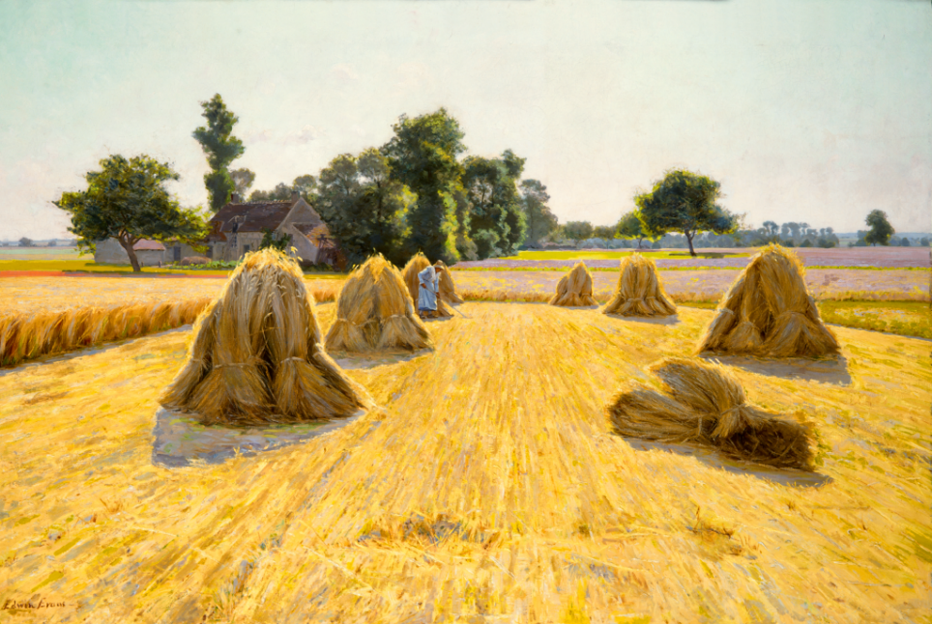
Grain Fields -- Edwin Evans, Brigham Young University Museum of Art, Provo, UT

Slide 18
… he said, '… I will pull down my barns and build larger ones, and there I will store all my grain and my goods.'
Luke 12:18

Slide 19
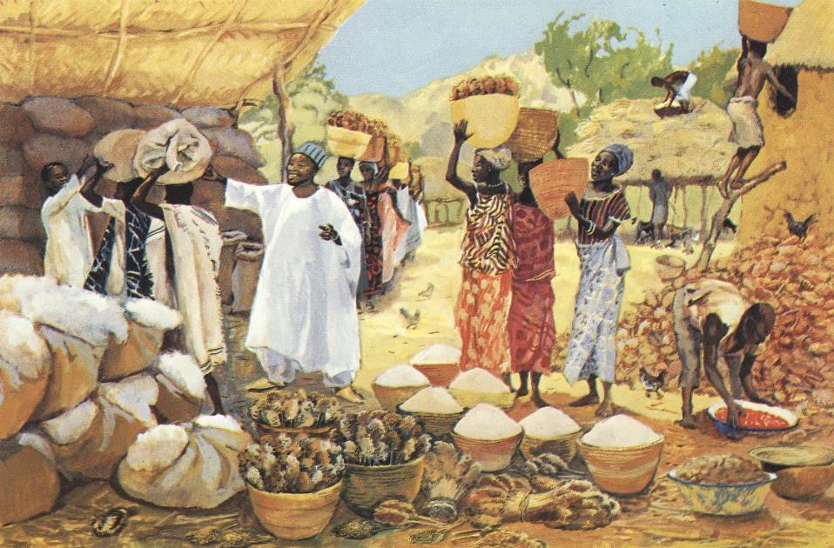
The Rich Fool -- JESUS MAFA, Cameroon

Slide 20
And I will say to my soul, 'Soul, you have ample goods laid up for many years; relax, eat, drink, be merry.'
Luke 12:19

Slide 21
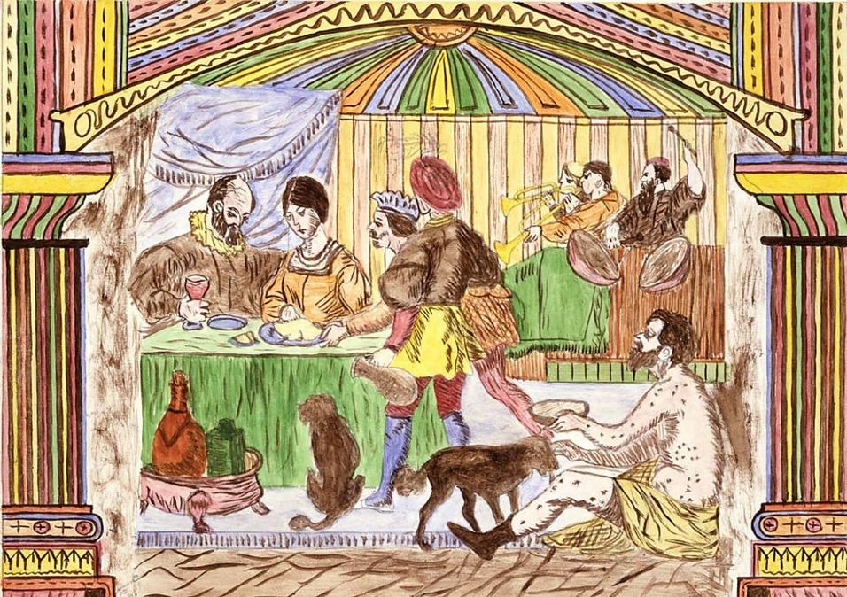
The Rich Man and Lazarus -- Lawrence Ladd, Smithsonian American Art Museum, Washington, DC

Slide 22
But God said to him, 'You fool! This very night your life is being demanded of you. And the things you have prepared, whose will they be?'
Luke 12:20

Slide 23
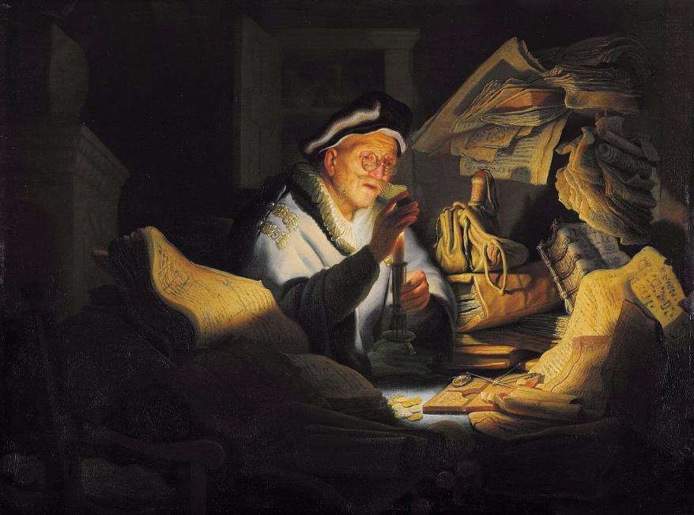
Parable of the Rich Man -- Rembrandt, Gemaldegalerie, Berlin, Germany

Slide 24
So it is with those who store up treasures for themselves but are not rich toward God."
Luke 12:21

Slide 25
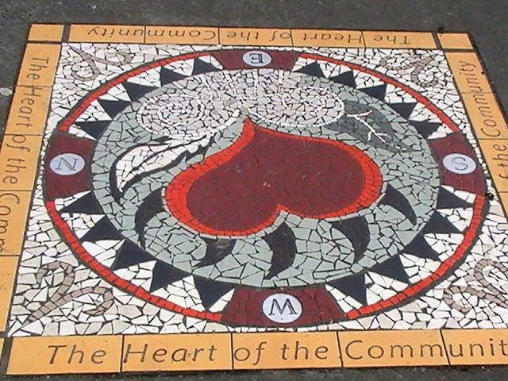
The Heart of the Community Mosaic -- East Hastings, Vancouver, CA

Slide 26
Credits
New Revised Standard Version Bible, copyright 1989, Division of Christian Education of the National Council of the Churches of Christ in the United States of America. Used by permission. All rights reserved.
http://commons.wikimedia.org/wiki/File:Karl_Hultstrom01.JPG - Bengt Oberger
http://commons.wikimedia.org/wiki/File:Motherhood.jpg
https://commons.wikimedia.org/wiki/File:Mary_Cassatt,_1898_-_Louise_nursing_her_child.jpg
https://commons.wikimedia.org/wiki/File:Gfp-wisconsin-madison-looking-over-the-fields.jpg – Yinan Chen
https://commons.wikimedia.org/wiki/File:William_Powell_Frith_-_Poverty_and_Wealth.JPG
https://www.flickr.com/photos/uk_parliament/7402060432
https://www.flickr.com/photos/seanbirm/31589314255 - Sean Birmingham
https://commons.wikimedia.org/wiki/File:Evans-GrainFields.png
http://diglib.library.vanderbilt.edu/act-imagelink.pl?RC=48266https://commons.wikimedia.org/wiki/File:Parable_of_the_Rich_Man_and_Lazarus_(Lawrence_W._Ladd).jpg
https://commons.wikimedia.org/wiki/File:Heart_of_the_Community_mural.jpeg - Eternalsleeper
https://commons.wikimedia.org/wiki/File:Rembrandt_-_The_Parable_of_the_Rich_Fool.jpg
https://commons.wikimedia.org/wiki/File:Parable_of_the_Rich_Man_and_Lazarus_(Lawrence_W._Ladd).jpg
Additional descriptions can be found at the Art in the Christian Tradition image library, a service of the Vanderbilt Divinity Library, http://diglib.library.vanderbilt.edu/. All images available via Creative Commons 3.0 License.

