Slide 1
Holy Saturday
Year A
Job 14:1-14 or Lamentations 3:1-9, 19-24 • Psalm 31:1-4, 15-16
1 Peter 4:1-8 • Matthew 27:57-66 or John 19:38-42

Slide 2
"A mortal, born of woman, few of days and full of trouble, comes up like a flower and withers, flees like a shadow and does not last.”
Job 14:1-2

Slide 3
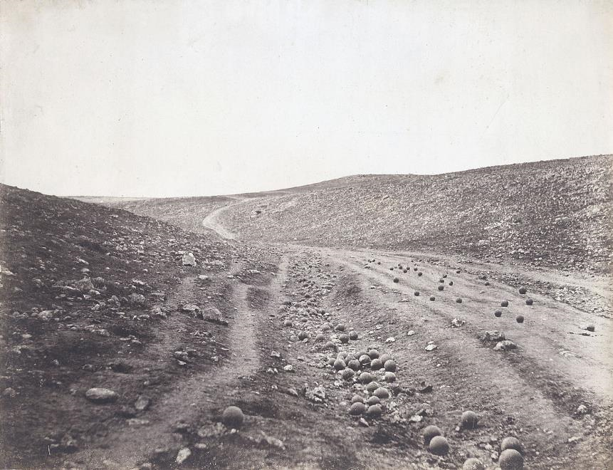
Valley of the Shadow of Death, Crimean War -- Roger Fenton, V&A Museum, London

Slide 4
But this I call to mind, and therefore I have hope: The steadfast love of the LORD never ceases, his mercies never come to an end;
Lamentations 3:21-22

Slide 5
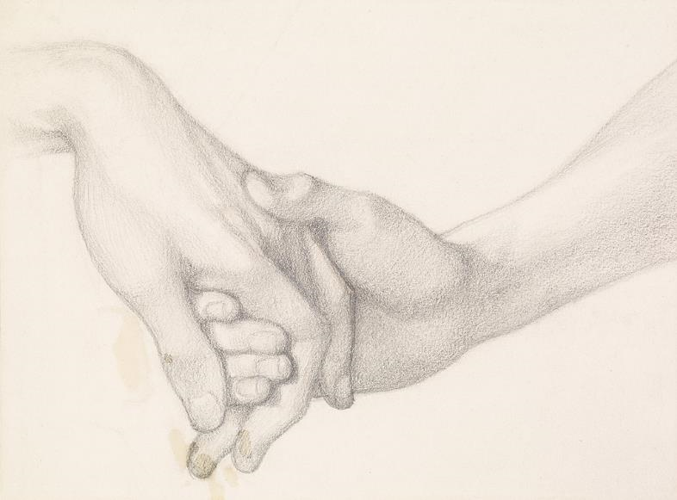
Hand of Love (study) -- Dante Rossetti, Birmingham Museum, Birmingham, England

Slide 6
Let your face shine upon your servant; save me in your steadfast love.
Psalm 31:16

Slide 7
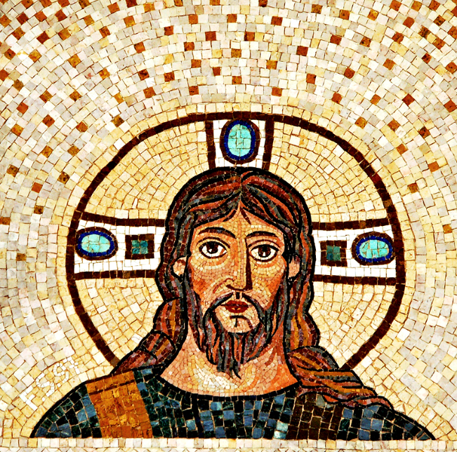
Face of God -- Mosaic, Jerusalem

Slide 8
Above all, maintain constant love for one another …
1 Peter 4:8a

Slide 9
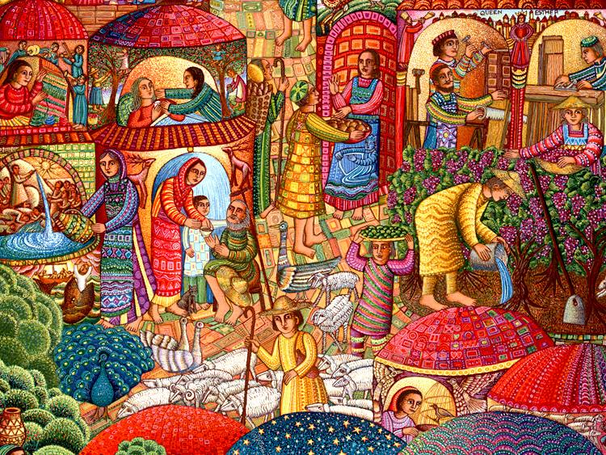
A Visit -- John August Swanson

Slide 10
Joseph of Arimathea, who was a disciple of Jesus, … asked Pilate to let him take away the body of Jesus.
John 19:38a, c

Slide 11
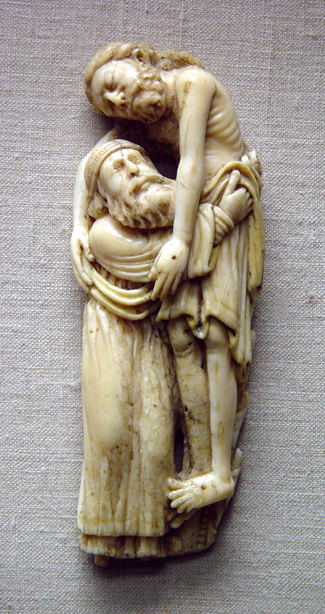
Joseph of Arimathea Removing Christ’s Body
Victoria and Albert Museum
London, England
?

Slide 12
Nicodemus, who had at first come to Jesus by night, also came, bringing a mixture of myrrh and aloes …
John 19:39a

Slide 13
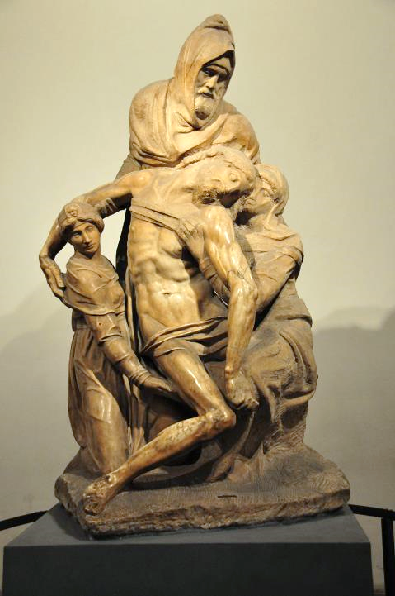
Nicodemus with the Body of Christ
Michelangelo
Museo dell'Opera del Duomo Florence, Italy

Slide 14
… in the garden there was a new tomb in which no one had ever been laid. And so because it was the Jewish day of Preparation … they laid Jesus there.
John 19:41b, 42ac

Slide 15
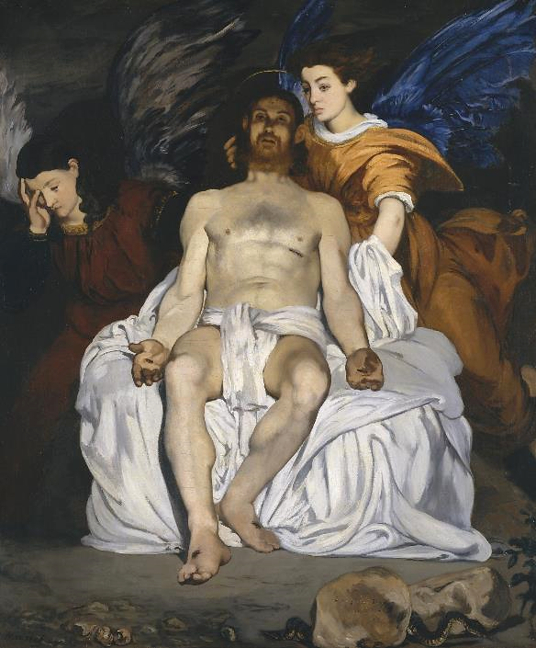
Angels with Christ in the Tomb
Eduard Manet
Metropolitan Museum of Art
New York, NY

Slide 16
Mary Magdalene and the other Mary were there, sitting opposite the tomb.
Matthew 27:61

Slide 17
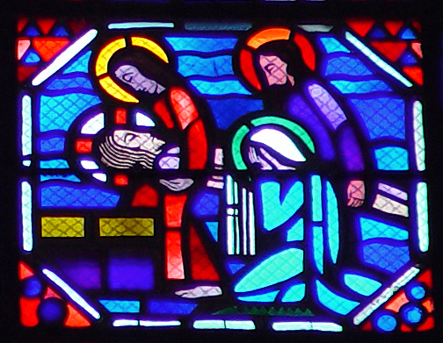
Mourning of Jesus -- Le Breton and Gaudin, Amiens Cathedral, Amiens, France

Slide 18
… the chief priests and the Pharisees gathered before Pilate and said, "Sir, we remember what that impostor said while he was still alive, 'After three days I will rise again.'
Matthew 27:62ac, 63

Slide 19
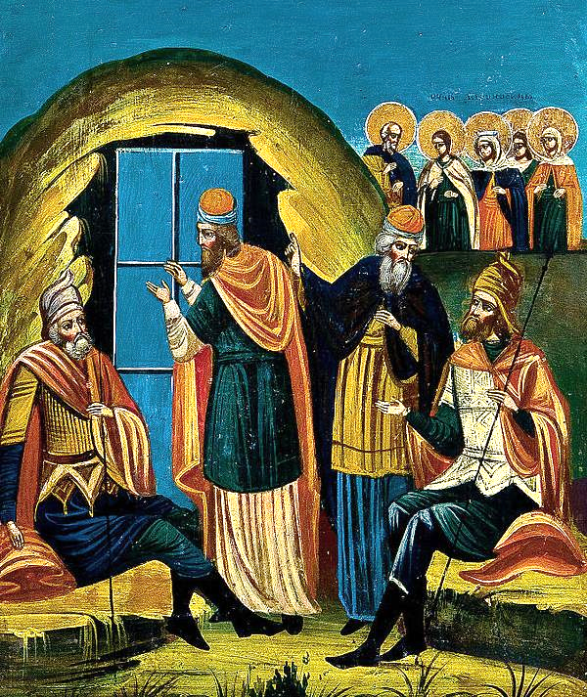
Sealing of Christ’s Tomb
Russian icon, late 19th c.

Slide 20
Therefore command the tomb to be made secure until the third day; otherwise his disciples may go and steal him away, and tell the people, 'He has been raised from the dead,'
Matthew 27:64ab

Slide 21
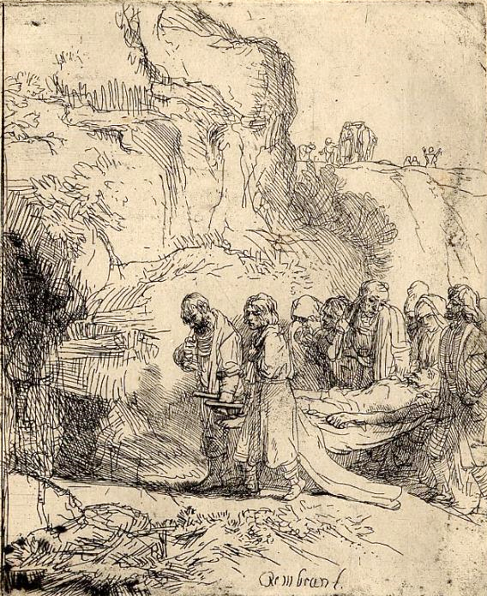
Christ Carried to the Tomb
Rembrandt
British Museum London

Slide 22
Pilate said to them, "You have a guard of soldiers; go, make it as secure as you can."
Matthew 27:65

Slide 23
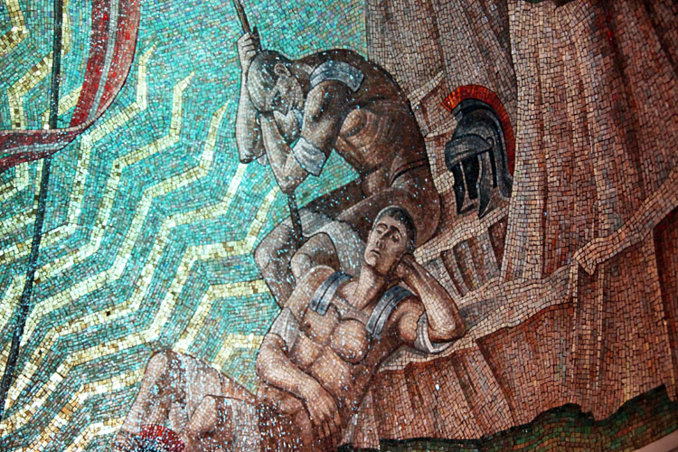
Sleeping Roman Soldiers -- Hildreth Meiere, Washington National Cathedral, Washington, DC

Slide 24
Credits
New Revised Standard Version Bible, copyright 1989, Division of Christian Education of the National Council of the Churches of Christ in the United States of America. Used by permission. All rights reserved.
https://commons.wikimedia.org/wiki/File:Valley_of_the_shadow_of_death.jpg
Estate of John August Swanson, https://www.johnaugustswanson.com/
http://www.flickr.com/photos/37122972@N06/3913846520/
https://www.flickr.com/photos/punktoad/9162288737/
http://diglib.library.vanderbilt.edu/act-imagelink.pl?RC=31721
http://www.flickr.com/photos/rimski/4718409281/
https://commons.wikimedia.org/wiki/File:%C3%89douard_Manet_-_Le_Christ_mort_et_les_anges.jpg
http://diglib.library.vanderbilt.edu/act-imagelink.pl?RC=51565
https://commons.wikimedia.org/wiki/File:Sealing_of_Christ%27s_Tomb_(Russia,_19th_c.).jpg
https://commons.wikimedia.org/wiki/File:B084_Rembrandt.jpg
https://commons.wikimedia.org/wiki/File:Mosaic_03_-_Resurrection_Chapel_-_National_Cathedral_-_DC.JPG
Additional descriptions can be found at the Art in the Christian Tradition image library, a service of the Vanderbilt Divinity Library, http://diglib.library.vanderbilt.edu/. All images available via Creative Commons 3.0 License.

