Slide 1
FOURTH SUNDAY IN LENT
Year C
Joshua 5:9-12 • Psalm 32 • 2 Corinthians 5:16-21 Luke 15:1-3, 11b-32

Slide 2
… the Pharisees … were grumbling and saying, "This fellow welcomes sinners and eats with them."
So he told them this parable:
"There was a man who had two sons.
Luke 15:3, 11b

Slide 3
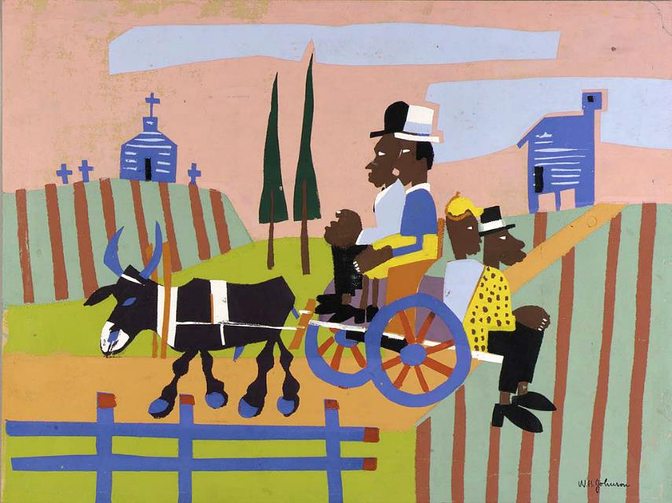
Going to Church -- Wiliiam H. Johnson, Smithsonian Museum of American Art, Washington, DC

Slide 4
The younger of them said to his father, 'Father, give me the share of the property that will belong to me.' So he divided his property between them.
Luke 15:12

Slide 5
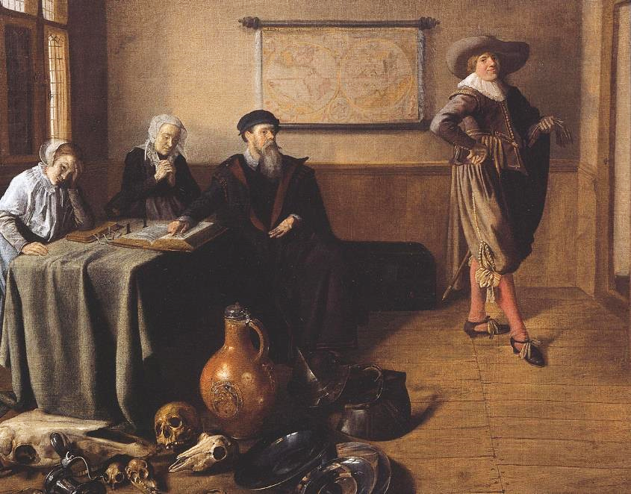
Departure of the Prodigal Son -- Jan Molenaer, Netherlands Institute of Art History

Slide 6
A few days later the younger son gathered all he had and traveled to a distant country, and there he squandered his property in dissolute living.
Luke 15:13

Slide 7
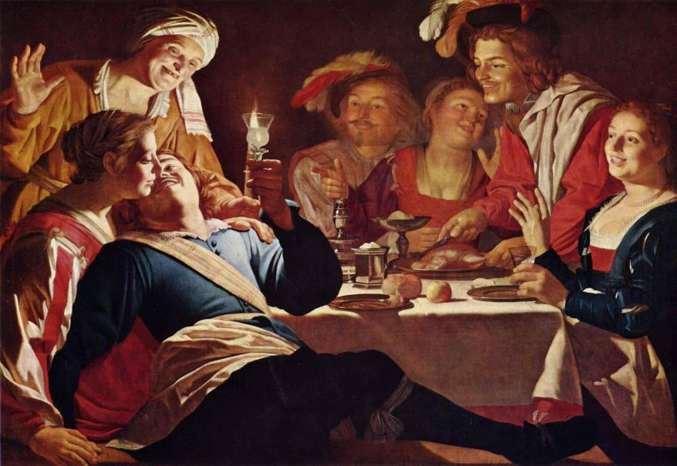
The Prodigal Son -- Gerard van Honthorst, Alte Pinakothek, Munich, Germany

Slide 8
So he went and hired himself out to … feed the pigs. 'How many of my father's hired hands have bread enough and to spare, but here I am dying of hunger!'
Luke 15:15ac, 17b

Slide 9
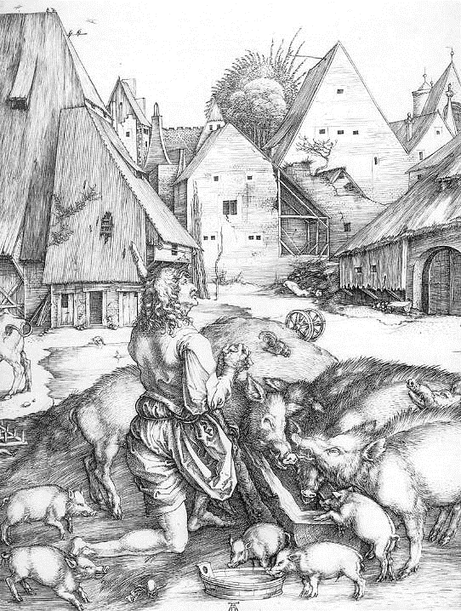
The Prodigal Son
Albrecht Durer
Staatliche Kunsthalle Karlsruhe, Germany

Slide 10
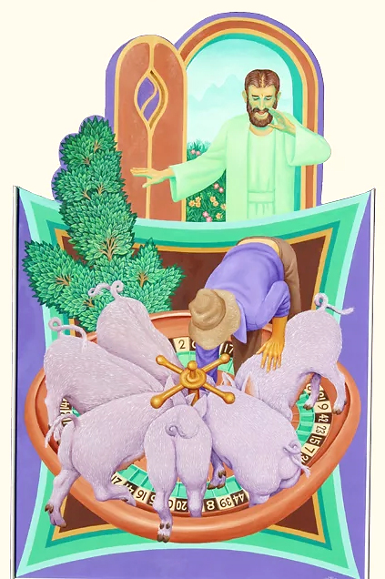
The Prodigal Son
Peter Koenig

Slide 11
I will get up and go to my father, and I will say to him, "… I am no longer worthy to be called your son; treat me like one of your hired hands."'
Luke 15:18a, 19

Slide 12
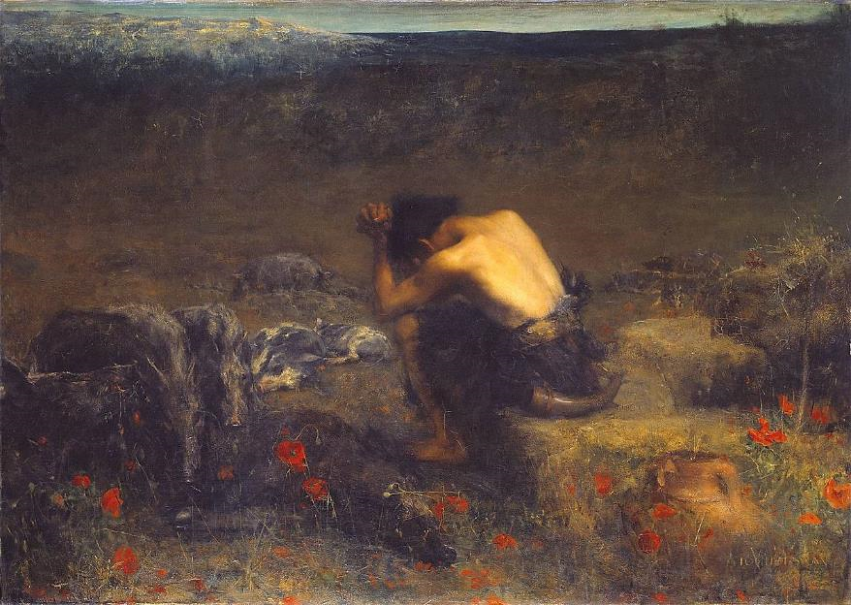
Prodigal Son -- John Swan, Tate Britain, London, England

Slide 13
… But while he was still far off, his father saw him and was filled with compassion; he ran and put his arms around him and kissed him.
Luke 15:20b

Slide 14
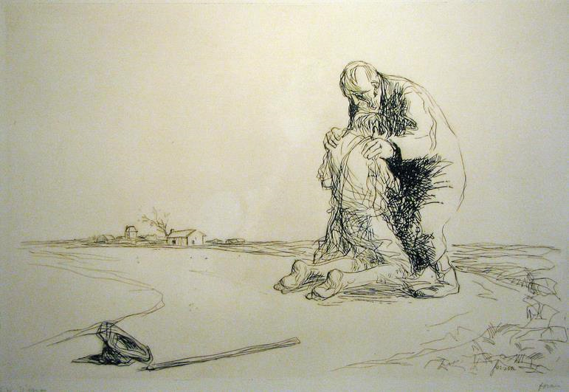
The Prodigal Son -- Jean Forain, ink drawing, early 20th century

Slide 15
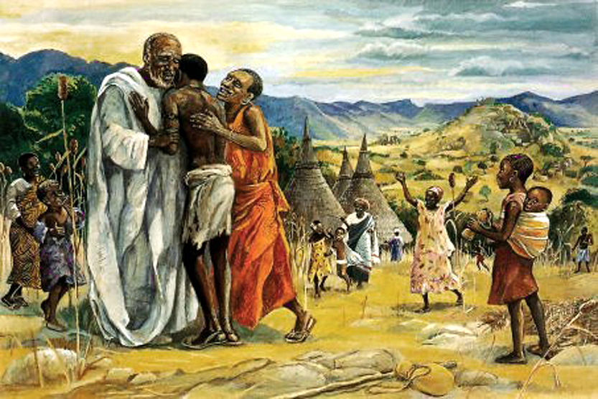
The Prodigal Son -- JESUS MAFA, Cameroon

Slide 16
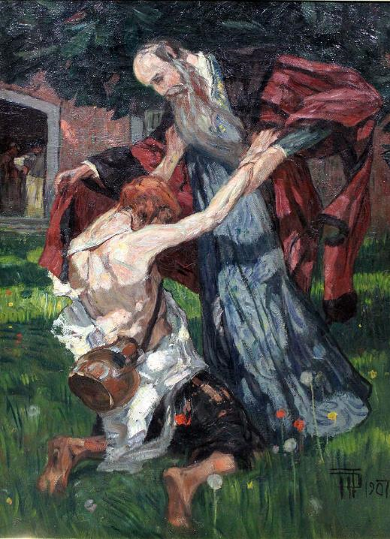
The Return of the Prodigal Son
Hans Feddersen
Kunsthalle Kiel
Kiel, Germany

Slide 17
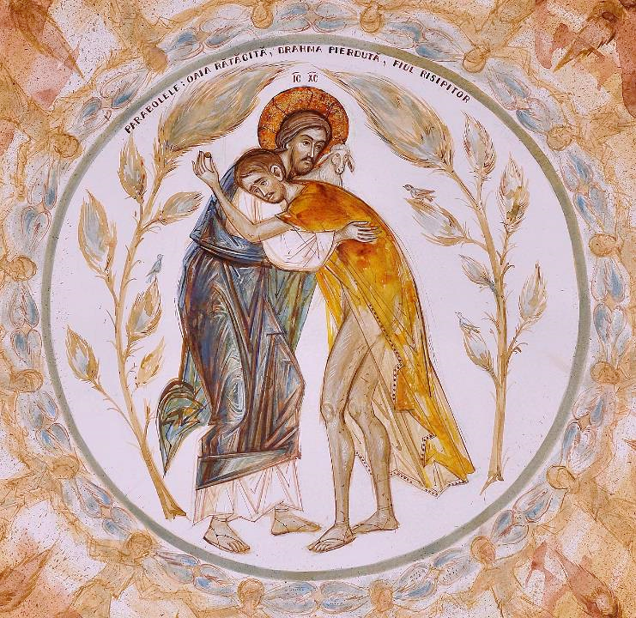
The Return of the Prodigal Son
Elena Murariu

Slide 18
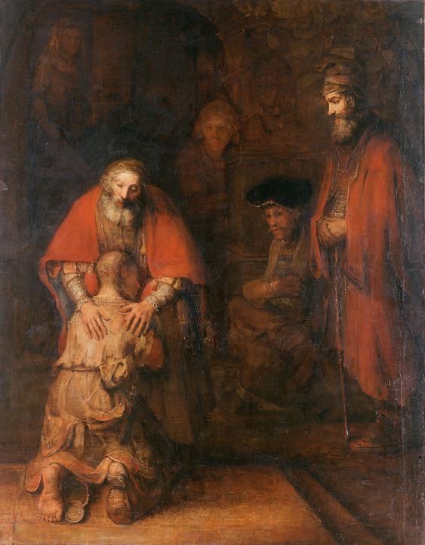
The Return of the Prodigal Son
Rembrandt
Hermitage Museum
St. Petersburg, Russia

Slide 19
'Quickly, bring out a robe--the best one--and put it on him; … And get the fatted calf and kill it, and let us eat and celebrate;
Luke 15:22a, 23

Slide 20
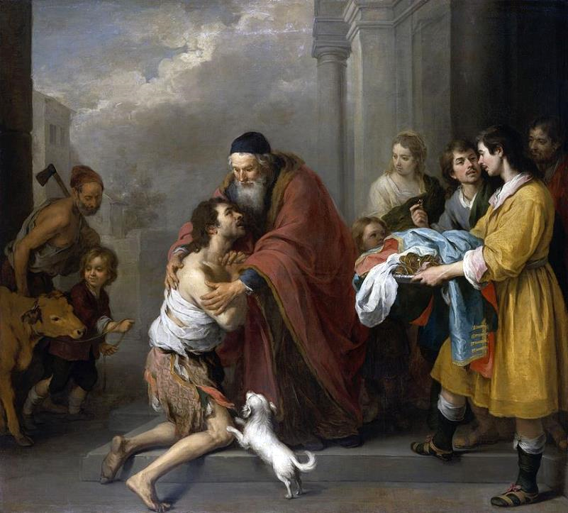
Bartholome Murillo
Return of the Prodigal Son
National Gallery of Art
Washington, DC

Slide 21
for this son of mine was dead and is alive again; he was lost and is found!'
Luke 15:24

Slide 22
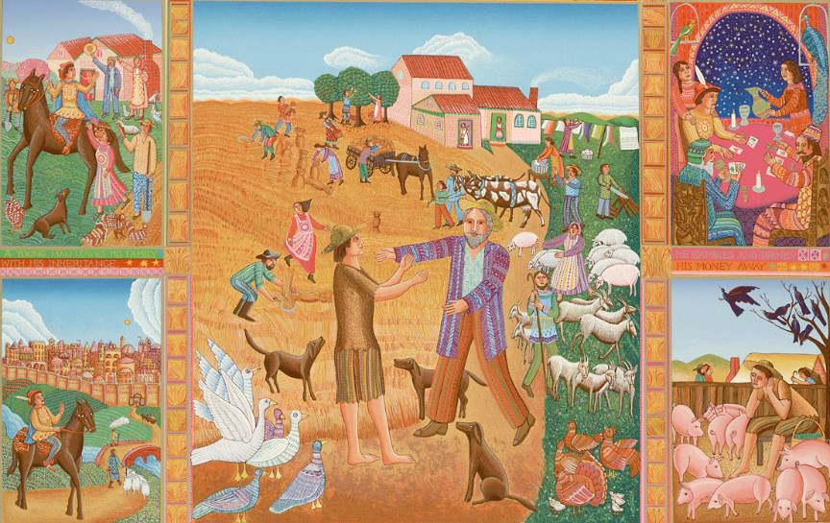
The Prodigal Son -- John August Swanson, serigraph, 1984

Slide 23
Credits
New Revised Standard Version Bible, copyright 1989, Division of Christian Education of the National Council of the Churches of Christ in the United States of America. Used by permission. All rights reserved.
https://commons.wikimedia.org/wiki/File:Going_to_Church,_by_William_H._Johnson.jpg
https://commons.m.wikimedia.org/wiki/File:Jan_Miense_Molenaer_-_Departure_of_the_Prodigal_Son.jpg
https://commons.wikimedia.org/wiki/File:Gerard_van_Honthorst_004.jpg
https://commons.m.wikimedia.org/wiki/File:John_Macallan_Swan_-_The_Prodigal_Son,_1888.jpg
https://commons.m.wikimedia.org/wiki/File:Albrecht_D%C3%BCrer_-_The_Prodigal_Son_-_WGA7275.jpg
https://www.pwkoenig.co.uk/
http://www.flickr.com/photos/edithosb/1464392429/
http://diglib.library.vanderbilt.edu/act-imagelink.pl?RC=54662
https://commons.m.wikimedia.org/wiki/File:1907_Feddersen_Heimkehr_des_verlorenen_Sohnes_anagoria.JPG
https://commons.wikimedia.org/wiki/File:The_return_of_the_prodigal_son,_Elena_Murariu.jpg
https://commons.wikimedia.org/wiki/File:Rembrandt_Harmensz._van_Rijn_-_The_Return_of_the_Prodigal_Son.jpg
https://commons.m.wikimedia.org/wiki/File:Return_of_the_Prodigal_Son_1667-1670_Murillo.jpg
www.JohnAugustSwanson.com - copyright 1984 by John August Swanson
Additional descriptions can be found at the Art in the Christian Tradition image library, a service of the Vanderbilt Divinity Library, http://diglib.library.vanderbilt.edu/. All images available via Creative Commons 3.0 License.

