Slide 1
FIFTH SUNDAY IN LENT
Year C
Isaiah 43:16-21 • Psalm 126 Philippians 3:4b-14 • John 12:1-8

Slide 2
Do not remember the former things,
or consider the things of old. I am about to do a new thing; now it springs forth, do you not perceive it?
Isaiah 43:18-19a

Slide 3
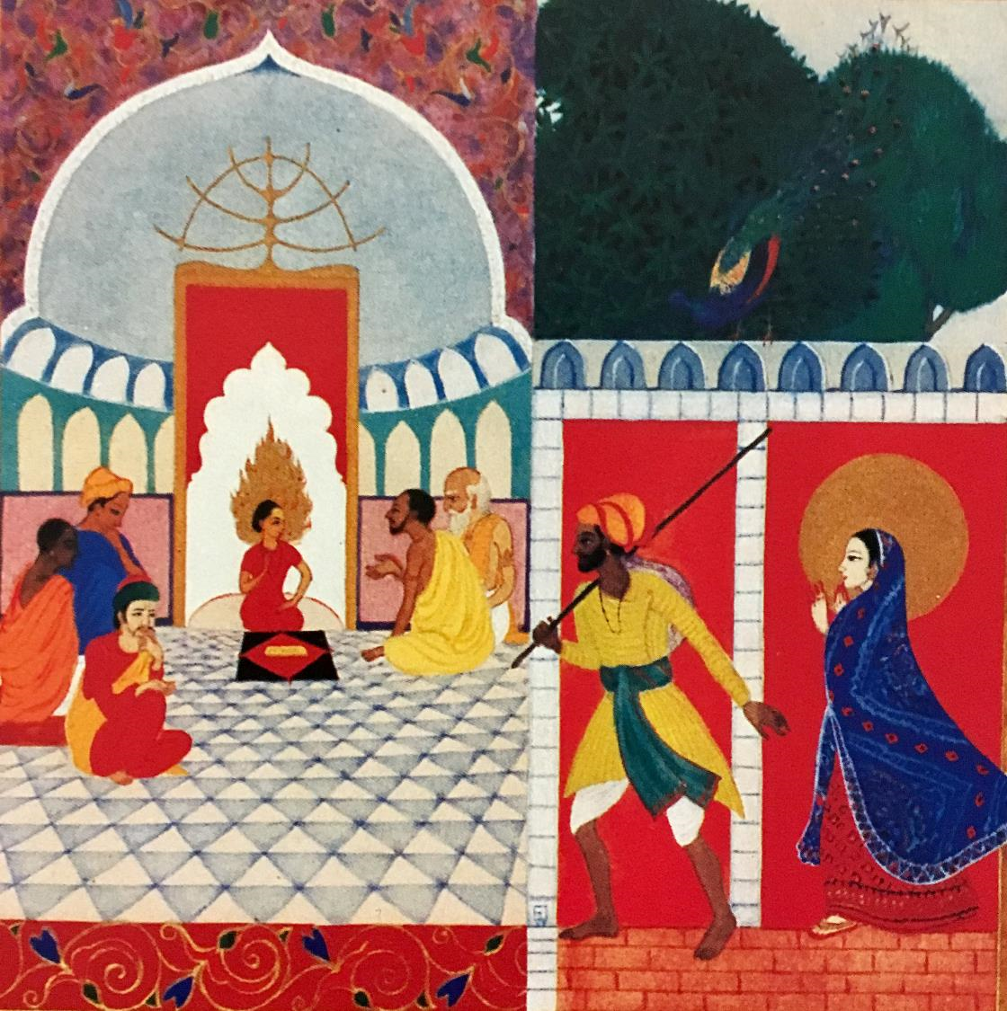
Boy Jesus in the Temple
Frank Wesley

Slide 4
May those who sow in tears
reap with shouts of joy.
Those who go out weeping,
… shall come home with
shouts of joy …
Psalm 126:5, 6ac

Slide 5
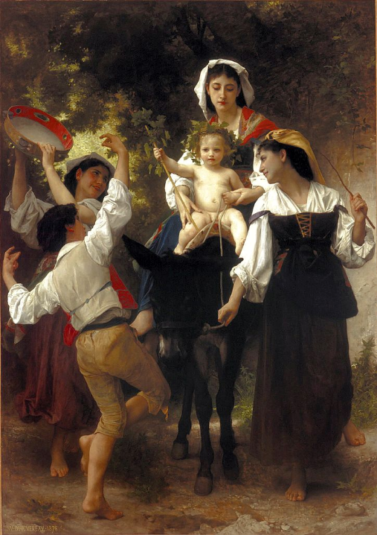
Return from the Harvest
W.-A. Bouguereau
Cummer Museum of Art
Jacksonville, FL

Slide 6
I want to know Christ and the power of his resurrection … forgetting what lies behind and straining forward to what lies ahead …
Philippians 3:10a, 13b

Slide 7
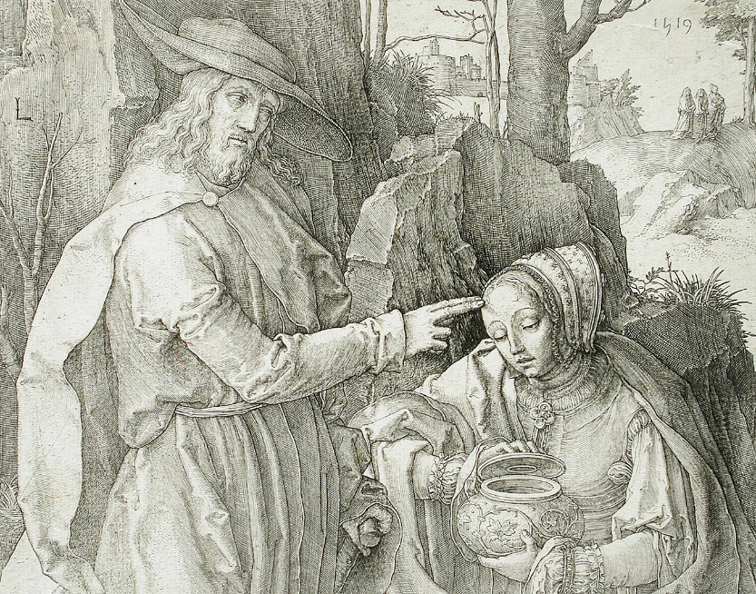
Christ Appears to Mary in the Garden -- Lucas van Leyden, Los Angeles County Museum of Art, CA

Slide 8
Six days before the Passover, Jesus came to Bethany, the home of Lazarus, whom he had raised from the dead.
John 12:1

Slide 9
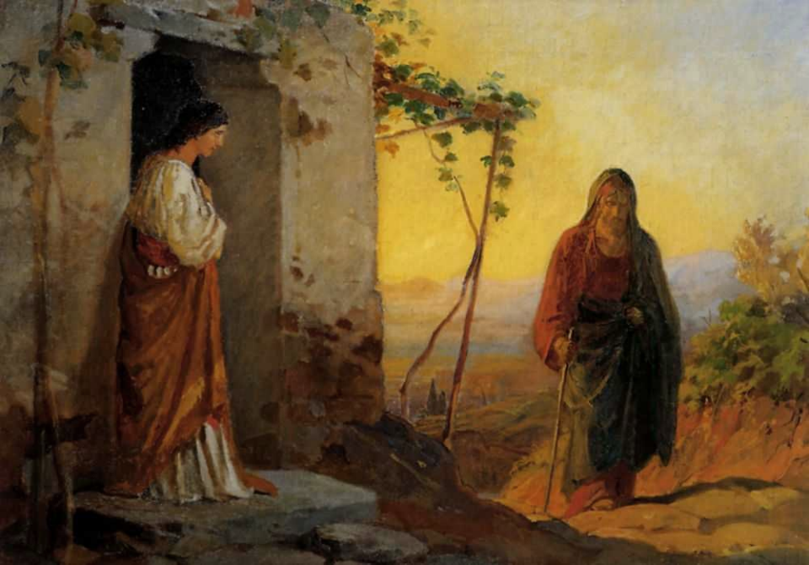
Mary, Sister of Lazarus, Greets Jesus -- Nikolai Ge, Russian, 1864

Slide 10
There they gave a dinner for him. Martha served, and Lazarus was one of those at the table with him.
John 12:2

Slide 11
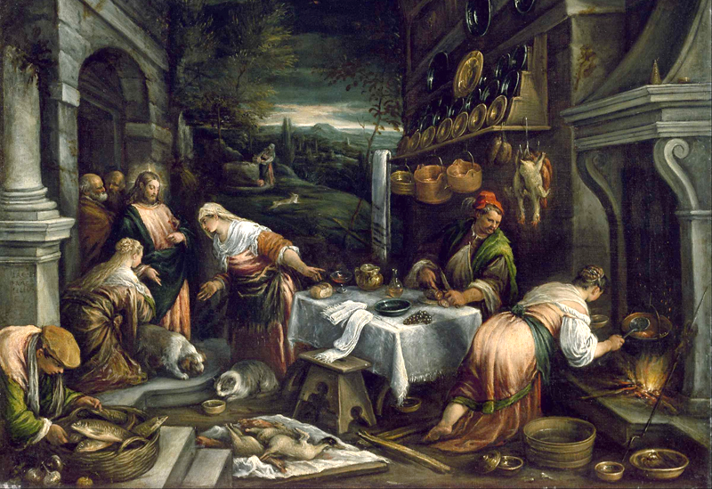
Christ in the House of Mary, Martha, and Lazarus -- Jacopo Bassano, Museum of Fine Arts, Houston, TX

Slide 12
Mary took a pound of costly perfume made of pure nard, anointed Jesus' feet, and wiped them with her hair.
John 12:3a

Slide 13
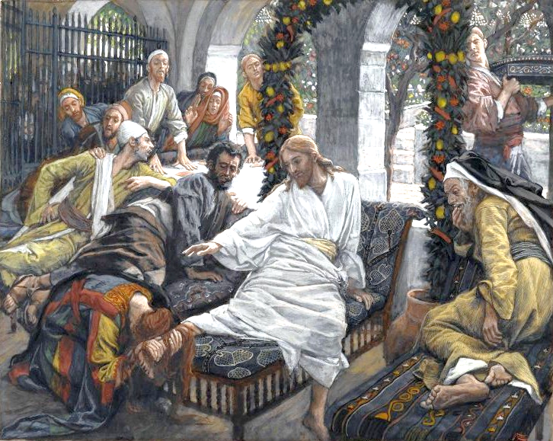
The Perfume of the Magdalene -- James Tissot, Brooklyn Museum, New York, NY

Slide 14
The house was filled with the fragrance of the perfume.
John 12:3b

Slide 15
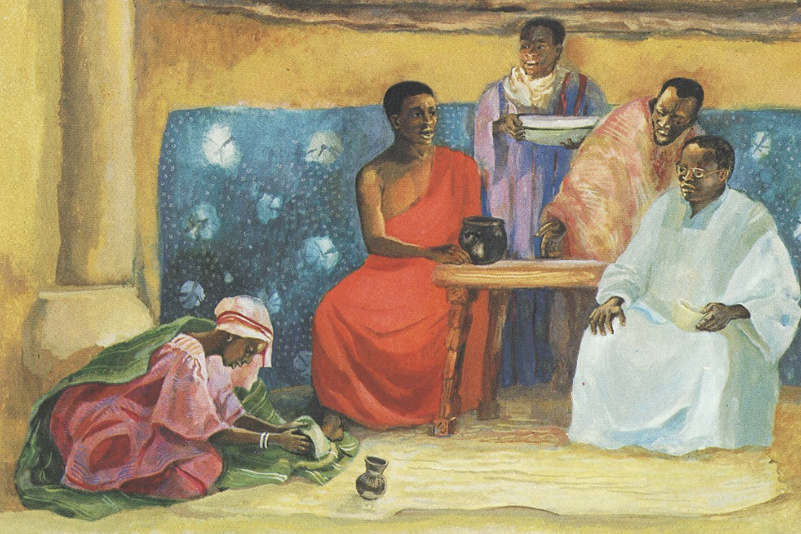
Mary Anoints Christ's Feet with Perfume -- JESUS MAFA, Cameroon

Slide 16
But Judas … said, "Why was this perfume not sold for three hundred denarii and the money given to the poor?"
John 12:4ac, 5

Slide 17
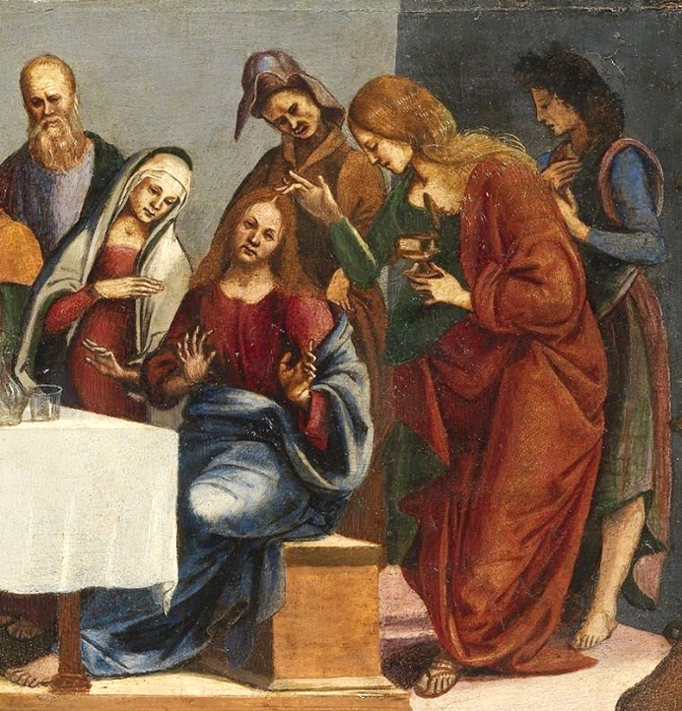
Mary Anoints Christ
Luca Signorelli
National Gallery of Ireland
Dublin, Ireland

Slide 18
Jesus said, "Leave her alone. She bought it so that she might keep it for the day of my burial.
John 12:7

Slide 19
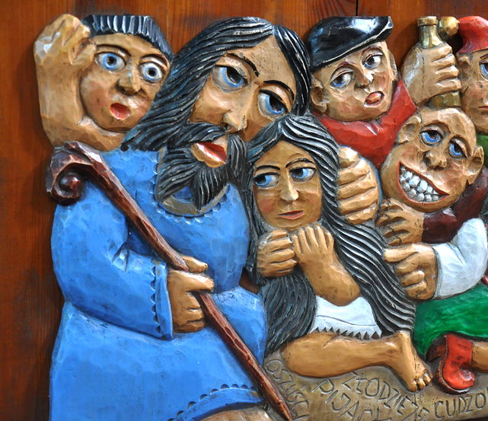
Mary of Bethany and Jesus -- Woodcarving, Paszyn, Poland

Slide 20
You always have the poor with you, but you do not always have me."
John 12:8

Slide 21
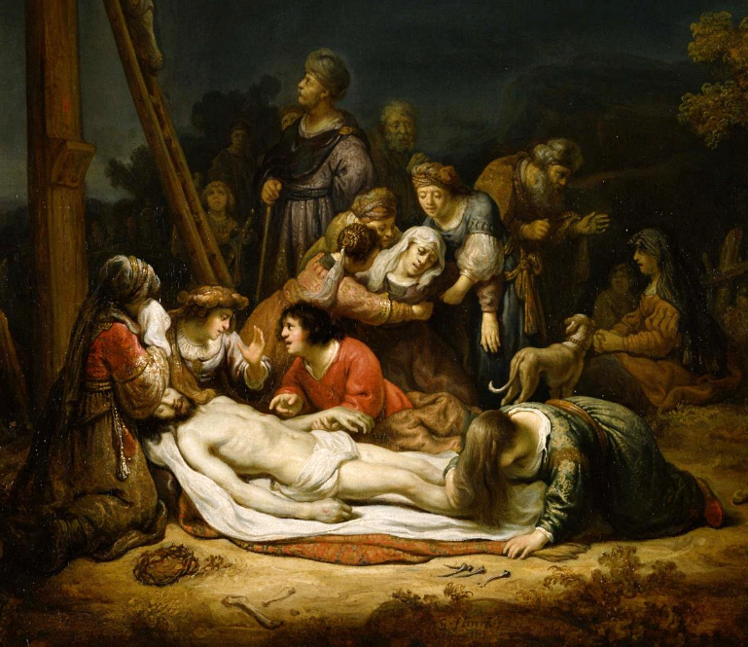
The Lamentation
Govert Flinck
National Museum of Western Art
Tokyo, Japan

Slide 22
Credits
New Revised Standard Version Bible, copyright 1989, Division of Christian Education of the National Council of the Churches of Christ in the United States of America. Used by permission. All rights reserved.
Estate of Frank Wesley, http://www.frankwesleyart.com/main_page.htm
https://commons.wikimedia.org/wiki/File:William-Adolphe_Bouguereau_(1825-1905)_-_Return_from_the_Harvest_(1878).jpg
https://www.flickr.com/photos/wikimediacommons/16213952900
https://commons.wikimedia.org/wiki/File:Nikolay_Ge_015.jpeg
Source: https://commons.wikimedia.org/wiki/File:Jacopo_Bassano_-_Christ_in_the_House_of_Mary,_Martha,_and_Lazarus_-_Google_Art_Project.jpg
https://commons.wikimedia.org/wiki/File:Brooklyn_Museum_-_The_Ointment_of_the_Magdalene_(Le_parfum_de_Madeleine)_-_James_Tissot.jpg
http://diglib.library.vanderbilt.edu/act-imagelink.pl?RC=48384
https://commons.wikimedia.org/wiki/File:Luca_Signorelli_-_Christ_in_the_House_of_Simon_the_Pharisee_-_National_Gallery_of_Ireland_(1).jpg
http://www.flickr.com/photos/feargal/5096168563/
https://commons.wikimedia.org/wiki/File:Govaert_Flinck_-_The_Lamentation_-_Google_Art_Project.jpg
Additional descriptions can be found at the Art in the Christian Tradition image library, a service of the Vanderbilt Divinity Library, http://diglib.library.vanderbilt.edu/. All images available via Creative Commons 3.0 License.

