Slide 1
Trinity Sunday
Year B
Isaiah 6:1-8
Psalm 29
Romans 8:12-17
John 3:1-17

Slide 2
Then I heard the voice of the Lord saying, "Whom shall I send, and who will go for us?" And I said, "Here am I; send me!"
Isaiah 6:8

Slide 3
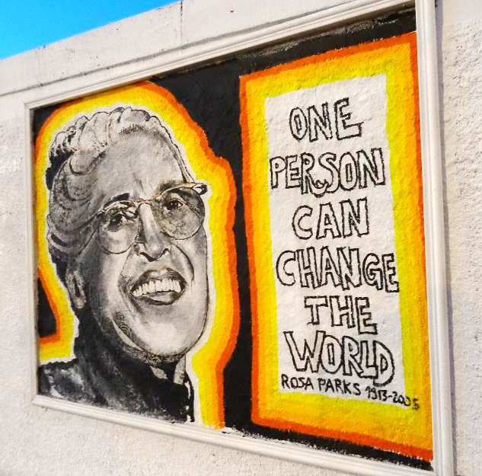
Rosa Parks
Mural
Paris, France

Slide 4
The voice of the LORD causes the oaks to whirl … and in his temple all say, "Glory!" … May the LORD bless his people with peace!
Psalm 29:6

Slide 5
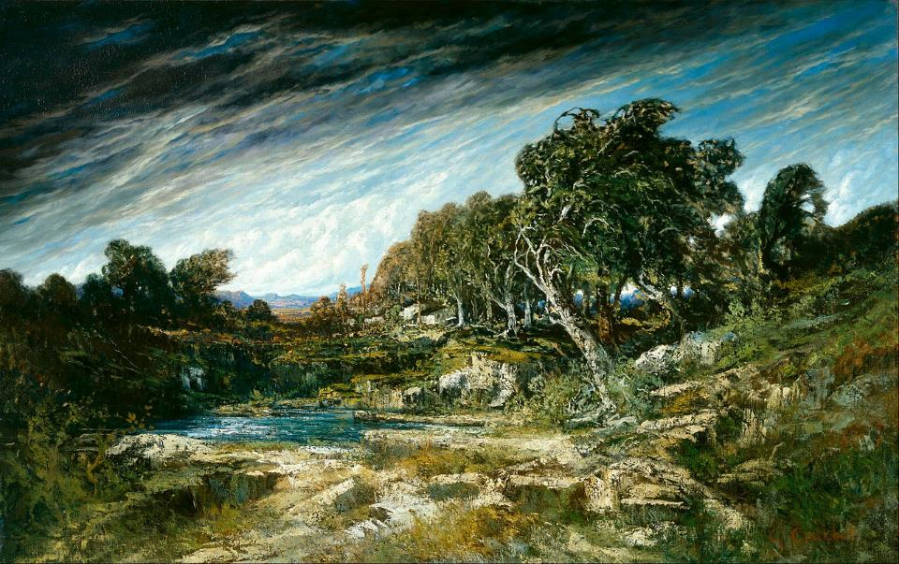
The Gust of Wind -- Gustave Courbet, Museum of Fine Arts, Houston, TX

Slide 6
For you did not receive a spirit of slavery to fall back into fear, but you have received a spirit of adoption. When we cry, "Abba! Father!"
Romans 8:15

Slide 7
Open Adoption Logo
S. M. Baker

Slide 8
Now there was a Pharisee named Nicodemus, a leader of the Jews.
John 3:17

Slide 9
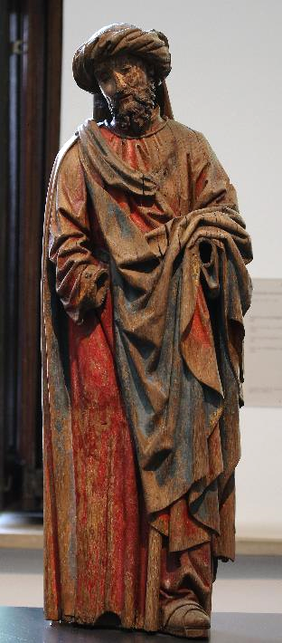
Nicodemus
Museum of Fine Arts
Ghent, Belgium

Slide 10
He came to Jesus by night and said to him, "Rabbi, we know that you are a teacher who has come from God …
John 3:2a

Slide 11
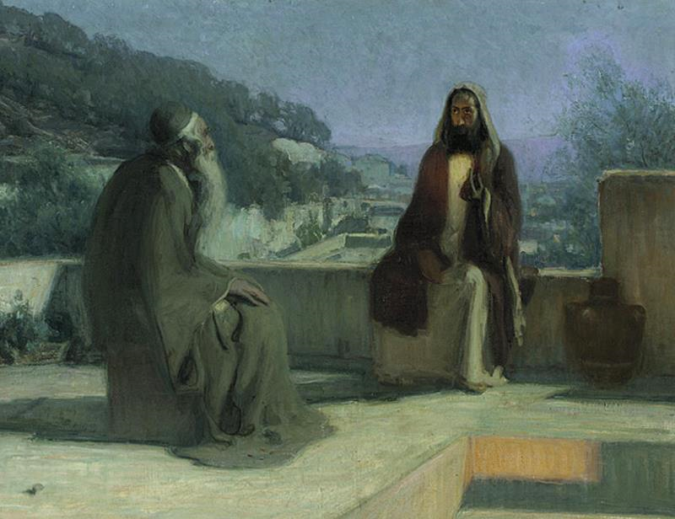
Nicodemus Comes to Jesus at Night -- Henry O. Tanner

Slide 12
Jesus answered him, "Very truly, I tell you, no one can see the kingdom of God without being
born from above."
John 3:3

Slide 13
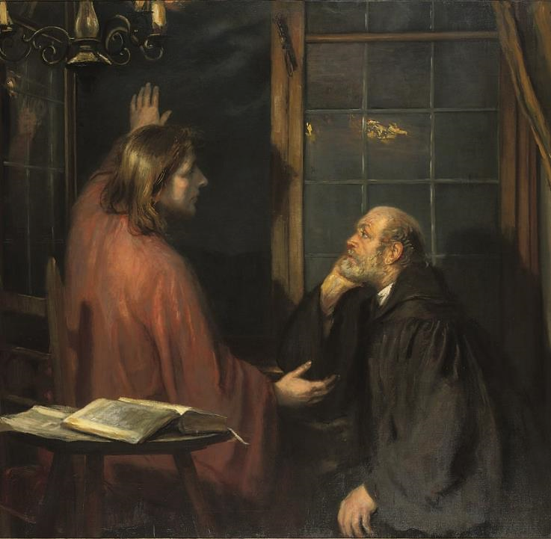
Christ and Nicodemus
Fritz von Uhde

Slide 14
Nicodemus said to him … "Can one enter a second time into the mother's womb and be born?"
John 3:4ac

Slide 15
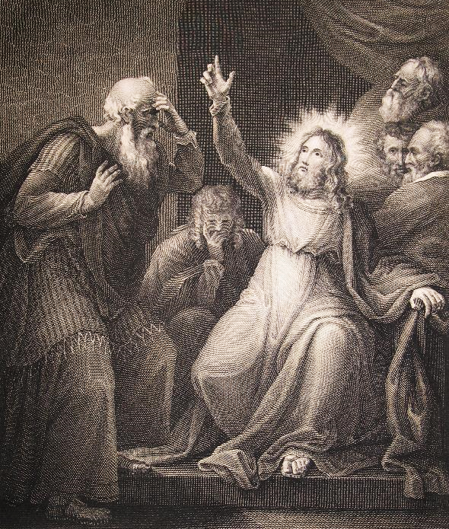
Nicodemus Comes to Jesus
Tresham and Shipster
Macklin Bible
Heard Library, Nashville, TN

Slide 16
Jesus answered … What is born of the flesh is flesh, and what is born of the Spirit is spirit.
John 3:6

Slide 17
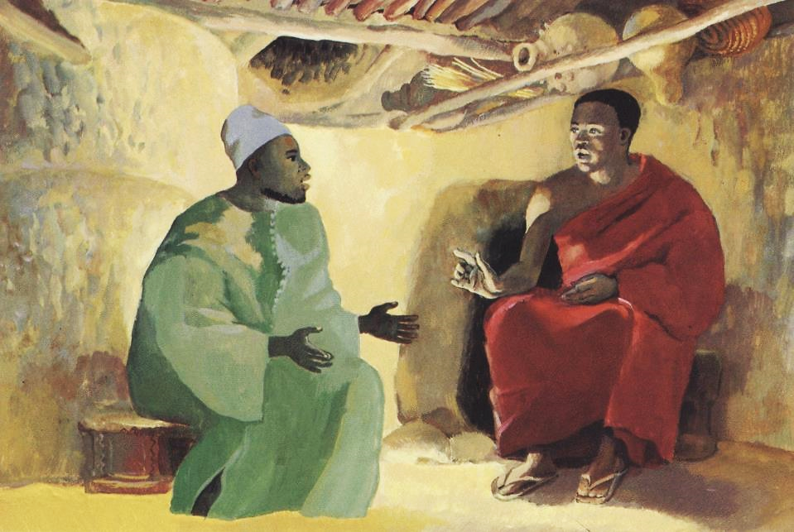
Nicodemus and Jesus -- JESUS MAFA, Cameroon

Slide 18
The wind blows … and you hear the sound of it, but you do not know … where it goes. So it is with everyone who is born of the Spirit."
John 3:8ac

Slide 19
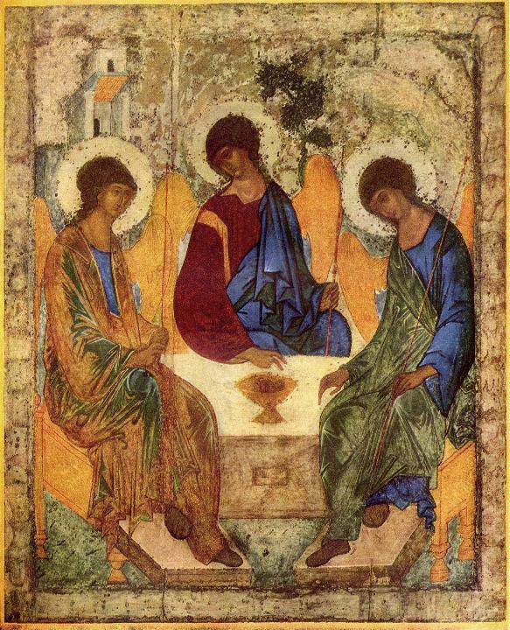
Holy Trinity
Andrei Rublev Tretyakov Gallery Moscow, Russia

Slide 20
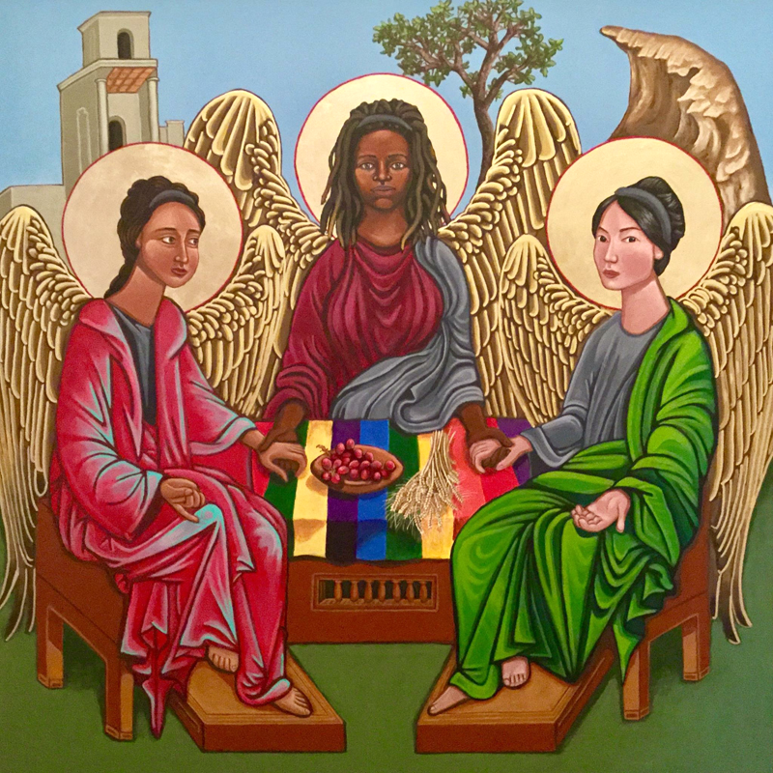
Holy Trinity
Kelly Latimore

Slide 21
"For God so loved the world that he gave his only Son, so that everyone who believes in him may not perish but may have eternal life."
John 3:16

Slide 22
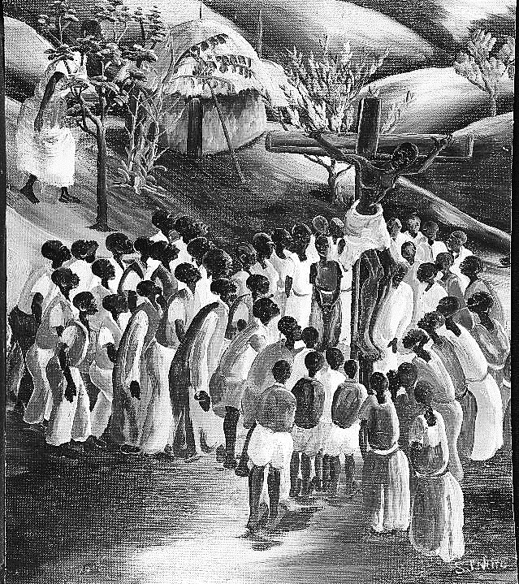
Kakindo Crucifixion
Sam Ntiro
National Archives College Park, MD

Slide 23
Credits
New Revised Standard Version Bible, copyright 1989, Division of Christian Education of the National Council of the Churches of Christ in the United States of America. Used by permission. All rights reserved.
https://www.flickr.com/photos/jmenj/14833115990
https://commons.wikimedia.org/wiki/File:Gustave_Courbet_-_The_Gust_of_Wind_-_Google_Art_Project.jpg
https://commons.wikimedia.org/wiki/File:Heart_For_Open_Adoption_Logo.jpg – smbaker79
https://commons.wikimedia.org/wiki/File:Wiki_Loves_Art_-_Gent_-_Museum_voor_Schone_Kunsten_-_Figuur_van_een_graflegging,_Nicodemus_(Q22235777)_(1).JPG - Romaine
http://commons.wikimedia.org/wiki/File:Henry_Ossawa_Tanner_-_Jesus_and_nicodemus.jpg
http://diglib.library.vanderbilt.edu/act-imagelink.pl?RC=48385
http://diglib.library.vanderbilt.edu/act-imagelink.pl?RC=54051
https://commons.wikimedia.org/wiki/File:Fritz_von_Uhde_-_Christus_und_Nikodemus_(ca.1886).jpg
https://commons.wikimedia.org/wiki/File:Andrej_Rubl%C3%ABv_001.jpg
https://kellylatimoreicons.com/contact/
http://commons.wikimedia.org/wiki/File:%22Kakindo_Crucifixion%22_-_NARA_-_558948.tif
Additional descriptions can be found at the Art in the Christian Tradition image library, a service of the Vanderbilt Divinity Library, http://diglib.library.vanderbilt.edu/. All images available via Creative Commons 3.0 License.

