Slide 1
Third Sunday of Easter
Year B
Acts 3:12-19
Psalm 4
1 John 3:1-7
Luke 24:36b-48

Slide 2
And by faith in his name … the faith that is through Jesus …
Acts 3:16ac

Slide 3
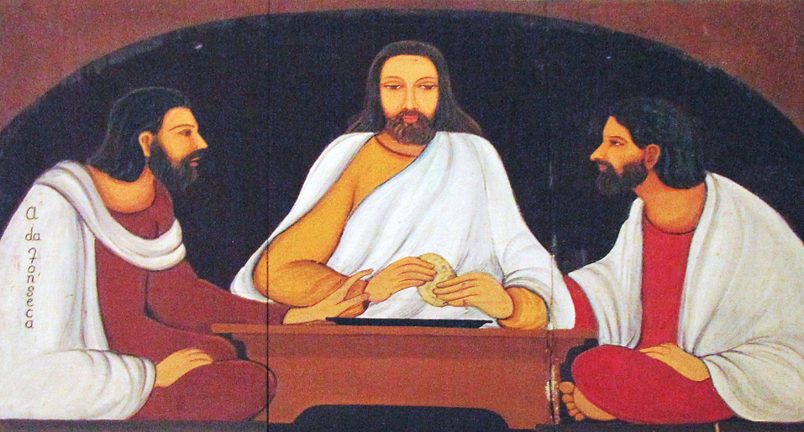
Christ Breaking Bread -- Angelo da Fonseca, Christa Prema Seva Ashram, Pune, India

Slide 4
"O that we might see some good! Let the light of your face shine on us, O LORD!"
Psalm 4:6b

Slide 5
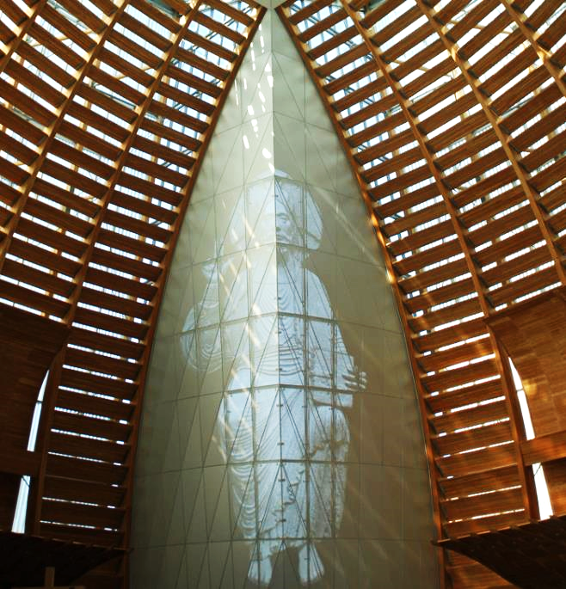
Cathedral of Christ the Light
Oakland, CA

Slide 6
See what love the Father has given us, that we should be called children of God; and that is what we are.
1 John 3:1a

Slide 7
Procession, detail -- John August Swanson

Slide 8
While they were talking about this, Jesus himself stood among them and said to them, "Peace be with you."
Luke 24:36b

Slide 9
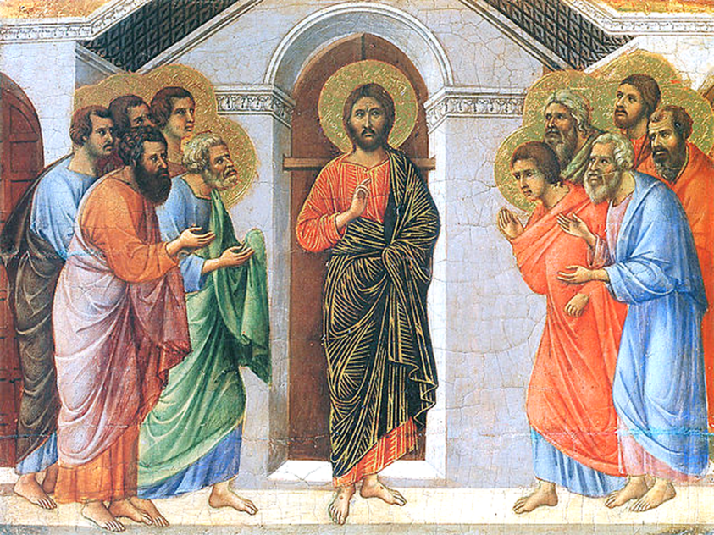
Christ Appears to the Apostles -- Duccio, Museo dell’Opera del Duomo, Siena, Italy

Slide 10
They were startled and terrified, and thought that they were seeing a ghost.
Luke 24:37

Slide 11
He said to them, "Why are you frightened, and why do doubts arise in your hearts?"
Luke 24:38

Slide 12
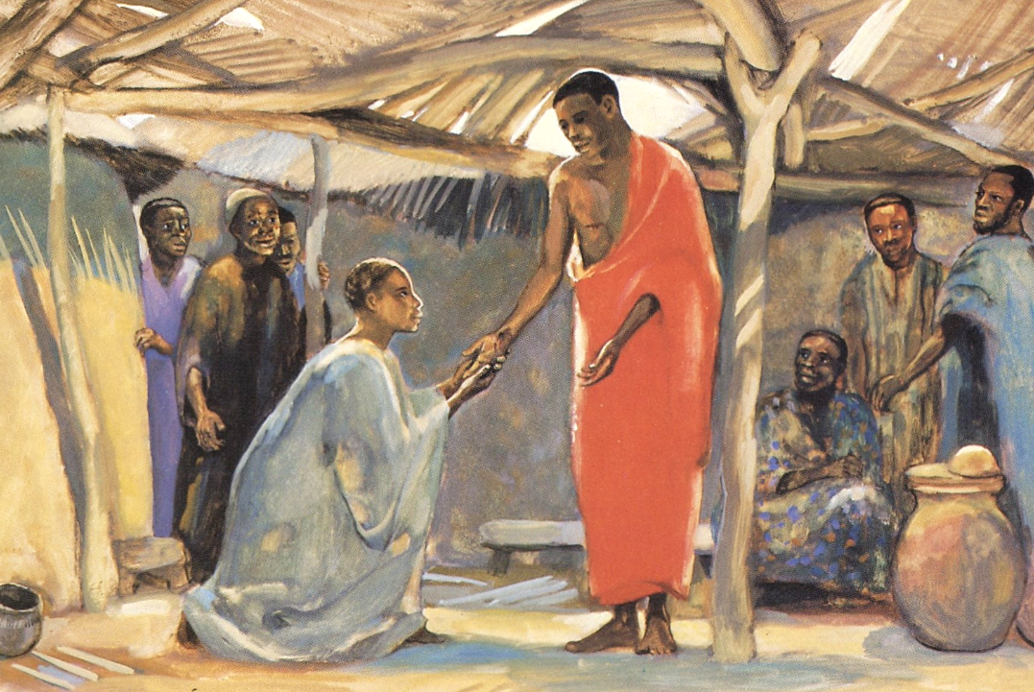
Christ Appears to Disciples
JESUS MAFA
Cameroon

Slide 13
"Look at my hands and my feet; see that it is I myself. Touch me and see …"
Luke 24:39

Slide 14
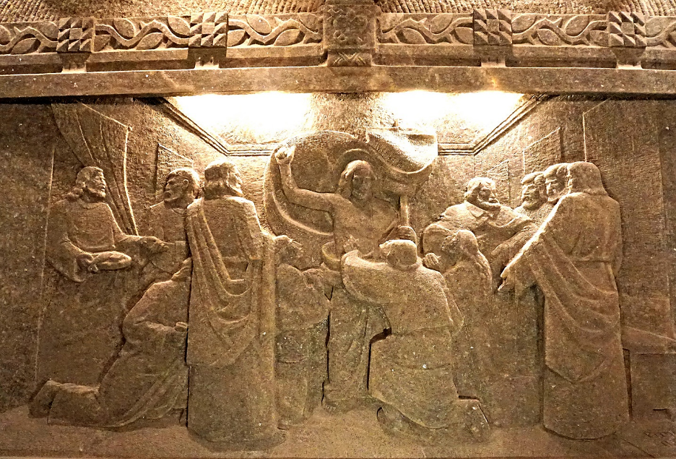
Christ Appears to Disciples -- Salt Mines Cathedral of Bogucice, Poland

Slide 15
While in their joy they were disbelieving and still wondering, he said to them, "Have you anything here to eat?"
Luke 24:41

Slide 16
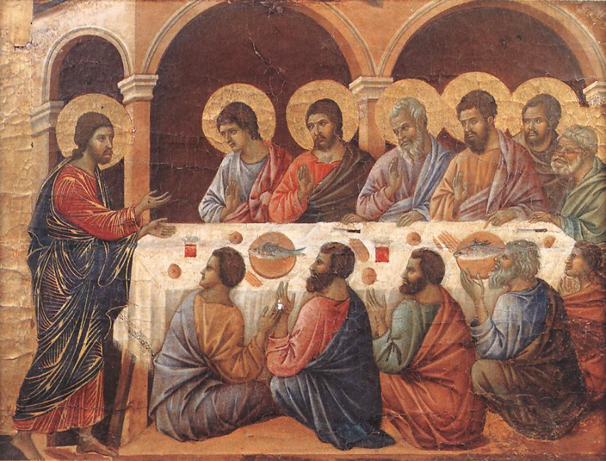
Christ Appears to the Disciples -- Duccio, Altar of Duomo, Siena, Italy

Slide 17
They gave him a piece of broiled fish,
and he took it and ate in their presence.
Luke 24:42-43

Slide 18
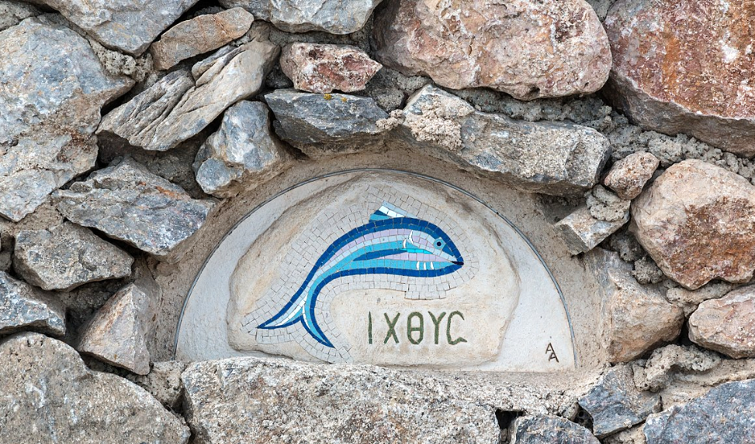
Cr
Fish Mosaic , Profítis Ilías Monastery, Kallistis, Greece

Slide 19
Then he opened their minds to understand the scriptures, and he said to them, "Thus it is written, that the Messiah is to suffer …
Luke 24:45-46a

Slide 20
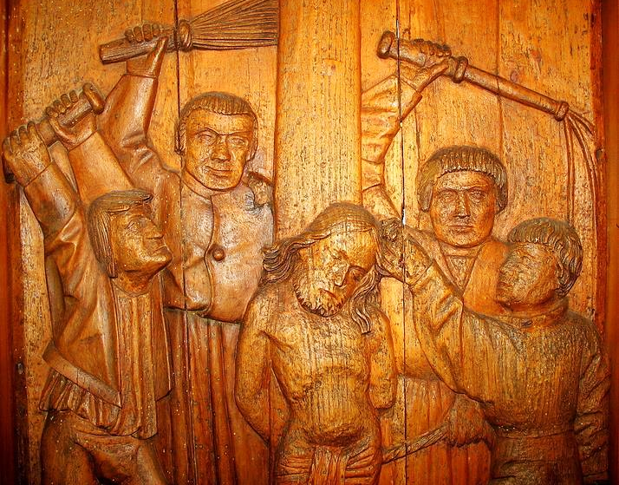
Flagellation of Jesus -- Museum Hallstatt, Hallstatt, Brazil

Slide 21
and to rise from the dead on the third day … You are witnesses of these things."
Luke 24:47b, 48

Slide 22
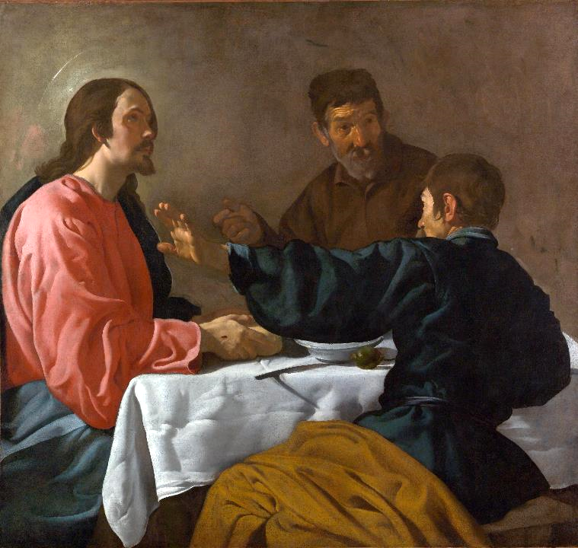
Supper at Emmaus
Diego Velazquez
Met Museum
New York, NY

Slide 23
Credits
New Revised Standard Version Bible, copyright 1989, Division of Christian Education of the National Council of the Churches of Christ in the United States of America. Used by permission. All rights reserved.
https://commons.wikimedia.org/wiki/File:Christa_Prema_Seva_ashram,_Pune_23_(Friar%27s_Balsam).jpg
http://www.flickr.com/photos/sicarr/3251258111/
Estate of John August Swanson, https://www.johnaugustswanson.com/
https://commons.wikimedia.org/wiki/File:Duccio_di_Buoninsegna_017.jpg
http://www.librairie-emmanuel.fr (contact page: https://www.librairie-emmanuel.fr/contact)
https://www.flickr.com/photos/archer10/31080403284 - Dennis Jarvis
https://commons.wikimedia.org/wiki/File:Duccio_di_Buoninsegna_-_Appearance_While_the_Apostles_are_at_Table_-_WGA06738.jpg
https://commons.wikimedia.org/wiki/File:Santorin_(GR),_Kallistis,_Kloster_Prof%C3%ADtis_Il%C3%ADas_--_2017_--_2896.jpg
http://commons.wikimedia.org/wiki/File:Hallstatt_5928.JPG
https://commons.wikimedia.org/wiki/File:La_cena_de_Ema%C3%BAs,_by_Diego_Vel%C3%A1zquez.jpg
Additional descriptions can be found at the Art in the Christian Tradition image library, a service of the Vanderbilt Divinity Library, http://diglib.library.vanderbilt.edu/. All images available via Creative Commons 3.0 License.

