Slide 1
Third Sunday after the Epiphany
Year B
Jonah 3:1-5, 10
Psalm 62:5-12
1 Corinthians 7:29-31
Mark 1:14-20

Slide 2
The word of the LORD came to Jonah … "Get up, go to Nineveh, that great city, and proclaim to it the message that I tell you."
Jonah 3:1a, 2

Slide 3
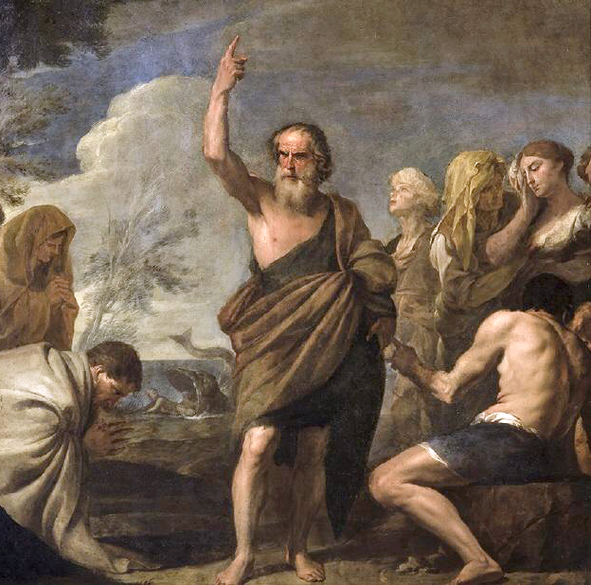
Jonah Preaching to the People of Nineveh
Andrea Vaccaro
Museo de Bellas Artes
Seville, Spain

Slide 4
Those of low estate …
those of high estate …
in the balances they go up;
they are together lighter than a breath.
Psalm 62:9

Slide 5
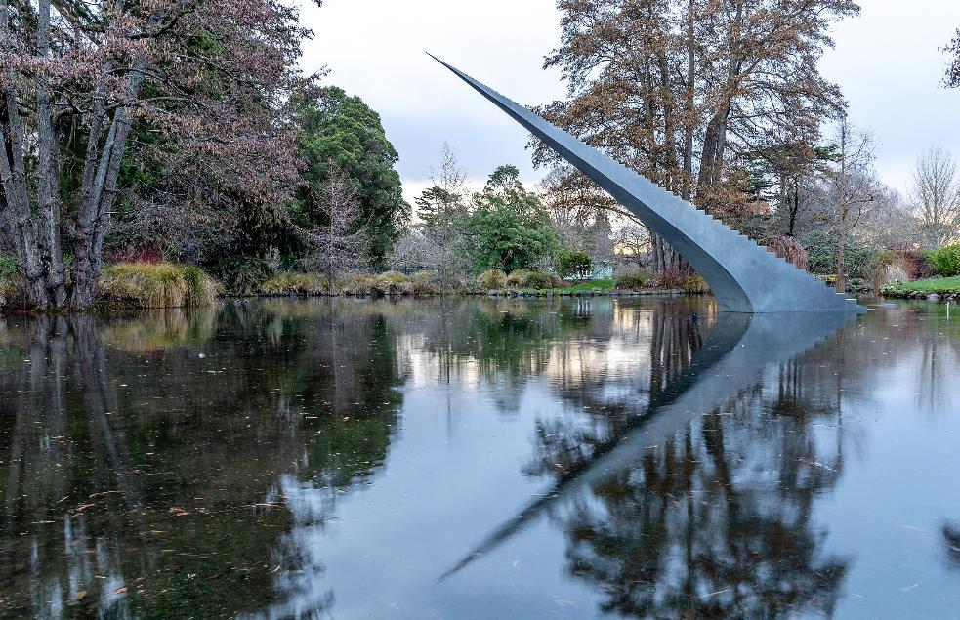
Diminish and Ascend -- David McCracken, Christchurch, New Zealand

Slide 6
I mean, brothers and sisters, the appointed time has grown short … the present form of this world is passing away.
1 Corinthians 7:29a, 31b

Slide 7
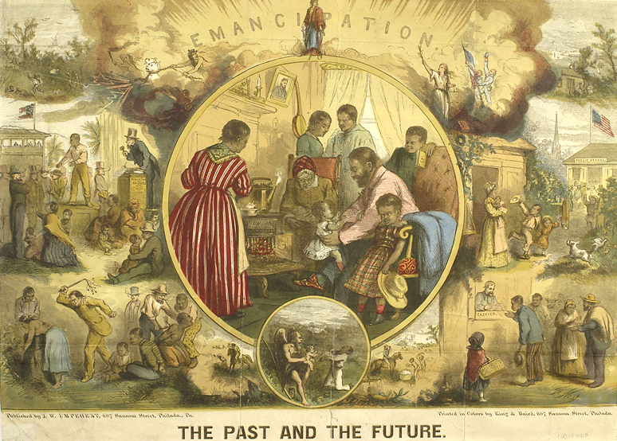
The Past and the Future – Emancipation -- Thomas Nast, Library Co. of Philadelphia

Slide 8
As Jesus passed along the Sea of Galilee, he saw Simon and his brother Andrew casting a net into the sea--for they were fishermen.
Mark 1:16

Slide 9
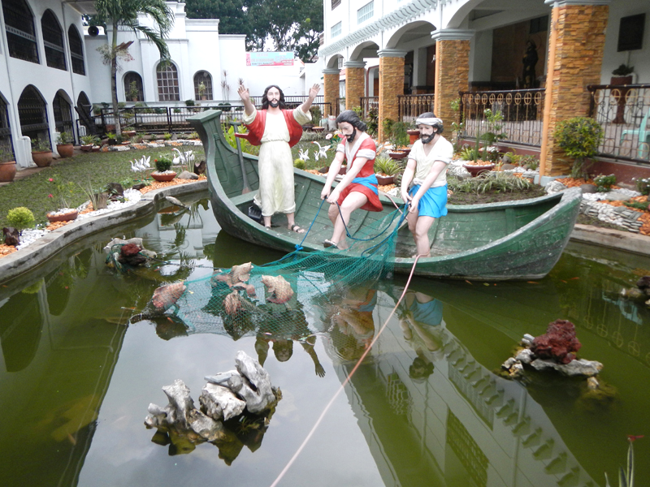
Christ Calling the Disciples -- Nuestra Senora de la Candelaria, Candelaria, Philippines

Slide 10
And Jesus said to them, "Follow me and I will make you fish for people."
Mark 1:17

Slide 11
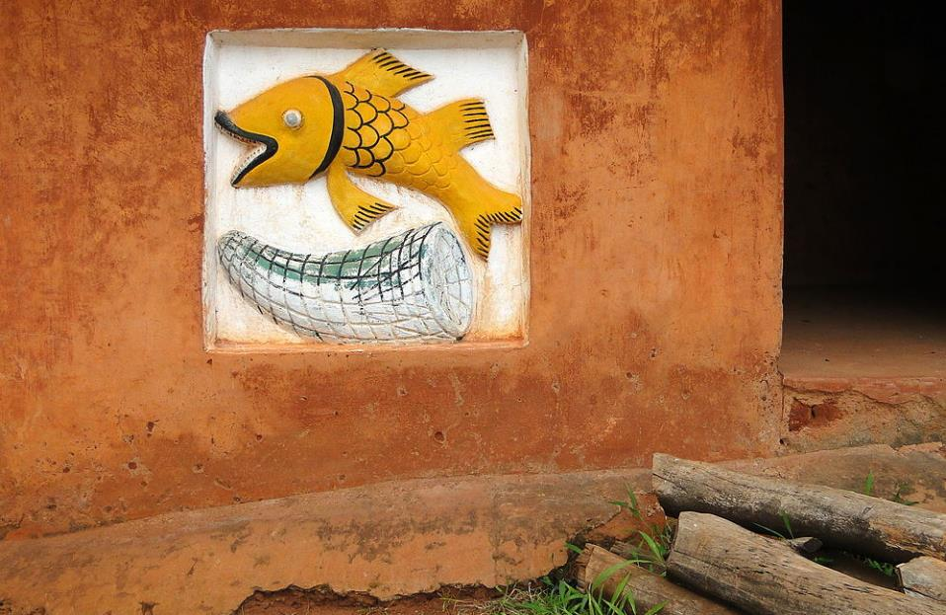
Fish Symbol on Shrine Wall -- Abomey, Benin

Slide 12
Logo of Presbytery of Marambaia, Brazil

Slide 13
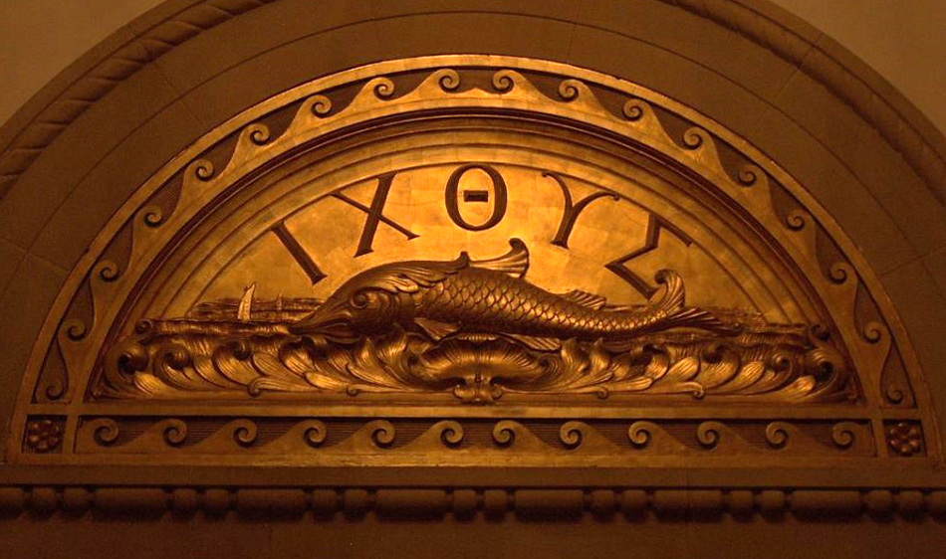
Ixthus Door -- Brite Divinity School, Texas Christian University, Fort Worth, TX

Slide 14
And immediately they left their nets and followed him.
Mark 1:18

Slide 15
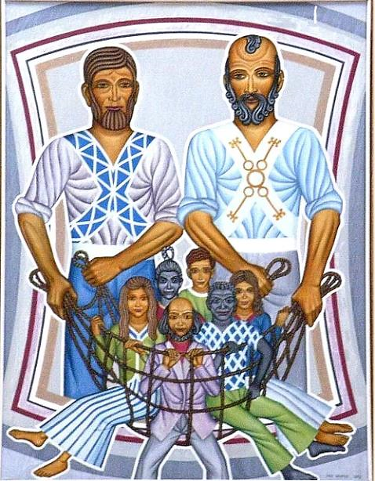
St. Peter and St. Andrew -- Peter Koenig

Slide 16
As he went a little farther, he saw James son of Zebedee and his brother John, who were in their boat mending the nets.
Mark 1:19

Slide 17
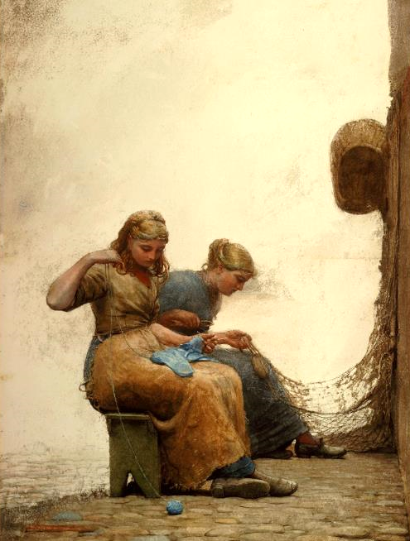
Mending the Nets
Winslow Homer
National Gallery of Art
Washington, DC

Slide 18
Immediately he called them; and they left their father Zebedee in the boat with the hired men, and followed him.
Mark 1:20

Slide 19
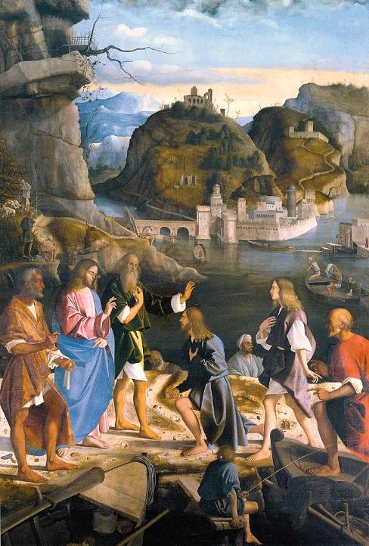
Calling of James and John, sons of Zebedee
Marco Basaiti
Accademia of Venice
Venice, Italy

Slide 20
Credits
New Revised Standard Version Bible, copyright 1989, Division of Christian Education of the National Council of the Churches of Christ in the United States of America. Used by permission. All rights reserved.
https://commons.wikimedia.org/wiki/File:Jon%C3%A1s_predicando_al_pueblo_de_N%C3%ADnive,_de_Andrea_Vaccaro_(Museo_de_Bellas_Artes_de_Sevilla).jpg
https://commons.wikimedia.org/wiki/File:Diminish_and_Ascend,_Christchurch_Botanic_Gardens,_Christchurch.jpg
https://commons.wikimedia.org/wiki/File:Emancipation-_the_past_and_the_future_(20186657008).jpghttps://commons.wikimedia.org/wiki/File:CandelariaChurchjf1988_08.JPG – Ramon Velazquez
https://commons.m.wikimedia.org/wiki/File:Fish_Symbol_on_Shrine_Wall_-_Abomey_-_Benin.jpg – Adam Jones PhD
https://commons.m.wikimedia.org/wiki/File:Igreja_Presbiteriana_em_Marambaia.jpg
https://www.flickr.com/photos/yumievriwan/4351729515
Peter Winfried (Canisius) Koenig, https://www.pwkoenig.co.uk/
https://commons.wikimedia.org/wiki/File:Mending_the_Nets_by_Winslow_Homer,_1881.png
https://commons.wikimedia.org/wiki/File:Basaiti_Call_of_the_Sons_of_Zebedee.jpg
Additional descriptions can be found at the Art in the Christian Tradition image library, a service of the Vanderbilt Divinity Library, http://diglib.library.vanderbilt.edu/. All images available via Creative Commons 3.0 License.

