Slide 1
Second Sunday in Lent
Year B
Genesis 17:1-7, 15-16
Psalm 22:23-31
Romans 4:13-25
Mark 8:31-38 or Mark 9:2-9

Slide 2
… the LORD appeared to Abram … "No longer shall your name be Abram, but … Abraham; for I have made you the ancestor of a multitude of nations."
Genesis 17:1b, 5

Slide 3
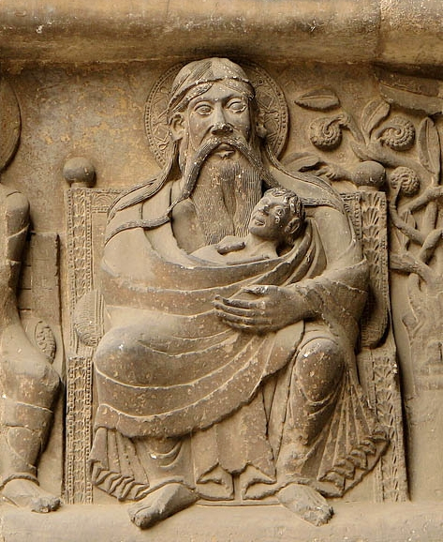
Abraham Holding a Soul in Heaven
Abbey of St. Pierre Moissac, France

Slide 4
God said to Abraham, "As for Sarai your wife, you shall not call her Sarai, but Sarah shall be her name."
Genesis 17:15

Slide 5
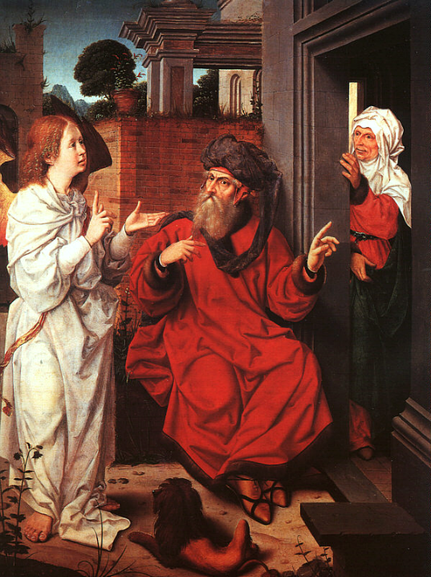
Abraham, Sarah, and the Angel
Jan Provoost
Louvre Museum
Paris, France

Slide 6
"I will bless her, and she shall give rise to nations; kings of peoples shall come from her."
Genesis 17:16b

Slide 7
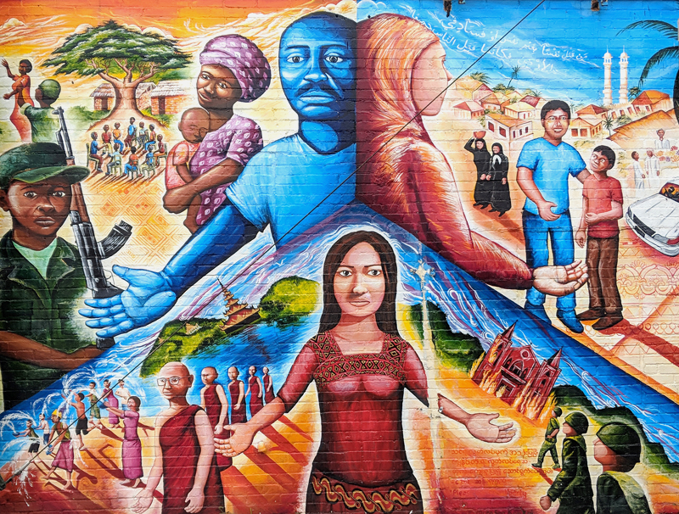
Global Refugee Mural -- Joel Bergner, Silver Spring, MD

Slide 8
The poor shall eat and be satisfied; those who seek him shall praise the LORD.
Psalm 22:26a

Slide 9
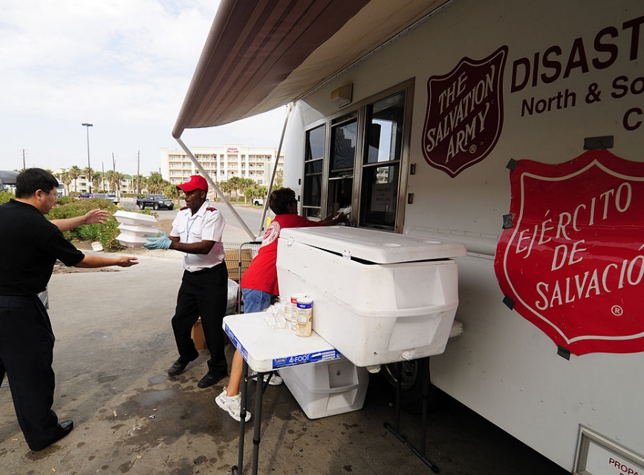
Salvation Army Disaster Relief, Galveston, TX, 2008

Slide 10
No distrust made him waver concerning the promise of God, but he grew strong in his faith as he gave glory to God …
Romans 4:20

Slide 11
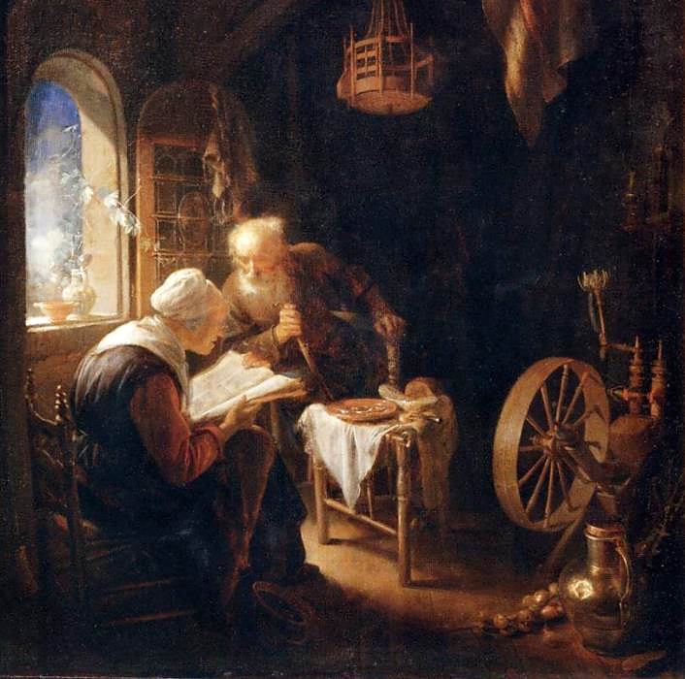
Reading the Bible
Gerrit Dou
Louvre Museum
Paris, France

Slide 12
Then he began to teach them that the Son of Man must undergo great suffering … and be killed, and after three days rise again.
Mark 8:31a,c

Slide 13
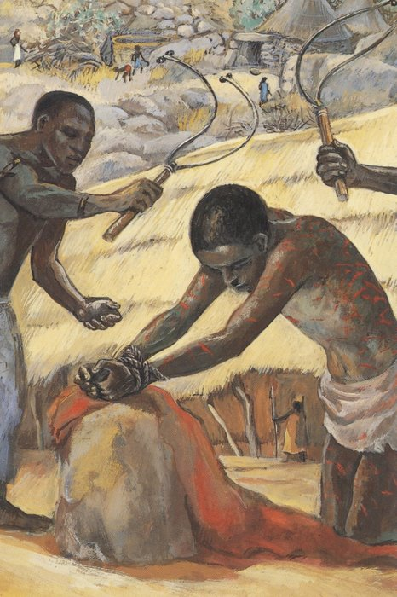
The Flagellation
JESUS MAFA
Cameroon

Slide 14
He said all this quite openly. And Peter took him aside and began to rebuke him.
Mark 8:32

Slide 15
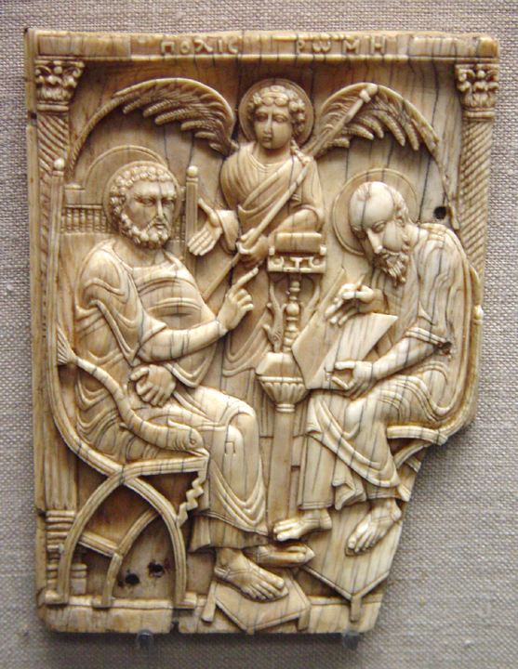
Peter's Dictation of the Gospel to Mark
Victoria and Albert Museum
London, England

Slide 16
But turning … he rebuked Peter and said, "Get behind me, Satan! For you are setting your mind not on divine things but on human things."
Mark 8:33a,c

Slide 17
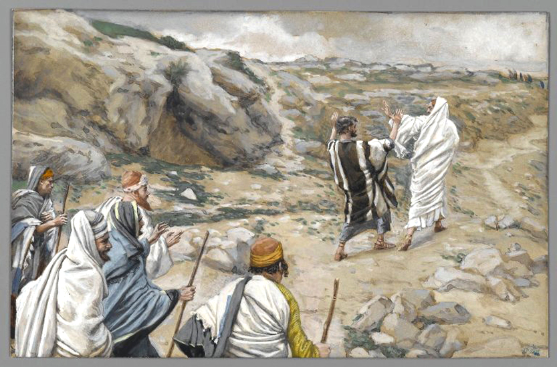
"Get Thee Behind Me, Satan!" -- James Tissot, Brooklyn Museum, New York, NY

Slide 18
He called the crowd with his disciples, and said to them, "If any want to become my followers, let them deny themselves and take up their cross and follow me."
Mark 8:34

Slide 19
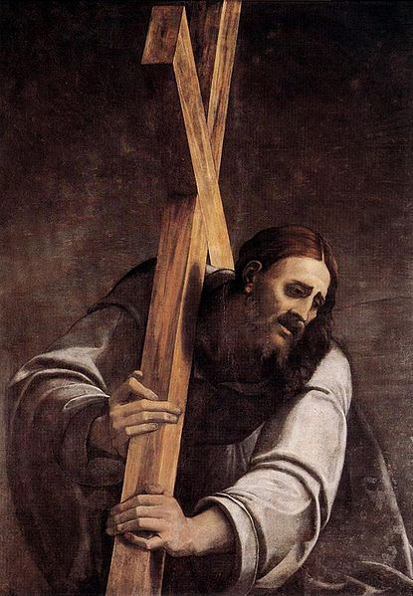
Christ Carrying the Cross
Del Piombo Sebastiano
Museum of Fine Arts
Budapest, Hungary

Slide 20
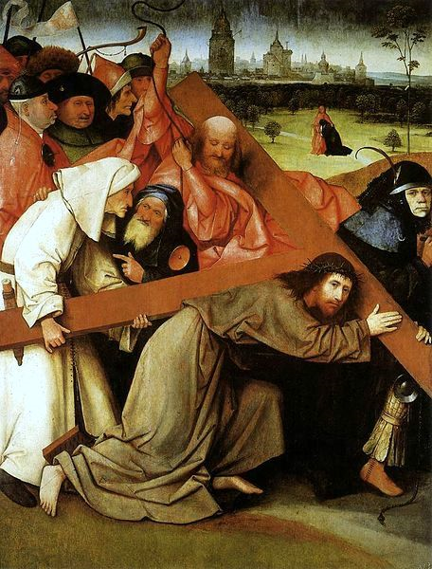
Carrying the Cross
Hieronymus Bosch
Palacio Real
Madrid, Spain

Slide 21
For those who want to save their life will lose it, and those who lose their life for my sake, and for the sake of the gospel, will save it.
Mark 8:35

Slide 22
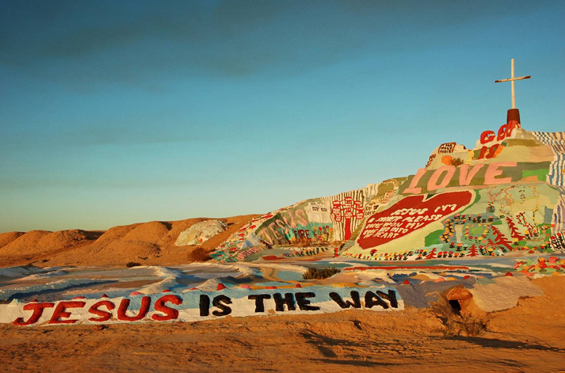
Salvation Mountain -- Leonard Knight, Niland, CA

Slide 23
Credits
New Revised Standard Version Bible, copyright 1989, Division of Christian Education of the National Council of the Churches of Christ in the United States of America. Used by permission. All rights reserved.
http://www.flickr.com/photos/pelegrino/561258331/
https://commons.wikimedia.org/wiki/File:Jan_Provoost_-_Abraham,_Sarah,_and_the_Angel_-_WGA18441.jpg
http://diglib.library.vanderbilt.edu/act-imagelink.pl?RC=56930
https://commons.wikimedia.org/wiki/File:FEMA_-_38827_-_The_Salvation_Army_feeding_people_returning_to_Galveston_Island.jpg
https://commons.wikimedia.org/wiki/File:Gerard_Dou_-_Reading_the_Bible_-_WGA06644.jpg
http://www.librairie-emmanuel.fr
http://diglib.library.vanderbilt.edu/act-imagelink.pl?RC=31748
http://commons.wikimedia.org/wiki/File:Brooklyn_Museum_-_Get_Thee_Behind_Me_Satan_(R%C3%A9tire-toi_Satan)_-_James_Tissot.jpg
http://commons.wikimedia.org/wiki/File:Sebastiano_del_Piombo_-_Christ_Carrying_the_Cross_-_WGA21099.jpg
http://commons.wikimedia.org/wiki/File:Hieronymus_Bosch_-_Christ_Carrying_the_Cross_-_WGA02556.jpg
http://www.flickr.com/photos/mexicaliblues/2193121903/
Additional descriptions can be found at the Art in the Christian Tradition image library, a service of the Vanderbilt Divinity Library, http://diglib.library.vanderbilt.edu/. All images available via Creative Commons 3.0 License.

