Slide 1
Twenty-Third Sunday after Pentecost
Year B
Job 42:1-6, 10-17 and Psalm 34:1-8, (19-22)
Jeremiah 31:7-9 and Psalm 126
Hebrews 7:23-28 • Mark 10:46-52

Slide 2
Then there came to him all his brothers and sisters and all who had known him … they showed him sympathy and comforted him …
Job 42:11a

Slide 3
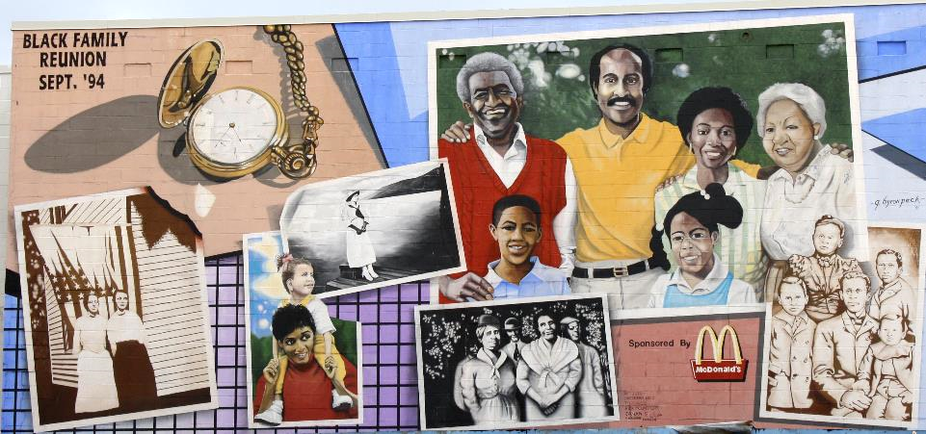
Black Family Reunion Mural -- G. Byron Peck, 14th and Florida, Washington, DC

Slide 4
I am going to … gather them from the farthest parts of the earth, among them the blind and the lame, those with child and those in labor …
Jeremiah 31:8ab

Slide 5
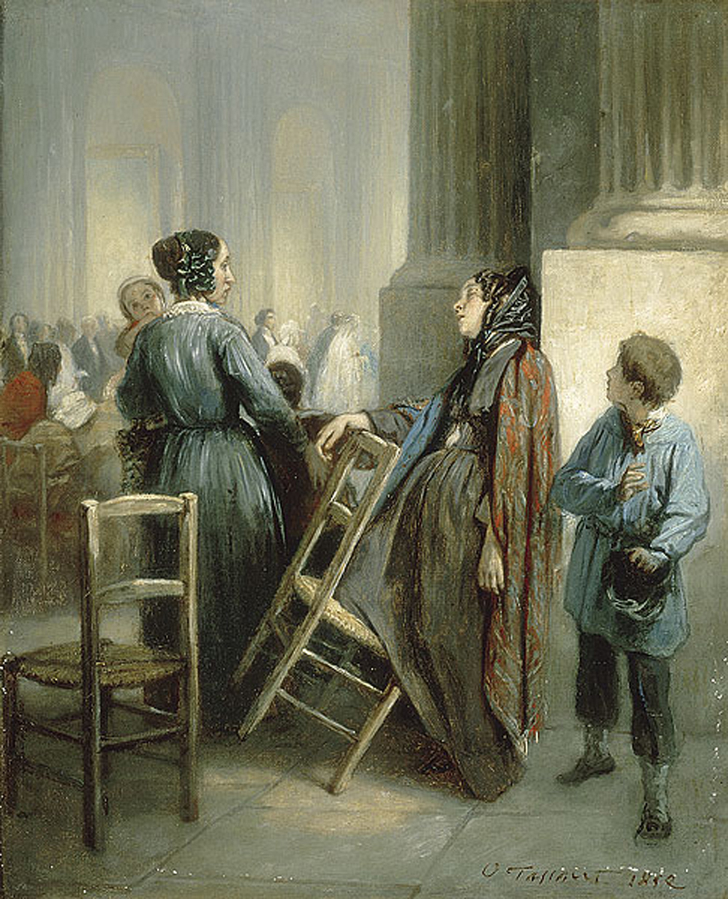
The Abandoned Woman
Octave Tassaert
Musee Fabre
Montpelier, France

Slide 6
O taste and see that the LORD is good; happy are those who take refuge in him.
Psalm 34:8

Slide 7
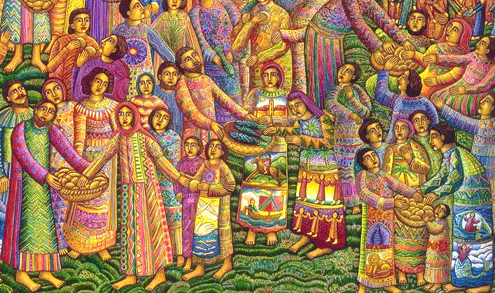
Loaves and Fishes -- John August Swanson, serigraph, 2003

Slide 8
… he is able for all time to save those who approach God … since he always lives …
Hebrews 7:25bc

Slide 9
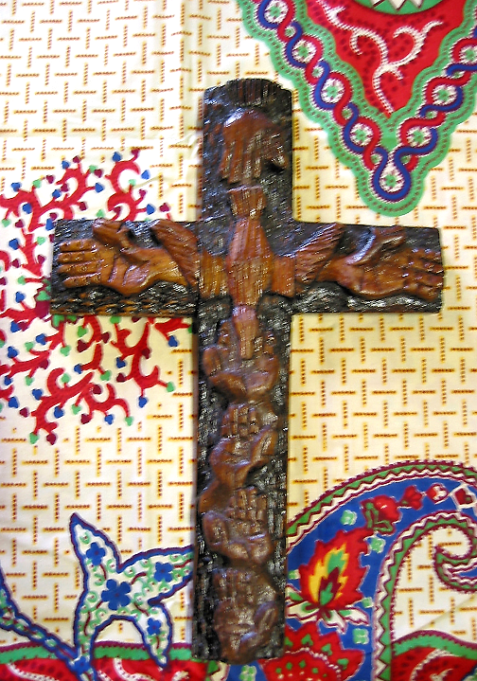
Mulungwishi Trinity Cross
Mulungwishi Mission
Democratic Republic of Congo

Slide 10
As he and his disciples and a large crowd were leaving Jericho, Bartimaeus son of Timaeus, a blind beggar, was sitting by the roadside.
Mark 10:46b

Slide 11
When he heard that it was Jesus of Nazareth, he began to shout out and say, "Jesus, Son of David, have mercy on me!"
Mark 10:47

Slide 12
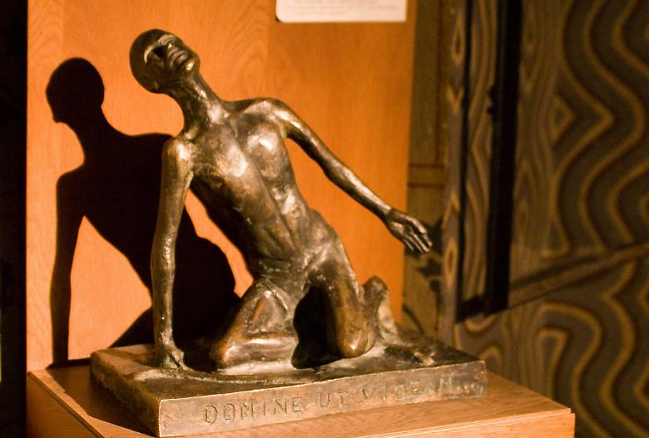
"Lord, That I Might See!" -- Matyas Church, Budapest, Hungary

Slide 13
Many sternly ordered him to be quiet, but he cried out even more loudly, "Son of David, have mercy on me!"
Mark 10:48

Slide 14
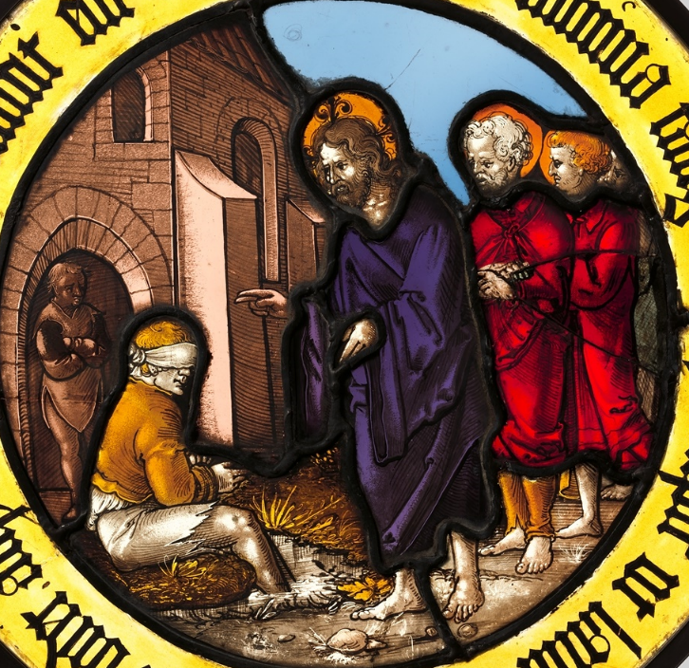
Christ Healing the Blind Man
German, early 16th c.
MET Cloisters
New York, NY

Slide 15
Jesus stood still and said, "Call him here." And they called the blind man, saying to him, "Take heart; get up, he is calling you."
Mark 10:49

Slide 16
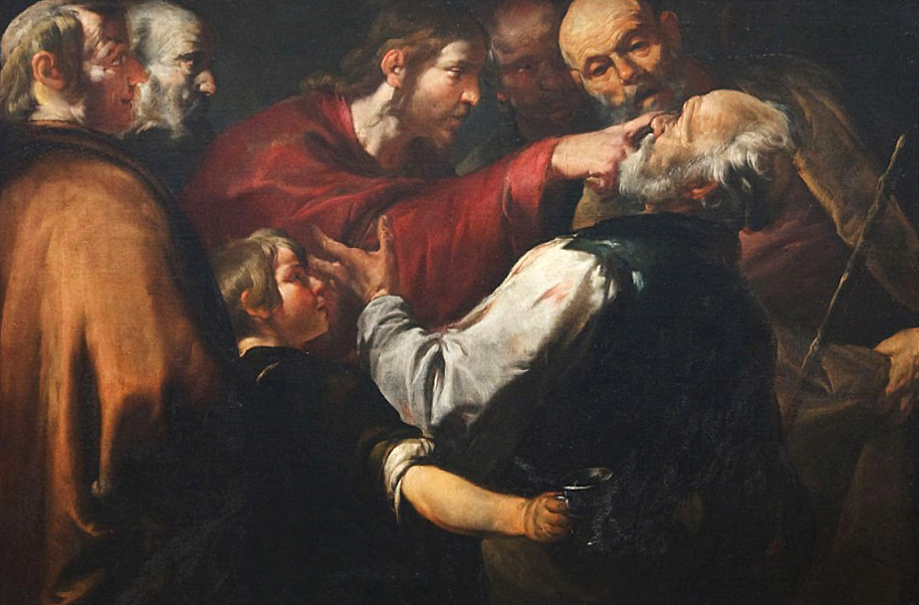
Christ Healing the Blind Man -- Gioacchino Assereto,

Slide 17
So throwing off his cloak, he sprang up and came to Jesus.
Mark 10:50

Slide 18
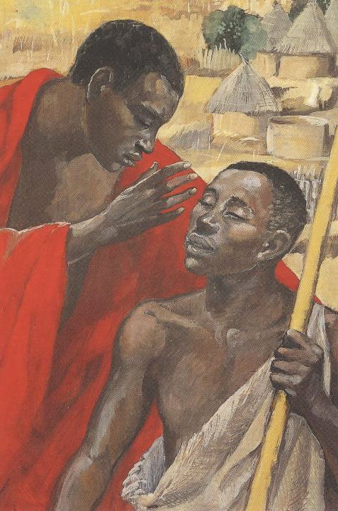
Jesus Heals the Blind
JESUS MAFA, Cameroon

Slide 19
Then Jesus said to him, "What do you want me to do for you?" The blind man said to him, "My teacher, let me see again."
Mark 10:51

Slide 20
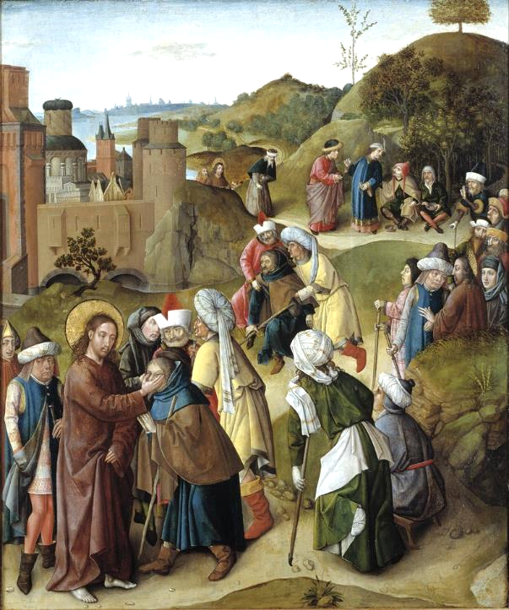
Healing of the Blind Man of Jericho
Master of the Gathering of the Manna

Slide 21
Jesus said to him, "Go; your faith has made you well." Immediately he regained his sight and followed him on the way.
Mark 10:52

Slide 22
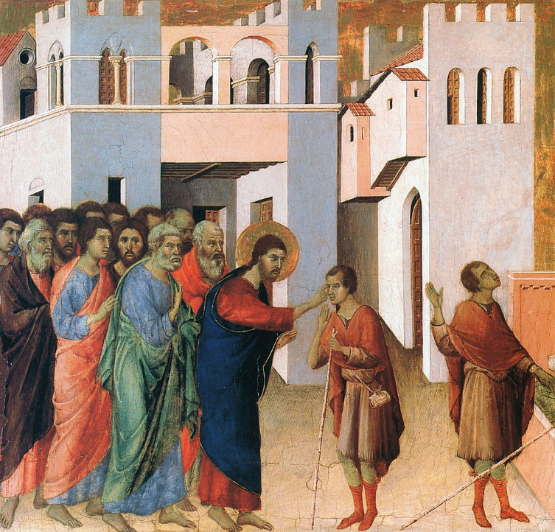
Healing of the Blind Man of Jericho
Duccio
National Gallery
London, England

Slide 23
Credits
New Revised Standard Version Bible, copyright 1989, Division of Christian Education of the National Council of the Churches of Christ in the United States of America. Used by permission. All rights reserved.
https://www.flickr.com/photos/perspective/5582269263
http://commons.wikimedia.org/wiki/File:Octave_TASSAERT_The_Waif_-L%27abandonn%C3%A9e.jpg
www.JohnAugustSwanson.com - copyright 2003 by John August Swanson
https://www.flickr.com/photos/umccongo/2051227883
http://www.flickr.com/photos/stephenr/2296612588/
https://commons.wikimedia.org/wiki/File:Roundel_with_Christ_Healing_the_Blind_Man_MET_DP250442.jpg
https://commons.wikimedia.org/wiki/File:WLA_cma_Christ_Healing_the_Blind_Man_c_1640.jpg
http://diglib.library.vanderbilt.edu/act-imagelink.pl?RC=48383
https://commons.wikimedia.org/wiki/File:De_genezing_van_de_blinde_te_Jericho.jpg - catharijneverhalen.nl
https://commons.wikimedia.org/wiki/File:Duccio_di_Buoninsegna_037.jpg
Additional descriptions can be found at the Art in the Christian Tradition image library, a service of the Vanderbilt Divinity Library, http://diglib.library.vanderbilt.edu/. All images available via Creative Commons 3.0 License.

