Slide 1
Fourteenth Sunday after Pentecost
Year B
1 Kings 8:(1,6,10-11), 22-30, 41-43 and Psalm 84
Joshua 24:1-2a, 14-18 and Psalm 34:15-22
Ephesians 6:10-20 • John 6:56-69

Slide 2
for they shall hear of your great name, your mighty hand, and your outstretched arm--when a foreigner comes and prays toward this house,
1 Kings 8:42

Slide 3
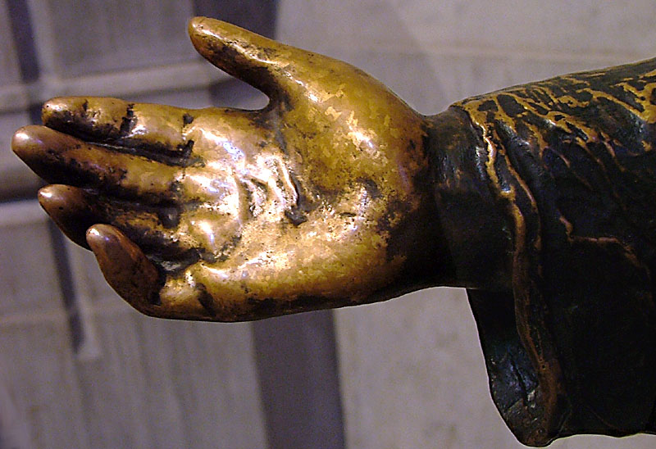
Hand of Christ Reaching out to Children -- Washington National Cathedral, Washington, DC

Slide 4
Even the sparrow finds a home, and the swallow a nest for herself, where she may lay her young …
Psalm 84:3

Slide 5
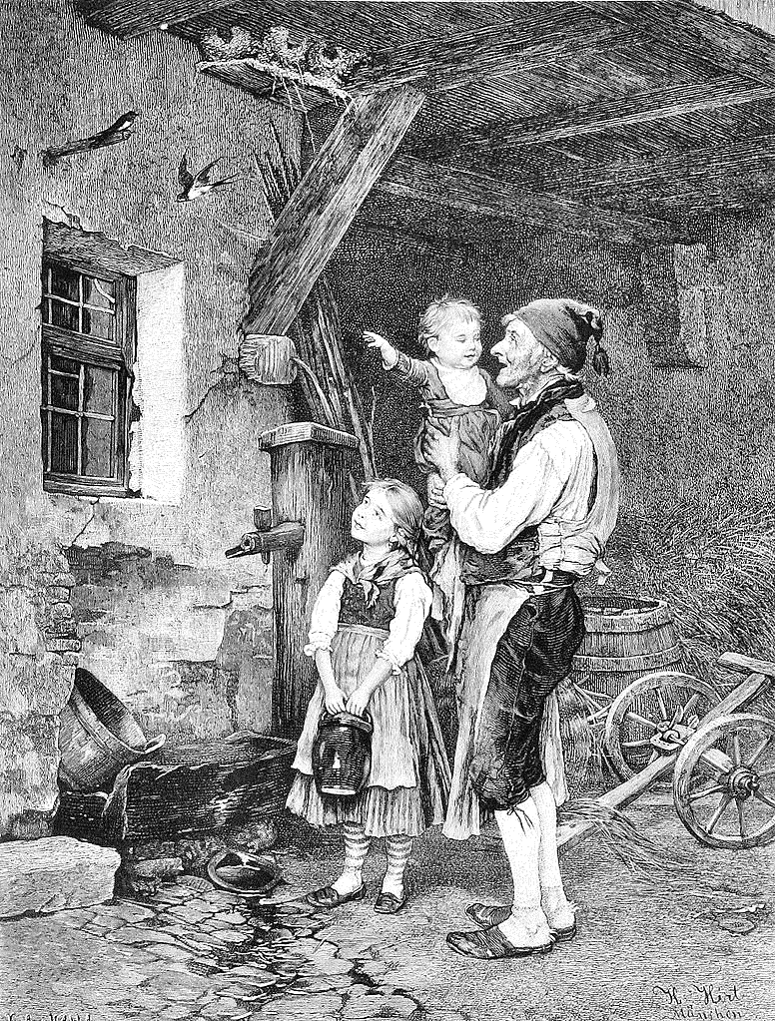
Swallow's Nest
H. Hirt
Print

Slide 6
for it is the LORD our God who brought us up from the land of Egypt, out of the house of slavery … He protected us along all the way …
Joshua 24:17ac

Slide 7
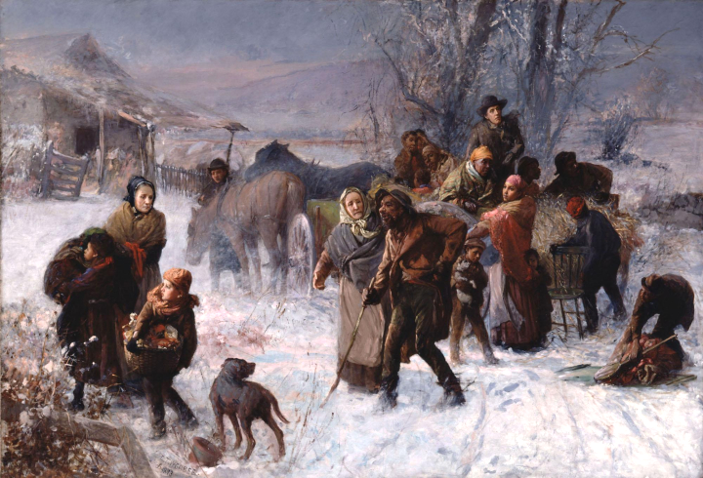
The Underground Railroad -- Charles T. Webber, Cincinnati Art Museum, Cincinnati, Ohio

Slide 8
The LORD is near to the brokenhearted, and saves the crushed in spirit.
Psalm 34:18

Slide 9
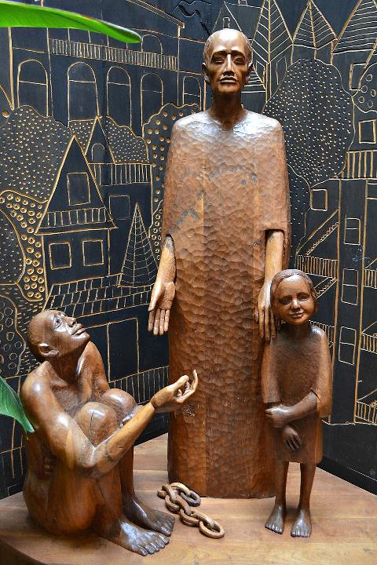
Martin de Porres with a Child and a Slave
Jerzy Kenar
St. Benedict the African Church
Chicago

Slide 10
As shoes for your feet put on whatever will make you ready to proclaim the gospel of peace.
Ephesians 6:15

Slide 11
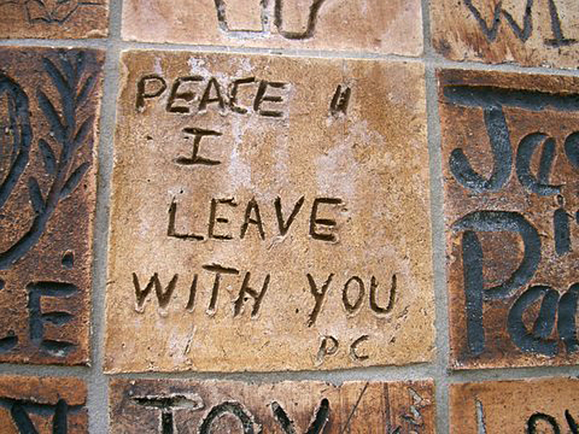
"Peace I Leave with You" -- Tile from Peace Wall, Hamilton, New Zealand

Slide 12
When many of his disciples heard it, they said, "This teaching is difficult; who can accept it?"
John 6:60

Slide 13
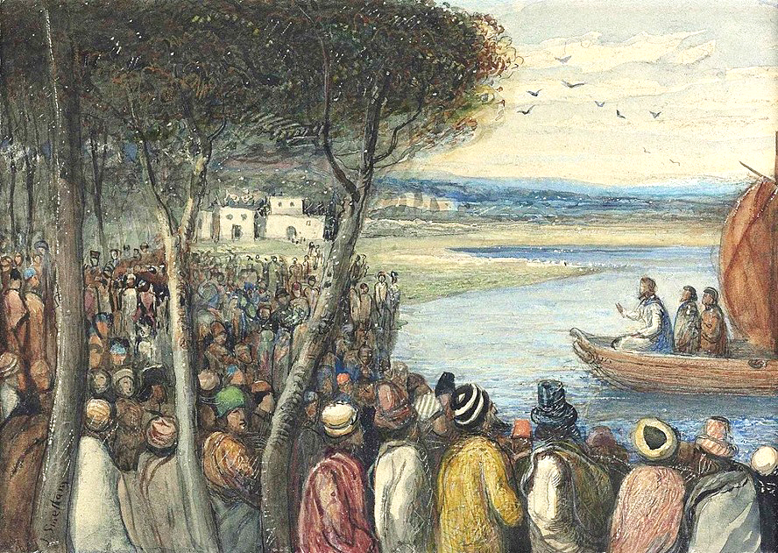
Christ Preaching to the Multitudes -- James Smetham, Fine Art Society, London, England

Slide 14
But Jesus … said to them, … "what if you were to see the Son of Man ascending to where he was before?"
John 6:61a, 62

Slide 15
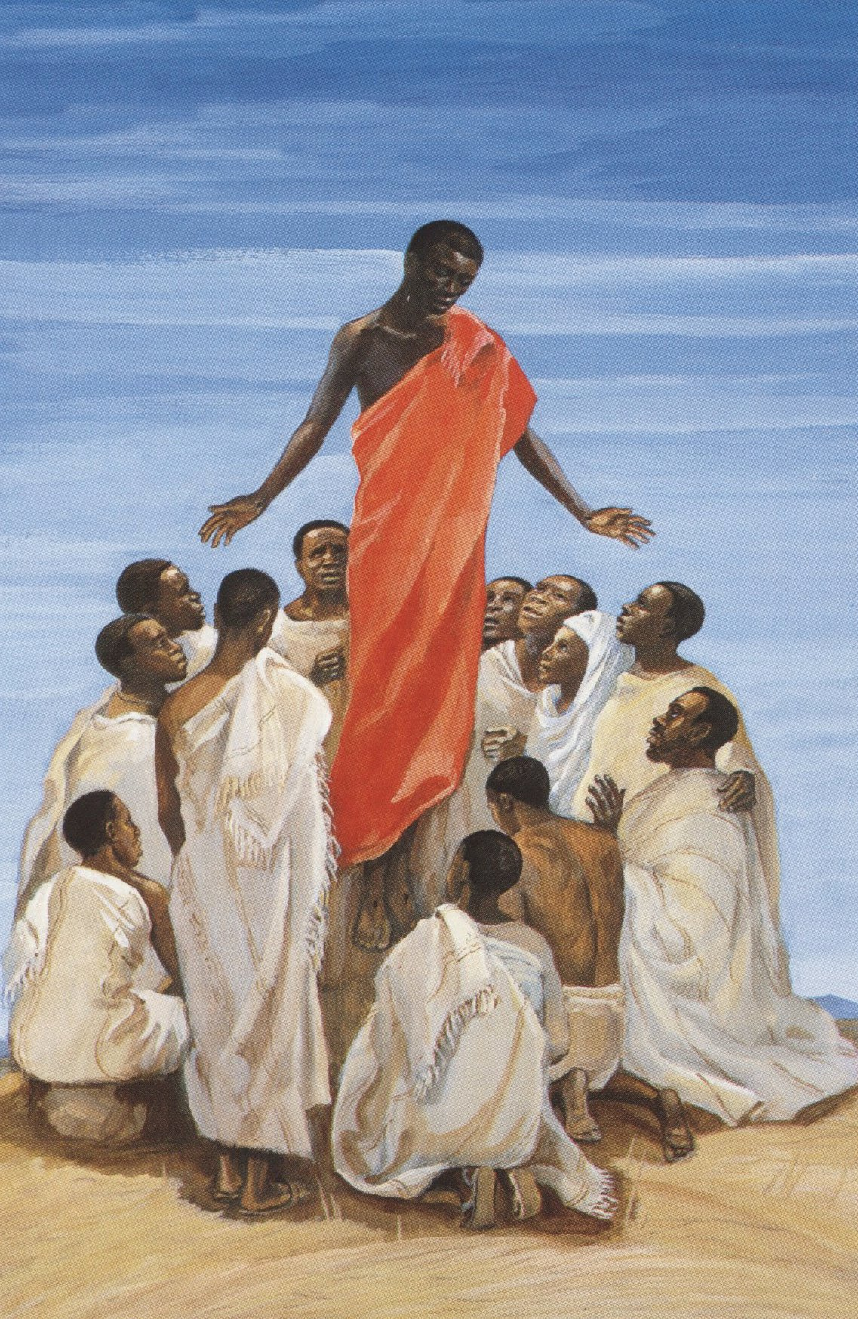
Ascension
JESUS MAFA
Cameroon

Slide 16
It is the spirit that gives life;
the flesh is useless. The words that I have spoken to you are spirit and life.
John 6:63

Slide 17
Holy Spirit Calligraphy -- Monastery of Moses the Abyssinian, Deir Mar Musa al-Habashi, Syria

Slide 18
Because of this many of his disciples …no longer went about with him. So Jesus asked the twelve, "Do you also wish to go away?"
John 6:66ac, 67

Slide 19
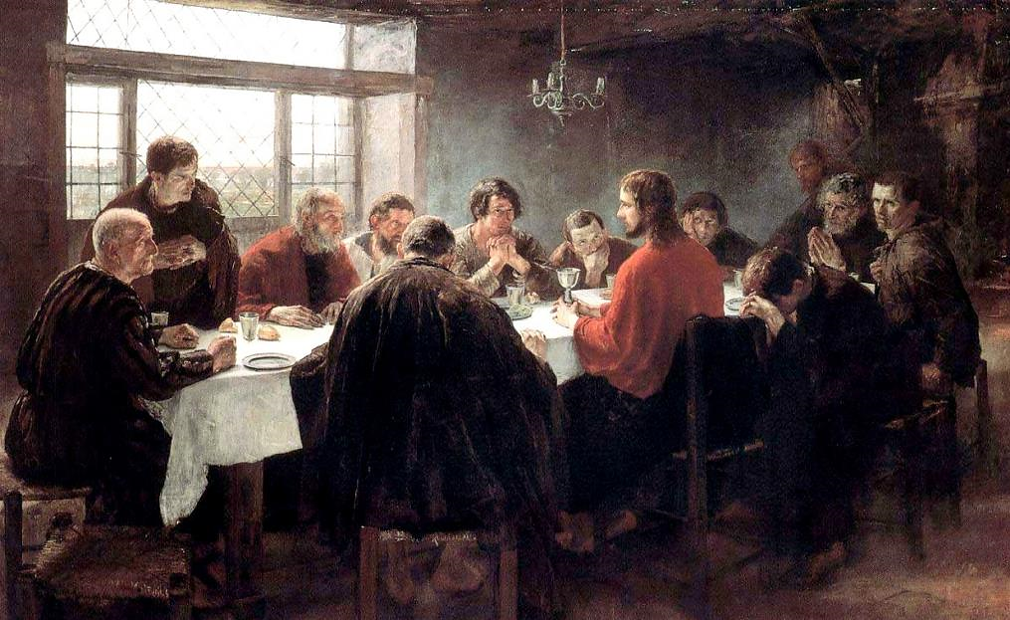
Last Supper -- Fritz Uhde, State Gallery, Stuttgart, Germany

Slide 20
Simon Peter answered him, "Lord, to whom can we go? You have the words of eternal life.
John 6:68

Slide 21
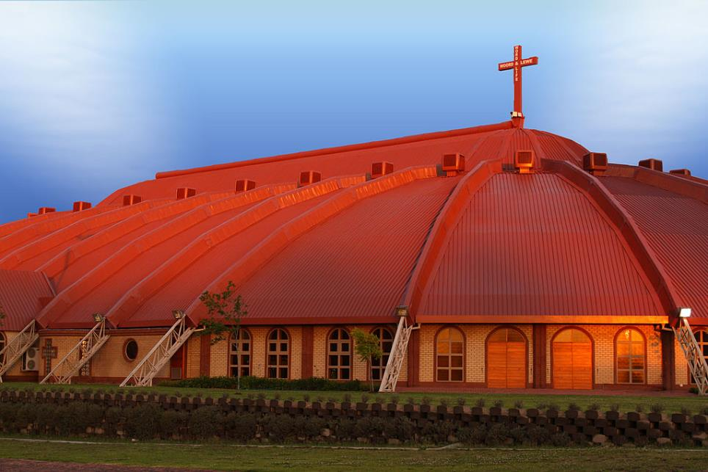
Word and Life Apostolic Mission Church -- Boksburg, South Africa

Slide 22
We have come to believe and know that you are the Holy One of God."
John 6:69

Slide 23
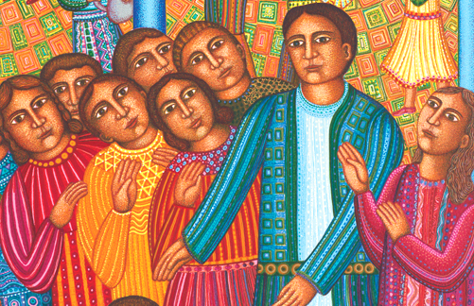
Christ of the Wedding Feast, detail -- John August Swanson, serigraph, 1996

Slide 24
Credits
New Revised Standard Version Bible, copyright 1989, Division of Christian Education of the National Council of the Churches of Christ in the United States of America. Used by permission. All rights reserved.
http://www.flickr.com/photos/mcbeth/1639385/
http://commons.wikimedia.org/wiki/File:Die_Gartenlaube_(1883)_261_(cropped).jpg
https://commons.wikimedia.org/wiki/File:The_Underground_Railroad_by_Charles_T._Webber,_1893.jpg
https://www.flickr.com/photos/seanbirm/31319836460
http://www.flickr.com/photos/taniwha/7186824/
https://commons.wikimedia.org/wiki/File:James_Smetham_-_Christ_preaching_to_the_multitudes.jpg
http://www.librairie-emmanuel.fr (contact page: https://www.librairie-emmanuel.fr/contact)
https://commons.wikimedia.org/wiki/File:Holy_Spirit_Calligraphy_in_the_church_of_Deir_Mar_Musa_al-Habashi.jpg
https://commons.wikimedia.org/wiki/File:The_Last_Supper_(1886),_by_Fritz_von_Uhde.jpg
https://commons.wikimedia.org/wiki/File:AFM_Word_And_Life.jpg – ShiningWolf
http://www.johnaugustswanson.com/default.cfm/PID%3d1.2.9-12.html
Additional descriptions can be found at the Art in the Christian Tradition image library, a service of the Vanderbilt Divinity Library, http://diglib.library.vanderbilt.edu/. All images available via Creative Commons 3.0 License.

