Slide 1
Thirteenth Sunday after Pentecost
Year B
1 Kings 2:10-12; 3:3-14 and Psalm 111 • Proverbs 9:1-6 and Psalm 34:9-14 • Ephesians 5:15-20 • John 6:51-58

Slide 2
And Solomon said … Give your servant therefore an understanding mind to govern your people, able to discern between good and evil;
1 Kings 3:6a, 9a

Slide 3
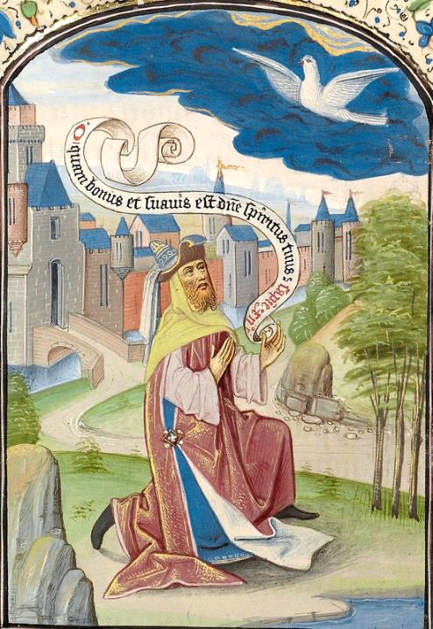
Solomon's Prayer
Guillaume Vrelant
Getty Museum
Los Angeles, CA

Slide 4
The fear of the LORD is the beginning of wisdom …
Psalm 111:10a

Slide 5
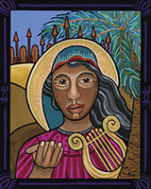
Deborah, the Prophet
Lauren Wright Pittman

Slide 6
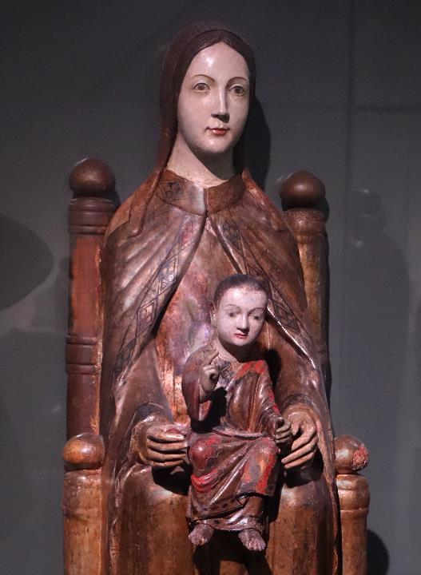
Seat of Wisdom
Museum Leuven
Leuven, Belgium

Slide 7
Wisdom has built her house, she has hewn her seven pillars.
Proverbs 9:1

Slide 8
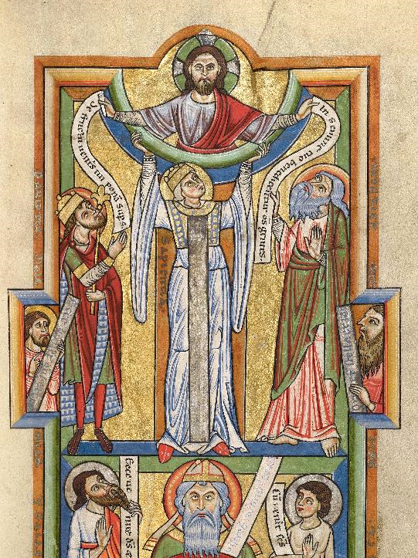
Seat of Wisdom
Manuscript Leaf
Getty Center
Los Angeles, CA

Slide 9
O fear the LORD, you his holy ones … Depart from evil, and do good; seek peace, and pursue it.
Psalm 34:9a, 14

Slide 10
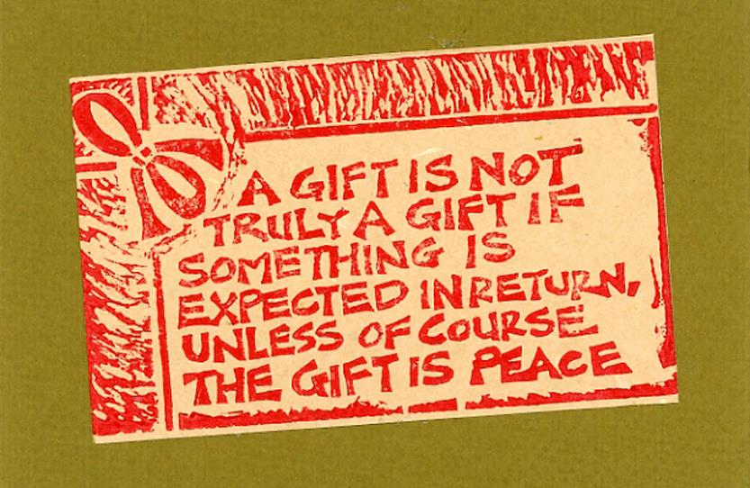
Gift of Peace -- Linoleum block print card

Slide 11
… be filled with the Spirit, as you sing psalms and hymns and spiritual songs among yourselves … making melody to the Lord in your hearts.
Ephesians 5:18b, 19

Slide 12
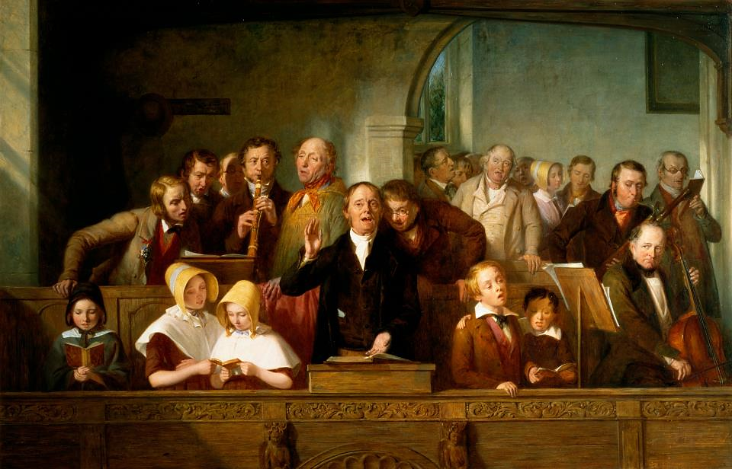
Village Choir -- Thomas Webster, Victoria and Albert Museum, London, England

Slide 13
The Jews then disputed among themselves, saying, "How can this man give us his flesh to eat?"
John 6:52

Slide 14
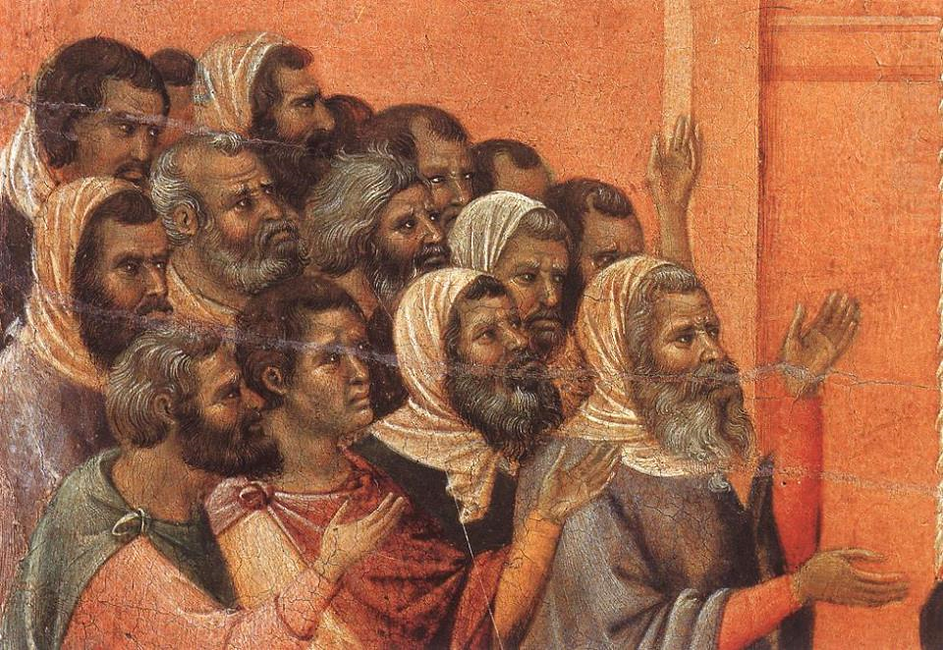
Christ Accused by the Pharisees -- Duccio, Museo dell'Opera del Duomo, Siena, Italy

Slide 15
So Jesus said to them, "Very truly, I tell you, unless you eat the flesh of the Son of Man and drink his blood, you have no life in you.
John 6:53

Slide 16
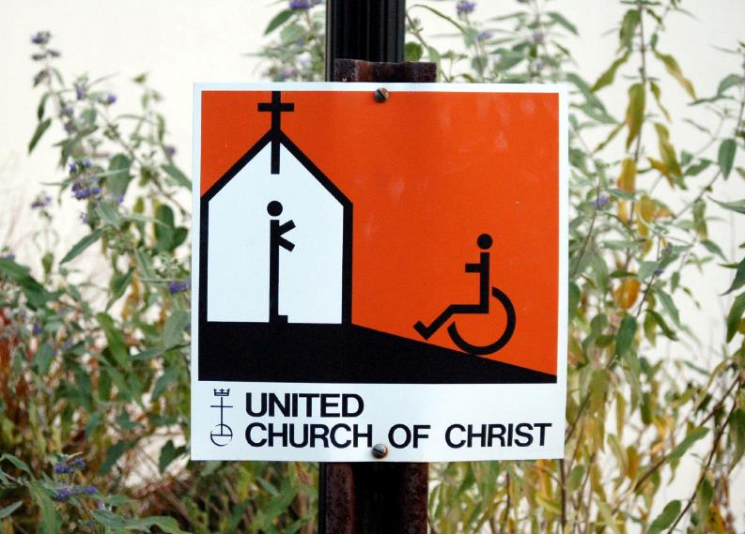
Welcome -- United Church of Christ

Slide 17
for my flesh is true food …
John 6:55

Slide 18
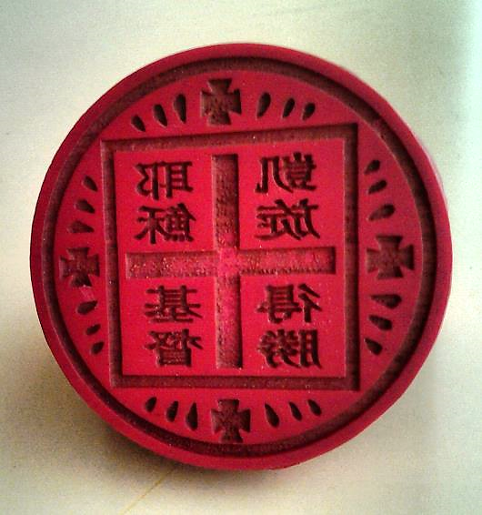
Chinese Orthodox Communion Bread Stamp -- Church of Apostles, Hong Kong China

Slide 19
and my blood is true drink.
John 6:55

Slide 20
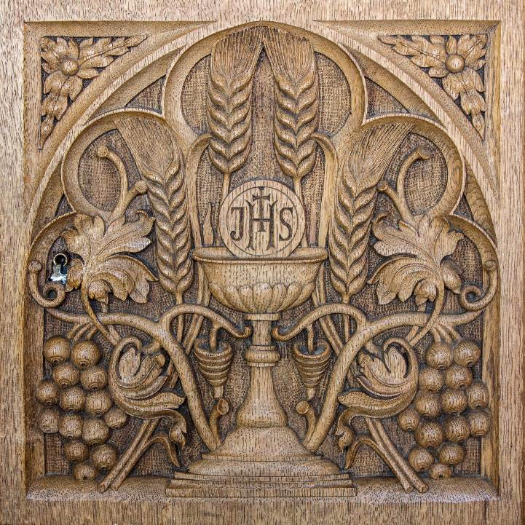
Communion Symbols
St Aloysius Chapel
Glasgow, Scotland

Slide 21
Those who eat my flesh and drink my blood abide in me, and I in them.
John 6:56

Slide 22
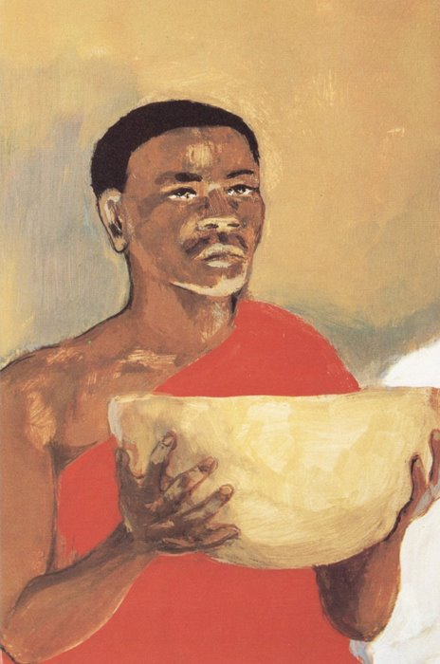
Last Supper, detail of Christ
JESUS MAFA

Slide 23
This is the bread that came down from heaven … the one who eats this bread will live forever."
John 6:58

Slide 24
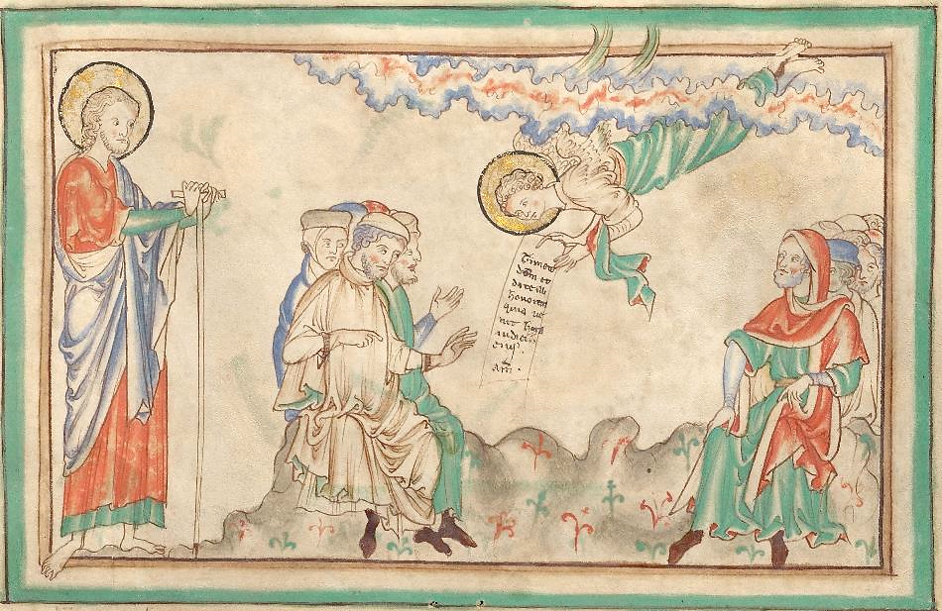
Angel with the Eternal Gospel -- 13th c. Manuscript, Getty Center, Los Angeles, CA

Slide 25
Credits
New Revised Standard Version Bible, copyright 1989, Division of Christian Education of the National Council of the Churches of Christ in the United States of America. Used by permission. All rights reserved.
http://commons.wikimedia.org/wiki/File:Willem_Vrelant_(Flemish,_died_1481,_active_1454_-_1481)_-_Solomon_Praying_to_the_Holy_Spirit_-_Google_Art_Project.jpg
http://www.lewpstudio.com - copyright by Lauren Wright Pittman
https://commons.wikimedia.org/wiki/File:Sedes_Sapientiae,_Maasland,_11th-12th_century,_with_Madonna%27s_head_from_a_Sedes_Sapientiae,_1st_half_of_16th_century_-_Museum_M_-_Leuven,_Belgium_-_DSC04879.JPG
http://commons.wikimedia.org/wiki/File:Wisdom_-_Google_Art_Project.jpg
http://www.flickr.com/photos/yardsale/76188544/
http://commons.wikimedia.org/wiki/File:Thomas_Webster_-_A_Village_Choir.jpg
https://commons.wikimedia.org/wiki/File:Duccio_di_Buoninsegna_-_Christ_Accused_by_the_Pharisees_(detail)_-_WGA06802.jpg
https://www.flickr.com/photos/g_originals/311426759 - Gwyn Michael
https://commons.wikimedia.org/wiki/File:Chinese_Orthodox_communion_bread_seal.jpg
shttps://www.flickr.com/photos/paullew/27005016208 - Lawrence OP
http://diglib.library.vanderbilt.edu/act-imagelink.pl?RC=48298
https://commons.wikimedia.org/wiki/File:An_Angel_with_the_Eternal_Gospel_-_Google_Art_Project.jpg
Additional descriptions can be found at the Art in the Christian Tradition image library, a service of the Vanderbilt Divinity Library, http://diglib.library.vanderbilt.edu/. All images available via Creative Commons 3.0 License.

