Slide 1
New Year’s Day
Year B
Ecclesiastes 3:1-13
Psalm 8
Revelation 21:1-6a
Matthew 25:31-46

Slide 2
For everything there is a season, and a time for every matter under heaven …
Ecclesiastes 3:1

Slide 3
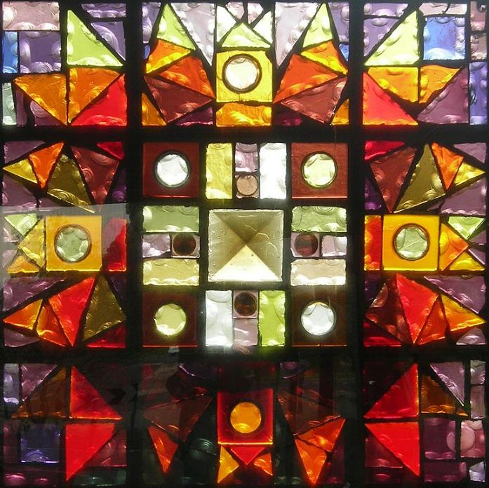
The Four Seasons
Leonard French
La Trobe University Sculpture Park
Melbourne, Australia

Slide 4
"It is done! I am the Alpha and the Omega, the beginning and the end.”
Revelation 21:6a

Slide 5
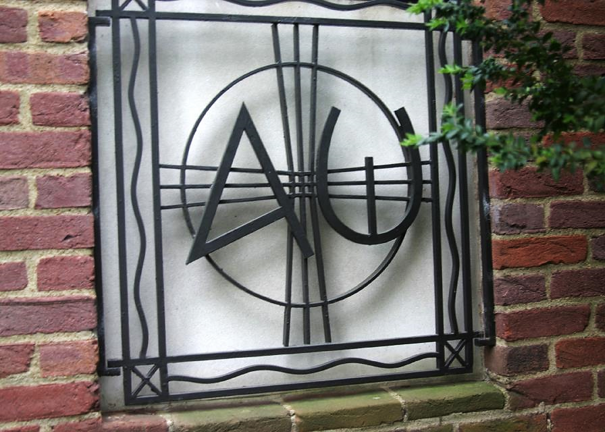
Alpha and Omega -- Metalwork, Benton Chapel, Vanderbilt University, Nashville, TN

Slide 6
'Lord, when was it that we saw you hungry and gave you food …'
Matthew 25:37a

Slide 7
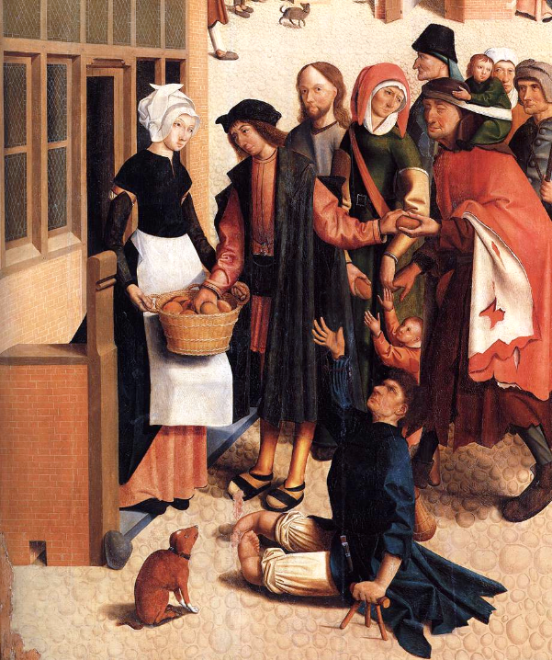
Seven Works of Mercy (with Christ as one of the recipients)
Master of Alkmaar
Rijksmuseum
Amsterdam

Slide 8
'… or thirsty and gave you something to drink?'
Matthew 25:37b

Slide 9
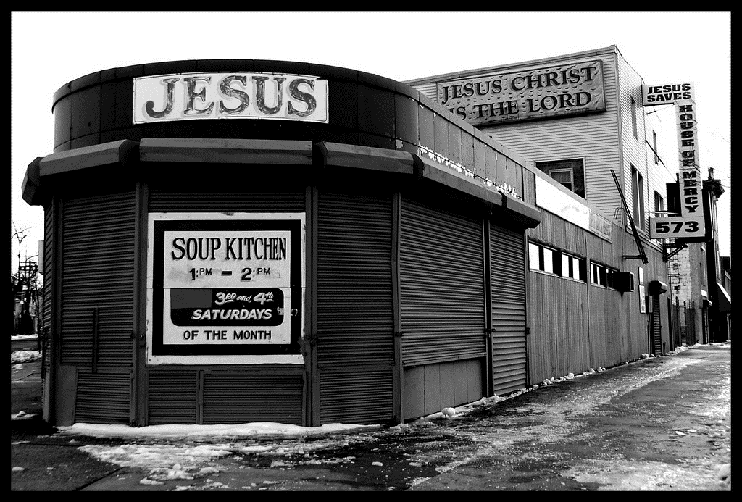
Soup Kitchen at the House of Mercy Church, Winter 2009 -- Tony Fischer, Newark, NJ

Slide 10
'And when was it that we saw you a stranger and welcomed you?'
Matthew 25:38a

Slide 11
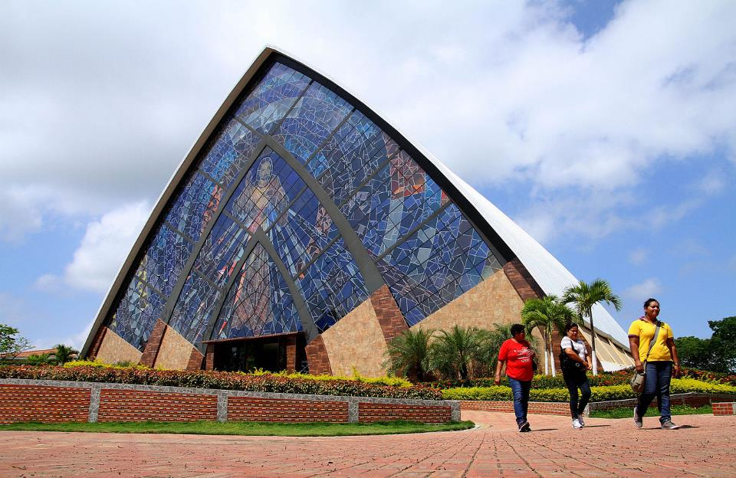
Sanctuary of the Divine Works of Mercy -- Guayaquil, Ecuador

Slide 12
"… or naked and gave you clothing?"
Matthew 25:38b

Slide 13
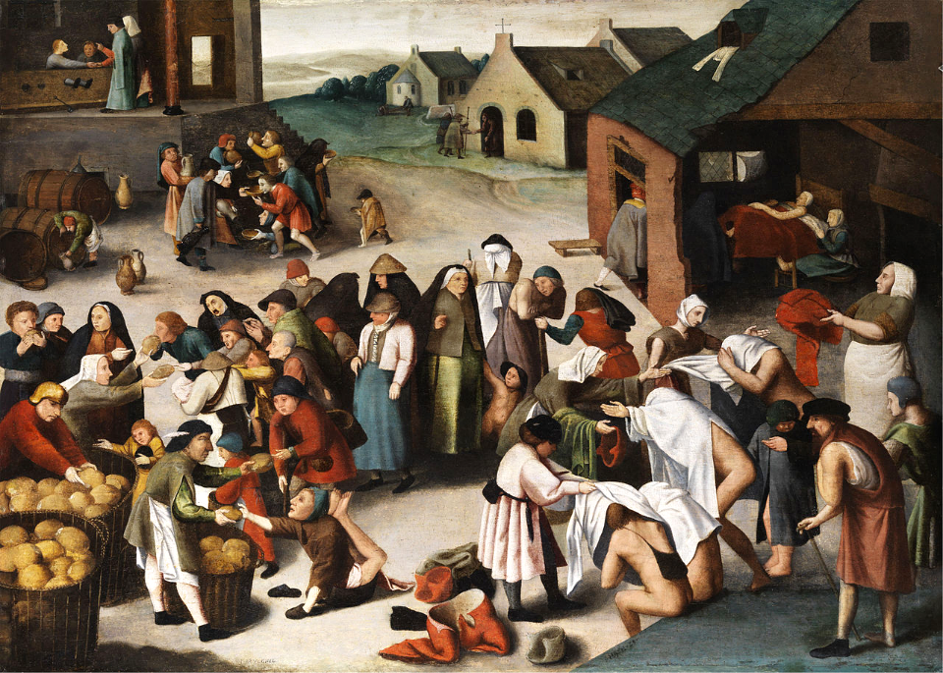
Works of Mercy -- Pieter Brueghel

Slide 14
'And when was it that we saw you sick … and visited you?'
Matthew 25:39ac

Slide 15
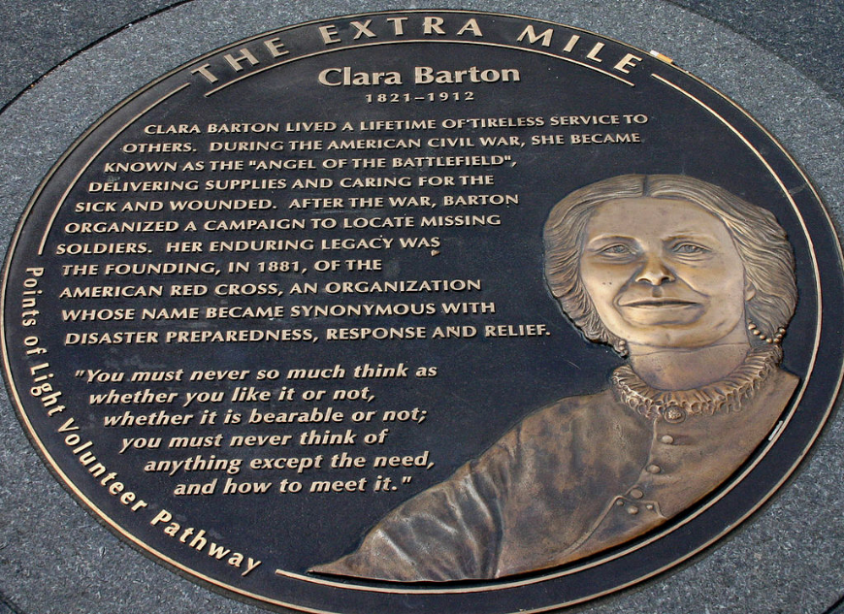
The Extra Mile – Clara Barton, Founder of the Red Cross -- Washington, DC

Slide 16
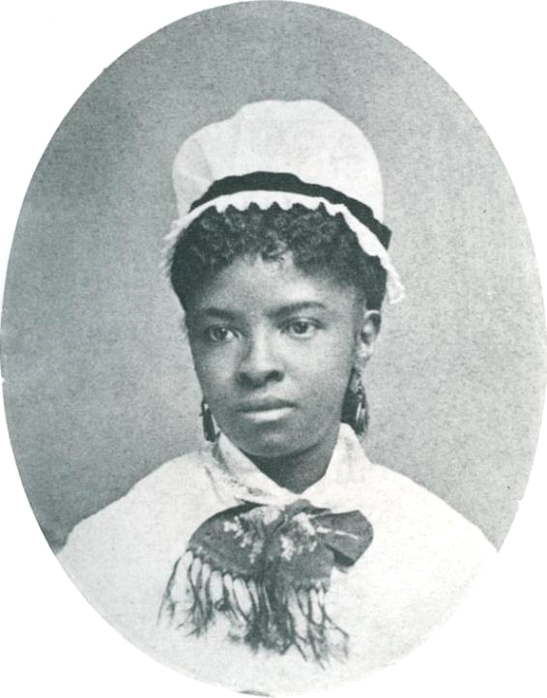
Mary Eliza Mahoney
Founder of National Association of Colored Graduate Nurses

Slide 17
'And when was it that we saw you … in prison and visited you?'
Matthew 25:39ac

Slide 18
Seven Works of Mercy
Diakonie Conference Center
Neuendettelsau, Germany

Slide 19
'Truly I tell you, just as you did it to one of the least of these …, you did it to me.'
Matthew 25:40

Slide 20
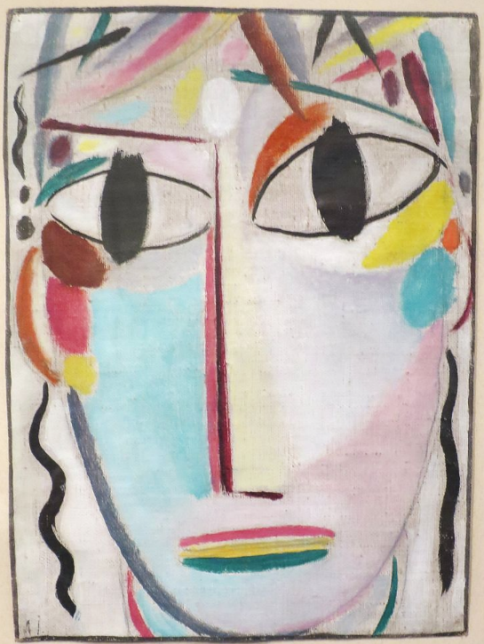
Jesus Christ
Alexi von Jawlensky
Los Angeles County Museum of Art
Los Angeles, CAs

Slide 21
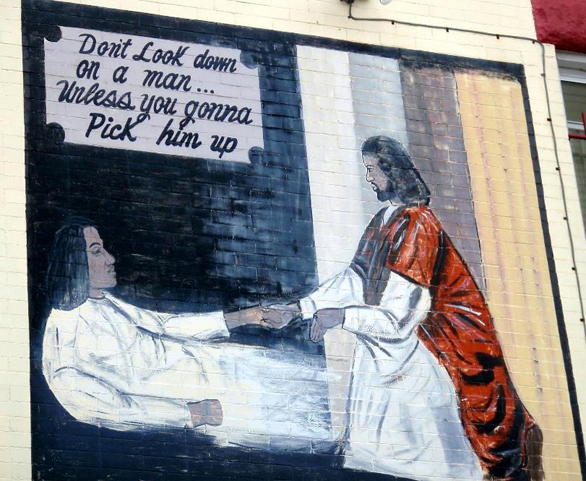
“Don’t Look Down on a Man…Unless You Gonna Pick Him Up -- Mural, Washington, DC

Slide 22
Credits
New Revised Standard Version Bible, copyright 1989, Division of Christian Education of the National Council of the Churches of Christ in the United States of America. Used by permission. All rights reserved.
https://commons.wikimedia.org/wiki/File:Leonard_French_La_Trobe_03-2_cropped.jpg
Http://diglib.library.vanderbilt.edu/act-imagelink.pl?RC=46042
https://commons.wikimedia.org/wiki/File:Master_of_Alkmaar_-_The_Seven_Works_of_Mercy_(detail)_-_WGA14368.jpg
https://www.flickr.com/photos/tonythemisfit/3254449443
https://commons.wikimedia.org/wiki/File:Santuario_de_la_Divina_Misericordia_de_Guayaquil_(17613500314).jpg
https://commons.wikimedia.org/wiki/File:Brueghel-Umkreis_Werke_der_Barmherzigkeit.jpg
https://commons.wikimedia.org/wiki/File:Clara_Barton,_founder_American_Red_Cross_(89684515).jpg
https://commons.wikimedia.org/wiki/File:Mary_Eliza_Mahoney.jpg
https://commons.wikimedia.org/wiki/File:Diakoniegemaelde_Neuendettelsau.jpg
Https://commons.wikimedia.org/wiki/File:%27The_Young_Christ%27_by_Alexej_von_Jawlensky,_1920-21,_LACMA.JPG
https://www.flickr.com/photos/daquellamanera/3994554964
Additional descriptions can be found at the Art in the Christian Tradition image library, a service of the Vanderbilt Divinity Library, http://diglib.library.vanderbilt.edu/. All images available via Creative Commons 3.0 License.

