Slide 1
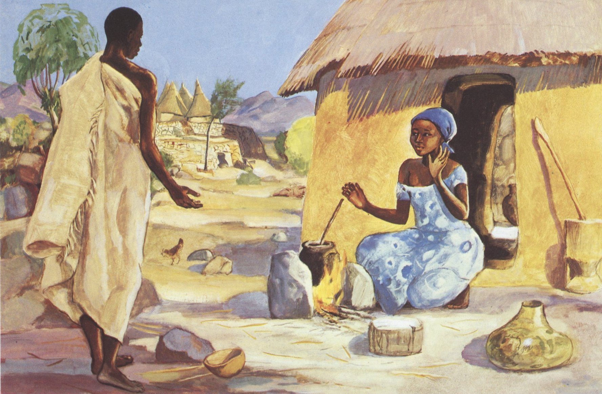
Fourth Sunday of Advent
Year B
2 Samuel 7:1-11, 16
Luke 1:46b-55
or Psalm 89:1-4, 19-26
Romans 16:25-27
Luke 1:26-38

Slide 2
Your house and your kingdom shall be made sure forever before me …
2 Samuel 7:16a

Slide 3
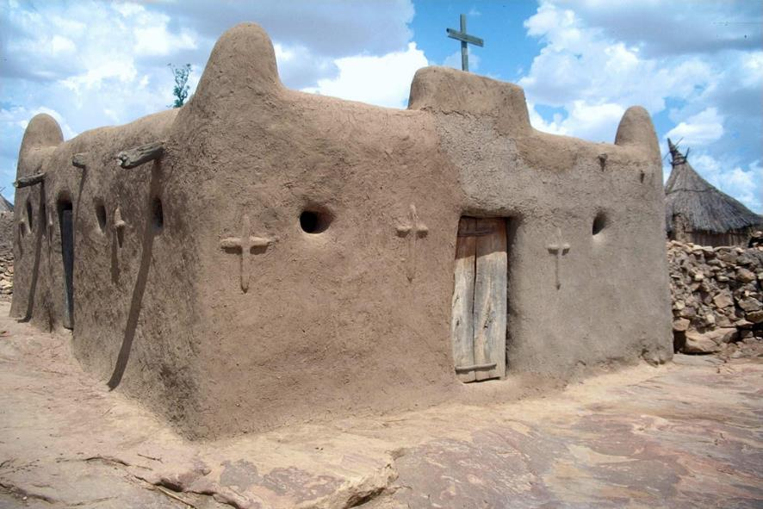
Church in a Dogon Village, Mali

Slide 4
I declare that your steadfast love is established forever; your faithfulness is as firm as the heavens.
Psalm 89:2

Slide 5
"Love is the Only Solution" - Dorothy Day -- Mural in San Francisco, CA

Slide 6
Now to God who is able to strengthen you … through Jesus Christ, to whom be the glory forever! Amen.
Romans 16:25a, 27b

Slide 7
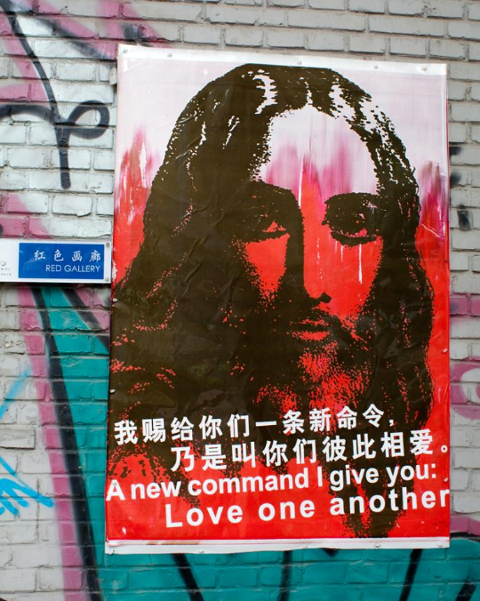
Jesus Christ: "Love One Another"
Red Gallery
Beijing, China

Slide 8
In the sixth month the angel Gabriel was sent by God to a town in Galilee called Nazareth,
Luke 1:26

Slide 9
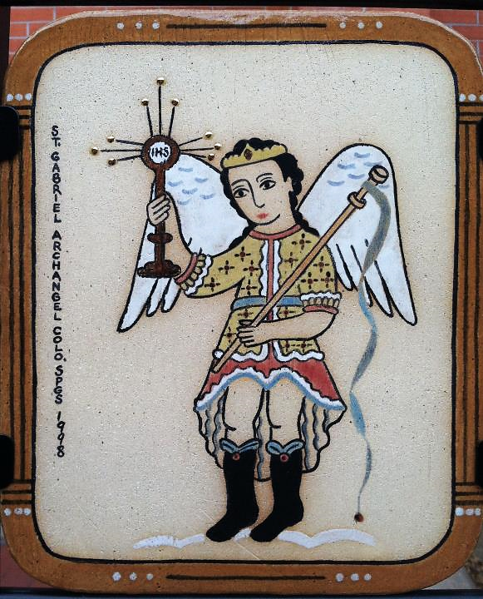
St. Gabriel,
Personal icon
Colorado Springs, CO

Slide 10
to a virgin engaged to a man whose name was Joseph, of the house of David.
Luke 1:27a

Slide 11
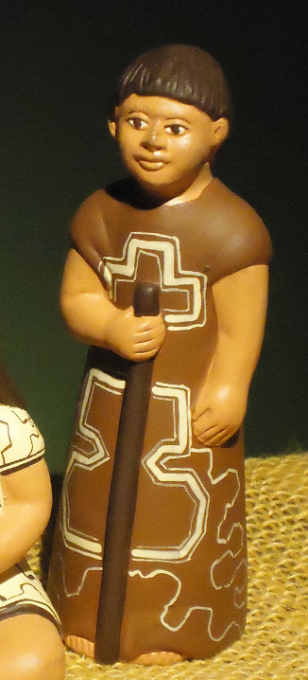
Joseph
Brazilian Nativity Scene

Slide 12
The virgin's name was Mary.
Luke 1:27b

Slide 13
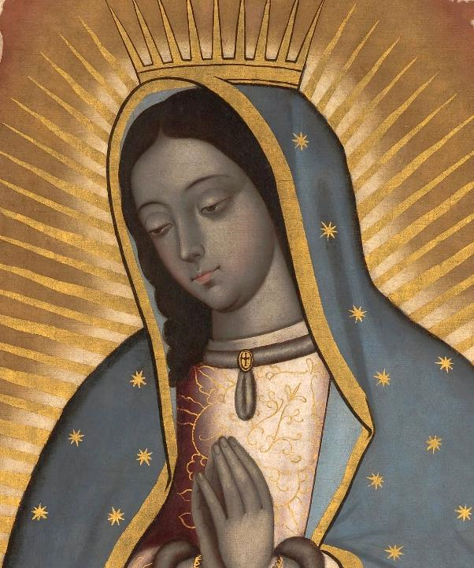
Virgin of Guadalupe
Indianapolis Museum of Art
Indianapolis, IN

Slide 14
And he came to her and said, "Greetings, favored one! The Lord is with you."
Luke 1:28

Slide 15
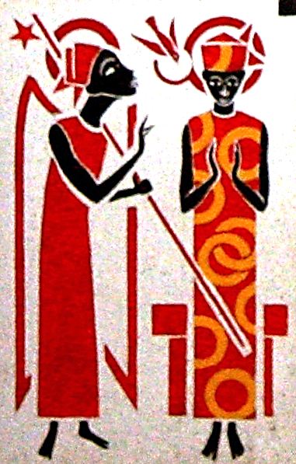
The Annunciation
Abbey of Keur Moussa, Keur Moussa, Senegal

Slide 16
But she was much perplexed by his words and pondered what sort of greeting this might be.
Luke 1:29

Slide 17
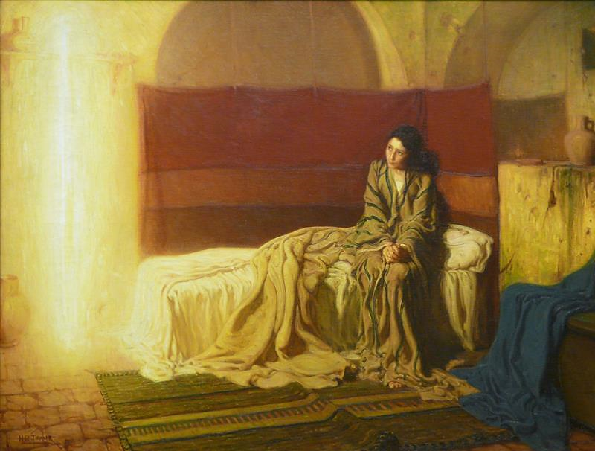
The Annunciation -- Henry Ossawa Tanner, Philadelphia Museum of Art, Philadelphia, PS

Slide 18
The angel said to her, "Do not be afraid, Mary, for you have found favor with God.
Luke 1:30

Slide 19
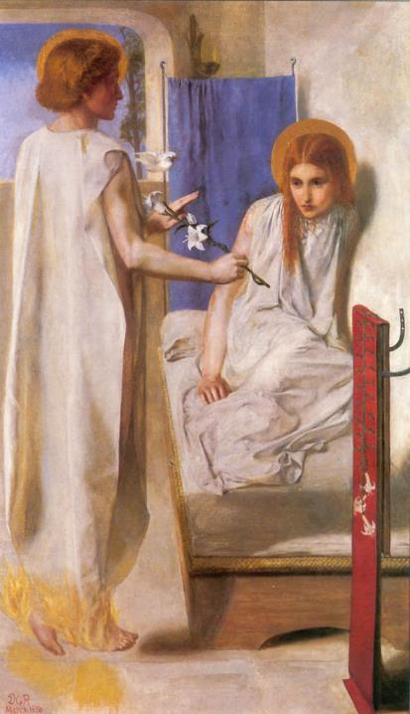
Behold the Lord's Servant
Dante Gabriel Rossetti
Tate Britain
London, England

Slide 20
And now, you will conceive in your womb and bear a son, and you will name him Jesus.
Luke 1:31

Slide 21
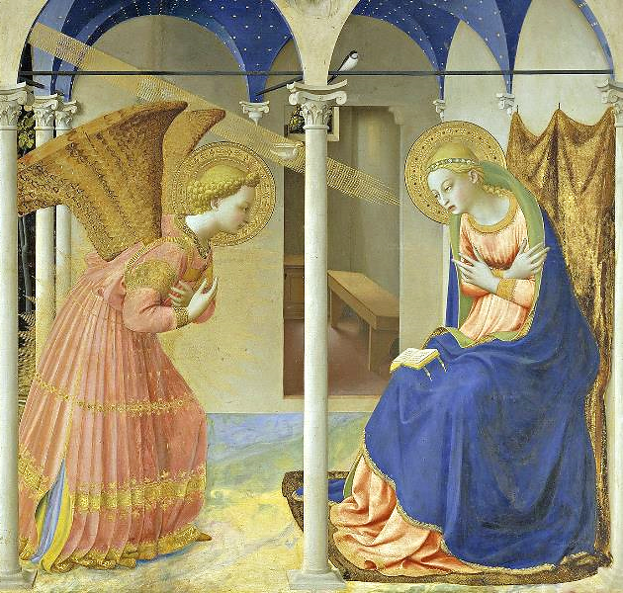
The Annunciation
Fra Angelico Prado Museum Madrid, Spain

Slide 22
Mary said to the angel, "How can this be, since I am a virgin?"
Luke 1:34

Slide 23
The Annunciation -- JESUS MAFA, Cameroon

Slide 24
The angel said to her, "The Holy Spirit will come upon you, and the power of the Most High will overshadow you;
Luke 1:35a

Slide 25
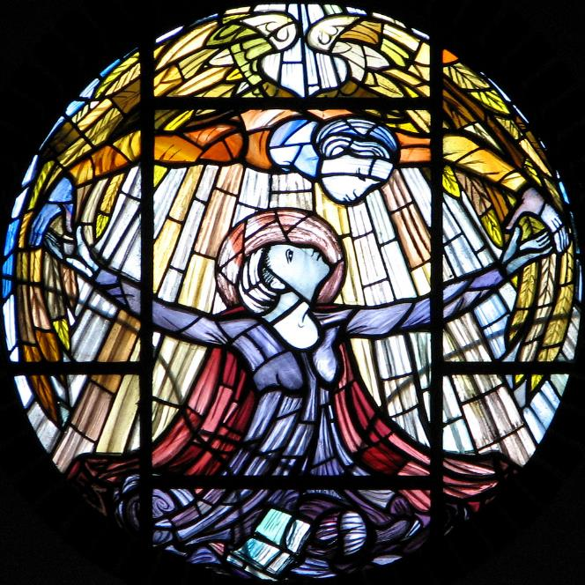
The Annunciation
Church of Our Lady of Pity
Swaffam, England

Slide 26
therefore the child to be born will be holy; he will be called Son of God.
Luke 1:35b

Slide 27
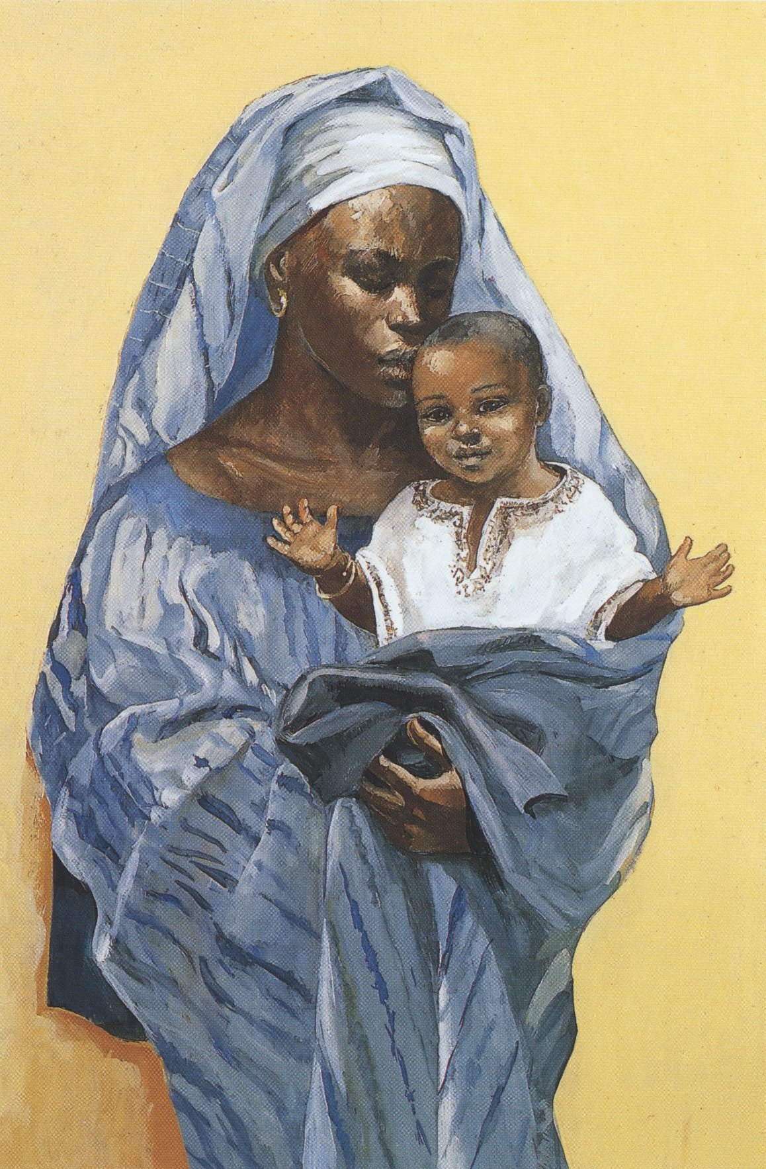
Mary and the Child Jesus
JESUS MAFA
Cameroon

Slide 28
For nothing will be impossible with God."
Luke 1:37

Slide 29
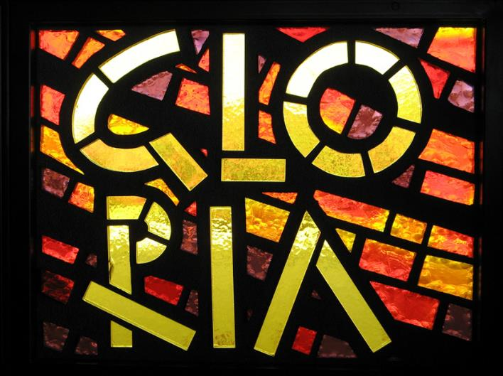
Gloria! -- Prince of Peace Abbey, Oceanside, CA

Slide 30
Credits
New Revised Standard Version Bible, copyright 1989, Division of Christian Education of the National Council of the Churches of Christ in the United States of America. Used by permission. All rights reserved.
https://www.flickr.com/photos/herr_hartmann/429627010
https://www.flickr.com/photos/thomashawk/5653108193 – Thomas Hawk
http://www.flickr.com/photos/portablematthew/3491085679/
https://commons.wikimedia.org/wiki/File:Saint_Gabriel_the_Archangel.jpg
https://commons.wikimedia.org/wiki/File:Nativity_scenes_01.jpg – Vagner Carvalhiero/Fr Hansen OFS
https://commons.wikimedia.org/wiki/File:Virgin_of_Guadalupe_-_Google_Art_Project.jpg
https://commons.wikimedia.org/wiki/File:KeurMoussaAutel.jpg
http://www.flickr.com/photos/ebarney/4762865759/
http://diglib.library.vanderbilt.edu/act-imagelink.pl?RC=54125
https://commons.wikimedia.org/wiki/File:Angelico,_prado.jpg
http://diglib.library.vanderbilt.edu/act-imagelink.pl?RC=48278
https://www.flickr.com/photos/paullew/2052404610/ - Fr Lawrence Lew, O.P.
http://www.librairie-emmanuel.fr (contact page: https://www.librairie-emmanuel.fr/contact)
http://www.flickr.com/photos/mariya_umama_wethemba_monastery/2646933603/
Additional descriptions can be found at the Art in the Christian Tradition image library, a service of the Vanderbilt Divinity Library, http://diglib.library.vanderbilt.edu/. All images available via Creative Commons 3.0 License.

