Slide 1
First Sunday of Advent
Year B
Isaiah 64:1-9
Psalm 80:1-7, 17-19
1 Corinthians 1:3-9
Mark 13:24-37

Slide 2
From ages past no one has heard, no ear has perceived, no eye has seen any God besides you …
Isaiah 64:4a

Slide 3
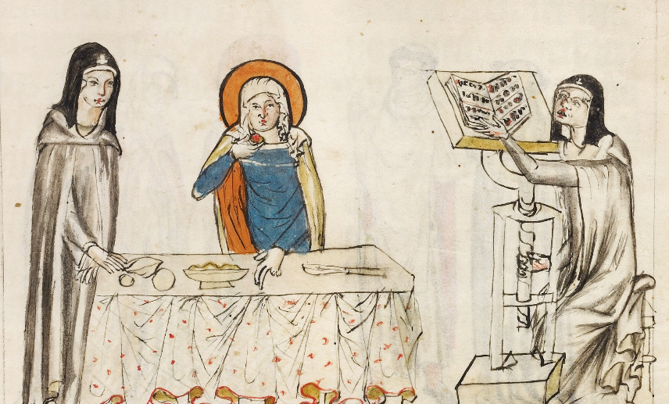
St. Hedwig of Silesia Listening to a Reading -- Getty Center, Los Angeles, CA

Slide 4
… we are the clay, and you are our potter;
Isaiah 64:8b

Slide 5
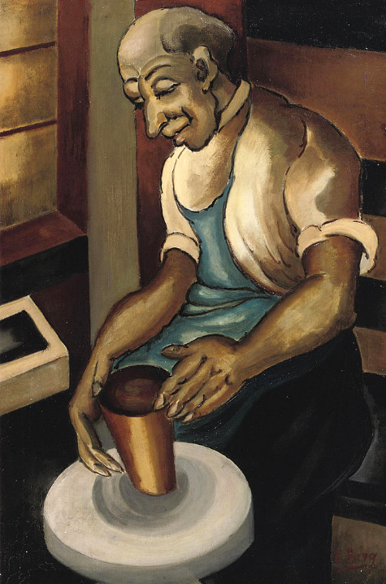
Potter's Wheel
Else Berg
prior to 1942

Slide 6
we are all the work of your hand.
Isaiah 64:8c

Slide 7
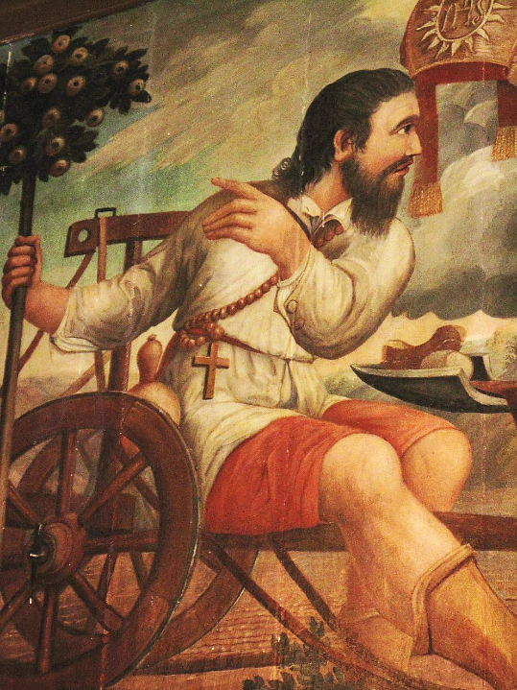
John Agnus in Wheelchair
Church of St-Marguerite Tihange, Belgium

Slide 8
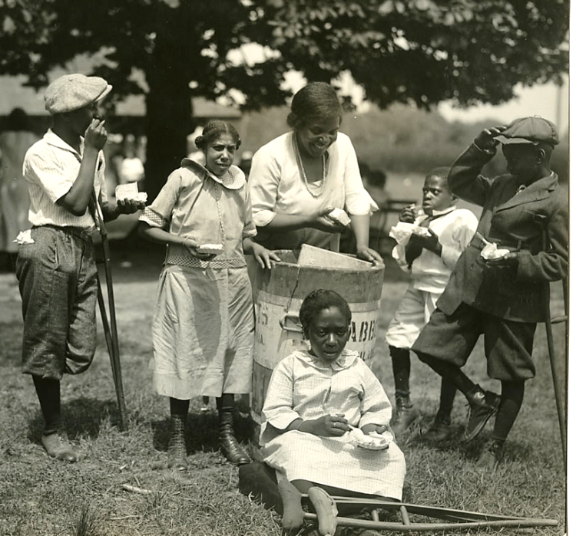
Ice Cream for Handicapped Children
Burlhome Park
Philadelphia, PA

Slide 9
Restore us, O LORD God of hosts;
let your face shine, that we may
be saved.
Psalm 80:19

Slide 10
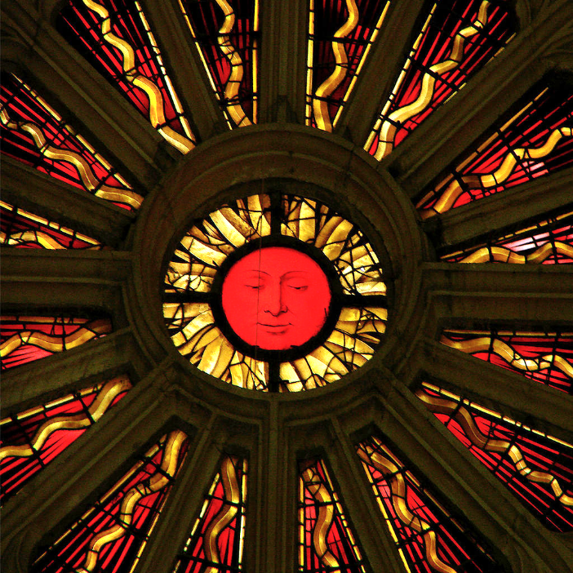
God's Shining Face
Church of St. Nicolas Saint-Nicolas-de-Port
France

Slide 11
I give thanks to my God always for you …
1 Corinthians 1:4a

Slide 12
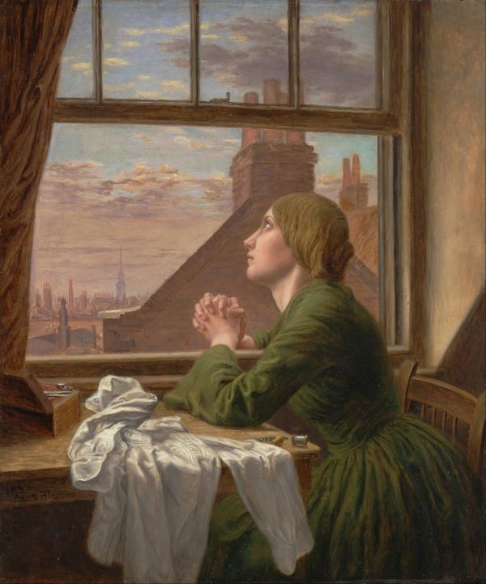
The Seamstress
Anna Blunden
Yale Center for British Art
New Haven, CT

Slide 13
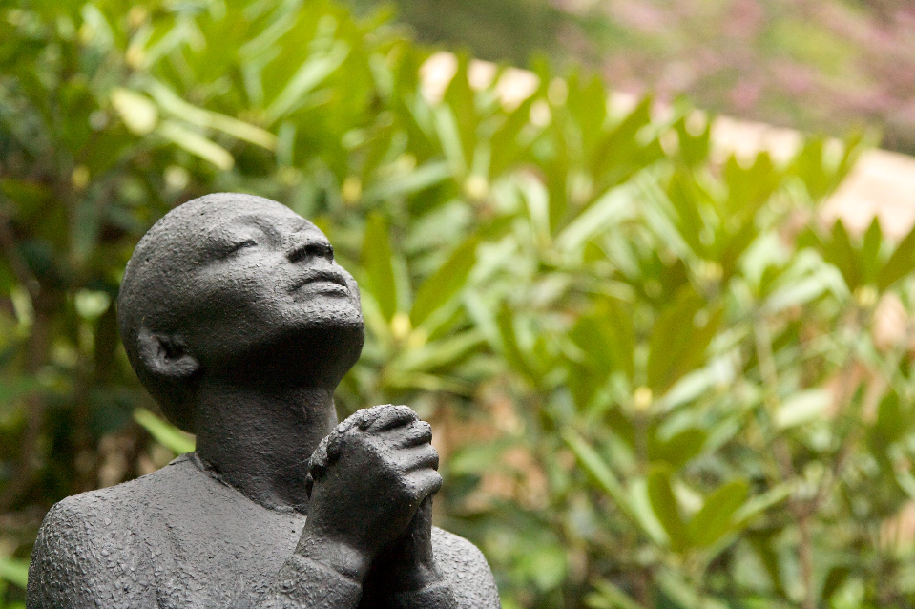
Rose McClendon in Prayer -- Richmond Barthe, Fallingwater, PA

Slide 14
… because of the grace of God that has been given you in Christ Jesus …
1 Corinthians 1:4b

Slide 15
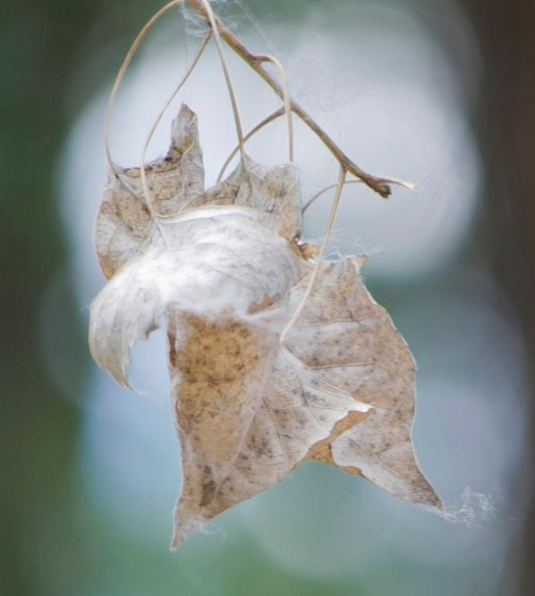
Aging Grace
Fe Langdon
Rio Grande State Park, Albuquerque, NM

Slide 16
… for in every way you have been enriched in him, in speech and knowledge of every kind …
1 Corinthians 1:5

Slide 17
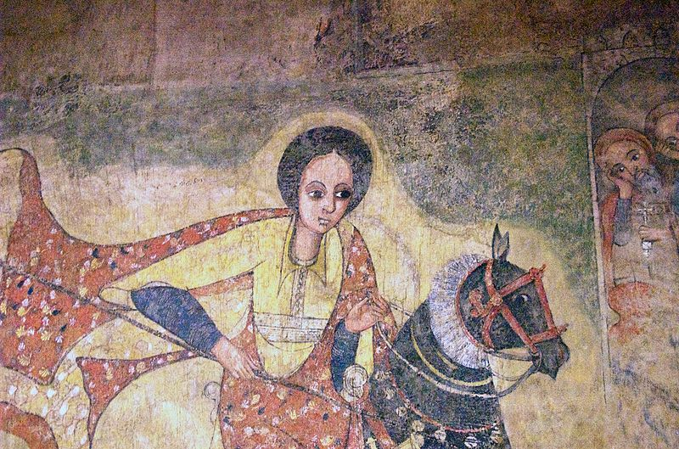
Queen of Sheba -- Lalibela Muralist, Addis Ababa National Museum, Addis Ababa, Ethiopia

Slide 18
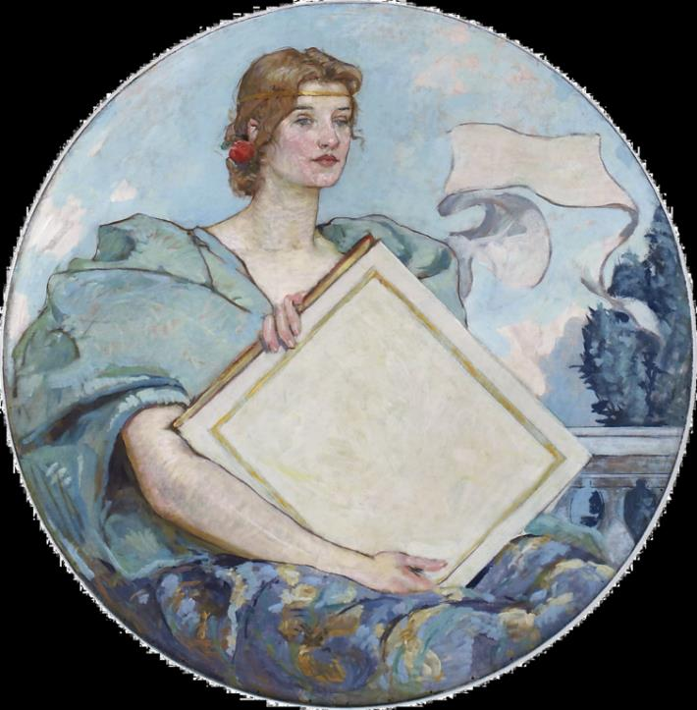
Knowledge
Robert Lewis Reid
Library of Congress
Washington, DC

Slide 19
"But in those days … the sun will be darkened, and the moon will not give its light,
Mark 13:24

Slide 20
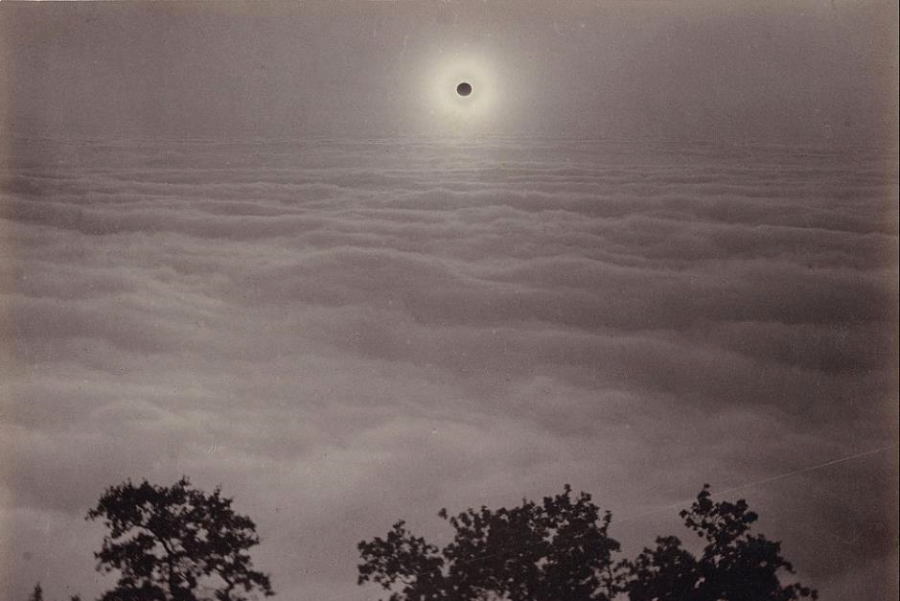
Solar Eclipse from Mount Santa Lucia -- Carleton Watkins, Getty Center, Los Angeles, CA

Slide 21
Then they will see 'the Son of Man coming in clouds' with great power and glory.
Mark 13:26

Slide 22
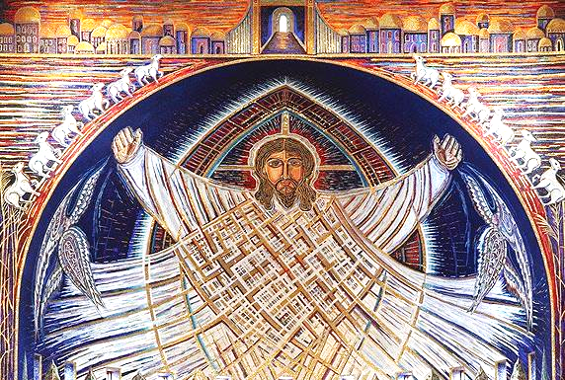
Christ in Glory -- Apse mosaic, Church of the Transfiguration, Barnstable County, MA

Slide 23
Heaven and earth will pass away, but my words will not pass away.
Mark 13:31

Slide 24
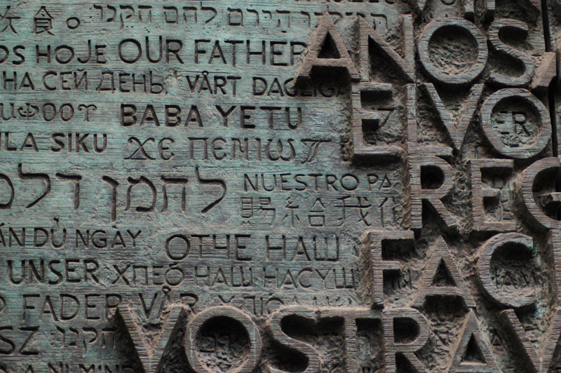
Eucharist Door with the Lord's Prayer -- Sagrada Familia, Barcelona, Spain

Slide 25
Therefore, keep awake … or else he may find you asleep when he comes suddenly."
Mark 13:35a, 36

Slide 26
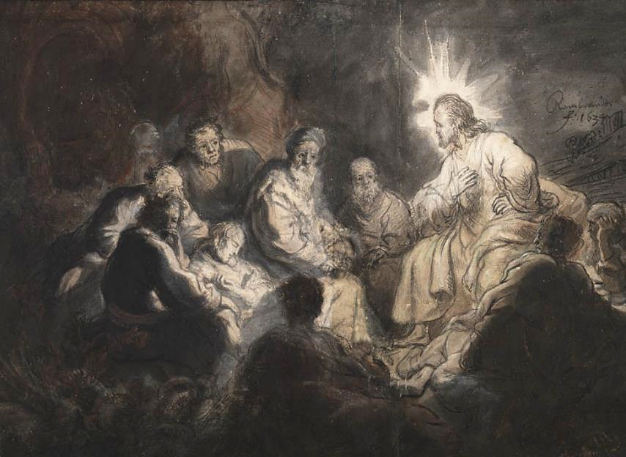
Jesus and His Disciples in Gethsemane -- Rembrandt, Teylers Museum, Haarlem, Netherlands

Slide 27
Credits
New Revised Standard Version Bible, copyright 1989, Division of Christian Education of the National Council of the Churches of Christ in the United States of America. Used by permission. All rights reserved.
https://commons.wikimedia.org/wiki/File:Court_workshop_of_Duke_Ludwig_I_of_Liegnitz_and_Brieg_(Polish_-_Hedwig_Listening_to_a_Reading;_Hedwig_Praying_-_Google_Art_Project.jpg
https://commons.wikimedia.org/wiki/File:Else_Berg_A_potter.jpg
https://commons.m.wikimedia.org/wiki/File:Joannes_Agnus.jpg – Freddy de Hosdent
https://commons.wikimedia.org/wiki/File:Burholme_Park_outing._%22Ice_Cream.%22_(20037282313).jpg
https://commons.wikimedia.org/wiki/File:Vitrail_Basilique_Saint-Nicolas_080208_05.jpg
https://commons.wikimedia.org/wiki/File:Anna_Blunden_-_%22For_Only_One_Short_Hour%22_-_Google_Art_Project.jpg
https://www.flickr.com/photos/via/2483710127 - Via Tsuji
http://www.flickr.com/photos/26145336@N08/6044127841/
https://commons.wikimedia.org/wiki/File:The_Queen_of_Sheba_(2131716999).jpg
https://commons.wikimedia.org/wiki/File:Knowledge-Reid-Highsmith.png
https://commons.wikimedia.org/wiki/File:Carleton_Watkins_(American_-_Solar_Eclipse_from_Mount_Santa_Lucia_-_Google_Art_Project.jpg
https://commons.wikimedia.org/wiki/File:Apse_mosaic_Christ_in_Glory.jpg - Karemin1094
https://commons.wikimedia.org/wiki/File:Portal_Detail_at_the_Sagrada_Familia.JPG
https://commons.wikimedia.org/wiki/File:Rembrandt_Jesus_and_his_Disciples.jpg
Additional descriptions can be found at the Art in the Christian Tradition image library, a service of the Vanderbilt Divinity Library, http://diglib.library.vanderbilt.edu/. All images available via Creative Commons 3.0 License.

