Slide 1
Fifth Sunday in Lent
Year B
Jeremiah 31:31-34
Psalm 51:1-12
or Psalm 119:9-16
Hebrews 5:5-10
John 12:20-33

Slide 2
The days are surely coming, says the LORD, when I will make a new covenant with the house of Israel and the house of Judah.
Jeremiah 31:31

Slide 3
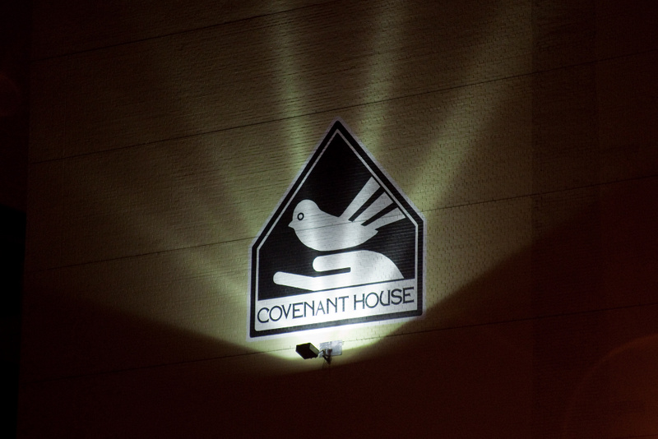
Covenant House Children and Youth Shelter -- New York, NY

Slide 4
… this is the covenant that I will make … I will put my law within them, and I will write it on their hearts …
Jeremiah 31:33b

Slide 5
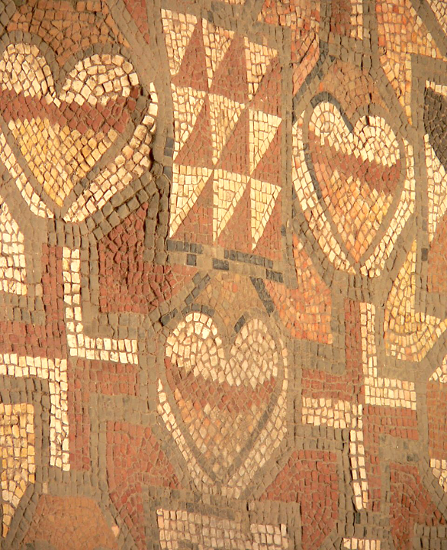
4th c. Christian Mosaic
Lullingstone Chapel
Eynsford, England

Slide 6
Have mercy on me, O God, according to your steadfast love; according to your abundant mercy blot out my transgressions.
Psalm 51:1

Slide 7
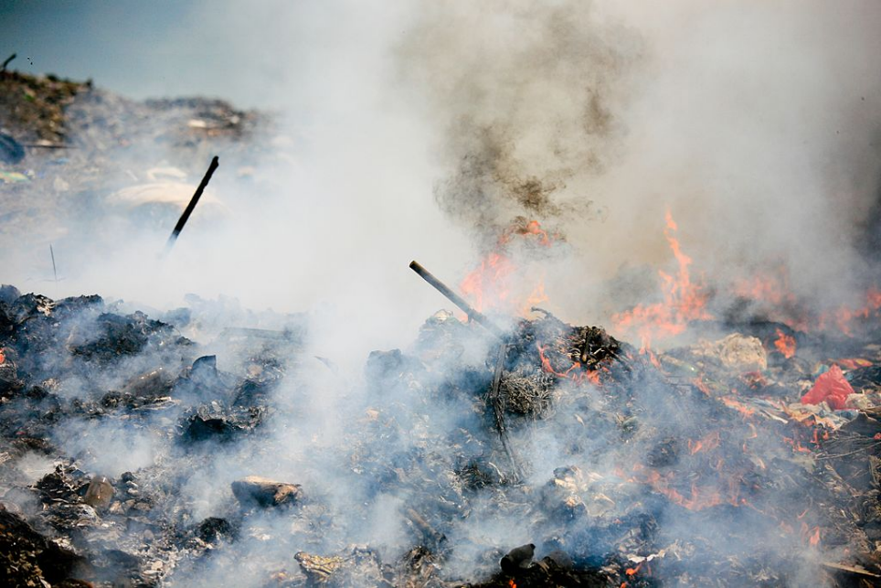
Burning waste on a landfill

Slide 8
You desire truth in the inward being; therefore teach me wisdom in my secret heart.
Psalm 51:6

Slide 9
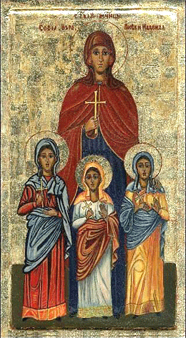
Sophia with her daughters, Faith, Hope, and Love
Bulgaria, 19th century

Slide 10
Restore to me the joy of your salvation, and sustain in me a willing spirit.
Psalm 51:12

Slide 11
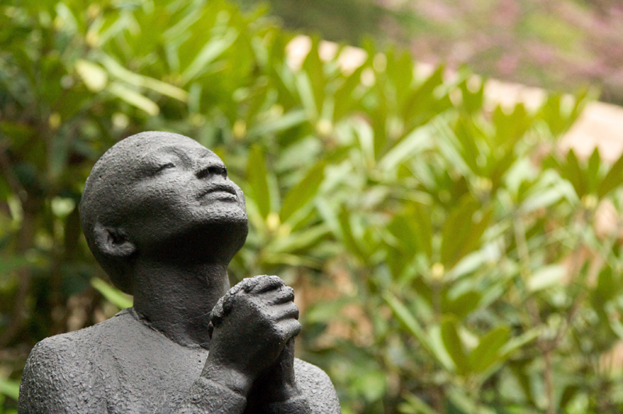
Rose McClendon in Prayer -- Richmond Barthe, Fallingwater, PA

Slide 12
In the days of his flesh, Jesus offered up prayers and supplications, with loud cries and tears …
Hebrews 5:7

Slide 13
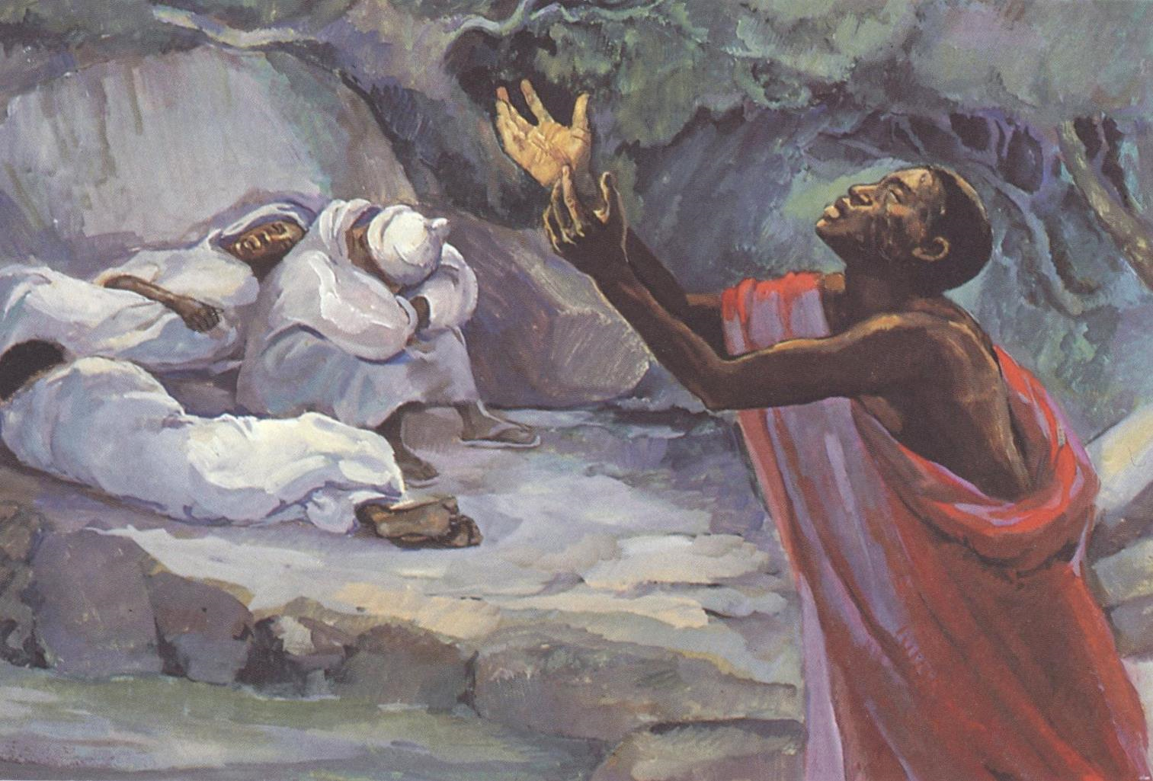
Christ on Gethsemane -- JESUS MAFA, Cameroon

Slide 14
Jesus answered them, "The hour has come for the Son of Man to be glorified.
John 12:23

Slide 15
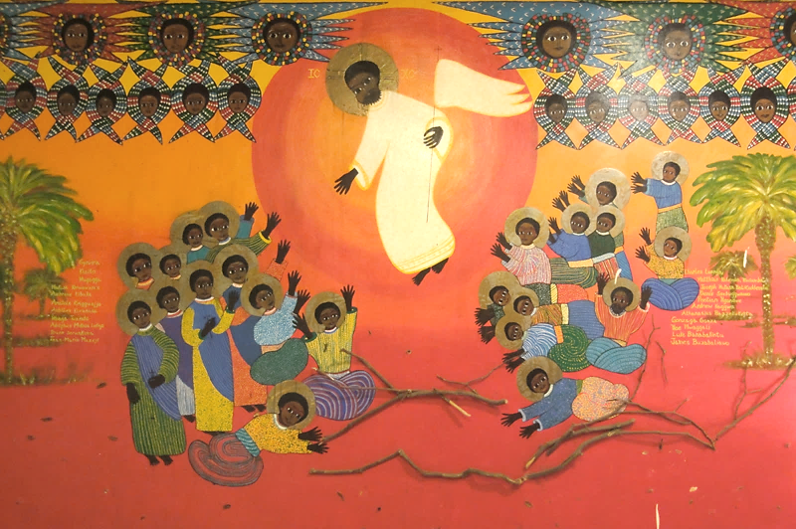
Martyrs of Uganda -- Emmaus House, Kampala, Uganda

Slide 16
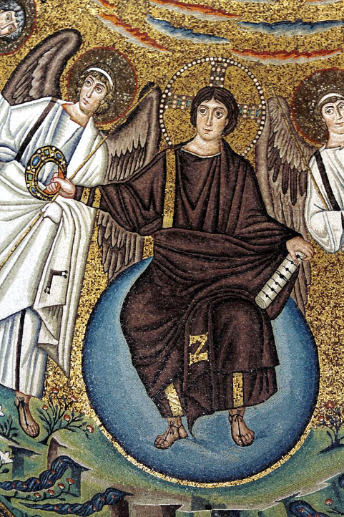
Christ in Glory
Basilica of San Vitale
Ravenna, Italy

Slide 17
Very truly, I tell you, unless a grain of wheat falls into the earth and dies, it remains just a single grain; but if it dies, it bears much fruit.
John 12:24

Slide 18
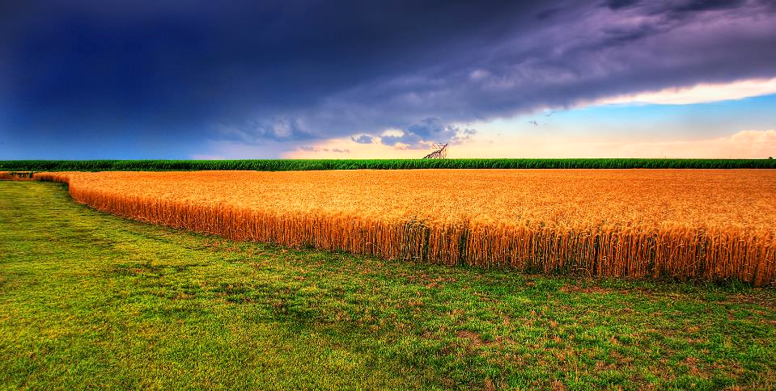
Kansas Summer Wheat -- James Watkins, photographer

Slide 19
Whoever serves me must follow me, and where I am, there will my servant be also.
John 12:26

Slide 20
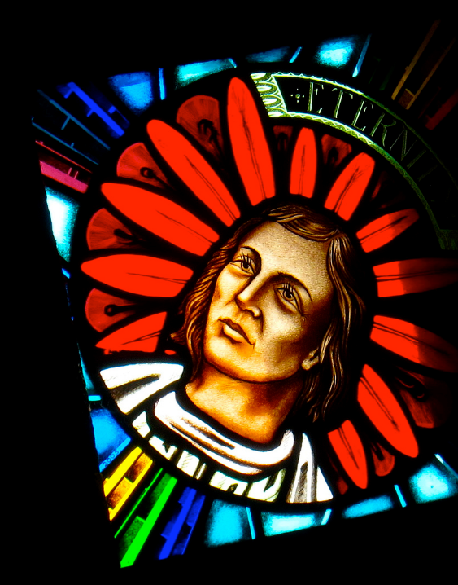
Memorial to Borneans
St. Michael’s Church
Sandkan, Borneo

Slide 21
"Now my soul is troubled. And what should I say-- 'Father, save me from this hour'? No, it is for this reason that I have come to this hour.
John 12:27

Slide 22
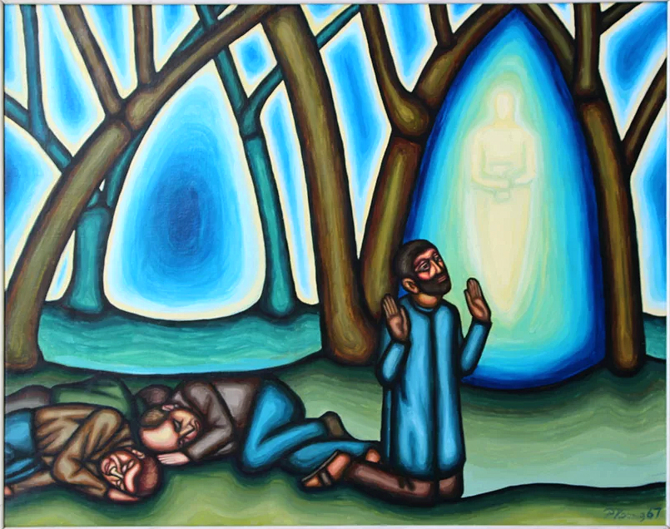
Garden of Gethsemane -- Peter Koenig

Slide 23
“Father, glorify your name." Then a voice came from heaven, "I have glorified it, and I will glorify it again."
John 12:28

Slide 24
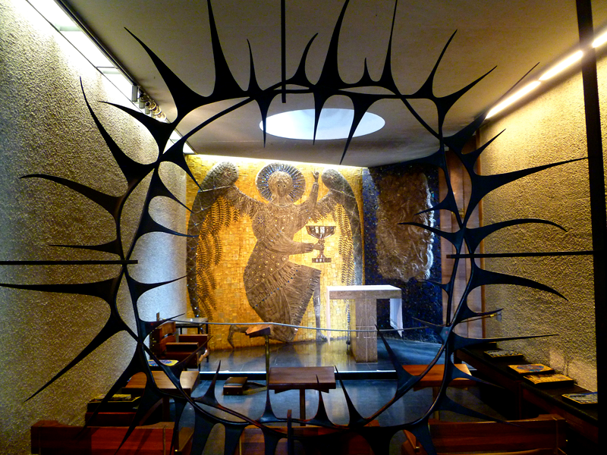
Garden of Gethsemane -- Stephen Sykes, Coventry Cathedral, Coventry, UK

Slide 25
And I, when I am lifted up from the earth, will draw all people to myself."
John 12:32

Slide 26
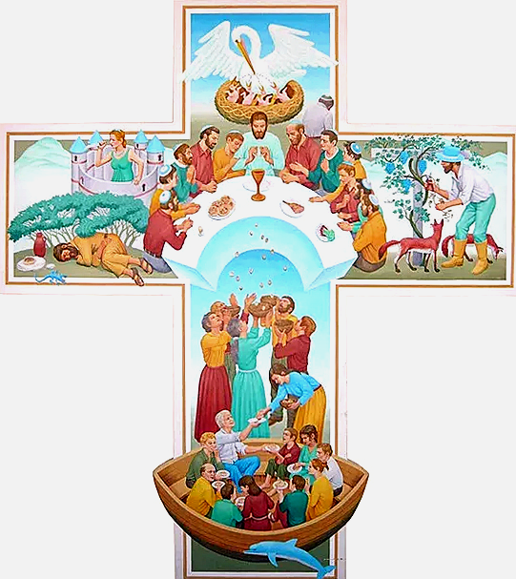
Cross of the Eucharist
Peter Koenig

Slide 27
Credits
New Revised Standard Version Bible, copyright 1989, Division of Christian Education of the National Council of the Churches of Christ in the United States of America. Used by permission. All rights reserved.
http://www.flickr.com/photos/44072707@N00/3593089779 - Jason Kuffer
http://www.flickr.com/photos/mharrsch/135554275/
https://commons.wikimedia.org/wiki/File:Environmental_Disaster_(6983486731).jpg – Alex Proimos
https://commons.wikimedia.org/wiki/File:Saint_sofia_bulgaria_icon.gif
https://www.flickr.com/photos/via/2483710127 - Via Tsuji
https://www.flickr.com/photos/bhsher/33474475 - Bryan Sherwood
Éditions de l’Emmanuel, https://www.editions-emmanuel.com/contact/
https://commons.wikimedia.org/wiki/File:Christ_in_Glory_-_Vaul_mosaic_-_San_Vitale_-_Ravenna_2016.jpg – Jose Luiz
https://www.flickr.com/photos/23737778@N00/7115229223
https://www.flickr.com/photos/jamescheuk/6166194713
Peter Winfried (Canisius) Koenig, https://www.pwkoenig.co.uk/
http://www.flickr.com/photos/90982314@N00/3210123241/
Peter Winfried (Canisius) Koenig, https://www.pwkoenig.co.uk/
Additional descriptions can be found at the Art in the Christian Tradition image library, a service of the Vanderbilt Divinity Library, http://diglib.library.vanderbilt.edu/. All images available via Creative Commons 3.0 License.

