Slide 1
Fifth Sunday after the Epiphany
Year B
Isaiah 40:21-31
Psalm 147:1-11, 20c
1 Corinthians 9:16-23
Mark 1:29-39

Slide 2
It is he who sits above the circle of the earth, and its inhabitants are like grasshoppers; who stretches out the heavens like a curtain …
Isaiah 40:22a

Slide 3
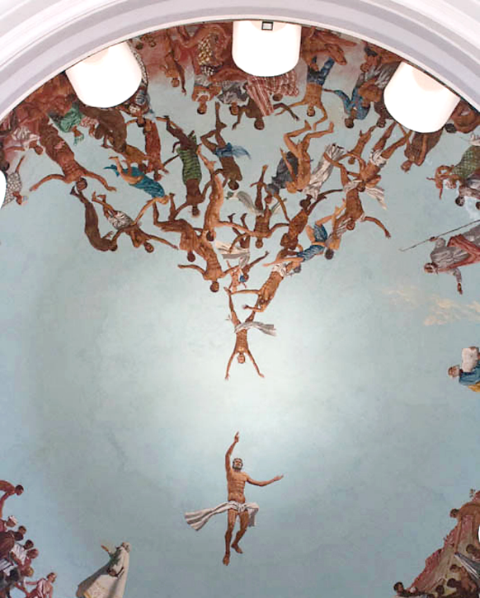
Coming to God
Cathedral of Dakar
Dakar, Senegal

Slide 4
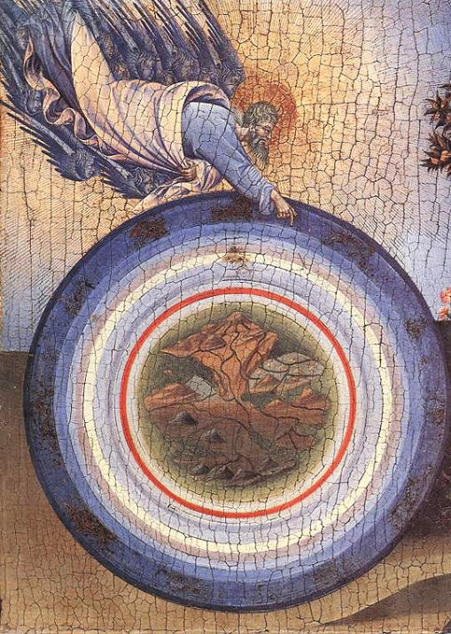
The Creation (detail)
Giovanni di Paolo Metropolitan Museum of Art
New York, NY

Slide 5
He gives to the animals their food, and to the young ravens when they cry.
Psalm 147:9

Slide 6
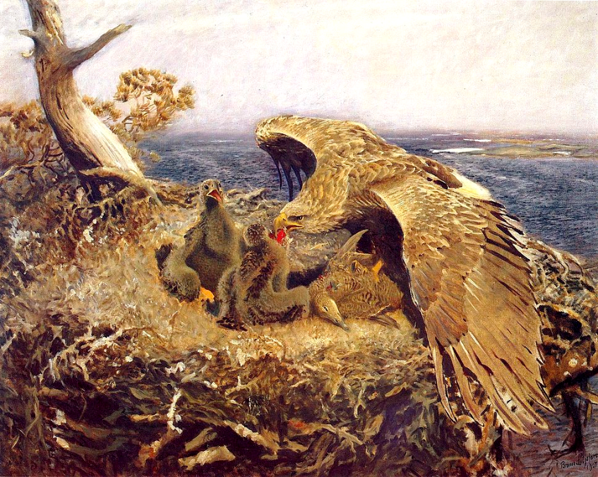
Sea Eagle's Nest -- Bruno Liljefors, National Museum, Stockholm, Sweden

Slide 7
To the weak I became weak, so that I might win the weak. I have become all things to all people, that I might by all means save some.
1 Corinthians 9:22

Slide 8
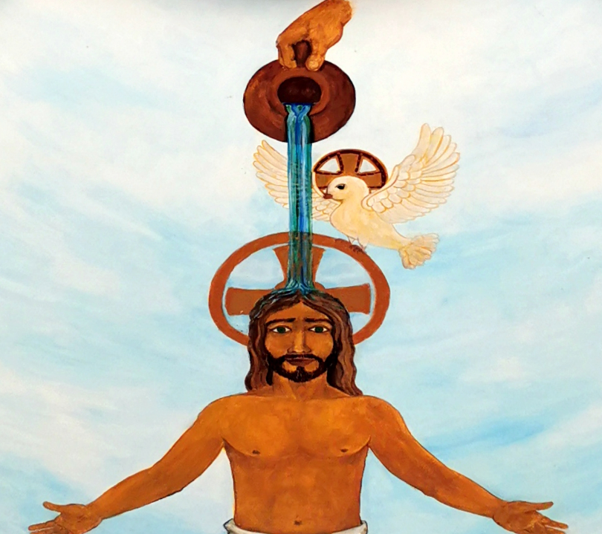
Holy Trinity
Zoltan Joo
Church of the Holy Spirit
Veresegyház, Hungary

Slide 9
Now Simon's mother-in-law was in bed with a fever, and they told him about her at once.
Mark 1:30

Slide 10
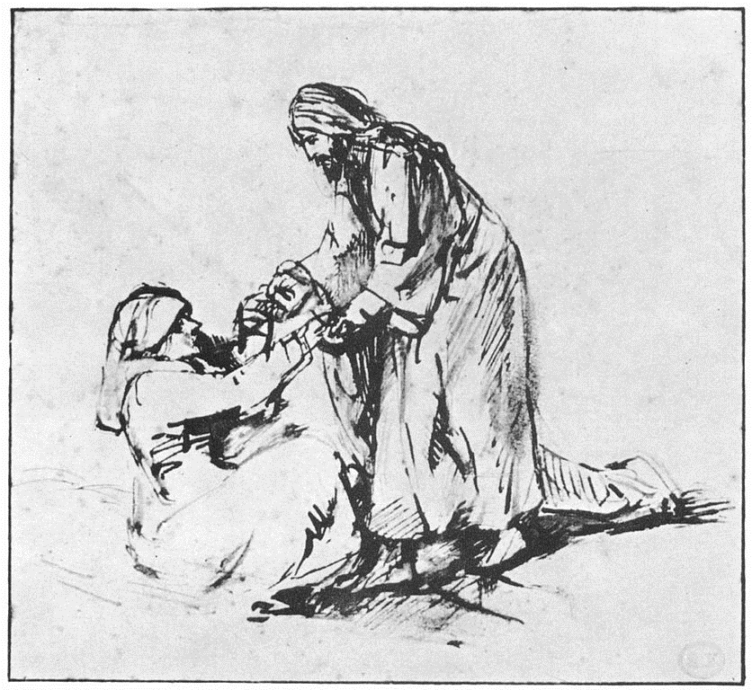
Healing Peter's Mother-in-Law
Rembrandt Fondation Custodia Amsterdam, Netherlands

Slide 11
He came and took her by the hand and lifted her up. Then the fever left her, and she began to serve them.
Mark 1:31

Slide 12
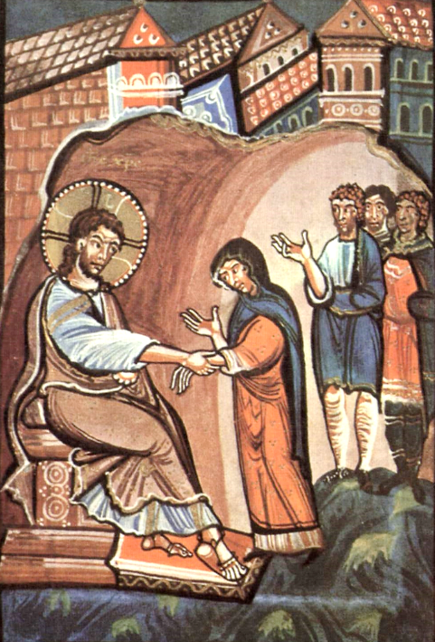
Healing Peter's Mother-in-Law
Abbess Hitda of Meschede Gospel
State and University Library
Darmstadt, Germany

Slide 13
That evening, at sundown, they brought to him all who were sick or possessed with demons.
Mark 1:32

Slide 14
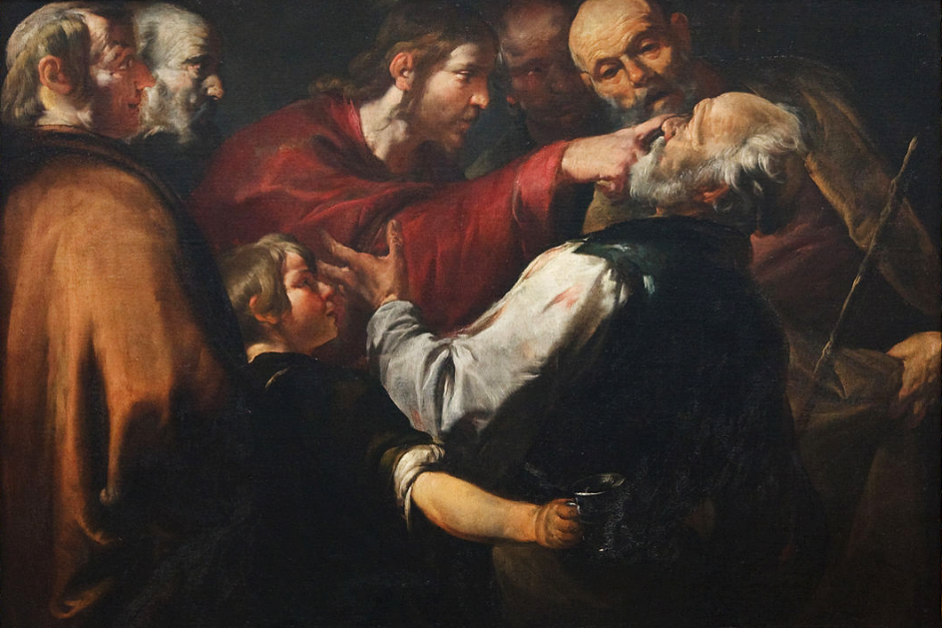
Christ Healing the Blind Man -- Gioacchino Assereto, Carnegie Museum of Art, Pittsburgh, PA

Slide 15
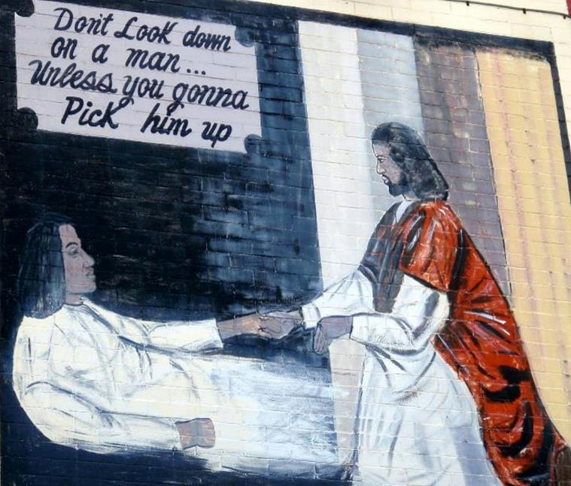
“Don’t Look Down on a Man…Unless You Gonna Pick Him Up” -- Washington, DC

Slide 16
And he cured many who were sick with various diseases, and cast out many demons; and he would not permit the demons to speak, because they knew him.
Mark 1:34

Slide 17
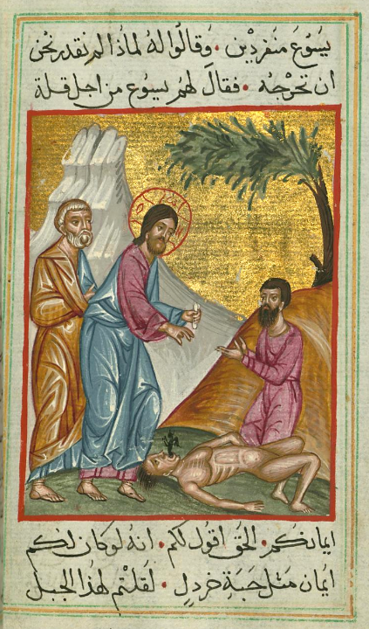
Jesus Heals a Demon-possessed Boy
Ilyas Bazzi Rahib
Walters Art Museum Baltimore, MD

Slide 18
In the morning, while it was still very dark, he got up and went out to a deserted place, and there he prayed.
Mark 1:35

Slide 19
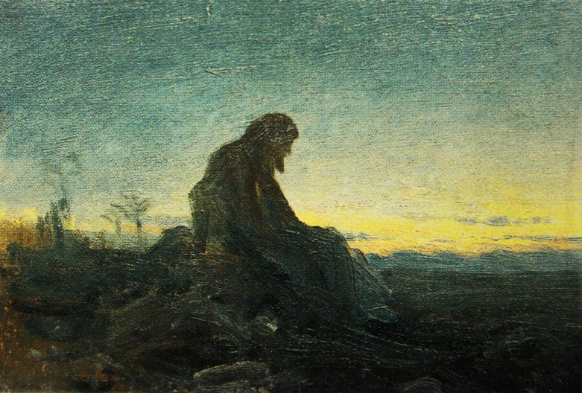
Christ in the Wilderness -- Ivan Kramskoy, study, 1872

Slide 20
And Simon and his companions hunted for him. When they found him, they said to him, "Everyone is searching for you."
Mark 1:36-37

Slide 21
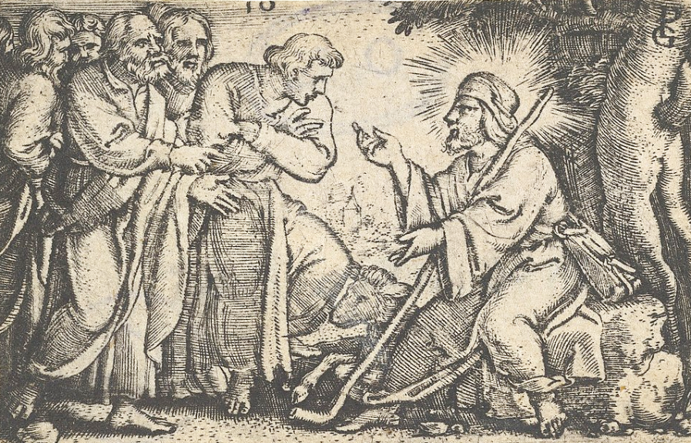
Christ Speaking to the Disciples -- Georg Pencz, Metropolitan Museum of Art, New York, NY

Slide 22
He answered, "Let us go on to the neighboring towns, so that I may proclaim the message there also; for that is what I came out to do."
Mark 1:38

Slide 23
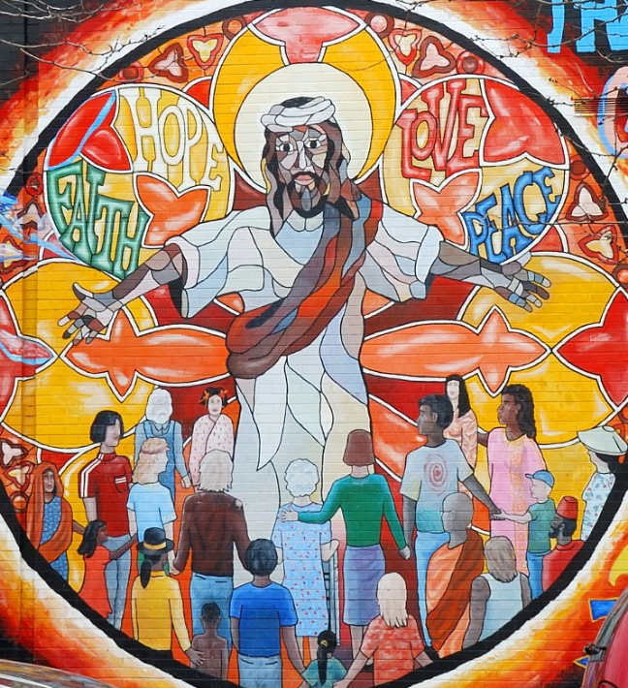
Message of Christ Mural
Chicago, IL

Slide 24
And he went throughout Galilee, proclaiming the message in their synagogues and casting out demons.
Mark 1:39

Slide 25
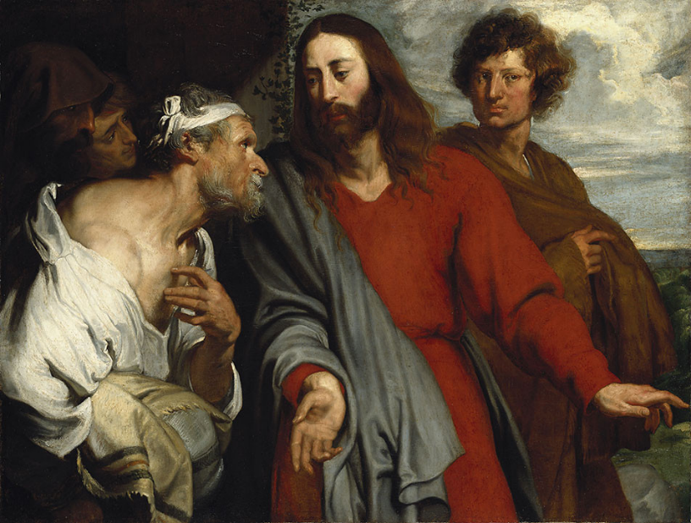
Healing of the Paralytic -- Anthony van Dyck, Staatsgalerie, Neuberg, Germany

Slide 26
Credits
New Revised Standard Version Bible, copyright 1989, Division of Christian Education of the National Council of the Churches of Christ in the United States of America. Used by permission. All rights reserved.
https://www.flickr.com/photos/carsten_tb/22260925034/ - Carsten ten Brink
https://commons.wikimedia.org/wiki/File:Giovanni_di_paolo,_Creation_and_the_Expulsion_from_the_Paradise.jpg
https://commons.wikimedia.org/wiki/File:Bruno_Liljefors_-_Sea_Eagles_Nest.jpg
https://commons.wikimedia.org/wiki/File:Coffered_ceiling_by_Zolt%C3%A1n_Jo%C3%B3,_Holy_Spirit_Church,_2019_Veresegyh%C3%A1z.jpg
https://commons.wikimedia.org/wiki/File:Rembrandt_Heilung_der_Schwiegermutter_des_Petrus.jpg
https://commons.wikimedia.org/wiki/File:Meister_des_Hitda-Evangeliars_002.jpg
https://commons.wikimedia.org/wiki/File:WLA_cma_Christ_Healing_the_Blind_Man_c_1640.jpg
https://www.flickr.com/photos/daquellamanera/3994554964
https://commons.wikimedia.org/wiki/File:Ilyas_Basim_Khuri_Bazzi_Rahib_-_Jesus_Heals_a_Demon-possessed_Boy_-_Walters_W59248B_-_Full_Page.jpg
https://commons.wikimedia.org/wiki/File:Kramskoi_Christ_in_the_Wilderness_study_gtg.jpg
https://commons.wikimedia.org/wiki/File:Christ_Speaking_to_the_Disciples,_from_The_Story_of_Christ_MET_DP855491.jpg
https://www.flickr.com/photos/36847973@N00/3342340183
https://commons.wikimedia.org/wiki/File:Anthony_van_Dyck_-_The_healing_of_the_paralytic.jpg
Additional descriptions can be found at the Art in the Christian Tradition image library, a service of the Vanderbilt Divinity Library, http://diglib.library.vanderbilt.edu/. All images available via Creative Commons 3.0 License.

