Slide 1
Baptism of the Lord
Year B
Genesis 1:1-5
Psalm 29
Acts 19:1-7
Mark 1:4-11

Slide 2
Then God said, "Let there be light"; and there was light. And God saw that the light was good.
Genesis 1:3, 4a

Slide 3
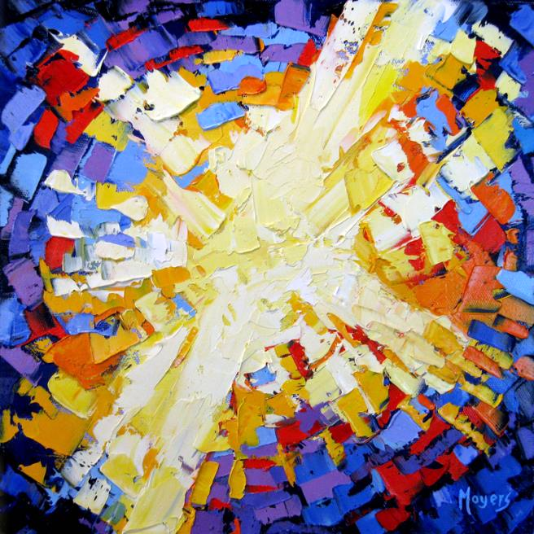
Awake My Soul
Mike Moyers
Nashville, TN

Slide 4
The voice of the LORD shakes the wilderness; …
The voice of the LORD causes the oaks to whirl …
May the LORD bless his people with peace!
Psalm 29:8a, 9a, 11b

Slide 5
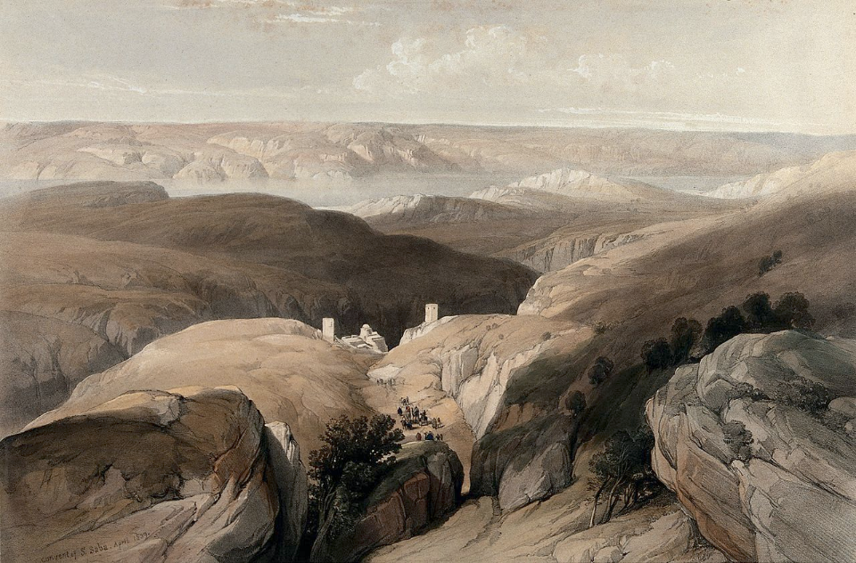
Engedi Wilderness, St. Saba Monastery, Israel -- David Roberts/Louis Haghe, Wellcome Trust

Slide 6
When Paul had laid his hands on them, the Holy Spirit came upon them, and they spoke in tongues and prophesied--
Acts 19:6

Slide 7
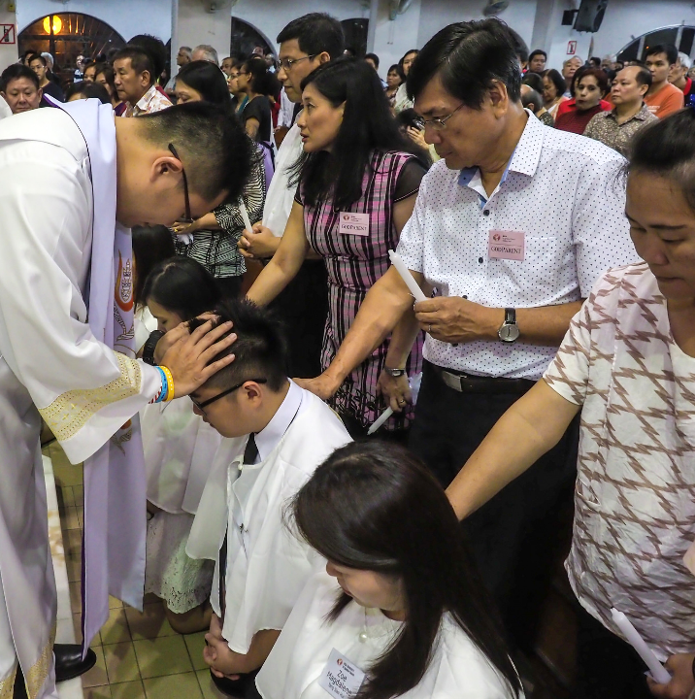
Easter Eve, Laying on of Hands
St. Ignatius Church

Slide 8
John the baptizer appeared in the wilderness, proclaiming a baptism of repentance for the forgiveness of sins.
Mark 1:4

Slide 9
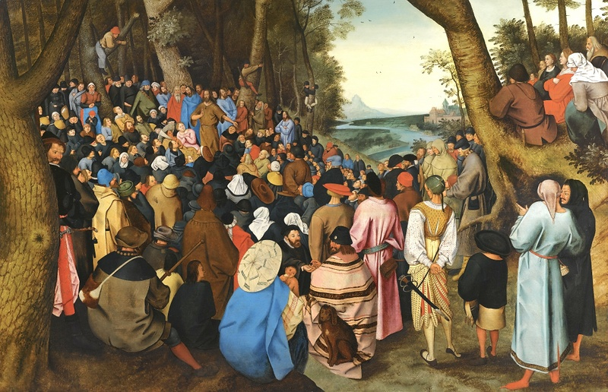
John the Baptist Preaching in the Wilderness -- Pieter Brueghel the Younger

Slide 10
And people from the whole Judean countryside and all the people of Jerusalem were going out to him, and were baptized by him in the river Jordan, confessing their sins.
Mark 1:5

Slide 11
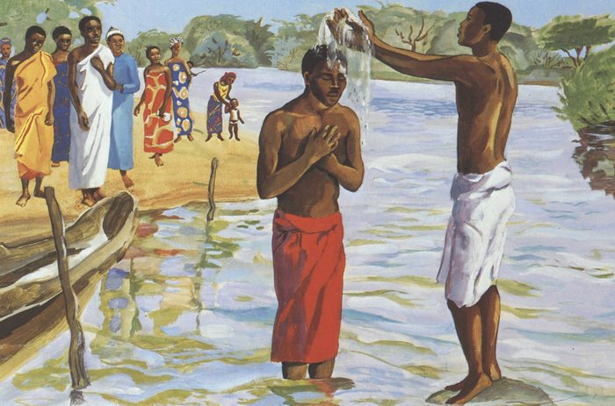
Baptism of Jesus -- JESUS MAFA, Cameroon

Slide 12
He proclaimed, "The one who is more powerful than I is coming after me; I am not worthy to stoop down and untie the thong of his sandals.
Mark 1:7

Slide 13
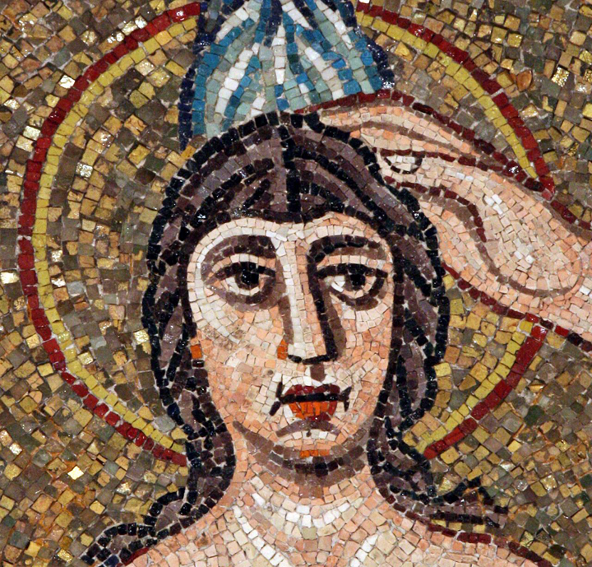
John Baptizing Christ
Arian Baptistery
Ravenna, Italy

Slide 14
I have baptized you with water; but he will baptize you with the Holy Spirit."
Mark 1:8

Slide 15
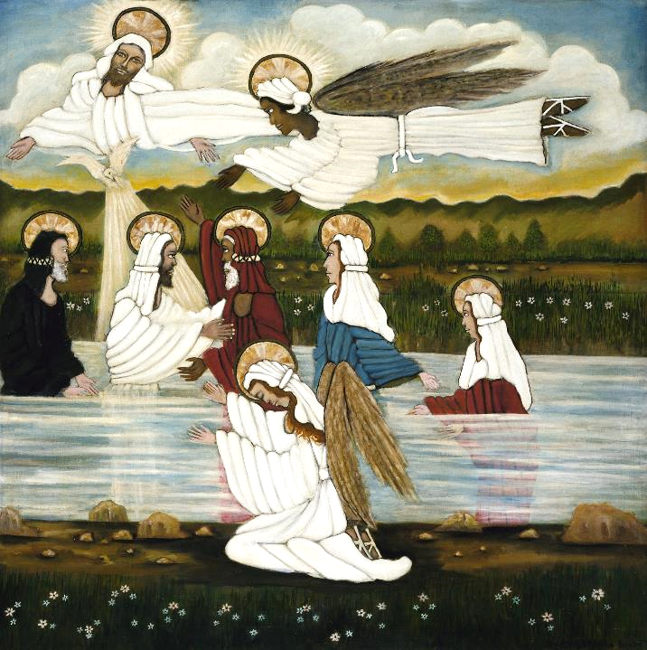
John Baptizing Christ
Lorenzo Scott
SAAM
Washington, DC

Slide 16
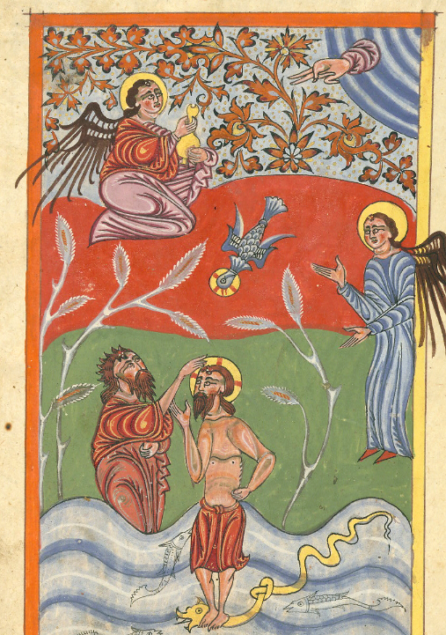
Baptism of Christ
Yohannes Vardapet
Armenian Gospel Book
Walters Art Museum
Baltimore, MD

Slide 17
In those days Jesus came from Nazareth of Galilee and was baptized by John in the Jordan.
Mark 1:9

Slide 18
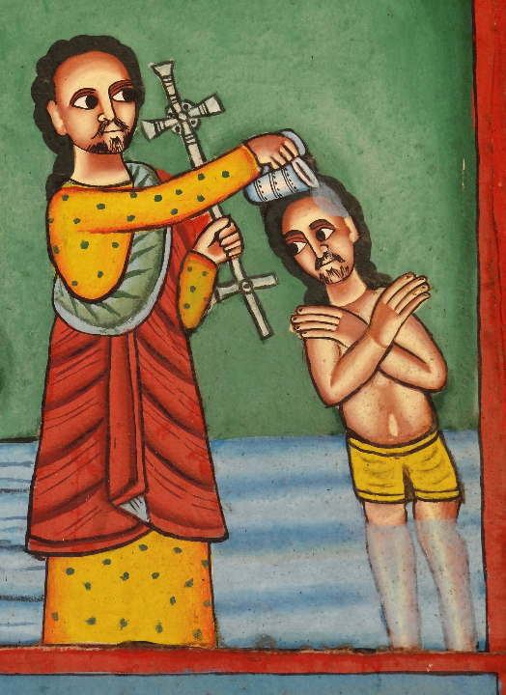
John Baptizing Jesus
I Yesus Church
Axum, Ethiopia

Slide 19
And just as he was coming up out of the water, he saw the heavens torn apart and the Spirit descending like a dove on him.
Mark 1:10

Slide 20
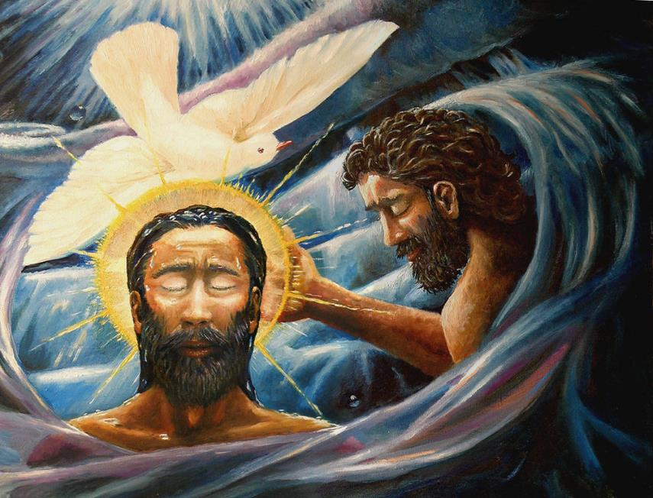
Baptism of Christ -- Dave Zelenka

Slide 21
And a voice came from heaven, "You are my Son, the Beloved; with you I am well pleased."
Mark 1:11

Slide 22
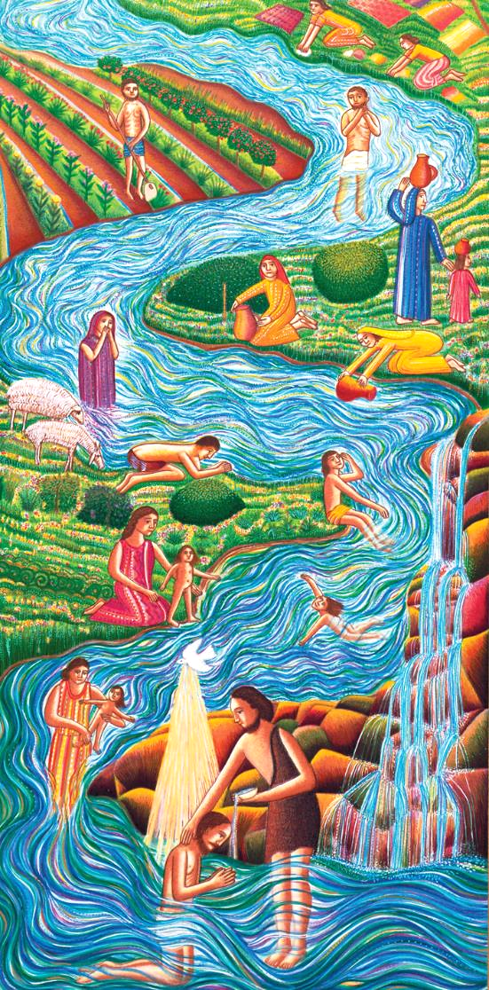
River
John August Swanson

Slide 23
Credits
New Revised Standard Version Bible, copyright 1989, Division of Christian Education of the National Council of the Churches of Christ in the United States of America. Used by permission. All rights reserved.
https://www.mikemoyersfineart.com/
https://commons.wikimedia.org/wiki/File:Wilderness_of_Engedi,_with_the_monastery_of_St._Saba,_lookin_Wellcome_V0049464.jpg
https://www.flickr.com/photos/johnragai/34003892444/
https://commons.wikimedia.org/wiki/File:Saint_John_the_Baptist_Preaching_to_the_Masses_in_the_Wilderness_oil_on_oak_panel_by_Pieter_Brueghel_the_Younger.jpg
http://diglib.library.vanderbilt.edu/act-imagelink.pl?RC=54494
http://diglib.library.vanderbilt.edu/act-imagelink.pl?RC=48290
https://americanart.si.edu/artwork/baptism-jesus-33953
https://www.flickr.com/photos/medmss/8614784984
https://www.flickr.com/photos/adam_jones/8701132677
https://commons.wikimedia.org/wiki/File:Baptism-of-Christ.jpg
Estate of John August Swanson, https://www.johnaugustswanson.com/
Additional descriptions can be found at the Art in the Christian Tradition image library, a service of the Vanderbilt Divinity Library, http://diglib.library.vanderbilt.edu/. All images available via Creative Commons 3.0 License.

