Slide 1
All Saints Day
Year B
Wisdom of Solomon 3:1-9 or Isaiah 25:6-9 and Psalm 24 Revelation 21:1-6a • John 11:32-44

Slide 2
Then the Lord GOD will wipe away the tears from all faces … let us be glad and rejoice …
Isaiah 25:8a, 9b

Slide 3
Rejoice Mural -- Mission District, San Francisco, CA

Slide 4
The earth is the Lord's and all that is in it … for he has founded it on the seas, and established it on the rivers.
Psalm 24:1a, 2

Slide 5
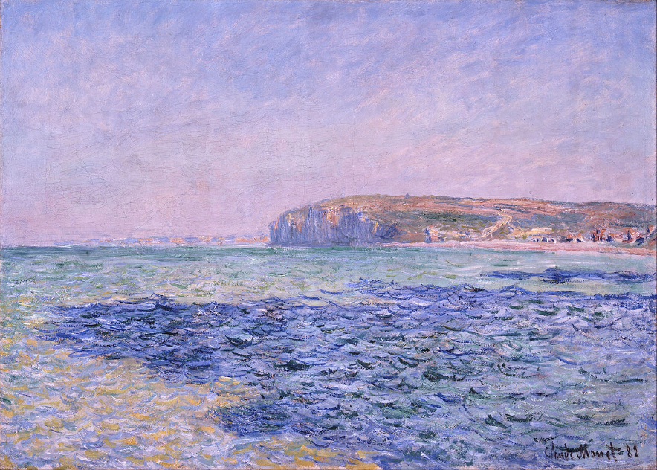
Cliffs at Pourville -- Claude Monet, Ny Carlsberg Glyptotek, Copenhagen, Denmark

Slide 6
"Death will be no more; mourning and crying and pain will be no more, for the first things have passed away."
Revelation 21:4b

Slide 7
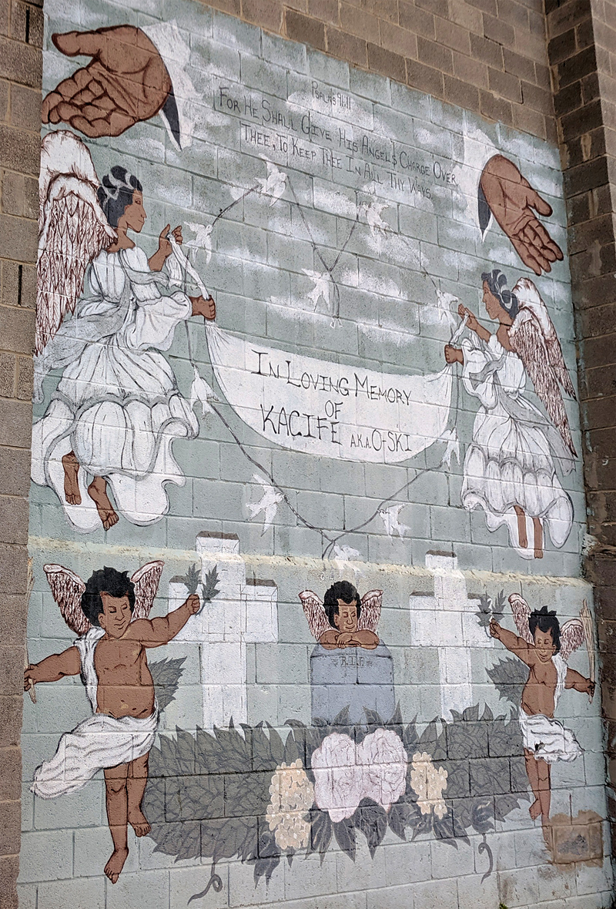
"In Loving Memory…"
Street Mural
Baltimore, MD

Slide 8
When Mary … saw him, she knelt at his feet and said to him, "Lord, if you had been here, my brother would not have died."
John 11:32

Slide 9
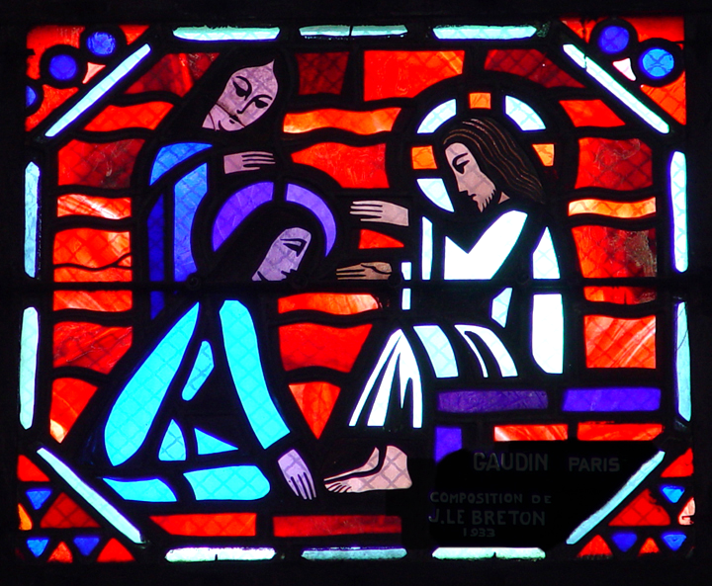
Mary Kneels at Jesus' Feet -- Gaudin and Le Breton, Amiens Cathedral, France

Slide 10
When Jesus saw her weeping, and the Jews who came with her also weeping, he was greatly disturbed in spirit and deeply moved.
John 11:33

Slide 11
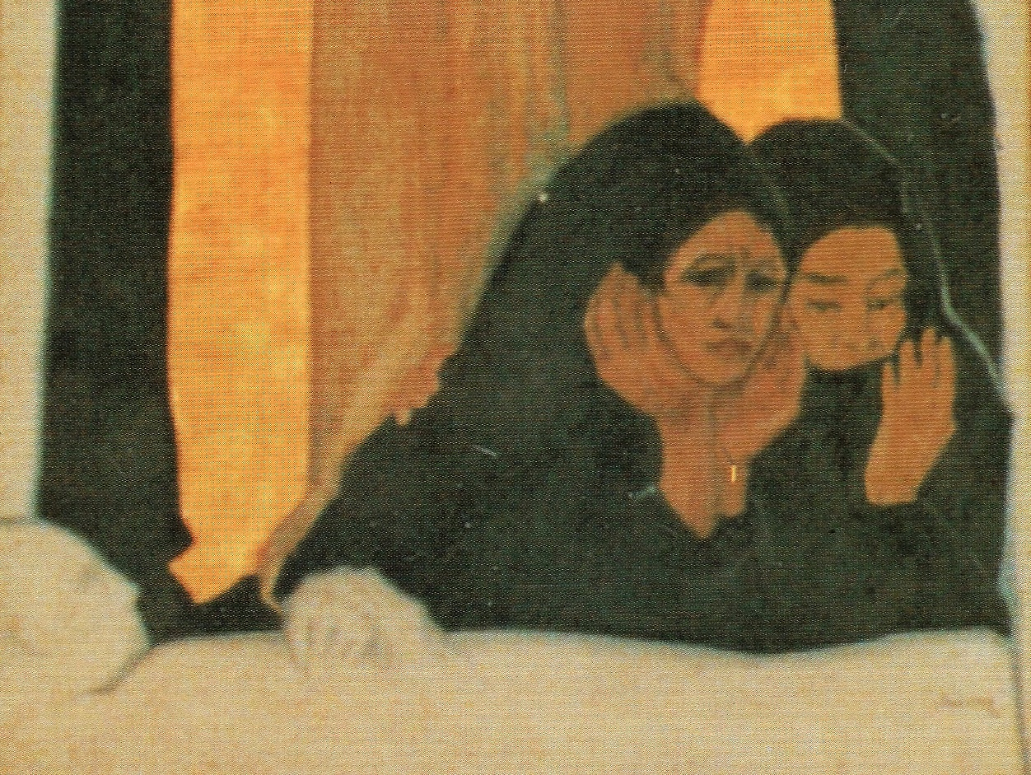
Raising of Lazarus, detail -- Frank Wesley

Slide 12
Jesus began to weep so the Jews said, "See how he loved him!"
John 11:35-36

Slide 13
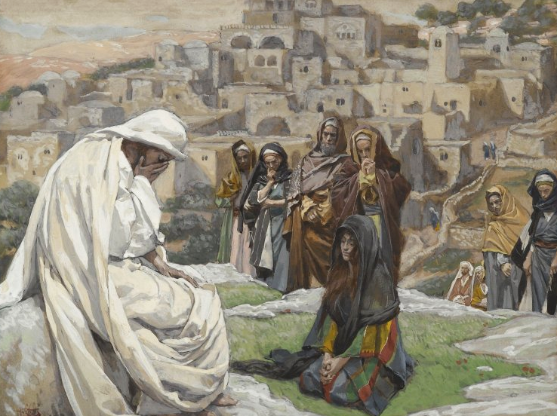
Jesus Began to Weep -- James Tissot, Brooklyn Museum of Art, New York, NY

Slide 14
Jesus said, "Take away the stone."
John 11:39a

Slide 15
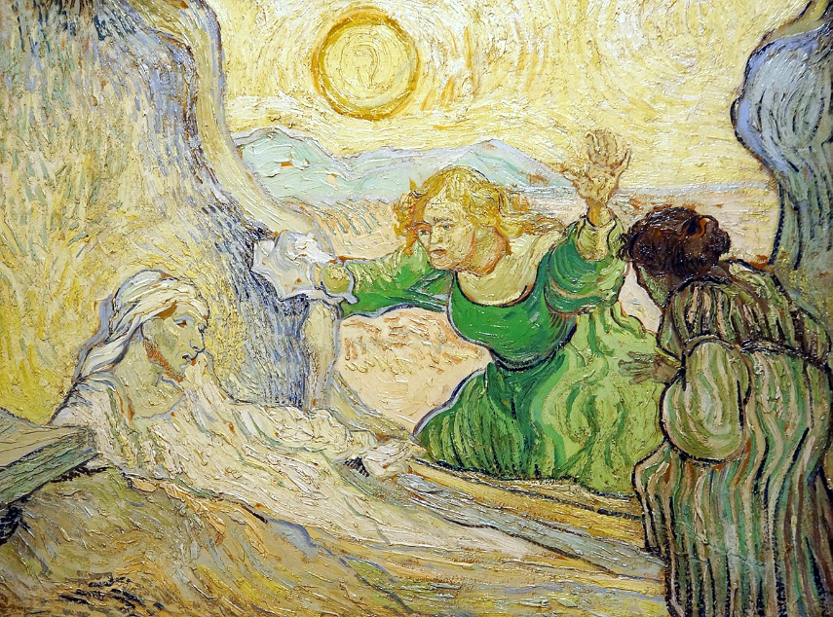
Raising of Lazarus -- Vincent van Gogh, Van Gogh Museum, Amsterdam, Netherlands

Slide 16
And Jesus looked upward and said, "Father, I thank you for having heard me."
John 11:41

Slide 17
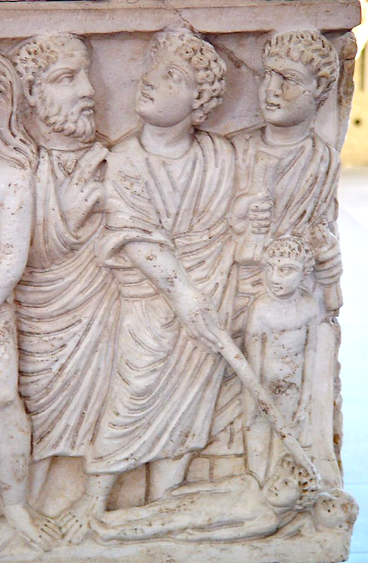
Christ speaking to God and Raising Lazarus
Sarcophagus
Vatican Museum
Vatican City

Slide 18
When he had said this, he cried with a loud voice, "Lazarus come out!"
John 11:43

Slide 19
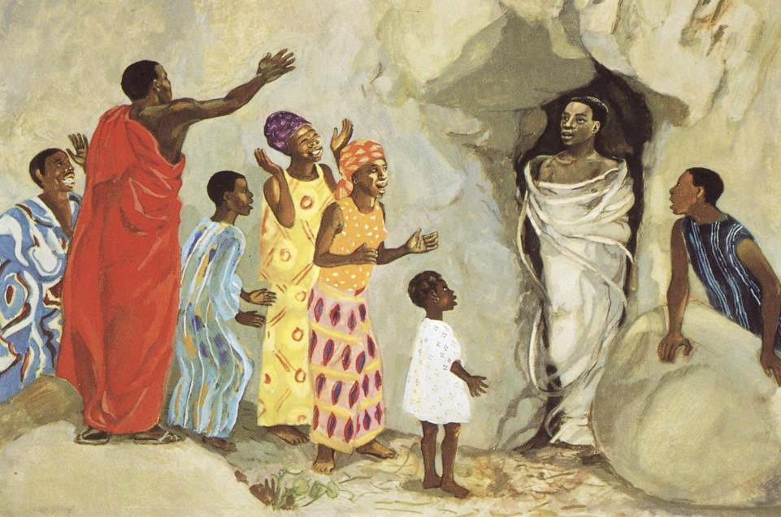
Christ Calls to Lazarus -- JESUS MAFA, Cameroon

Slide 20
The dead man came out, … bound with strips of cloth … Jesus said to them, "Unbind him and let him go."
John 11:44ac

Slide 21
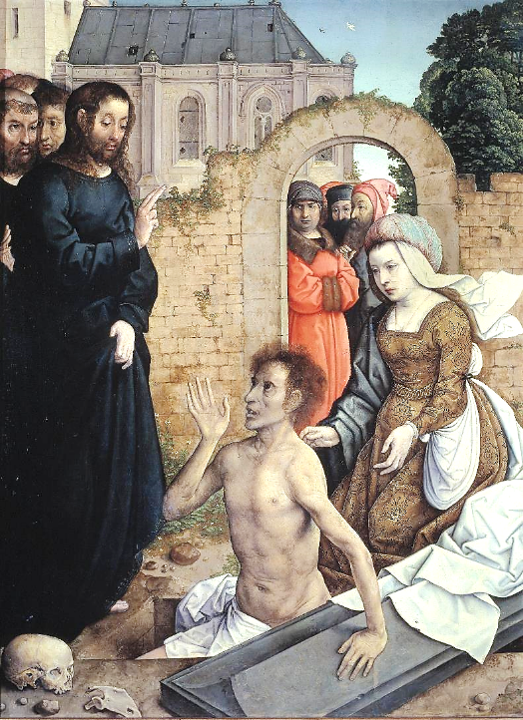
The Resurrection of Lazarus
Juan de Flandes
Museo del Prado
Madrid, Spain
?

Slide 22
Credits
New Revised Standard Version Bible, copyright 1989, Division of Christian Education of the National Council of the Churches of Christ in the United States of America. Used by permission. All rights reserved.
https://www.flickr.com/photos/ecastro/5697805010
https://commons.wikimedia.org/wiki/File:Claude_Monet_-_Shadows_on_the_Sea._The_Cliffs_at_Pourville_-_Google_Art_Project.jpg
https://commons.wikimedia.org/wiki/File:Black_Angels_of_Biddle_Street_03.jpg
http://diglib.library.vanderbilt.edu/act-imagelink.pl?RC=29384s
Estate of Frank Wesley, http://www.frankwesleyart.com/main_page.htm
https://commons.wikimedia.org/wiki/File:Brooklyn_Museum_-_Jesus_Wept_(J%C3%A9sus_pleura)_-_James_Tissot.jpg
https://commons.wikimedia.org/wiki/File:Netherlands-3994_-_Raising_of_Lazarus_(11612472006).jpg – Dennis Jarvis
http://diglib.library.vanderbilt.edu/act-imagelink.pl?RC=51991
http://diglib.library.vanderbilt.edu/act-imagelink.pl?RC=48269
https://commons.wikimedia.org/wiki/File:Juan_de_Flandes_001.jpg
Additional descriptions can be found at the Art in the Christian Tradition image library, a service of the Vanderbilt Divinity Library, http://diglib.library.vanderbilt.edu/. All images available via Creative Commons 3.0 License.

