Slide 1
Transfiguration Sunday
Year A
Exodus 24:12-18 • Psalm 2 or Psalm 99
2 Peter 1:16-21 • Matthew 17:1-9

Slide 2
Then Moses went up on the mountain, and the cloud covered the mountain. Now the appearance of the glory of the LORD was like a devouring fire …
Exodus 24:15, 17a

Slide 3
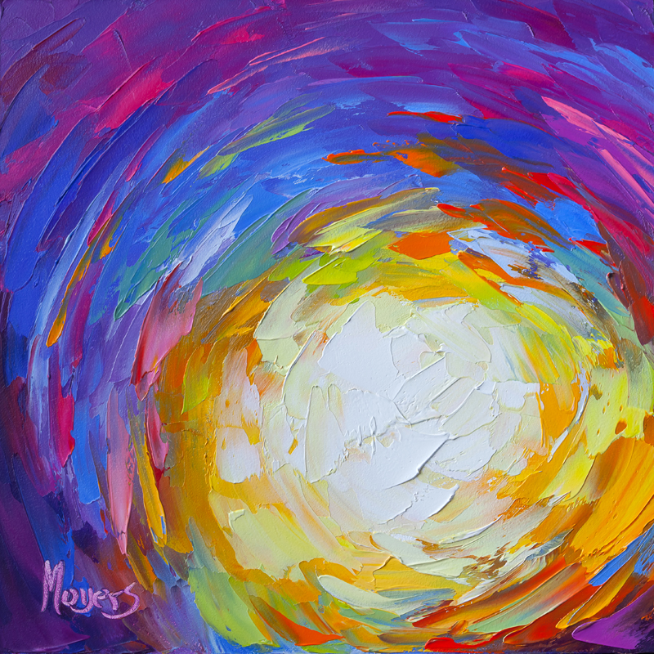
Be Thou My Vision
Mike Moyers

Slide 4
"I have set my king on Zion, my holy hill."
Psalm 2:6

Slide 5
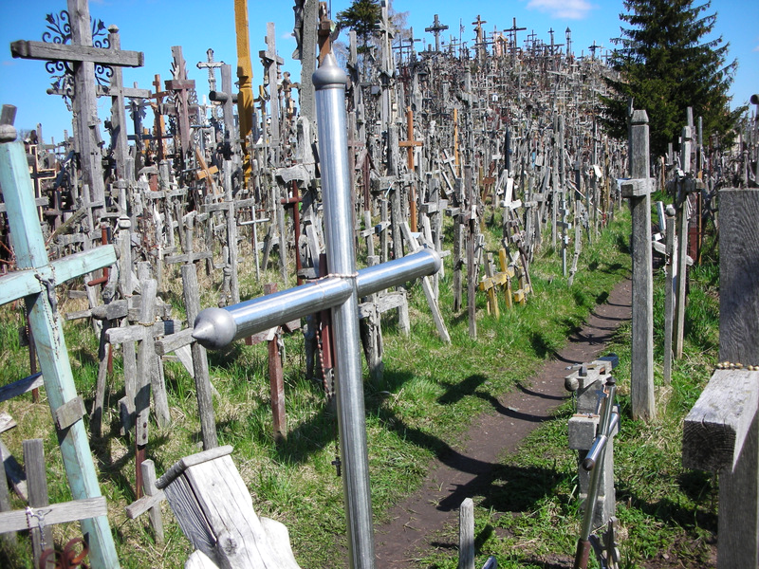
Hill of Crosses -- Saiuilia, Lithuania

Slide 6
… lover of justice,
you have established equity;
you have executed justice and righteousness …
Psalm 99:4b

Slide 7
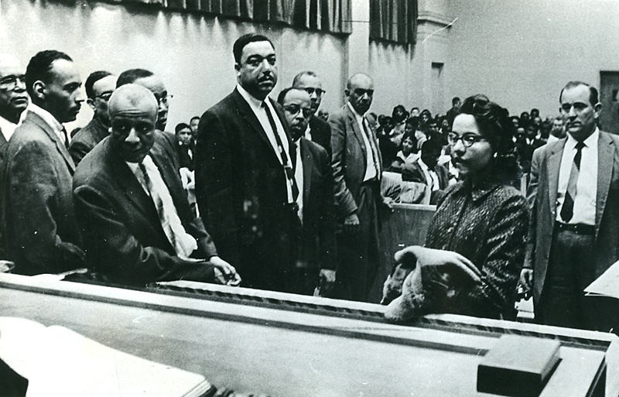
Courtroom Hearing, Civil Rights Protest, Nashville, TN, Vanderbilt Archives

Slide 8
… be attentive to this as to a lamp shining in a dark place, until the day dawns and the morning star rises in your hearts.
2 Peter 1:19b

Slide 9
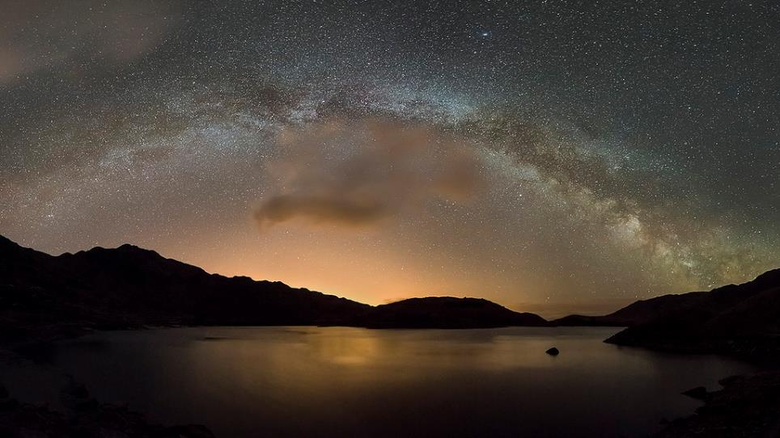
Spirit of the Lake (Milky Way between moon set and sun rise) -- Kris Williams, Llyn Llydaw, Wales

Slide 10
… Jesus took with him Peter and James and his brother John and led them up a high mountain, by themselves.
Matthew 17:1b

Slide 11
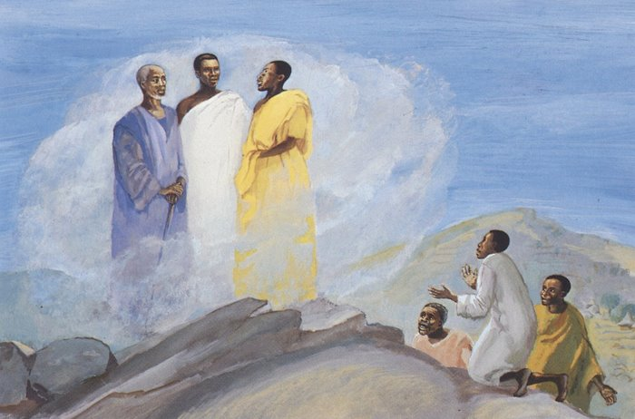
Transfiguration -- JESUS MAFA, Cameroon

Slide 12
And he was transfigured before them, and his face shone like the sun, and his clothes became dazzling white.
Matthew 17:2

Slide 13
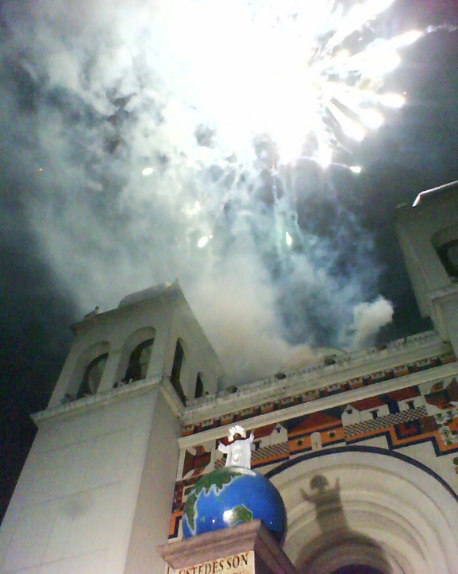
Transfiguracion del Divino Salvador del Mundo
Catedral Metropolitana
San Salvador,
El Salvador

Slide 14
Suddenly there appeared to them Moses and Elijah, talking with him.
Matthew 17:3

Slide 15
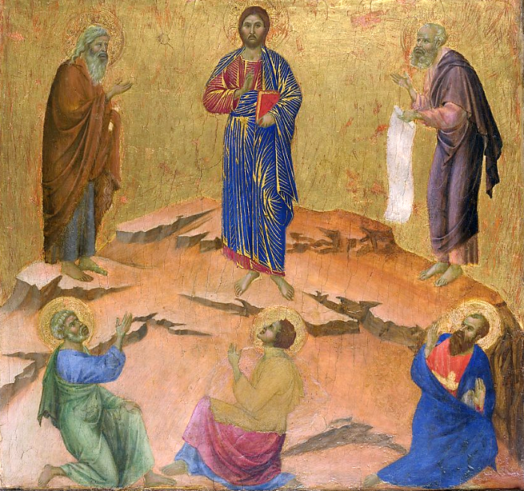
Transfiguration -- Duccio, National Gallery of Art, Washington, DC

Slide 16
Then Peter said to Jesus, "Lord, it is good for us to be here; if you wish, I will make three dwellings here, one for you, one for Moses, and one for Elijah."
Matthew 17:4

Slide 17
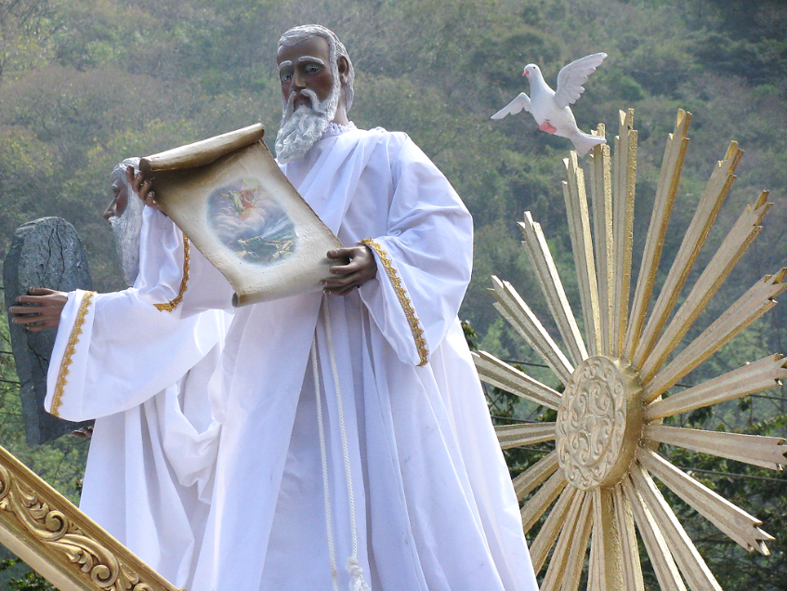
Moses, Procession of the Transfiguration, Mount Tabor, Antigua, Guatemala

Slide 18
… suddenly a bright cloud overshadowed them, and from the cloud a voice said, "This is my Son, the Beloved; with him I am well pleased; listen to him!"
Matthew 17:5

Slide 19
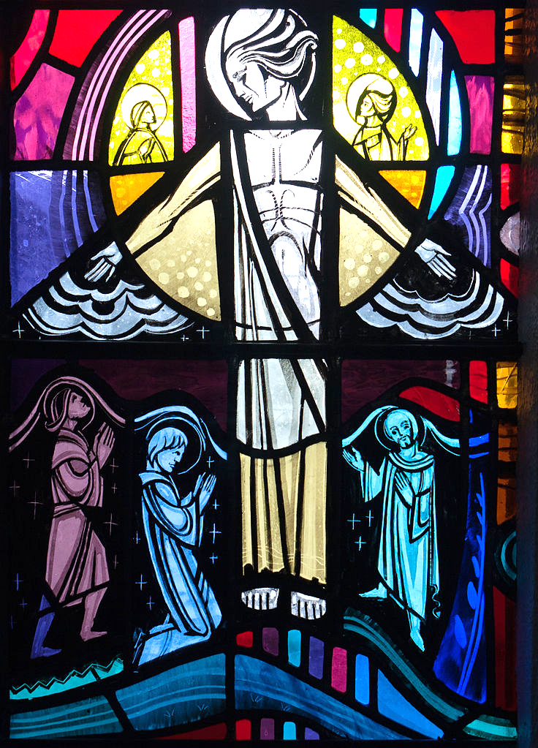
Transfiguration
George Walsh
Most Holy Rosary Church
Tullow, Ireland

Slide 20
When the disciples heard this, they fell to the ground and were overcome by fear.
Matthew 17:6

Slide 21
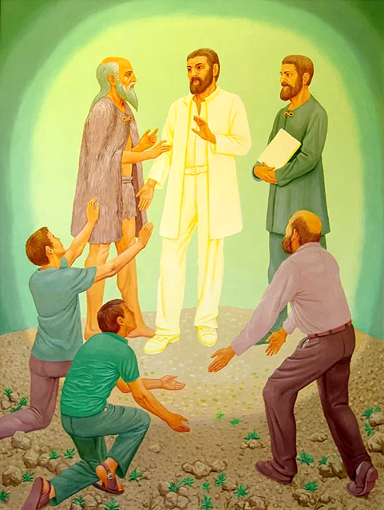
Transfiguration -- Peter Koenig

Slide 22
But Jesus came and touched them, saying, "Get up and do not be afraid."
Matthew 17:7

Slide 23
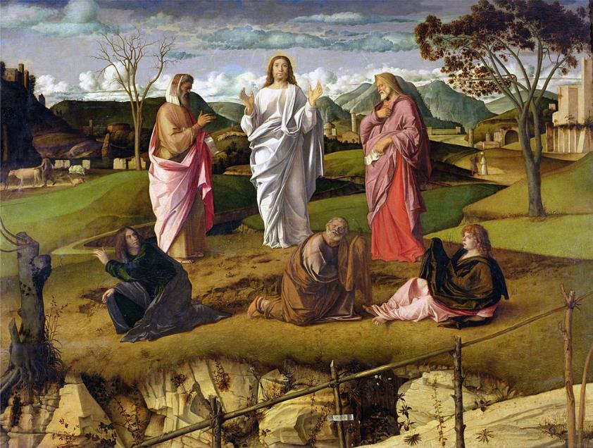
Transfiguration of Christ -- Giovanni Bellini, National Museum of Capiodimonte, Naples, Italy

Slide 24
And when they looked up, they saw no one except Jesus himself alone.
Matthew 17:8

Slide 25
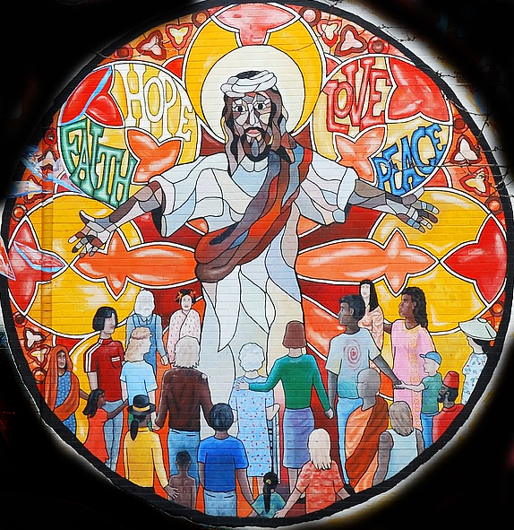
Jesus Mural
In Uptown
Chicago, IL

Slide 26
Credits
New Revised Standard Version Bible, copyright 1989, Division of Christian Education of the National Council of the Churches of Christ in the United States of America. Used by permission. All rights reserved.
https://www.mikemoyersfineart.com/
https://www.flickr.com/photos/benbeiske/2436563279
http://diglib.library.vanderbilt.edu/act-imagelink.pl?RC=54246 – Vanderbilt University Special Collections
https://www.flickr.com/photos/jixxer/17085812878/
http://diglib.library.vanderbilt.edu/act-imagelink.pl?RC=48307; imagn.com
http://commons.wikimedia.org/wiki/File:Transfiguracion_del_Divino_Salvador_del_Mundo.jpg
https://commons.wikimedia.org/wiki/File:Duccio_di_Buoninsegna_039.jpg
http://www.flickr.com/photos/robertourrea7/3344334604/
https://commons.wikimedia.org/wiki/File:Tullow_Church_of_the_Most_Holy_Rosary_South_Transept_Window_Mysteries_of_Light_and_Pope_John_Paul_II_Detail_Transfiguration_2013_09_06.jpg
Peter Winfried (Canisius) Koenig, https://www.pwkoenig.co.uk/
https://commons.wikimedia.org/wiki/File:The-Transfiguration-1480-xx-Giovanni-Bellini.JPG
https://www.flickr.com/photos/36847973@N00/3342340183/
Additional descriptions can be found at the Art in the Christian Tradition image library, a service of the Vanderbilt Divinity Library, http://diglib.library.vanderbilt.edu/. All images available via Creative Commons 3.0 License.

