Slide 1
Third Sunday of Advent
Year A
Isaiah 35:1-10 • Psalm 146:5-10 or Luke 1:46b-55 • James 5:7-10
Matthew 11:2-11

Slide 2
The wilderness and the dry land shall be glad, the desert shall rejoice and blossom...
Isaiah 35:1ab

Slide 3
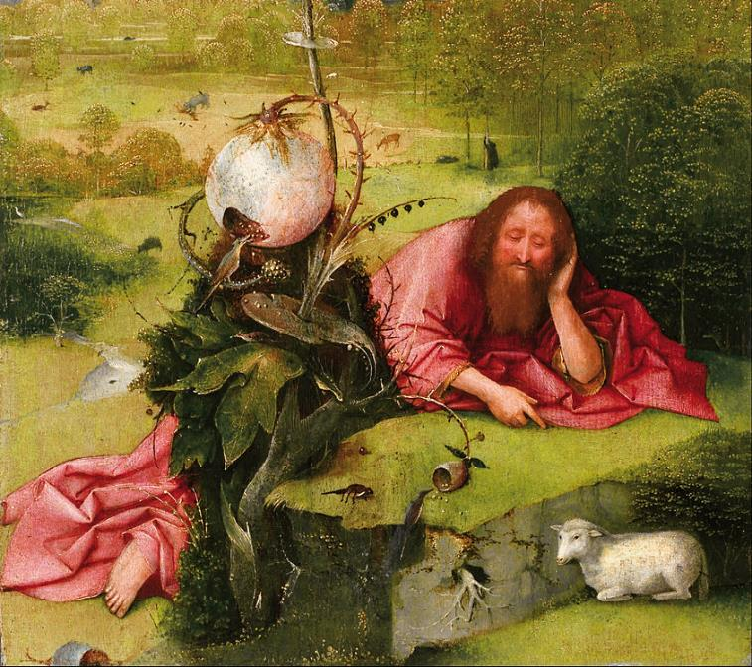
John the Baptist in the Wilderness
Hieronymus Bosch
Museum of Lazaro Galdiano
Madrid, Spain

Slide 4
Then the eyes of the blind shall be opened, and the ears of the deaf unstopped.
Isaiah 35:5

Slide 5
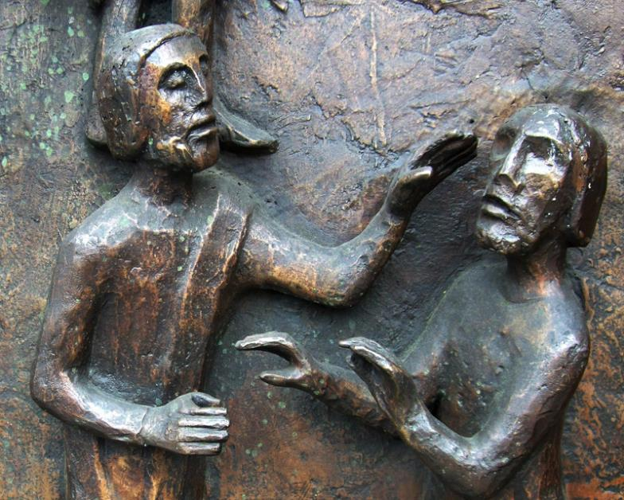
Healing the Sick -- Ulrich Henn, St. James Cathedral, Seattle, WA

Slide 6
And the ransomed of the LORD shall return, and come to Zion with singing…
Isaiah 35:10a

Slide 7
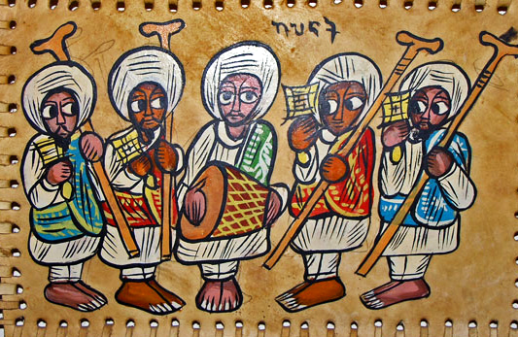
Ethiopian Orthodox Choir -- Paint on stretched leather

Slide 8
…come to Zion with singing; everlasting joy shall be upon their heads...
Isaiah 35:1ab

Slide 9
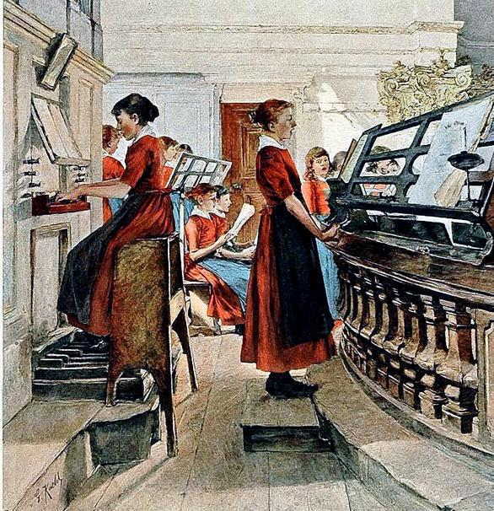
A Mighty Fortress is Our God
Gotthardt Kuehl

Slide 10
…hope is in the LORD…who executes justice for the oppressed; who gives food to the hungry.
Psalm 146:7a

Slide 11
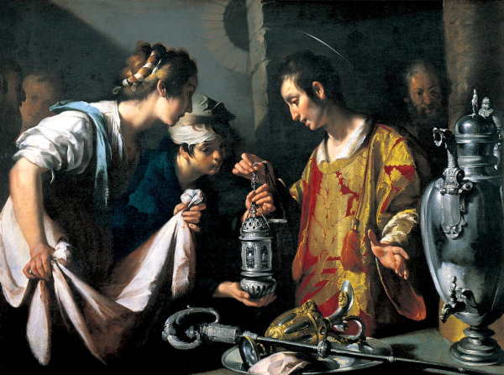
St. Lawrence Distributing the Riches of the Church -- Bernardo Strozzi, St. Louis Art Museum

Slide 12
The LORD watches over the strangers; he upholds the orphan and the widow…
Psalm 146:9a

Slide 13
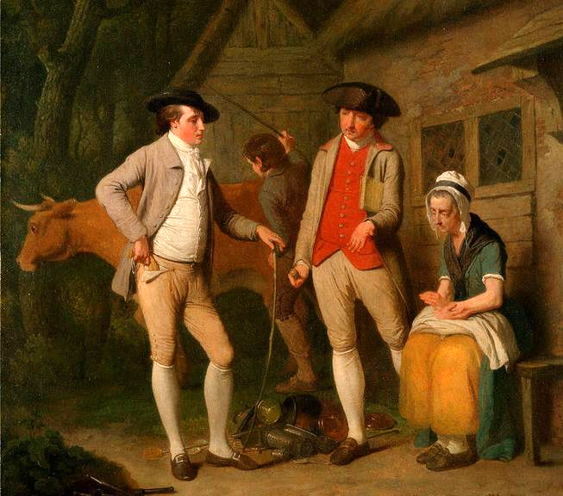
Widow Costard's cow and goods, distrained for taxes, are redeemed by the generosity of Johnny Pearmain
Edward Penney
Yale Center for British Art

Slide 14
"My soul magnifies the Lord, and
my spirit rejoices in God my Savior…”
Luke 1:46b-47

Slide 15
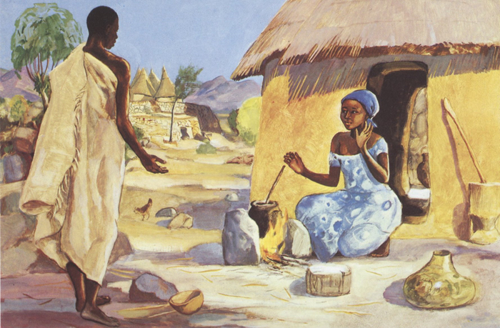
The Annunciation -- JESUS MAFA, Cameroon

Slide 16
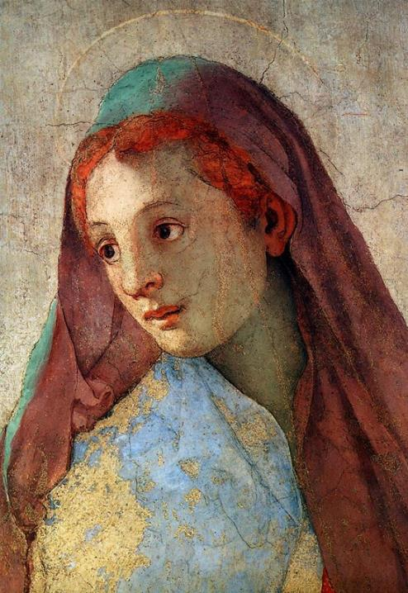
Annuniciation to the Virgin Mary
Jacopo da Pontormo, Chiesa da Santa Felicita
Florence, Italy

Slide 17
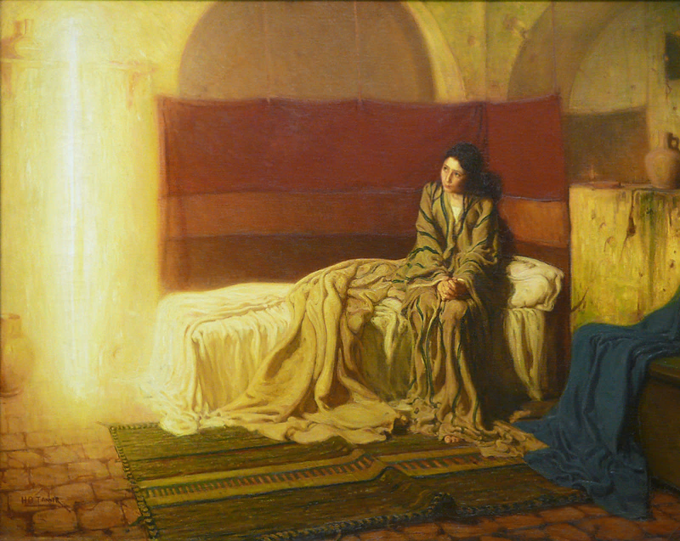
Annunciation -- Henry Ossawa Tanner, Philadelphia Museum of Art

Slide 18
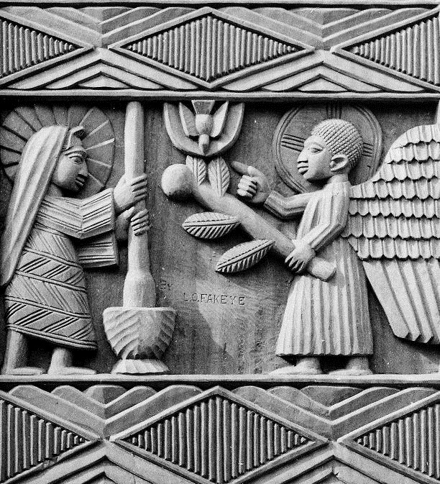
Annunciation to Mary
L. O. Fakeye, photo of carved panel from National Archives

Slide 19
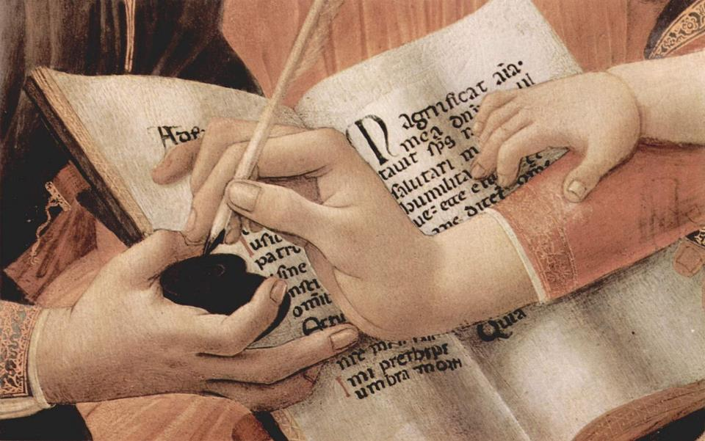
Madonna of the Magnificat -- Botticelli, Uffizi, Florence, Italy

Slide 20
Be patient, therefore, beloved, until the coming of the Lord. The farmer waits for the precious crop from the earth, being patient with it until it receives the early and the late rains.
James 5:7

Slide 21
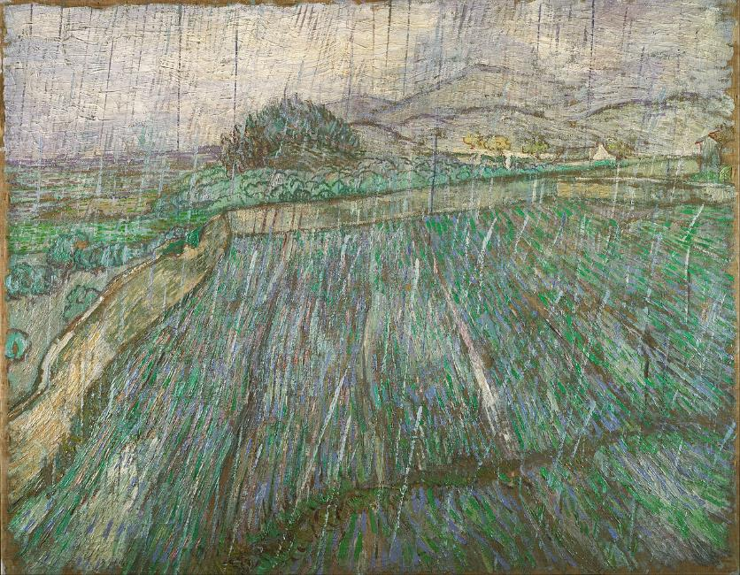
Wheat Field in Rain -- Vincent van Gogh, Philadelphia Museum of Art

Slide 22
the blind receive their sight, the lame walk, the lepers are cleansed, the deaf hear, the dead are raised, and the poor have good news brought to them.
Matthew 11:5

Slide 23
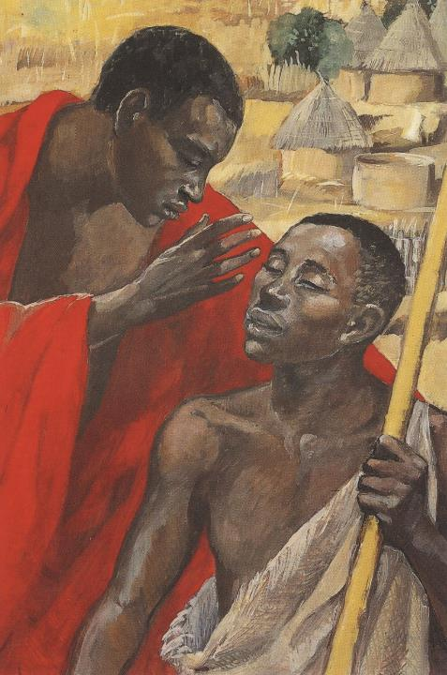
Jesus Cures the Man Born Blind
JESUS MAFA
Cameroon

Slide 24
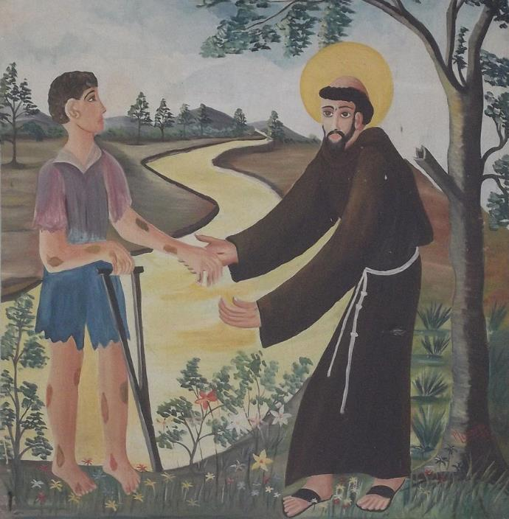
Healing of the Leper
Basilica of St. Francis of the Leper
Caninde, Brazil

Slide 25
Truly I tell you, among those born of women no one has arisen greater than John the Baptist; yet the least in the kingdom of heaven is greater than he.
Matthew 11:11

Slide 26
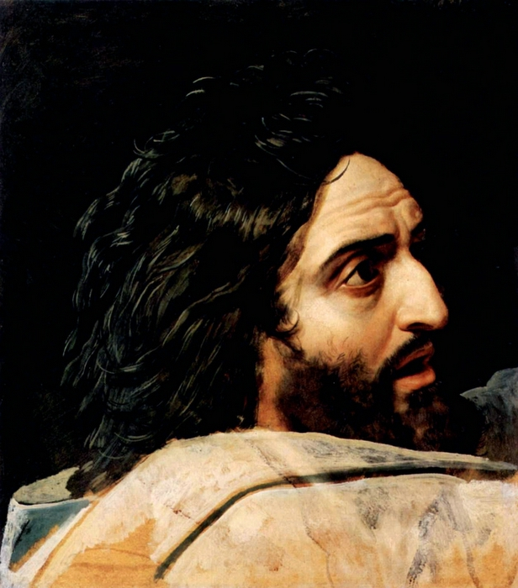
John the Baptist
Aleksandr Ivanov
Tretyakov Gallery Moscow, Russia

Slide 27
Credits
New Revised Standard Version Bible, copyright 1989, Division of Christian Education of the National Council of the Churches of Christ in the United States of America. Used by permission. All rights reserved.
https://commons.wikimedia.org/wiki/File:Hieronymus_Bosch_-_Saint_John_the_Baptist_in_the_Desert_-_Google_Art_Project.jpg
http://www.flickr.com/photos/33392350@N00/2397577578/
http://commons.wikimedia.org/wiki/File:Ethiopian_painting_of_Ethiopian_Orthodox_choir.png
http://commons.wikimedia.org/wiki/File:Gotthardt_Kuehl_Ein_feste_Burg_ist_unser_Gott_crop_balance.jpg
http://commons.wikimedia.org/wiki/File:Bernardo_Strozzi_-_St._Lawrence_Distributing_the_Riches_of_the_Church.jpg
http://commons.wikimedia.org/wiki/File:Edward_Penny_-_Widow_Costard%27s_cow_and_goods,_distrained_for_taxes,_are_redeemed_by_the_generosity_of_Johnny_Pearma..._-_Google_Art_Project.jpg
http://diglib.library.vanderbilt.edu/act-imagelink.pl?RC=48278
http://www.flickr.com/photos/8545333@N07/2236199623/
http://www.flickr.com/photos/ebarney/4762865759/
https://commons.wikimedia.org/wiki/File:%22Annunciation_of_the_Angel_to_Mary%22_-_NARA_-_558880.jpg
http://www.flickr.com/photos/8545333@N07/2236199623/
https://commons.wikimedia.org/wiki/File:Vincent_Willem_van_Gogh,_Dutch_-_Rain_-_Google_Art_Project.jpg
http://www.librairie-emmanuel.fr
https://commons.wikimedia.org/wiki/File:Bas%C3%ADlica_de_S%C3%A3o_Francisco_das_Chagas_(Canind%C3%A9)_-_Casa_dos_Milagres_008.JPG
http://diglib.library.vanderbilt.edu/act-imagelink.pl?RC=46166
Additional descriptions can be found at the Art in the Christian Tradition image library, a service of the Vanderbilt Divinity Library, http://diglib.library.vanderbilt.edu/. All images available via Creative Commons 3.0 License.

