Slide 1
Third Sunday after Epiphany
Year A
Isaiah 9:1-4 • Psalm 27:1, 4-9 • 1 Corinthians 1:10-18
Matthew 4:12-23

Slide 2
The people who walked in darkness have seen a great light;
Isaiah 9:2a

Slide 3
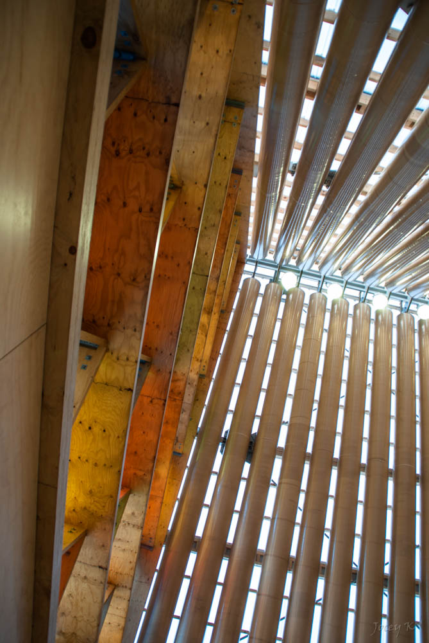
Light from roof of Cardboard Cathedral
Shigeru Ban
Christchurch, New Zealand

Slide 4
…those who lived in a land of deep darkness on them light has shined.
Isaiah 9:2b

Slide 5
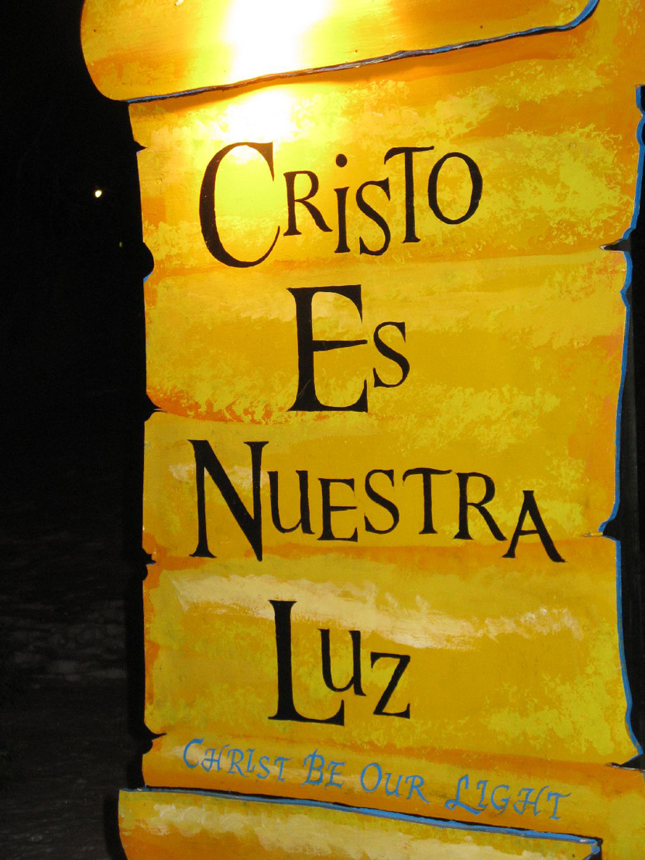
La Salette Festival of Light
Attleboro, MA

Slide 6
The Lord is my light and my salvation; whom shall I fear?
Psalm 27:1

Slide 7
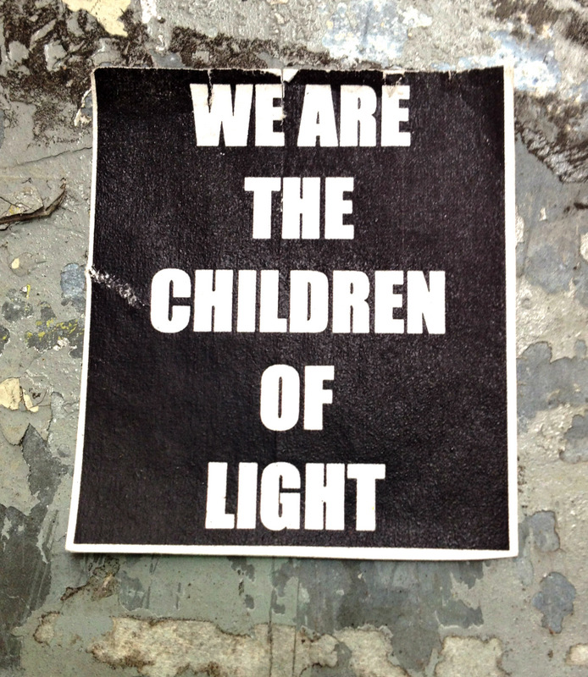
Poster on Wall in Williamsburg
Brooklyn, New York

Slide 8
One thing I asked of the Lord, … to behold the beauty of the Lord…
Psalm 27:4

Slide 9
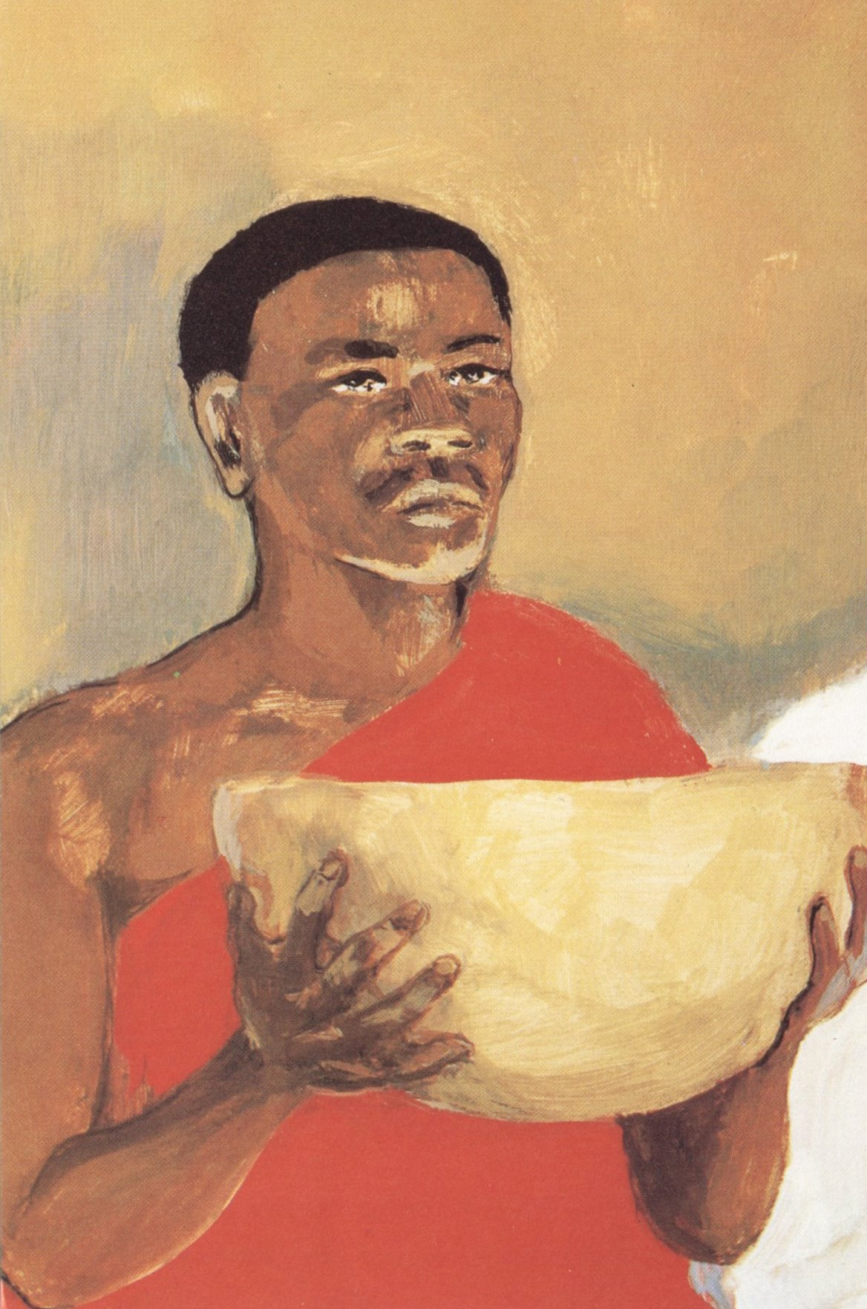
Christ at Table
JESUS MAFA, Cameroon

Slide 10
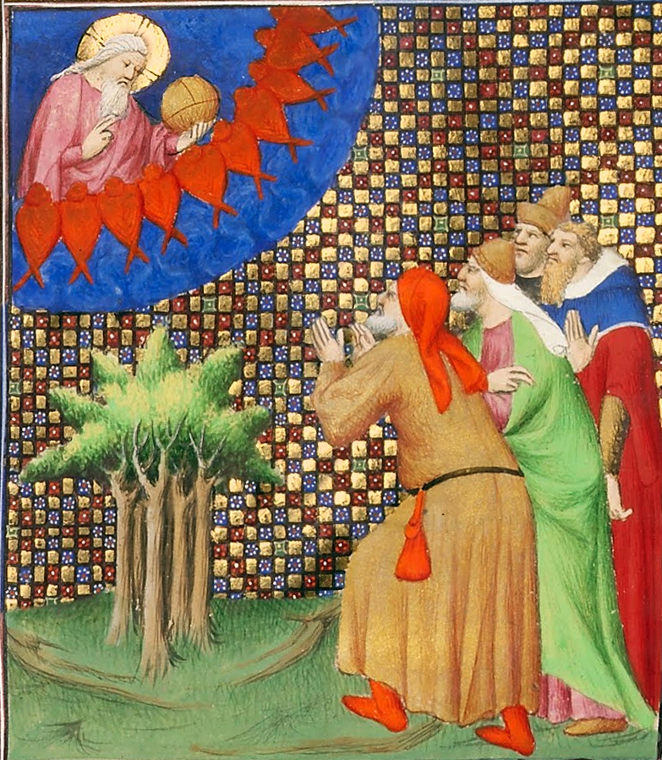
Four Men Kneeling before God
Getty Center, Los Angeles

Slide 11
"Come," my heart says, "seek his face!" Your face, Lord, do I seek.
Psalm 27:8

Slide 12
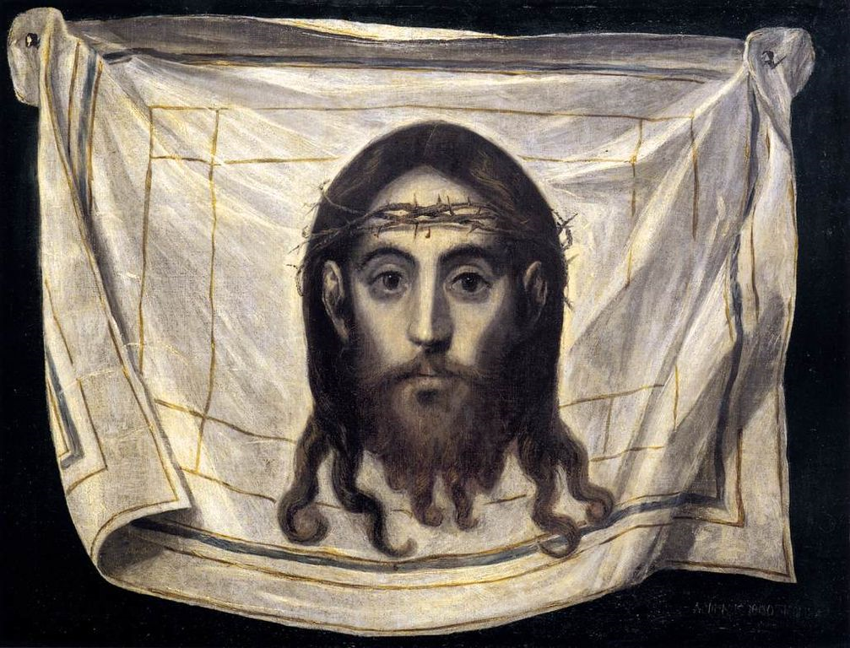
Veil of St. Veronica, detail -- El Greco

Slide 13
Now I appeal to you, brothers and sisters, …that there be no divisions among you, but that you be united in the same mind and the same purpose.
1 Corinthians 1:10

Slide 14
Hands All Together
Avondale Pattillo United Methodist Church
Decatur, GA

Slide 15
As he walked by the Sea of Galilee, he saw two brothers, Simon, who is called Peter, and Andrew his brother, casting a net into the sea for they were fishermen.
Matthew 4:13b

Slide 16
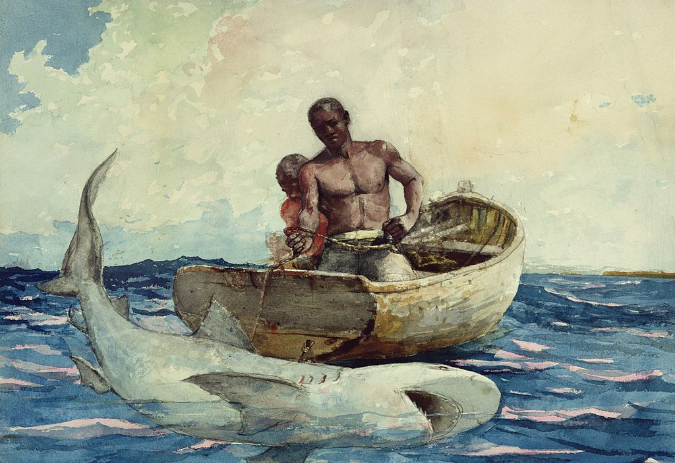
Shark Fishing -- Winslow Homer

Slide 17
And he said to them, "Follow me, and I will make you fish for people."
Matthew 4:19

Slide 18
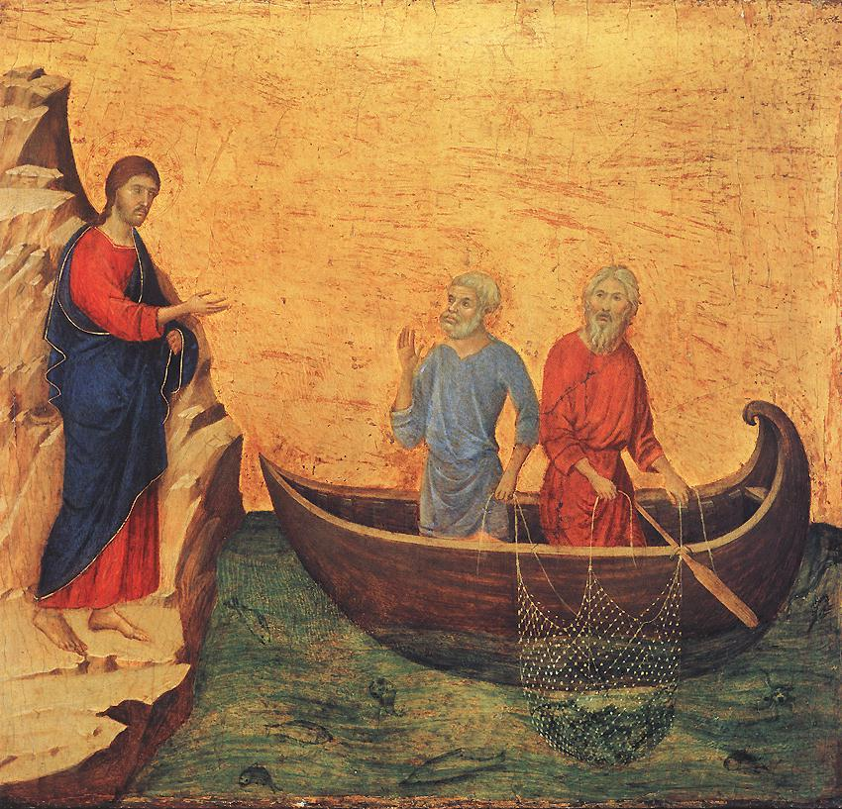
Calling of Peter and Andrew
National Gallery of Art Washington, DC

Slide 19
… he saw two other brothers, James son of Zebedee and his brother John, mending their nets, and he called them.
Matthew 4:21

Slide 20
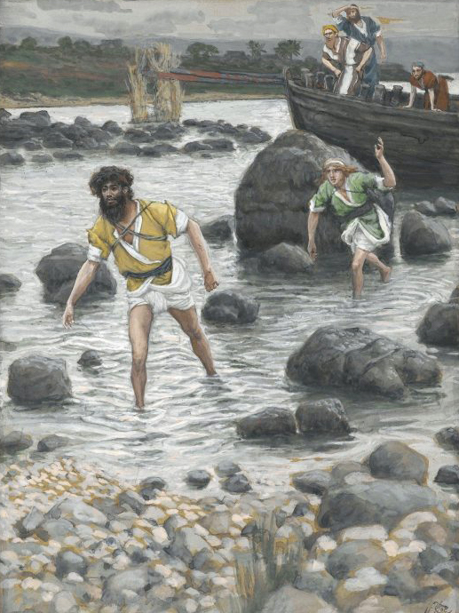
The Calling of James and John
James Tissot
Brooklyn Museum, New York, NY

Slide 21
Jesus went throughout Galilee, teaching in their synagogues and proclaiming the good news of the kingdom…
Matthew 4:23ab

Slide 22
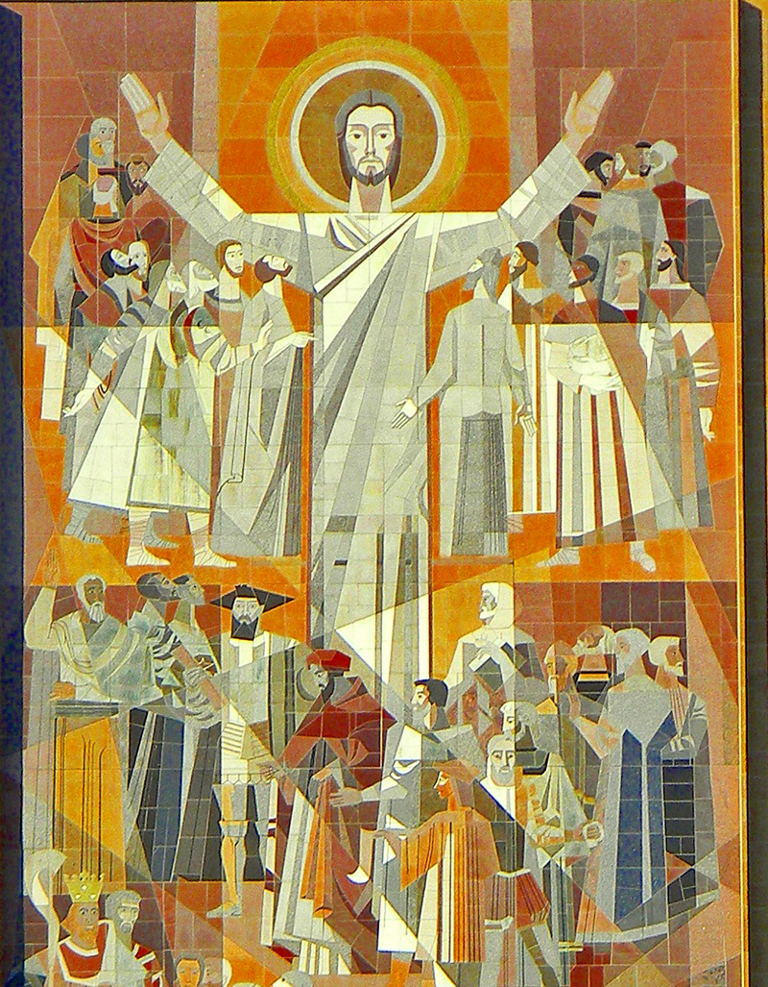
Word of Life Mural
University of Notre Dame
South Bend, IN

Slide 23
…and curing every disease and every sickness among the people.
Matthew 4:23c

Slide 24
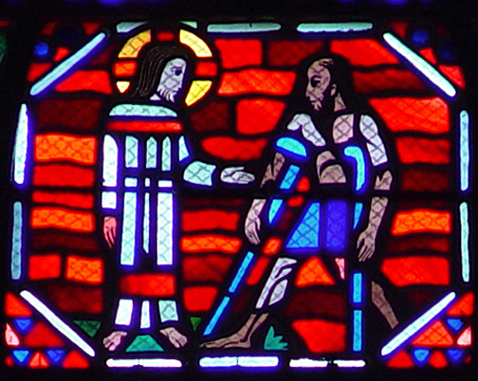
Jesus Heals the Lame -- Jacques Le Breton and Jean Gaudin, Amiens Cathedral

Slide 25
Credits
New Revised Standard Version Bible, copyright 1989, Division of Christian Education of the National Council of the Churches of Christ in the United States of America. Used by permission. All rights reserved.
https://commons.wikimedia.org/wiki/File:Cardboard_Cathedral_lots_of_light.jpg - Jocelyn Kinghorn
http://www.flickr.com/photos/heartlover1717/4141462290/
http://www.flickr.com/photos/lilomoony/6560430275/
http://diglib.library.vanderbilt.edu/act-imagelink.pl?RC=48298
https://commons.wikimedia.org/wiki/File:Four_Men_Kneeling_before_God_-_Google_Art_Project.jpg
https://commons.wikimedia.org/wiki/File:El_Greco_-_The_Veil_of_St_Veronica_-_WGA10461.jpg
http://www.flickr.com/photos/apmethodist/1678695596/
https://commons.wikimedia.org/wiki/File:Winslow_Homer_-_Shark_fishing.jpg
https://commons.wikimedia.org/wiki/File:Duccio_di_Buoninsegna_-_Calling_of_Peter_and_Andrew_-_WGA06774.jpg
https://commons.wikimedia.org/wiki/File:Brooklyn_Museum_-_The_Calling_of_Saint_James_and_Saint_John_(Vocation_de_Saint_Jacques_et_de_Saint_Jean)_-_James_Tissot_-_overall.jpg
http://www.flickr.com/photos/jburzynski68/6221624293/
http://diglib.library.vanderbilt.edu/act-imagelink.pl?RC=51562
Additional descriptions can be found at the Art in the Christian Tradition image library, a service of the Vanderbilt Divinity Library, http://diglib.library.vanderbilt.edu/. All images available via Creative Commons 3.0 License.

