Slide 1
Reign of Christ
Year A
Ezekiel 34:11-16, 20-24 and Psalm 100 • Ezekiel 34:11-16, 20-24 and Psalm 95:1-7a • Ephesians 1:15-23
Matthew 25:31-46

Slide 2
I will seek the lost,
and I will bring back the strayed,
and I will bind up the injured …
Ezekiel 34:16a

Slide 3
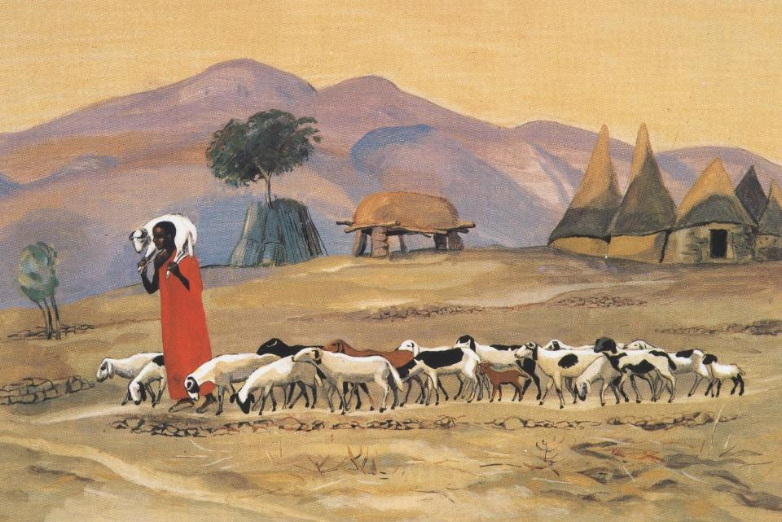
The Good Shepherd -- JESUS MAFA, Cameroon

Slide 4
Make a joyful noise to the LORD,
all the earth.
Psalm 100:1

Slide 5
Making Joyful Noise -- Susan Murtaugh

Slide 6
For he is our God,
and we are the people of his pasture, and the sheep of his hand.
Psalm 95:7a

Slide 7
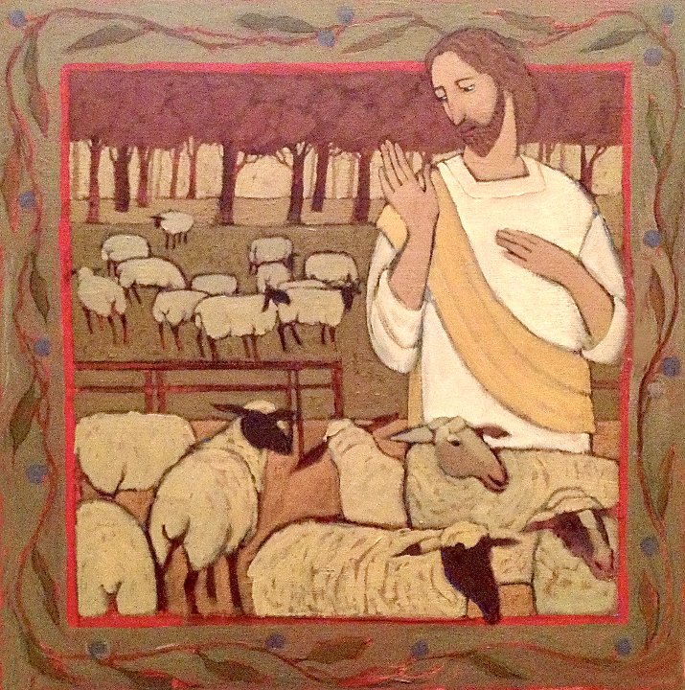
Other Sheep
Kathleen Peterson

Slide 8
I pray that the God of our Lord Jesus Christ … may give you a spirit of wisdom and revelation as you come to know him …
Ephesians 1:17a

Slide 9
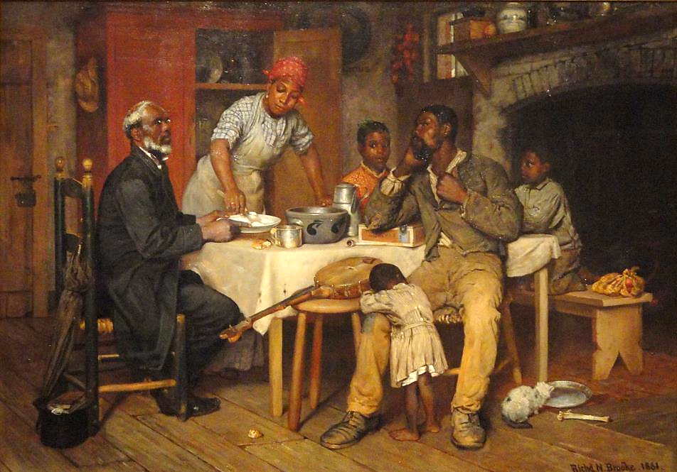
A Pastoral Visit -- Richard Brooke, Corcoran Gallery of Art, Washington, DC

Slide 10
'Lord, when was it that we saw you hungry and gave you food …'
Matthew 25:37a

Slide 11
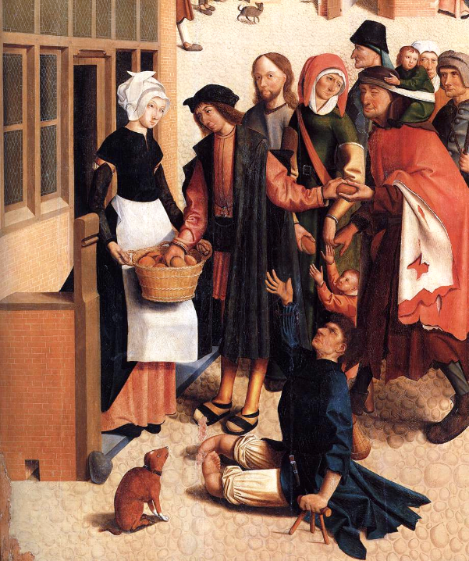
Seven Works of Mercy (with Christ as one of the recipients)
Master of Alkmaar
Rijksmuseum
Amsterdam

Slide 12
'… or thirsty and gave you something to drink?'
Matthew 25:37b

Slide 13
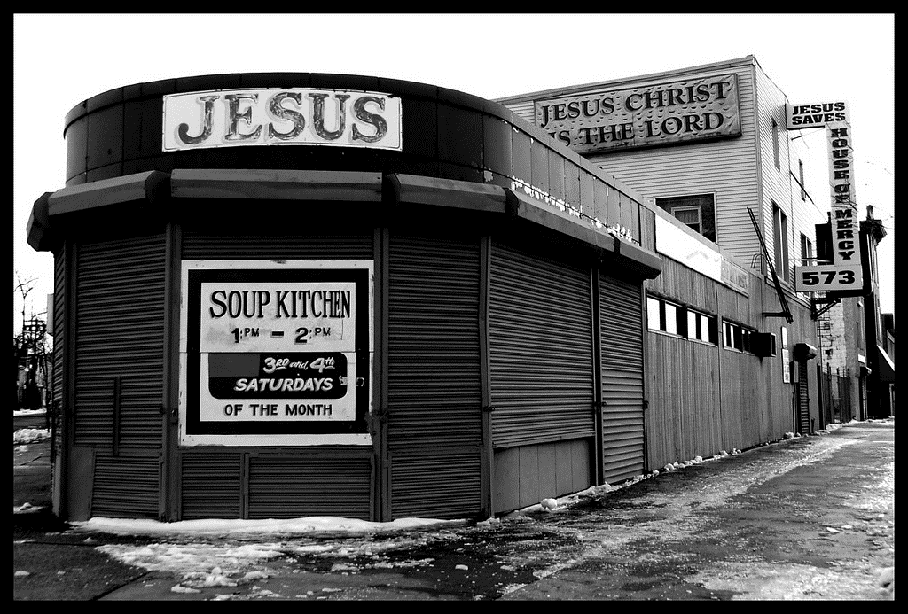
Soup Kitchen at the House of Mercy Church, Winter 2009 -- Tony Fischer, Newark, NJ

Slide 14
'And when was it that we saw you a stranger and welcomed you?'
Matthew 25:38a

Slide 15
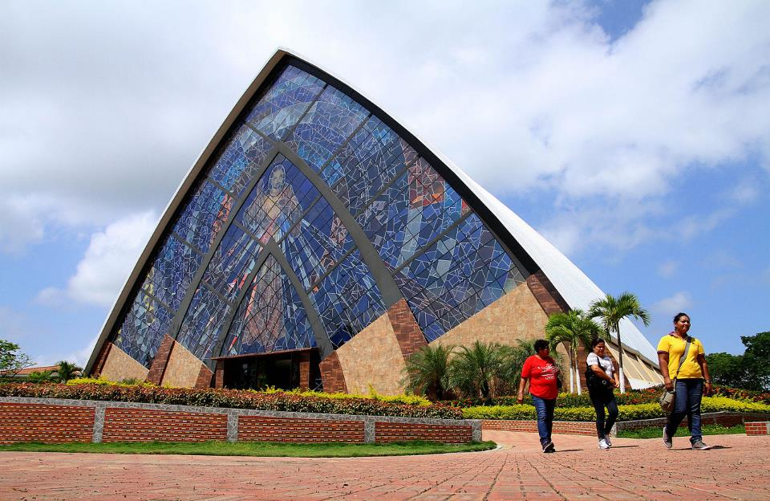
Sanctuary of the Divine Works of Mercy -- Guayaquil, Ecuador

Slide 16
"… or naked and gave you clothing?"
Matthew 25:38b

Slide 17
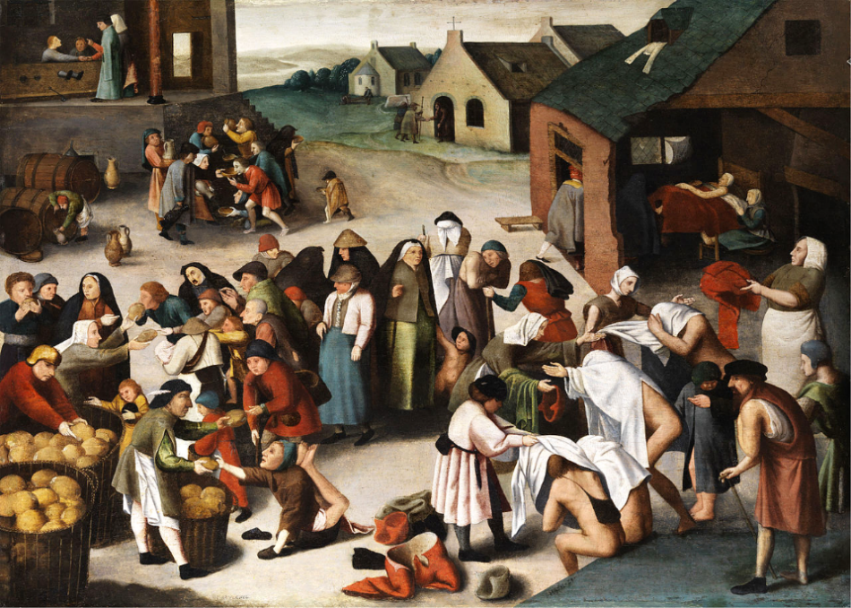
Works of Mercy -- Pieter Bruegel

Slide 18
'And when was it that we saw you sick … and visited you?'
Matthew 25:39ac

Slide 19
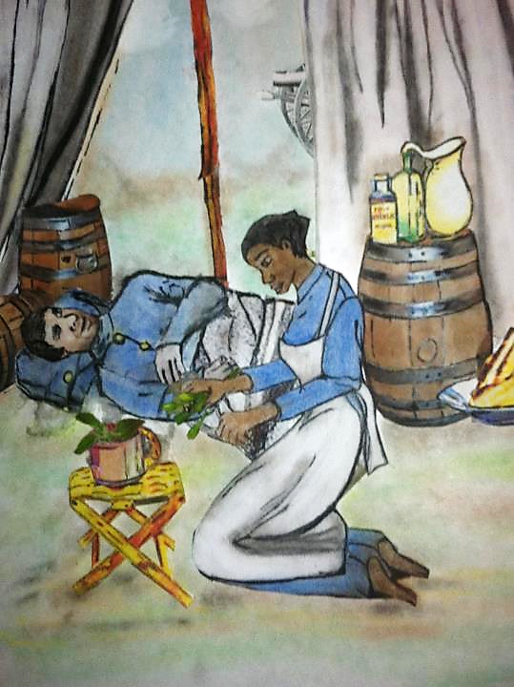
Lucy Higgs Treating Wounded Soldier
Kathy Grant, 2013

Slide 20
'And when was it that we saw you … in prison and visited you?'
Matthew 25:39ac

Slide 21
Seven Works of Mercy
Mural in Diakonie Conference Center
Neuendettelsau, Germany

Slide 22
'Truly I tell you, just as you did it to one of the least of these …, you did it to me.'
Matthew 25:40

Slide 23
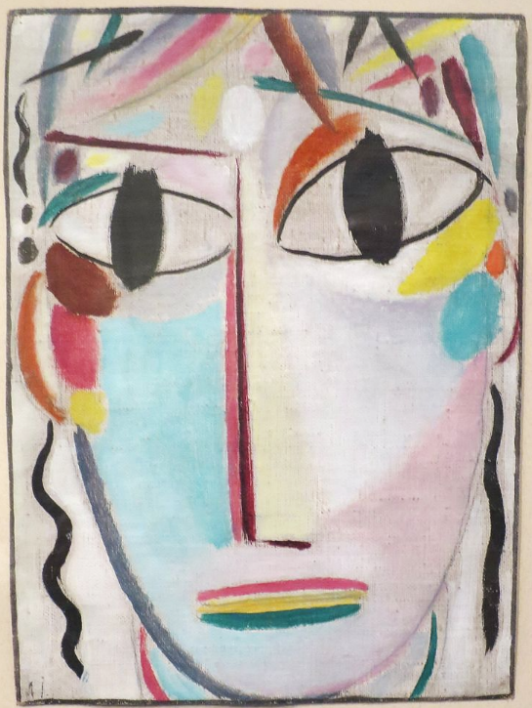
Jesus Christ
Alexi von Jawlensky
Los Angeles County Museum of Art
Los Angeles, CA

Slide 24
Credits
New Revised Standard Version Bible, copyright 1989, Division of Christian Education of the National Council of the Churches of Christ in the United States of America. Used by permission. All rights reserved.
http://diglib.library.vanderbilt.edu/act-imagelink.pl?RC=48288
https://www.flickr.com/photos/suzi54241/26338596572 - Susan Murtaugh
Kathleen Peterson, https://www.kathleenpetersonart.com
https://commons.wikimedia.org/wiki/File:A_Pastoral_Visit,_Virgina,_by_Richard_Norris_Brooke,_1881_-_Corcoran_Gallery_of_Art_-_DSC01173.JPG
https://commons.wikimedia.org/wiki/File:Master_of_Alkmaar_-_The_Seven_Works_of_Mercy_(detail)_-_WGA14368.jpg
https://www.flickr.com/photos/tonythemisfit/3254449443
https://commons.wikimedia.org/wiki/File:Santuario_de_la_Divina_Misericordia_de_Guayaquil_(17613500314).jpg
https://commons.wikimedia.org/wiki/File:Brueghel-Umkreis_Werke_der_Barmherzigkeit.jpg
https://commons.wikimedia.org/wiki/File:Lucy_Higgs_Union_Civil_War_Nurse.JPG
https://commons.wikimedia.org/wiki/File:Diakoniegemaelde_Neuendettelsau.jpg
https://commons.wikimedia.org/wiki/File:%27The_Young_Christ%27_by_Alexej_von_Jawlensky,_1920-21,_LACMA.JPG
Additional descriptions can be found at the Art in the Christian Tradition image library, a service of the Vanderbilt Divinity Library, http://diglib.library.vanderbilt.edu/. All images available via Creative Commons 3.0 License.

