Slide 1
Fourth Sunday after Pentecost
Year A
Genesis 21:8-21 and Psalm 86:1-10, 16-17
Jeremiah 20:7-13 and Psalm 69:7-10, (11-15), 16-18
Romans 6:1b-11
Matthew 10:24-39

Slide 2
Sarah … said to Abraham, "Cast out this slave woman with her son…"
Genesis 21:9a, 22a

Slide 3
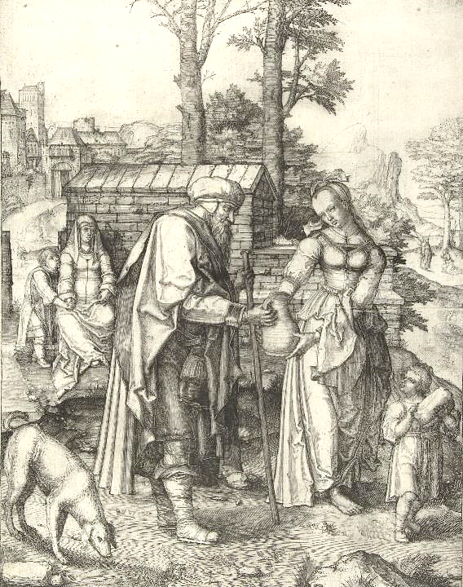
Sarah and Ishmael Depart
Lucas van Leyden
Rijksmuseum
Amsterdam, Netherlands

Slide 4
God said to Abraham, "Do not be distressed because of the boy and because of your slave woman … I will make a nation of him also …"
Genesis 21:12a, 13b

Slide 5
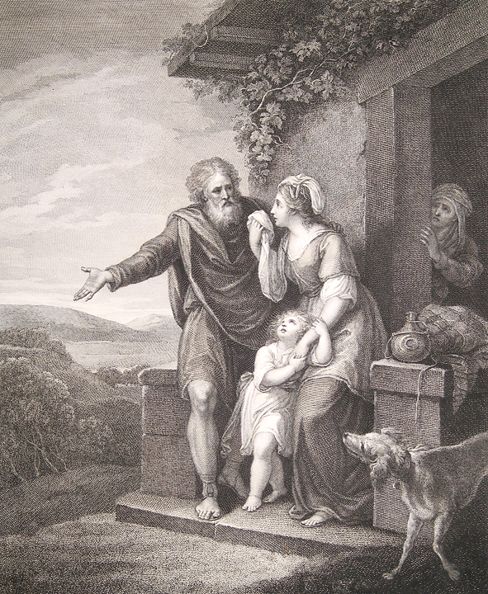
Departure of Hagar and Ishmael
William Hamilton
The Macklin Bible
Jean and Alexander Heard Library
Nashville, TN

Slide 6
"What troubles you, Hagar? Do not be afraid; for God has heard the voice of the boy where he is.
Genesis 21:17b

Slide 7
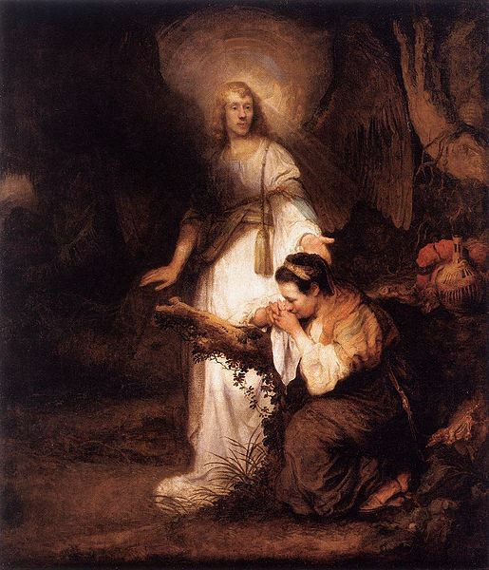
Carel Fabritius
Hagar and the Angel Residenzgalerie Salzburg, Austria

Slide 8
"Come, lift up the boy and hold him fast with your hand…"
Genesis 21:18a

Slide 9
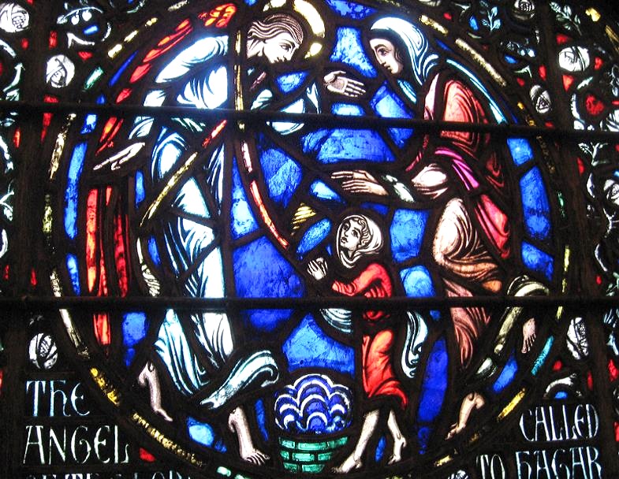
The Angel Called to Hagar -- Westminster Presbyterian Church, Minneapolis, MN

Slide 10
Turn to me and be gracious to me; give your strength to your servant; save the child of your serving girl.
Psalm 86:16

Slide 11
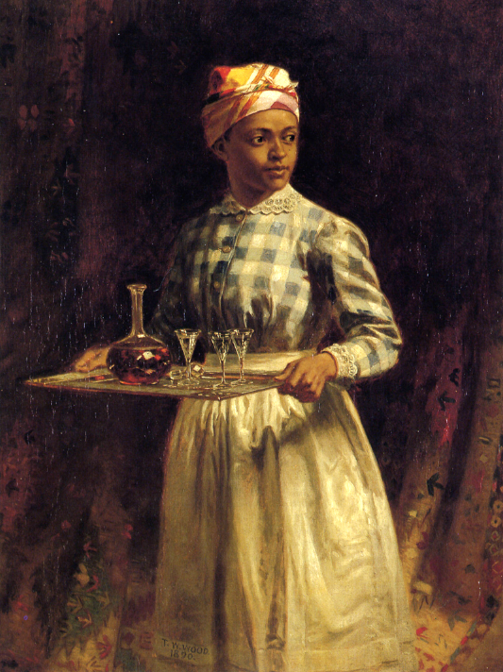
Sherry, Sir?
Thomas Waterman Wood
Detroit Institute of the Arts, Detroit, MI

Slide 12
Sing to the LORD; praise the LORD! For he has delivered the life of the needy …
Jeremiah 20:13

Slide 13
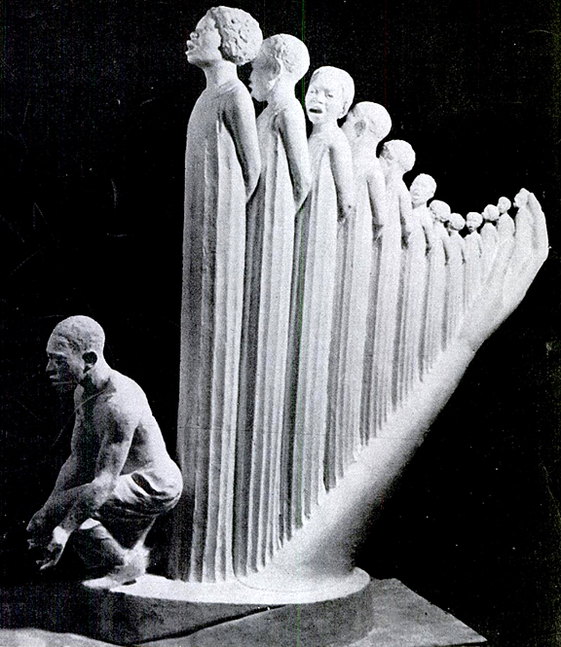
Lift Every Voice and Sing, or, The Harp
Augusta Savage
1939 New York World's Fair

Slide 14
But as for me, my prayer is to you, O LORD. At an acceptable time, O God, in the abundance of your steadfast love, answer me.
Psalm 69:13

Slide 15
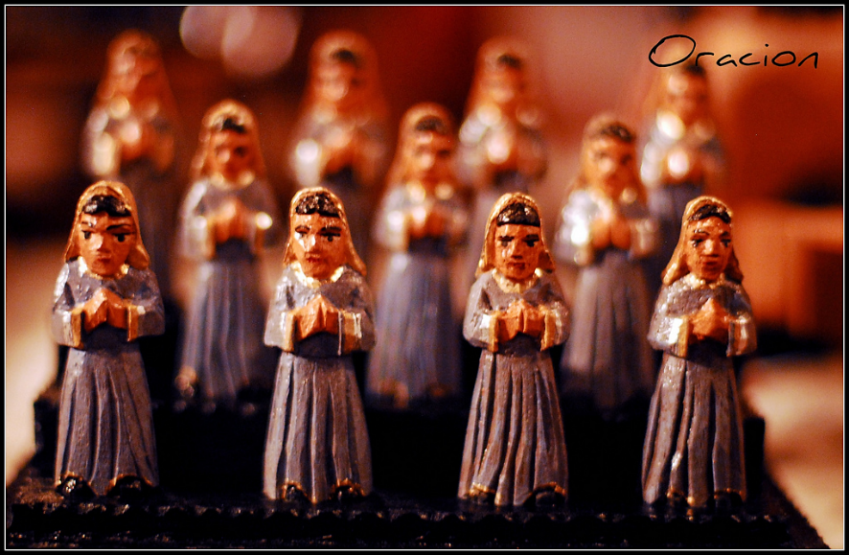
Oracion (Prayer) -- Orta Woodworking, Lakeland, FL

Slide 16
… just as Christ was raised from the dead by the glory of the Father, so we too might walk in the newness of life.
Romans 6:4b

Slide 17
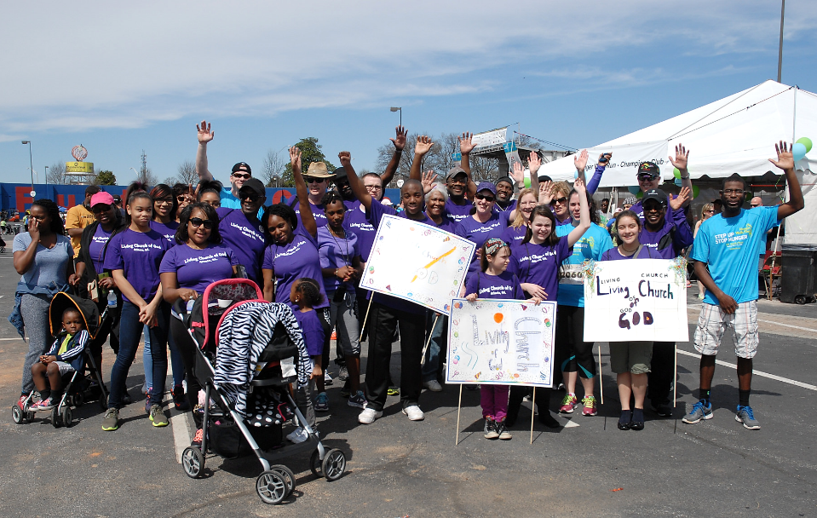
Hunger Walk, Living Church of God, Atlanta, GA

Slide 18
Are not two sparrows sold for a penny? Yet not one of them will fall to the ground apart from your Father.
Matthew 10:29

Slide 19
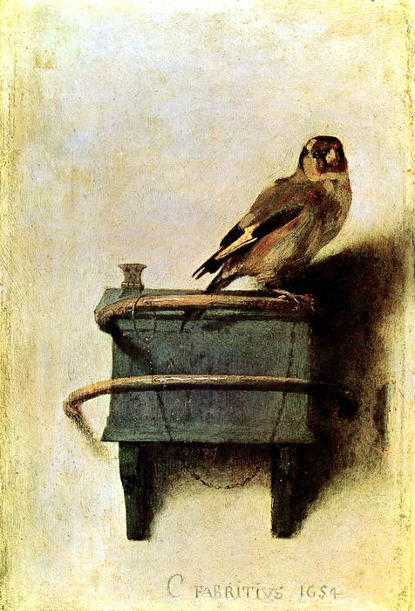
Thistlefinch
Carl Fabritius
Mauritshuis
The Hague, Netherlands

Slide 20
What I say to you in the dark,
tell in the light;
Matthew 10:27a

Slide 21
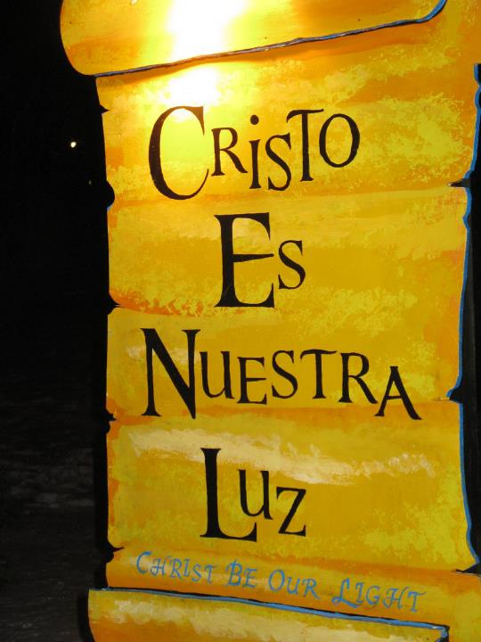
Cristo Es Nuestra Luz
LaSalette Festival of Light
Attleboro, MA

Slide 22
and what you hear whispered, proclaim from the housetops.
Matthew 10:27b

Slide 23
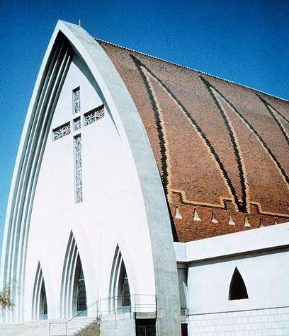
Cathedral of Our Lady of Peace
N'Djamena, Chad

Slide 24
Credits
New Revised Standard Version Bible, copyright 1989, Division of Christian Education of the National Council of the Churches of Christ in the United States of America. Used by permission. All rights reserved.
https://commons.wikimedia.org/wiki/File:Abraham_verstoot_Hagar_en_Isma%C3%ABl,_RP-P-OB-1588.jpg
http://diglib.library.vanderbilt.edu/act-imagelink.pl?RC=54092
https://commons.wikimedia.org/wiki/File:Carel_Fabritius_-_Hagar_and_the_Angel_-_WGA07722.jpg
https://www.flickr.com/photos/wasabijane/5802170479
http://www.flickr.com/photos/freeparking/2224821427/
https://books.google.com/books?id=5VoEAAAAMBAJ&printsec=frontcover&dq=the+crisis+magazine+1939&hl=en&sa=X&ved=0ahUKEwiy8rT1_d_QAhVL8WMKHWw1AKA4ChDoAQgZMAA#v=onepage&q&f=false
https://www.flickr.com/photos/nickodemo/3467666088/- Raphael Alvarez
https://www.flickr.com/photos/acfb/16823029210
http://www.yorckproject.de
http://www.flickr.com/photos/heartlover1717/4141462290/
https://commons.m.wikimedia.org/wiki/File:Church_in_Fort_Lamy,_Chad.jpg
Additional descriptions can be found at the Art in the Christian Tradition image library, a service of the Vanderbilt Divinity Library, http://diglib.library.vanderbilt.edu/. All images available via Creative Commons 3.0 License.

