Slide 1
Second Sunday after Pentecost
Year A
Genesis 12:1-9 and Psalm 33:1-12 • Hosea 5:15-6:6 and Psalm 50:7-15
Romans 4:13-25 • Matthew 9:9-13, 18-26

Slide 2
I will make of you a great nation, and I will bless you, and make your name great, so that you will be a blessing.
Genesis 12:2

Slide 3
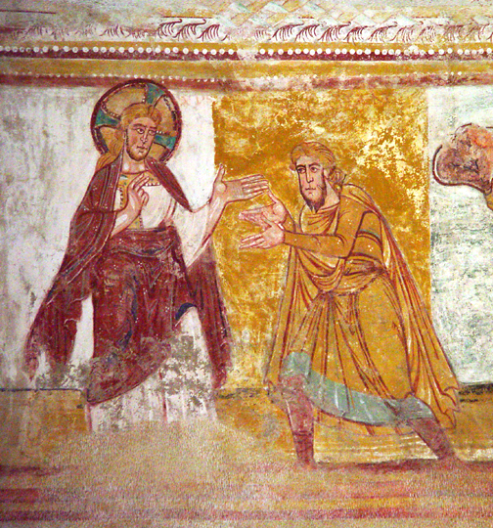
The Calling of Abraham
Abbey of At. Savin
Vienne, France

Slide 4
He loves righteousness and justice; the earth is full of the steadfast love of the Lord.
Psalm 33:5

Slide 5
"Do Justice" -- T-Shirt slogan from Youth Mission trip to Honduras

Slide 6
Let us know, let us press on to know the Lord … he will come to us like the showers, like the spring rains that water the earth.
Hosea 6:3

Slide 7
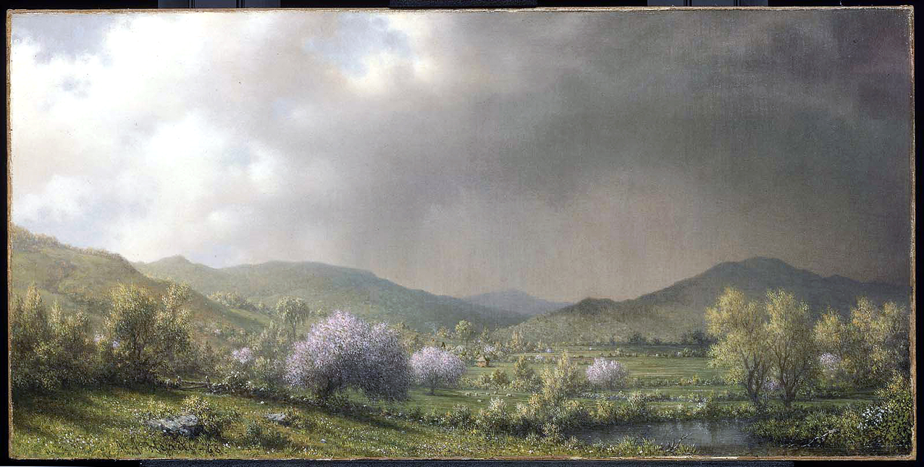
April Showers -- Martin Johnson Heade, Museum of Fine Arts, Boston, MA

Slide 8
"For every wild animal of the forest is mine … I know all the birds of the air, and all that moves in the field … "
Psalm 50:10a-11a

Slide 9
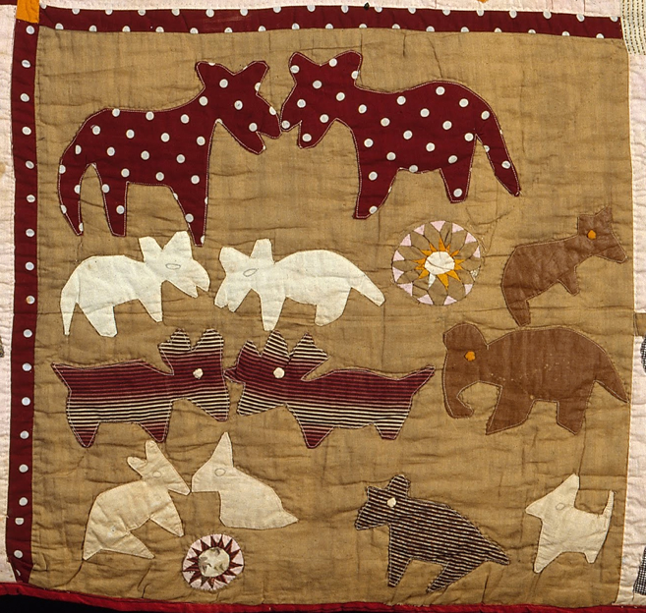
Animals Square from The Bible Quilt -- Harriet Powers, Museum of Fine Arts, Boston , MA

Slide 10
He did not weaken in faith when he considered his own body, which was already as good as dead (for he was about a hundred years old), or when he considered the barrenness of Sarah's womb.
Romans 4:19

Slide 11
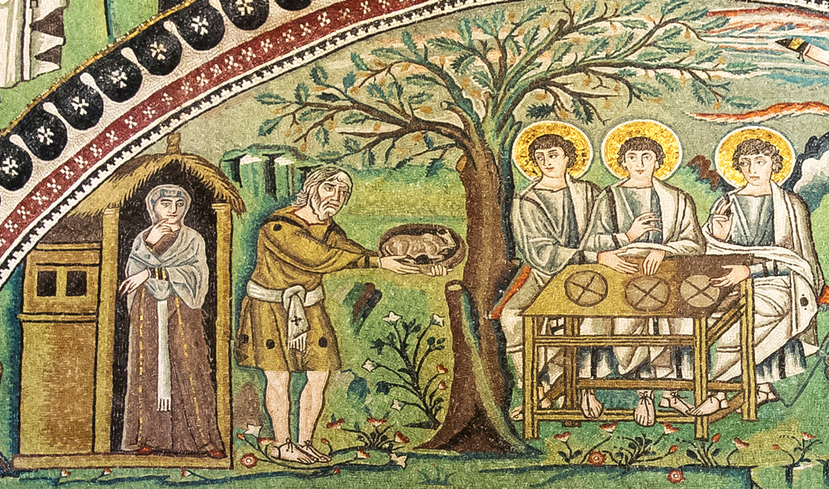
Sarah and Abraham Offer Hospitality to God's Messengers -- San Vitale, Ravenna, Italy

Slide 12
As Jesus was walking along, he saw a man called Matthew sitting at the tax booth; and he said to him, "Follow me." And he got up and followed him.
Matthew 9:9

Slide 13
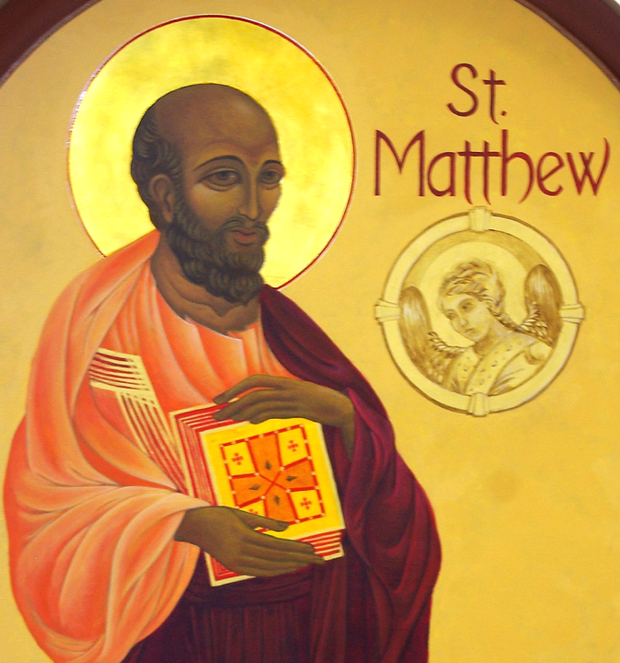
The Apostle Matthew
Christ the King
Ann Arbor, MI

Slide 14
Then suddenly a woman who had been suffering from hemorrhages for twelve years came up behind him and touched the fringe of his cloak,
Matthew 9:20

Slide 15
for she said to herself, "If I only touch his cloak, I will be made well."
Matthew 9:21

Slide 16
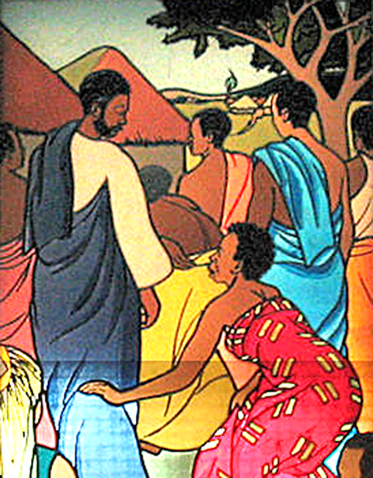
She Touches the Cloak of Jesus -- Stained glass window, Mulungwishi Methodist Church, DR Congo

Slide 17
Jesus turned, and seeing her he said, "Take heart, daughter; your faith has made you well." and instantly the woman was made well.
Matthew 9:22

Slide 18
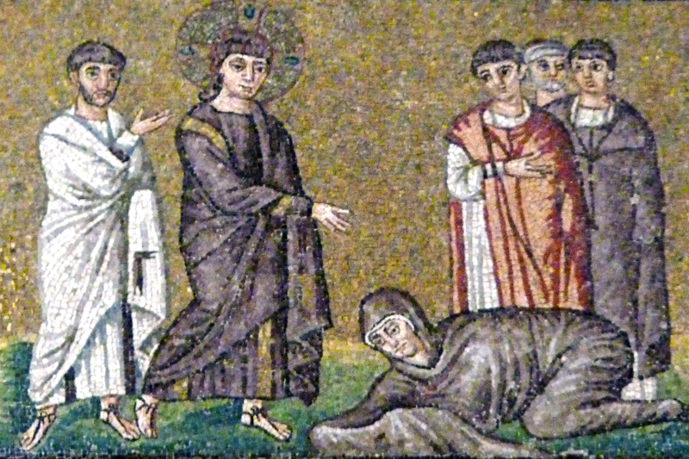
Christ Heals the Woman Who Touched His Cloak -- Sant'Apollinaire Nuovo, Ravenna, Italy

Slide 19
… suddenly a leader of the synagogue came in and knelt before him, saying, "My daughter has just died; but come and lay your hand on her, and she will live."
Matthew 9:18b

Slide 20
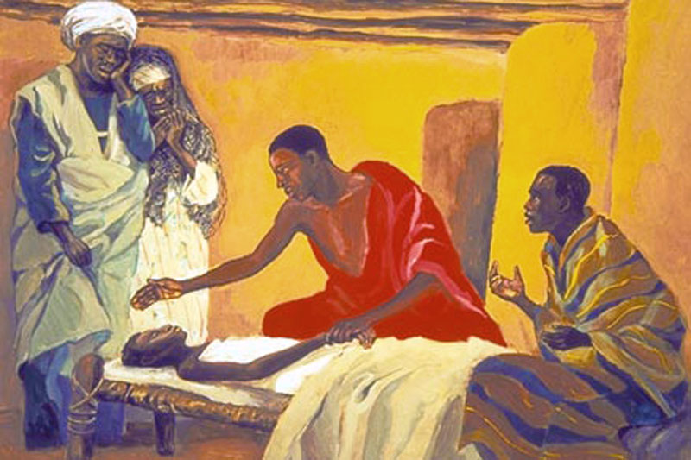
Jesus Raises the Child -- JESUS MAFA, Cameroon

Slide 21
When Jesus came to the leader's house and saw the flute players and the crowd making a commotion,
he said, "Go away; for the girl is not dead but sleeping." And they laughed at him.
Matthew 9:23-24

Slide 22
But when the crowd had been put outside, he went in and took her by the hand, and the girl got up.
And the report of this spread throughout that district.
Matthew 9:25-26

Slide 23
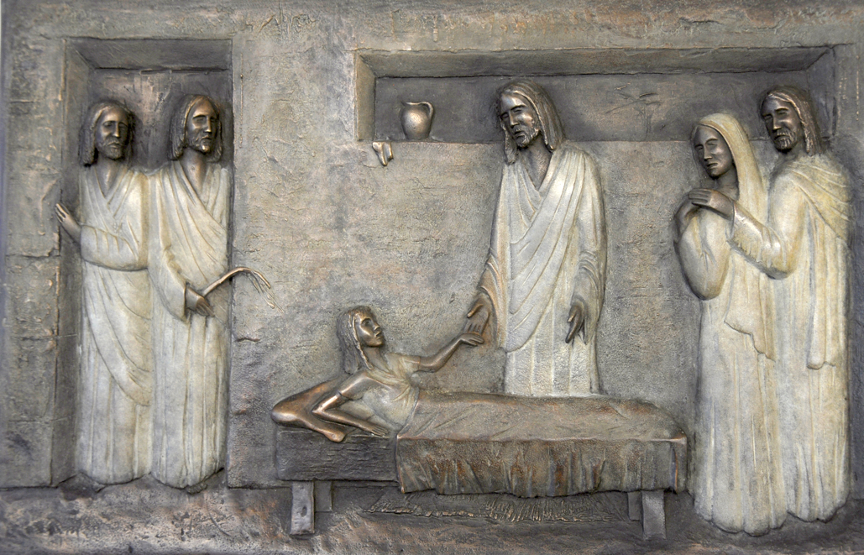
Jesus Raises the Daughter to Life -- National Children's Hospital, Tallaght, Dublin, Ireland

Slide 24
Credits
New Revised Standard Version Bible, copyright 1989, Division of Christian Education of the National Council of the Churches of Christ in the United States of America. Used by permission. All rights reserved.
Creative Commons Attribution ShareAlike - CC-BY-SA-3.0
http://www.flickr.com/photos/lorenabuena/343060350/
https://commons.wikimedia.org/wiki/File:Martin_Johnson_Heade_-_April_Showers_-_47.1173_-_Museum_of_Fine_Arts.jpg
https://commons.wikimedia.org/wiki/File:Harriet_Powers_-_Pictorial_quilt_-_Google_Art_Project.jpg
https://commons.wikimedia.org/wiki/File:Ravenna_Basilica_of_San_Vitale_mosaic2.jpg
https://commons.wikimedia.org/wiki/File:Christ_the_King_Catholic_Church_(Ann_Arbor,_Michigan)_-_interior,_Gospel_mural,_Saint_Matthew.jpg
https://www.flickr.com/photos/umccongo/2188556416
https://www.flickr.com/photos/damiavos/14125575880
http://www.librairie-emmanuel.fr
http://www.flickr.com/photos/feargal/6410830967/
Additional descriptions can be found at the Art in the Christian Tradition image library, a service of the Vanderbilt Divinity Library, http://diglib.library.vanderbilt.edu/. All images available via Creative Commons 3.0 License.

