Slide 1
Twenty-Second Sunday after Pentecost
Year A
Deuteronomy 34:1-12 and Psalm 90:1-6, 13-17 • Leviticus 19:1-2, 15-18 and Psalm 1 • 1 Thessalonians 2:1-8 Matthew 22:34-46

Slide 2
Never since has there arisen a prophet in Israel like Moses, whom the LORD knew face to face.
Exodus 34:10

Slide 3
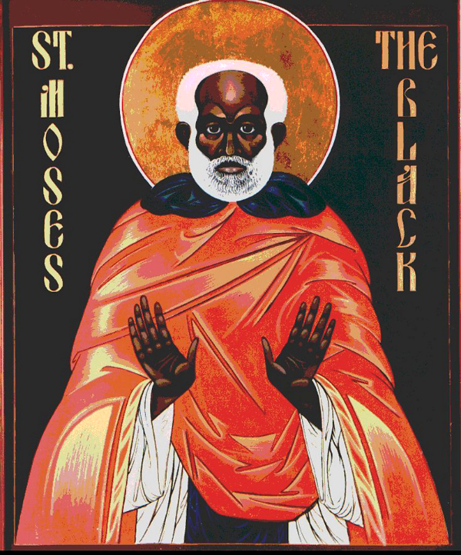
Moses the Black,
early 5th century
Contemporary icon

Slide 4
For a thousand years in your sight are like yesterday when it is past … You sweep them away; they are like a dream …
Psalm 90:4, 5a

Slide 5
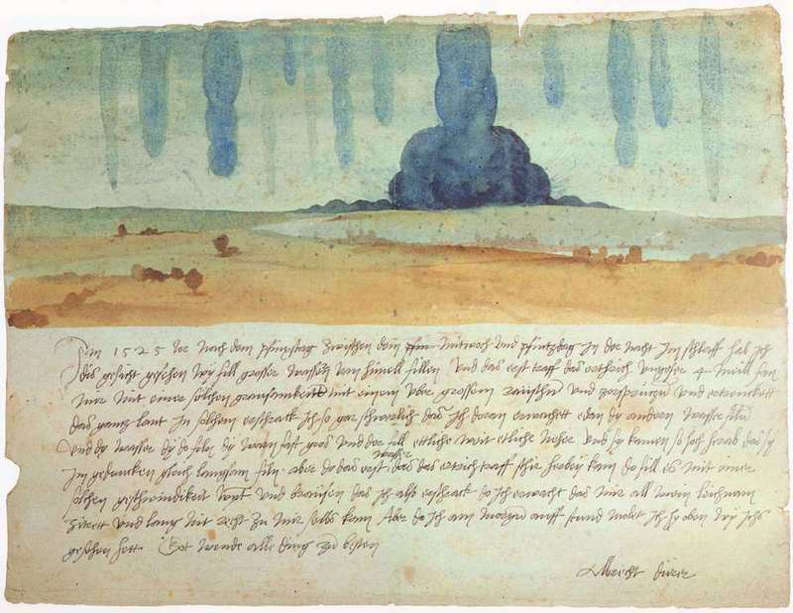
Dream Vision -- Albrecht Durer, Kunsthistorisches Museum, Vienna, austria

Slide 6
… you shall love your neighbor as yourself: I am the LORD.
Leviticus 19:18b

Slide 7
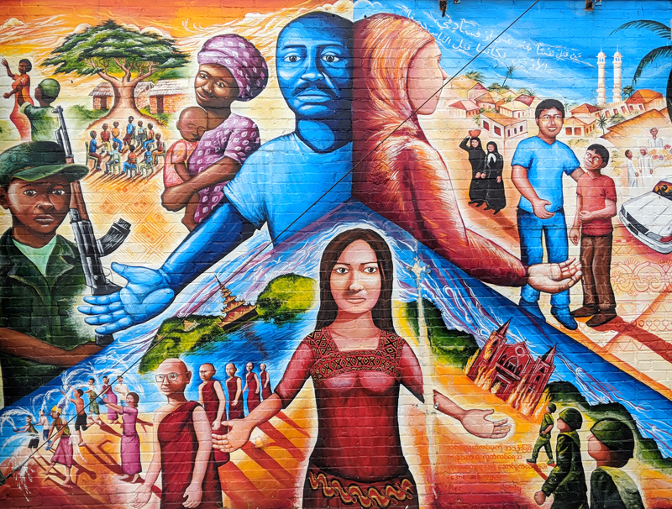
Global Refugee Mural -- Joel Bergner, Silver Spring, MD

Slide 8
Happy are those who do not sit in the seat of scoffers … they are like trees planted by streams of water, which yield their fruit in its season …
Psalm 1:1ac, 3a

Slide 9
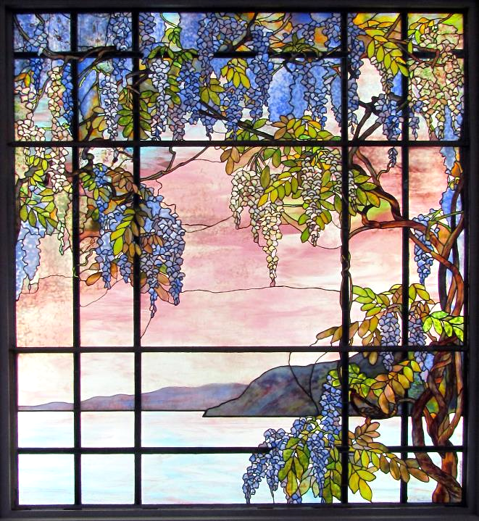
View of Oyster Bay
Tiffany Studios Metropolitan Museum of Art, New York, NY

Slide 10
So deeply do we care for you that we are determined to share not only the gospel of God …
1 Thessalonians 2:8a

Slide 11
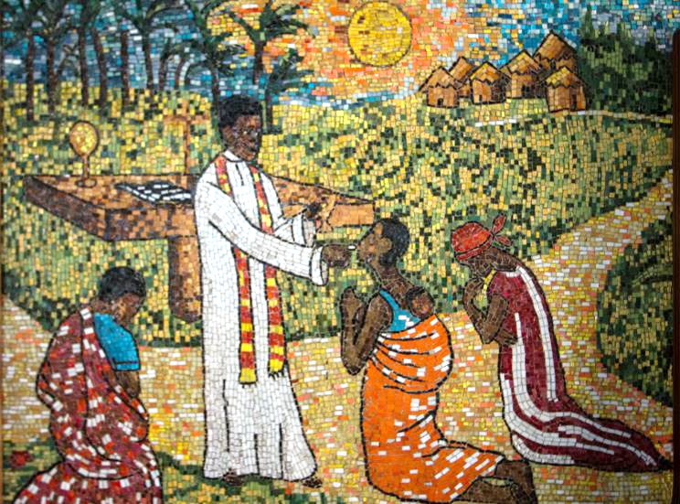
Sharing Communion -- Cathedral of St. Paul, Abidjan, Ivory Coast

Slide 12
… but also our own selves, because you have become very dear to us.
1 Thessalonians 2:8b

Slide 13
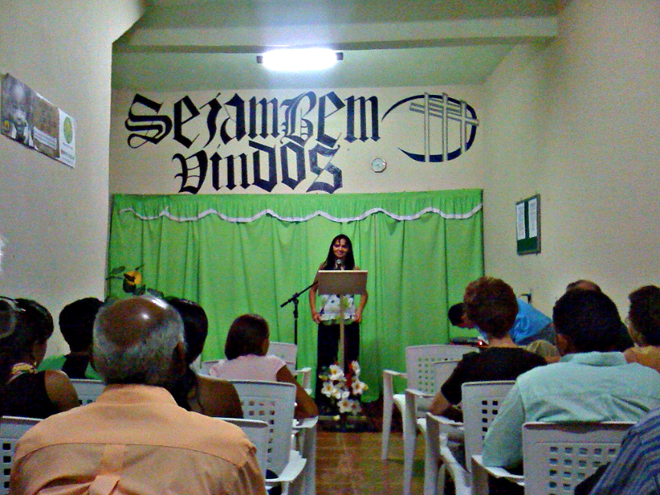
"Everyone is Welcome" -- Calvary Baptist Church, Brazil, Indiana

Slide 14
… one of them … asked him a question to test him. "Teacher, which commandment in the law is the greatest?"
Matthew 22:35a, 36

Slide 15
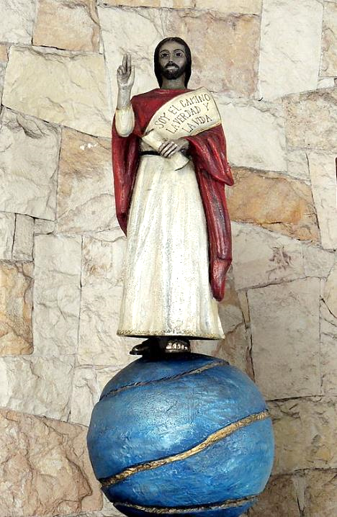
Christ as The Way, The Truth, The Life
Mar del Plata,
Argentina

Slide 16
He said to him, "You shall love the Lord your God with all your heart, and with all your soul, and with all your mind."
Matthew 22:37

Slide 17
Wooden Sign, Doi Inthanon National Park, Thailand

Slide 18
This is the greatest and first commandment. And a second is like it: 'You shall love your neighbor as yourself.'
Matthew 22:38a, 39

Slide 19
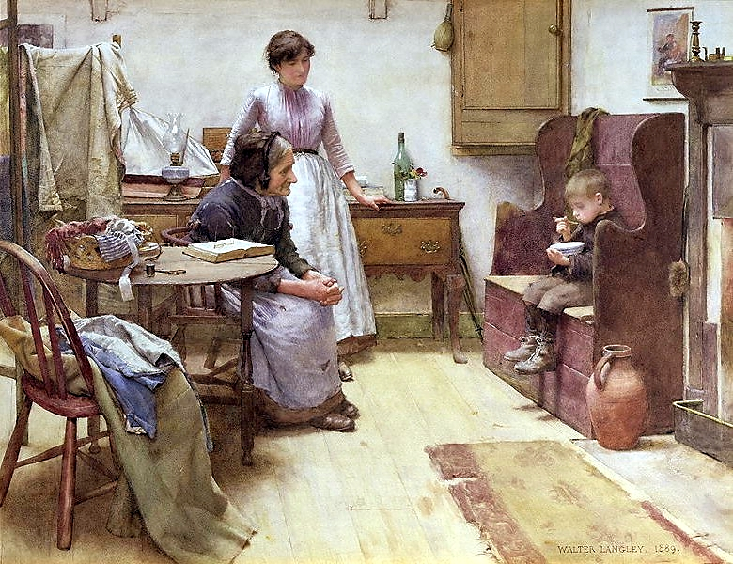
The Waif -- Walter Langley

Slide 20
On these two commandments hang all the law and the prophets."
Matthew 22:40

Slide 21
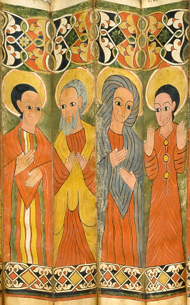
Prophets and Prophetesses, detail
Folds from Ethiopian Processional Icon
Walters Art Museum
Baltimore, MD

Slide 22
Credits
New Revised Standard Version Bible, copyright 1989, Division of Christian Education of the National Council of the Churches of Christ in the United States of America. Used by permission. All rights reserved.
http://www.flickr.com/photos/jimforest/159476385/
http://commons.wikimedia.org/wiki/File:Traumgesicht,_Albrecht_D%C3%BCrer_dokumentiert_einen_seiner_Albtr%C3%A4ume_(1525).jpg
https://joelartista.com/about/
https://www.flickr.com/photos/bobistraveling/6886465855
https://www.flickr.com/photos/carsten_tb/39169356530 - Carsten ten Brink
https://www.flickr.com/photos/rhruzek/4113869854 - Robert Hruzek
https://commons.wikimedia.org/wiki/File:Jesucristo-CapillaDivinoRostro-MDP.jpg
https://www.flickr.com/photos/mastababa/2398441001/
https://commons.wikimedia.org/wiki/File:Walter_Langley_-_The_Waif_1889.jpg
https://commons.wikimedia.org/wiki/File:Ethiopian_-_Folding_Processional_Icon_in_the_Shape_of_a_Fan_-_Walters_369_-_Open.jpg
Additional descriptions can be found at the Art in the Christian Tradition image library, a service of the Vanderbilt Divinity Library, http://diglib.library.vanderbilt.edu/. All images available via Creative Commons 3.0 License.

