Slide 1
Twenty-First Sunday after Pentecost
Year A
Exodus 33:12-23 and Psalm 99 • Isaiah 45:1-7 and Psalm 96:1-9, (10-13) • 1 Thessalonians 1:1-10 • Matthew 22:15-22

Slide 2
"My presence will go with you,
and I will give you rest."
Exodus 33:14b

Slide 3
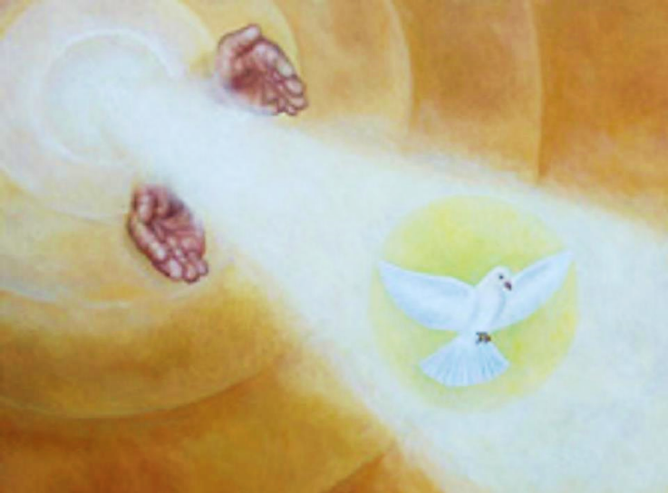
Church of the Holy Trinity, Caacupe, Paraguay

Slide 4
… lover of justice, you have established equity; you have executed justice and righteousness …
Psalm 99:4

Slide 5
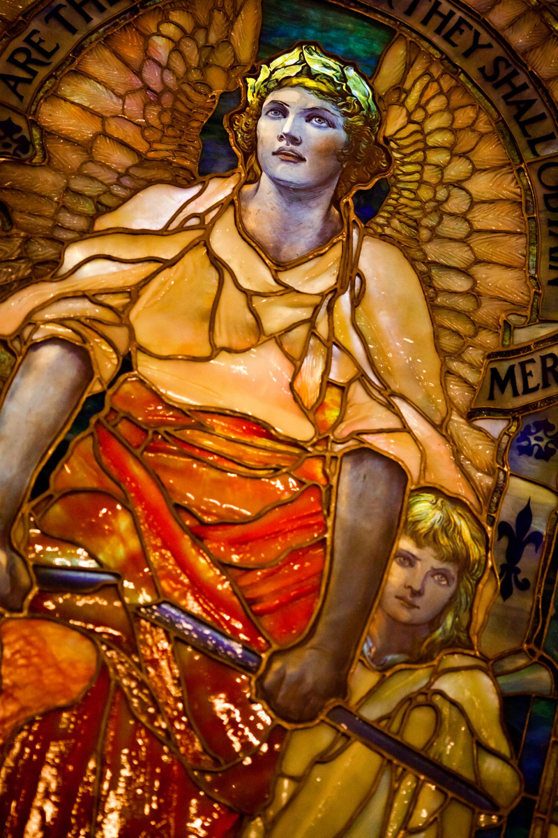
Blessed Are the Merciful
Louis Comfort Tiffany
Arlington Street Church
Boston, MA

Slide 6
I call you by your name, I surname you, though you do not know me.
Isaiah 45:4b

Slide 7
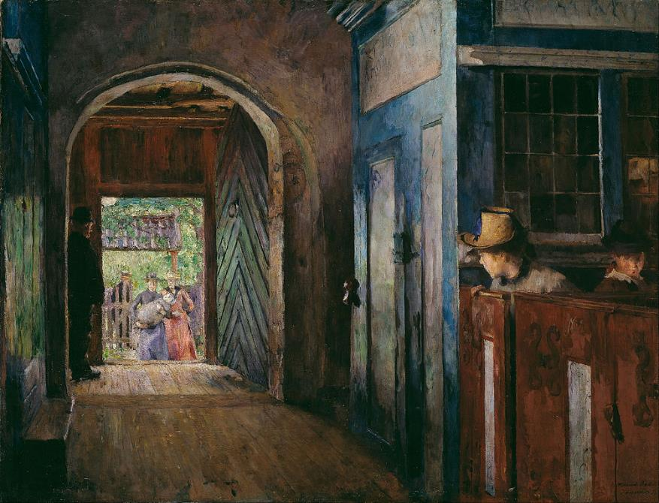
Christening in Tanum Church -- Harriet Backer, National Gallery of Norway, Oslo

Slide 8
… let the earth rejoice; let the sea roar, and all that fills it … all the trees of the forest sing for joy …
Psalm 96:11b, 12b

Slide 9
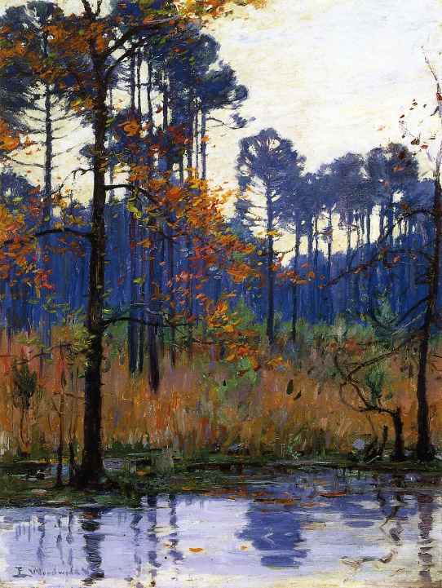
Winter in Southern Louisiana
Ellsworth Woodward
1911

Slide 10
We always give thanks to God for all of you and mention you in our prayers …
1 Thessalonians 1:2

Slide 11
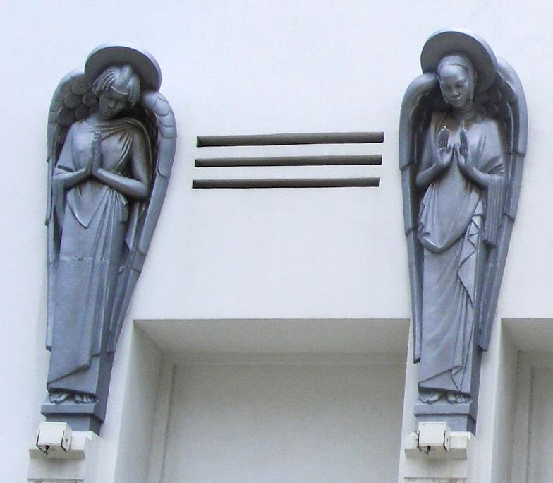
In Prayer
Cathedral of Our Lady of Victories Dakar, Senegal

Slide 12
For we know, brothers and sisters beloved by God, … you received the word with joy inspired by the Holy Spirit …
1 Thessalonians 1:4a, 6b

Slide 13
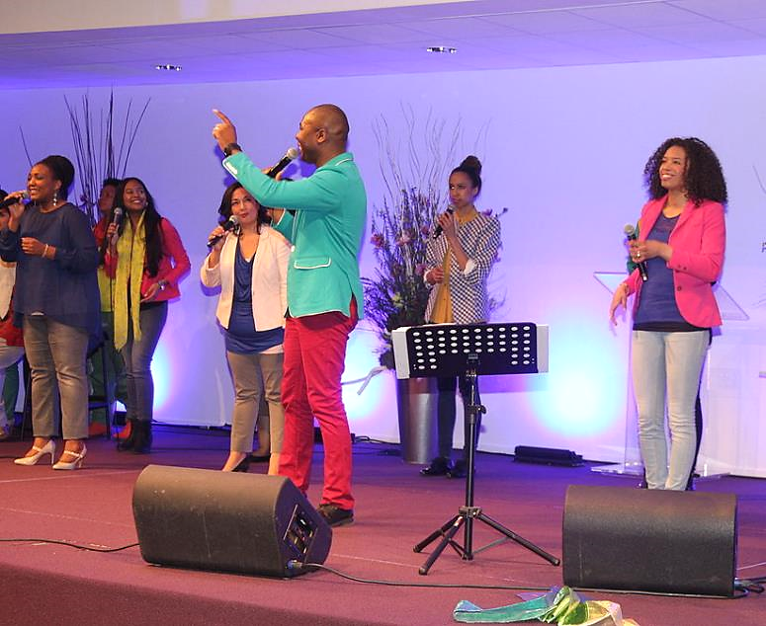
Singers and Choir -- Pentecostal Church of the Living Stone, Spijkenisse, Netherlands

Slide 14
"Tell us, then, what you think. Is it lawful to pay taxes to the emperor, or not?"
Matthew 22:17

Slide 15
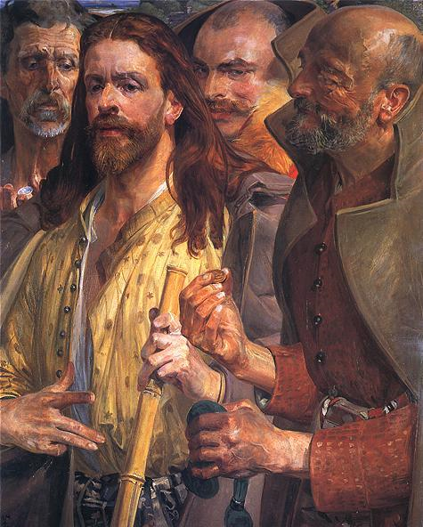
The Tribute Money
Jacek Malczewski National Museum Warsaw, Poland

Slide 16
But Jesus, aware of their malice, said, "Why are you putting me to the test, you hypocrites?"
Matthew 22:18

Slide 17
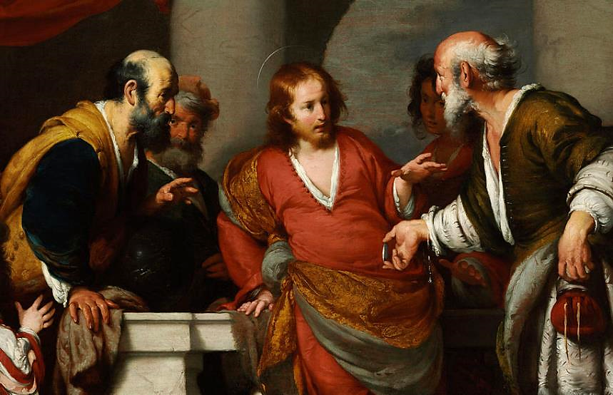
The Tribute Money -- Bernardo Strozzi, Museum of Fine Arts, Budapest, Hungary

Slide 18
"Show me the coin used for the tax." And they brought him a denarius.
Matthew 22:19

Slide 19
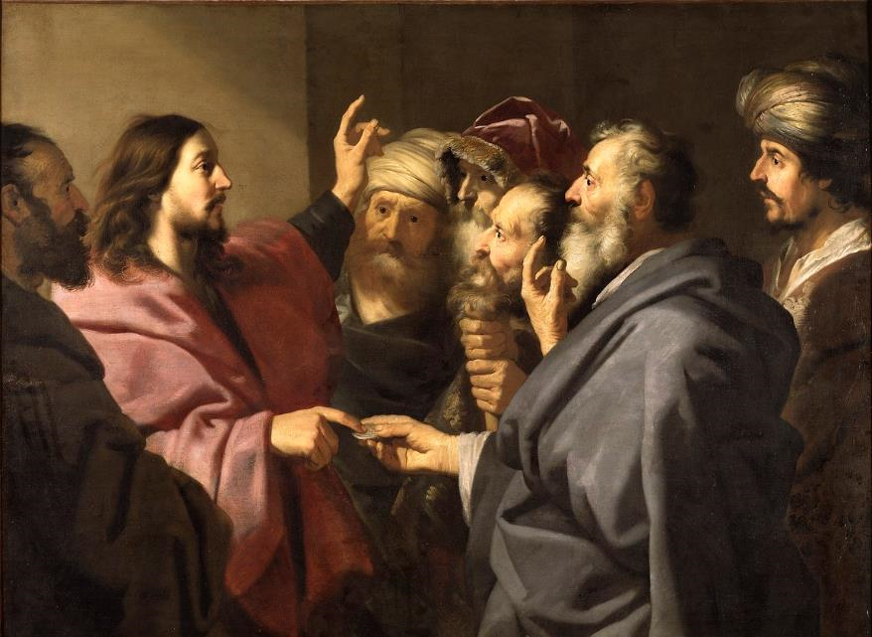
The Tribute Money -- Jacob Backer, National Museum, Stockholm, Sweden

Slide 20
Then he said to them, "Whose head is this, and whose title?" They answered, "The emperor's."
Matthew 22:20-21a

Slide 21
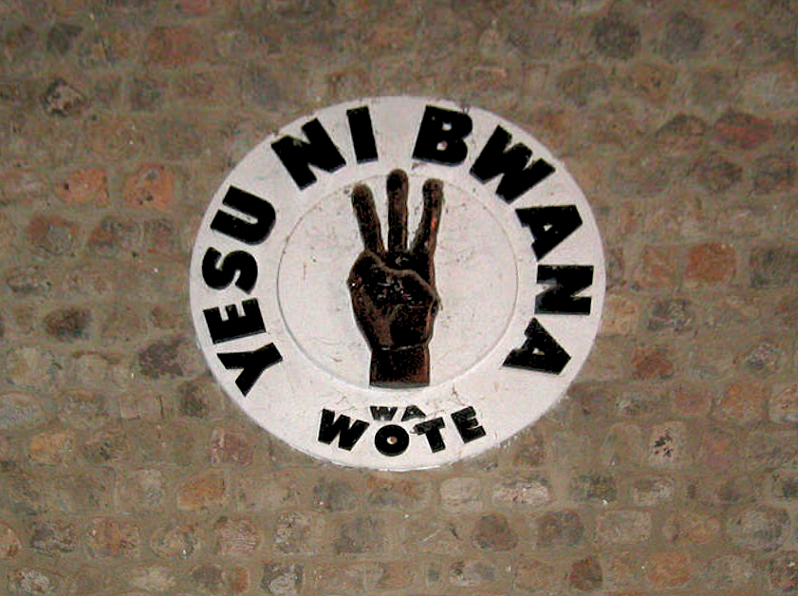
JESUS IS LORD! -- From a United Methodist Church in Congo (DRC)

Slide 22
"Give therefore to the emperor the things that are the emperor's, and to God the things that are God's."
Matthew 22:21

Slide 23
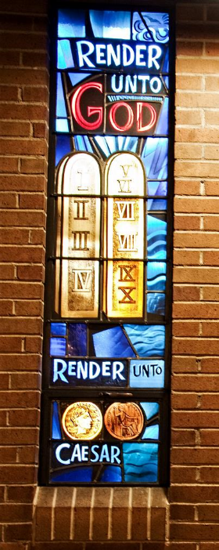
Render unto God
Rambusch Company
First Presbyterian Church,
Boise, Idaho

Slide 24
Credits
New Revised Standard Version Bible, copyright 1989, Division of Christian Education of the National Council of the Churches of Christ in the United States of America. Used by permission. All rights reserved.
https://commons.wikimedia.org/wiki/File:Berazategui-Caacupe-Poliptico-Trinidad.jpg
https://www.flickr.com/photos/thomashawk/5391897874/ - Thomas Hawk
https://commons.wikimedia.org/wiki/File:Harriet_Backer_-_Christening_in_Tanum_Church_-_Google_Art_Project.jpg
https://commons.wikimedia.org/wiki/File:Winter_in_Southern_Louisiana_E_Woodward_1911.jpg
https://commons.wikimedia.org/wiki/File:Cath%C3%A9drale_du_Souvenir_africain_de_DakarDSCF0298_1.jpg – Lamine Niang
https://commons.wikimedia.org/wiki/File:Singers_and_choir_pentecostal_church.JPG - Peter van der Sluijs
http://commons.wikimedia.org/wiki/File:Malczewski_Jacek_Grosz_czynszowy.jpg
https://commons.wikimedia.org/wiki/File:Bernardo_Strozzi_-_The_Tribute_Money_-_Google_Art_Project.jpg
https://commons.wikimedia.org/wiki/File:The_Tribute_Money_(Jacob_Adriaensz._Backer)_-_Nationalmuseum_-_17634.tif
https://www.flickr.com/photos/umccongo/2188556374
https://www.flickr.com/photos/genbug/4224456786/ - Laura Gilmore
Additional descriptions can be found at the Art in the Christian Tradition image library, a service of the Vanderbilt Divinity Library, http://diglib.library.vanderbilt.edu/. All images available via Creative Commons 3.0 License.

