Slide 1
Fourteenth Sunday after Pentecost
Year A
Exodus 3:1-15 and Psalm 105:1-6, 23-26, 45b
Jeremiah 15:15-21 and Psalm 26:1-8 • Romans 12:9-21
Matthew 16:21-28

Slide 2
There the angel of the LORD appeared to him in a flame of fire out of a bush; he looked, and the bush was blazing, yet it was not consumed.
Exodus 3:2

Slide 3
Burning Bush
Joe Schumaker
An arrangement of leaves from Euonymus alatus, known as the "Burning Bush"

Slide 4
God called to him out of the bush, "Moses, Moses!" And he said, "Here I am."
Exodus 3:4b

Slide 5
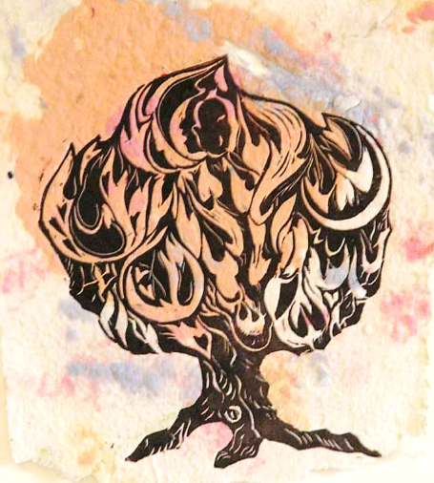
Burning Bush
Annette Fortt Gandy

Slide 6
Then the LORD said, "I have observed the misery of my people … and I have come down to deliver them from the Egyptians …"
Exodus 3:7a, 8a

Slide 7
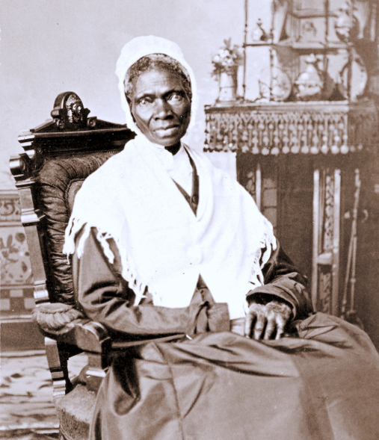
Sojourner Truth
Smithsonian National Portrait Gallery,
Washington, DC

Slide 8
But Moses said to God, "If I come to the Israelites … and they ask me, 'What is his name?' what shall I say to them?
Exodus 3:13ac

Slide 9
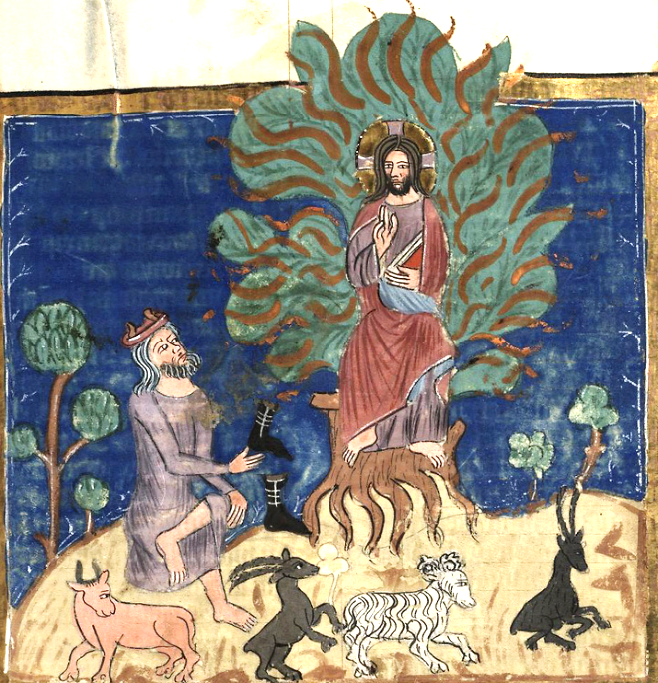
Burning Bush
Rudolph von Ems
Fulda, Germany

Slide 10
God said to Moses, "I AM WHO I AM."
Exodus 3:14a

Slide 11
Moses and the Burning Bush
Frank Wesley

Slide 12
Seek the LORD and his strength; seek his presence continually.
Psalm 105:4

Slide 13
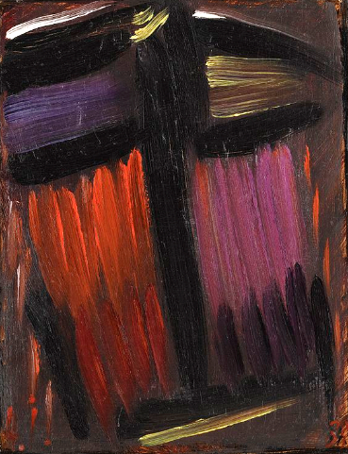
Meditation
Alexej von Jawlensky
Neue Galerie
New York, NY

Slide 14
your words became to me a joy and the delight of my heart …
Jeremiah 15:16b

Slide 15
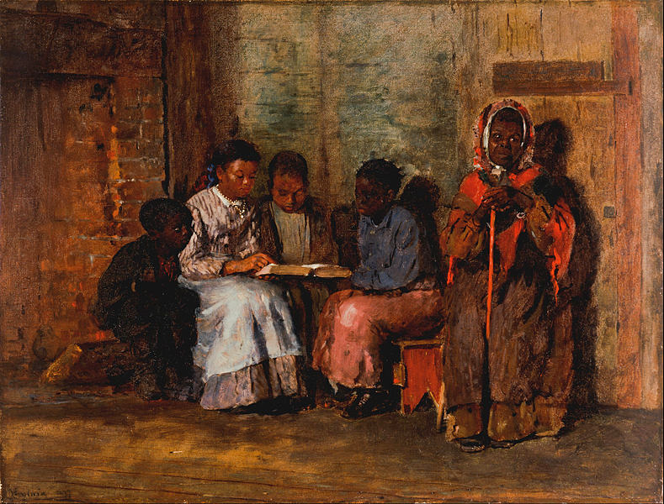
Sunday Morning in Virginia -- Winslow Homer, Cincinnati Art Museum, Cincinnati, OH

Slide 16
I … go around your altar, O LORD,
singing aloud a song of thanksgiving, and telling all your wondrous deeds.
Psalm 26:6b, 7

Slide 17
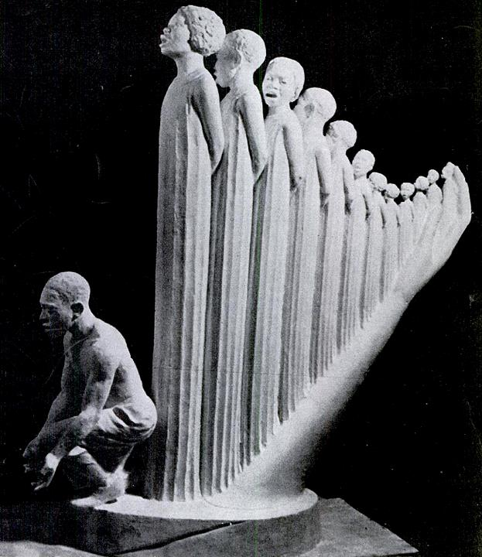
Lift Every Voice and Sing
Augusta Savage
1939 NY World's Fair
Benin Coptic Christians Celebrate the Feast of the Nativity

Slide 18
Let love be genuine; hate what is evil, hold fast to what is good …
Romans 12:9

Slide 19
Be Thou My Vision -- Mike Moyers

Slide 20
From that time on, Jesus began to show his disciples that he must … undergo great suffering … and be killed, and on the third day be raised.
Matthew 16:21ac

Slide 21
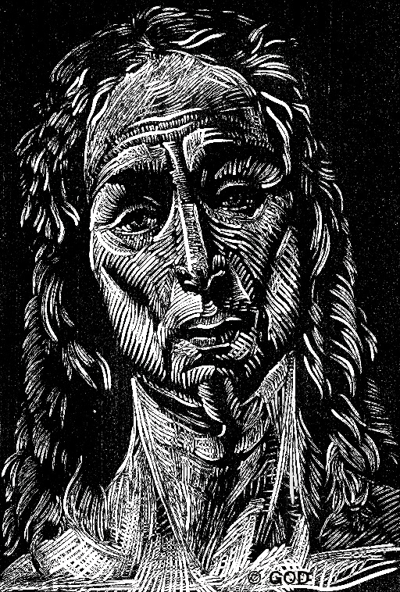
The Risen Christ
Bramantino
Civico Museo d'Arte Antica
Milan, Italy

Slide 22
And Peter took him aside and began to rebuke him, saying, "God forbid it, Lord! This must never happen to you."
Matthew 16:22

Slide 23
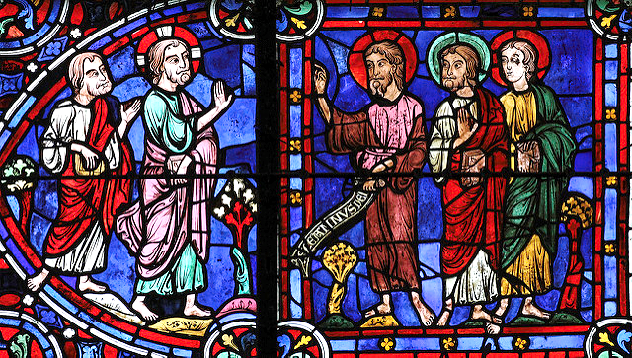
Jesus with Disciples -- Chartres Cathedral, Chartres, France

Slide 24
But he turned and said to Peter, "Get behind me, Satan! You are a stumbling block to me; for you are setting your mind not on divine things but on human things."
Matthew 16:23

Slide 25
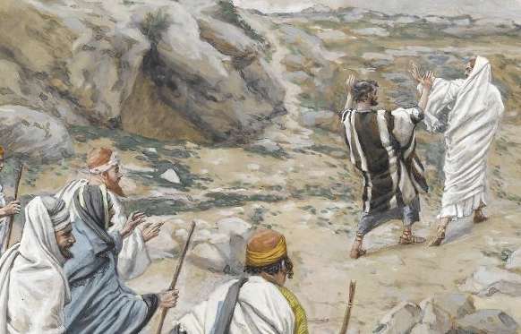
"Get Thee Behind Me, Satan!" -- James Tissot, Brooklyn Museum, Brooklyn, NY

Slide 26
Then Jesus told his disciples, "If any want to become my followers, let them deny themselves and take up their cross and follow me.
Matthew 16:24

Slide 27
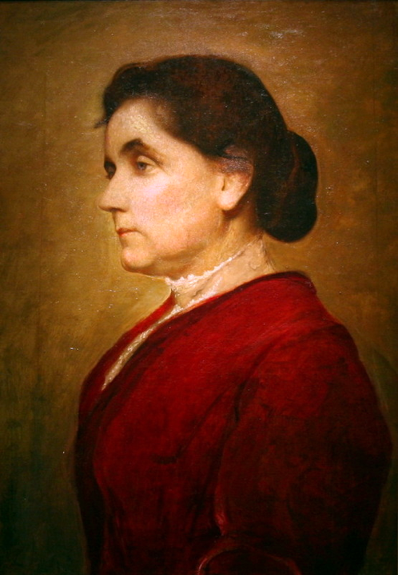
Jane Addams, established Hull-House in Chicago
George de Forest Brush
Smithsonian American Art Museum, Washington, DC

Slide 28
For those who want to save their life will lose it, and those who lose their life for my sake will find it."
Matthew 16:25

Slide 29
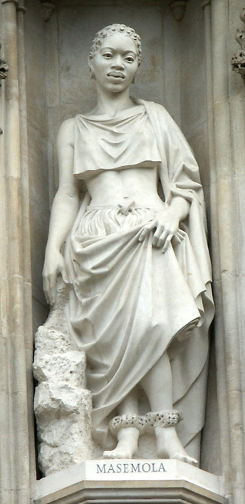
Manche Masemola
South African Christian Martyr
Westminster Abbey
London, England

Slide 30
Credits
New Revised Standard Version Bible, copyright 1989, Division of Christian Education of the National Council of the Churches of Christ in the United States of America. Used by permission. All rights reserved.
https://www.flickr.com/photos/jschumacher/6386697855
annettefortt.com – with permission
https://commons.wikimedia.org/wiki/File:Sojourner_truth_c1870.jpg
http://commons.wikimedia.org/wiki/File:Weltchronik_Fulda_Aa88_087r_detail.jpg
Estate of Frank Wesley, http://www.frankwesleyart.com/main_page.htm
https://commons.m.wikimedia.org/wiki/File:Alexej_von_Jawlensky_-_Meditation.jpg
https://commons.wikimedia.org/wiki/File:Winslow_Homer_-_Sunday_Morning_in_Virginia_-_Google_Art_Project.jpg
https://books.google.com/books?id=5VoEAAAAMBAJ&printsec=frontcover&dq=the+crisis+magazine+1939&hl=en&sa=X&ved=0ahUKEwiy8rT1_d_QAhVL8WMKHWw1AKA4ChDoAQgZMAA#v=onepage&q&f=false
Mike Moyers, https://www.mikemoyersfineart.com/
https://www.flickr.com/photos/duckmarx/16090353529/
https://www.flickr.com/photos/paullew/16120011720 - Fr. Lawrence Lew
https://commons.wikimedia.org/wiki/File:Brooklyn_Museum_-_Get_Thee_Behind_Me_Satan_(R%C3%A9tire-toi_Satan)_-_James_Tissot.jpg
http://commons.wikimedia.org/wiki/File:Jane_Addams,_1906_by_George_de_Forest_Brush,_(3011183811).jpg
https://commons.wikimedia.org/wiki/File:WestminsterAbbey-Martyrs.jpg
Additional descriptions can be found at the Art in the Christian Tradition image library, a service of the Vanderbilt Divinity Library, http://diglib.library.vanderbilt.edu/. All images available via Creative Commons 3.0 License.

