Slide 1
Ninth Sunday after Pentecost
Year A
Genesis 29:15-28 and Psalm 105:1-11, 45b or Psalm 128 1 Kings 3:5-12 and Psalm 119:129-136
Romans 8:26-39 • Matthew 13:31-33, 44-52

Slide 2
… Jacob served seven years for Rachel, and they seemed to him but a few days because of the love he had for her.
Genesis 29:20

Slide 3
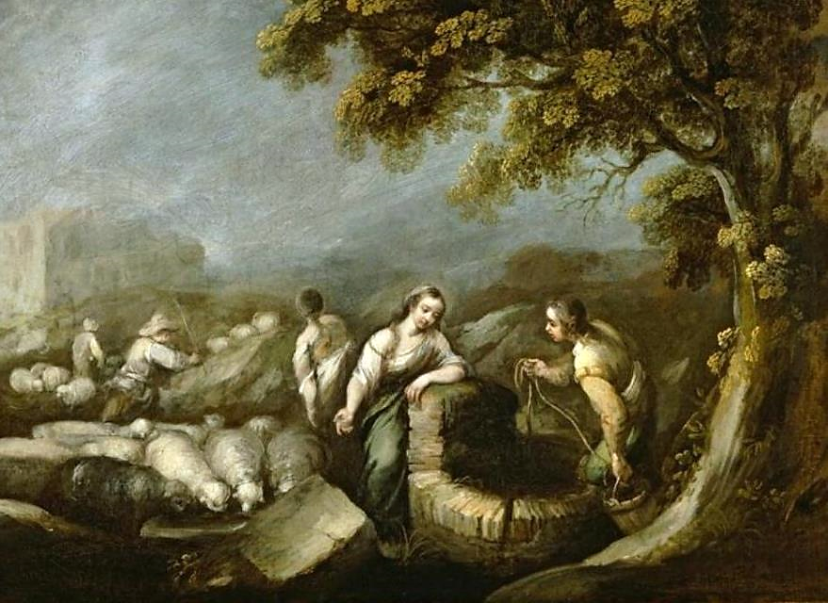
Jacob and Rachel at the Well -- F. Antolínez y Sarabia, El Paso Museum of Art, El Paso, TX

Slide 4
Seek the LORD and his strength;
seek his presence continually.
Psalm 105:4

Slide 5
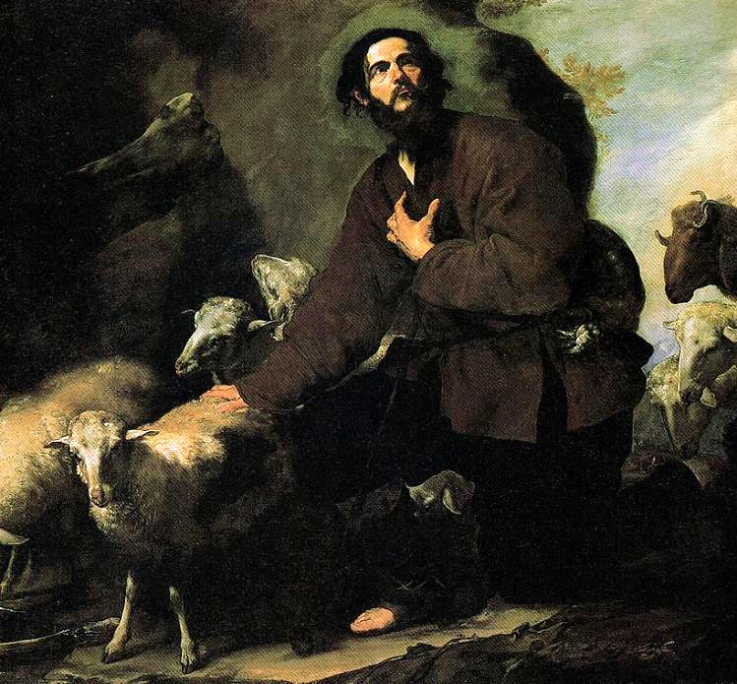
Jacob Tending Flock
Jose de Ribera
El Escorial Madrid, Spain

Slide 6
Give your servant … an understanding mind to govern your people, able to discern between good and evil;
1 Kings 3:9a

Slide 7
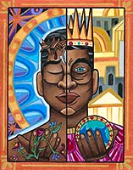
A Choice
Lauren Wright Pittman
Liturgical artist

Slide 8
The unfolding of your words gives light; it imparts understanding …
Psalm 119:130a

Slide 9
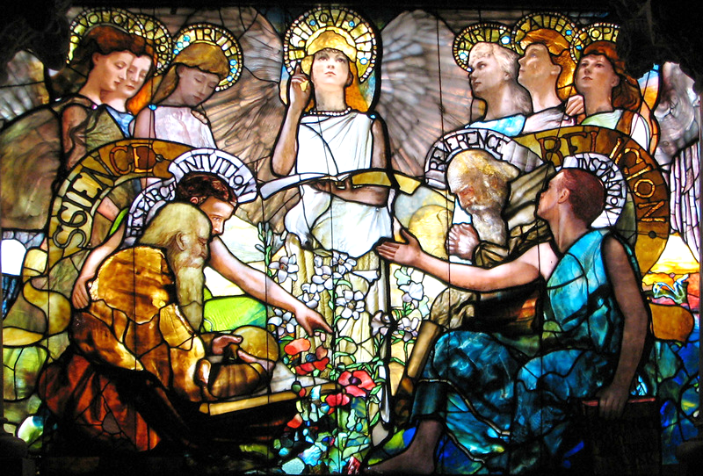
Light, Love, Life -- Louis Comfort Tiffany, Yale University, New Haven, CT

Slide 10
For I am convinced that neither death, nor life, nor angels, nor rulers, nor things present, nor things to come,
nor powers,
Romans 8:38

Slide 11
nor height, nor depth, nor anything else in all creation, will be able to separate us from the love of God in Christ Jesus our Lord.
Romans 8:38

Slide 12
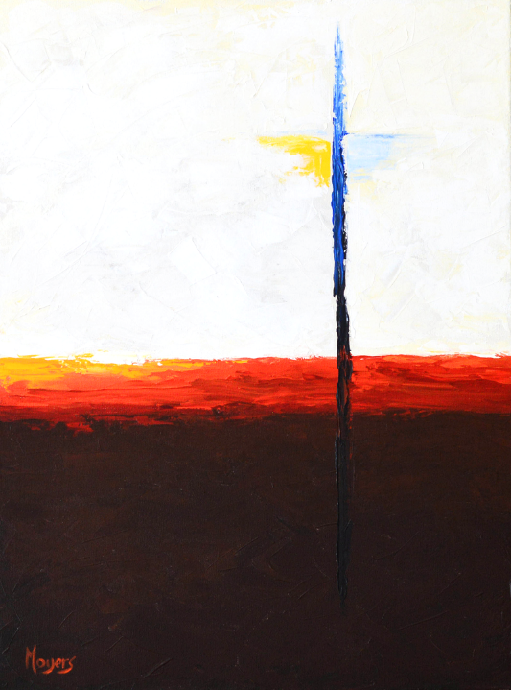
What Wondrous Love is This
Mike Moyers
Nashville, TN

Slide 13
"The kingdom of heaven is like a mustard seed … it is the smallest of all the seeds, but when it has grown it is the greatest of shrubs … "
Matthew 13:31b, 32a

Slide 14
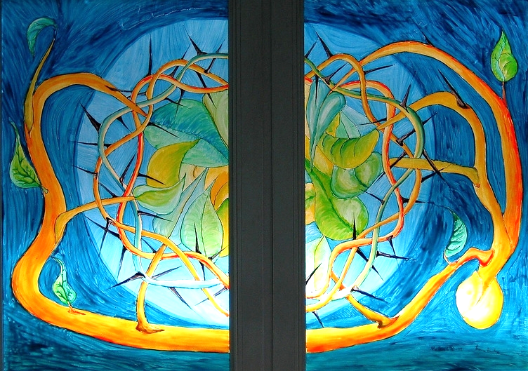
Parable of the Mustard Seed -- YMCA Training Center, Kassel, Germany

Slide 15
"The kingdom of heaven is like yeast that a woman took and mixed in with three measures of flour until all of it was leavened."
Matthew 13:33b

Slide 16
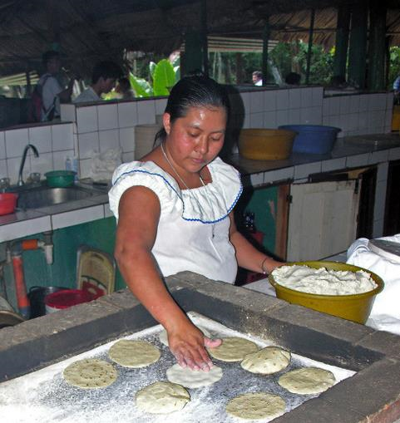
The Art of Making Bread
Tikal, Guatemala

Slide 17
"The kingdom of heaven is like treasure hidden in a field, which someone found and hid …
Matthew 13:44a

Slide 18
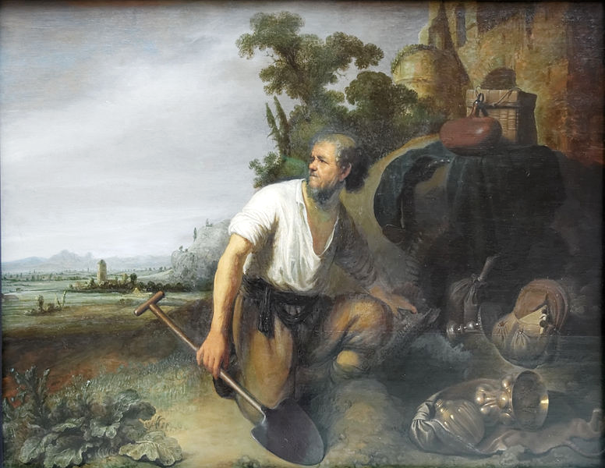
The Hidden Treasure -- Workshop of Rembrandt, Museum of Fine Arts, Budapest, Hungary

Slide 19
"… then in his joy he goes and sells all that he has and buys that field."
Matthew 13:44b

Slide 20
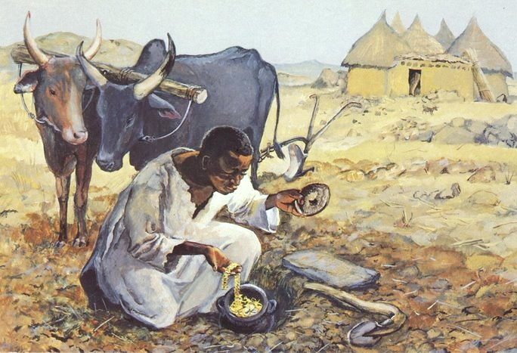
Parable of the Hidden Treasure -- JESUS MAFA, Cameroon

Slide 21
"Again, the kingdom of heaven is like a merchant in search of fine pearls;
on finding one pearl of great value, he went and sold all that he had and bought it."
Matthew 13:46

Slide 22
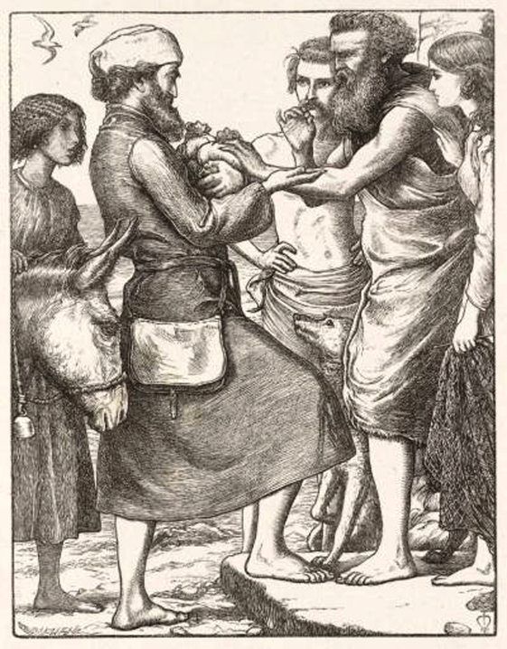
Pearl of Great Price
John Everett Millais
from Parables of Our Lord

Slide 23
Credits
New Revised Standard Version Bible, copyright 1989, Division of Christian Education of the National Council of the Churches of Christ in the United States of America. Used by permission. All rights reserved.
https://commons.m.wikimedia.org/wiki/File:Francisco_Antolinez_y_Sarabia_-_%27Jacob_and_Rachel_at_the_Well%27,_oil_on_canvas,_1670,_El_Paso_Museum_of_Art.jpg
https://commons.m.wikimedia.org/wiki/File:Jacob_y_el_reba%C3%B1o_de_Lab%C3%A1n,_de_Jos%C3%A9_de_Ribera_(Monasterio_de_El_Escorial).jpg
http://www.lewpstudio.com - copyright by Lauren Wright Pittman
http://commons.wikimedia.org/wiki/File:Tiffany_Education_(center).JPG
https://www.mikemoyersfineart.com/
https://www.flickr.com/photos/tin-g/90272565
http://commons.wikimedia.org/wiki/File:Flickr_-_archer10_(Dennis)_-_Guatemala-1682.jpg
https://commons.wikimedia.org/wiki/File:Parable_of_the_hidden_treasure_Rembrandt_-_Gerard_Dou.jpg
http://diglib.library.vanderbilt.edu/act-imagelink.pl?RC=48286
http://commons.wikimedia.org/wiki/File:Pearl_of_great_price.jpg
Additional descriptions can be found at the Art in the Christian Tradition image library, a service of the Vanderbilt Divinity Library, http://diglib.library.vanderbilt.edu/. All images available via Creative Commons 3.0 License.

