Slide 1
Eighth Sunday after Pentecost
Year A
Genesis 28:10-19a and Psalm 139:1-12, 23-24
Wisdom of Solomon 12:13, 16-19 or Isaiah 44:6-8 and Psalm 86:11-17 • Romans 8:12-25
Matthew 13:24-30, 36-43

Slide 2
And he dreamed that there was a ladder set up on the earth, the top of it reaching to heaven …
Genesis 28:12a

Slide 3
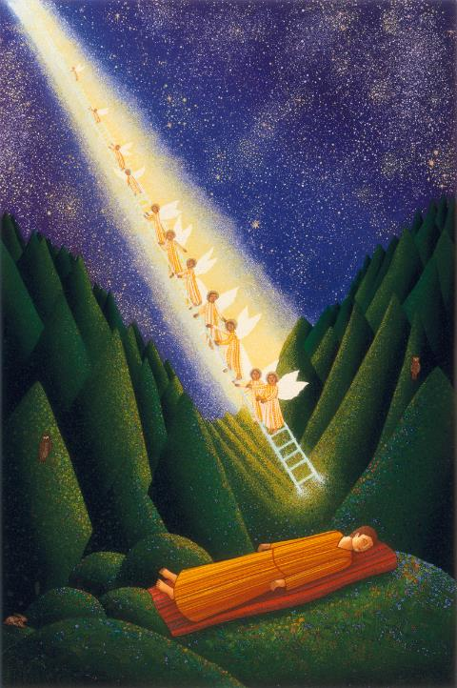
Dream of Jacob
John August Swanson
Print, 1986

Slide 4
… and the angels of God were ascending and descending on it.
Genesis 28:12b

Slide 5
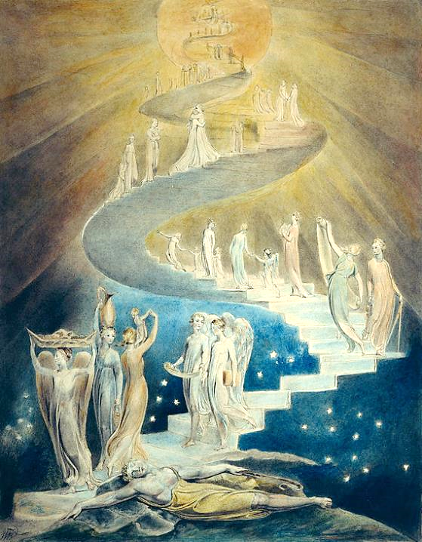
Jacob's Dream
William Blake
British Museum
London, England

Slide 6
And he was afraid, and said, "How awesome is this place!"
Genesis 28:17a

Slide 7
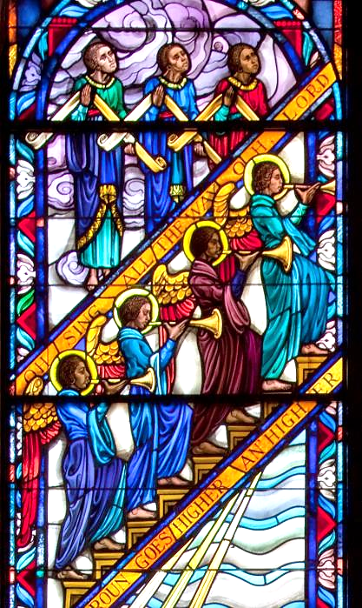
Climbing Jacob's Ladder
J. & R. Lamb Studios
Tuskeegee University, Alabama

Slide 8
"This is none other than the house of God, and this is the gate of heaven."
Genesis 28:17b

Slide 9
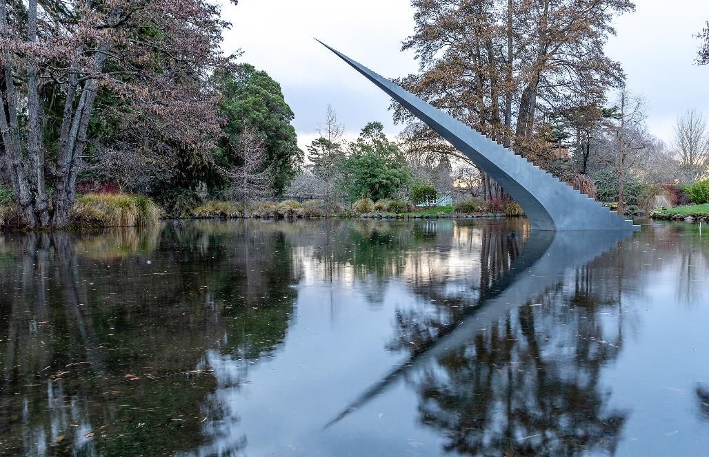
Diminish and Ascend -- David McCracken, Christchurch, New Zealand

Slide 10
If I take the wings of the morning
and settle at the farthest limits of the sea,
even there your hand shall lead me …
Psalm 139:9, 10a

Slide 11
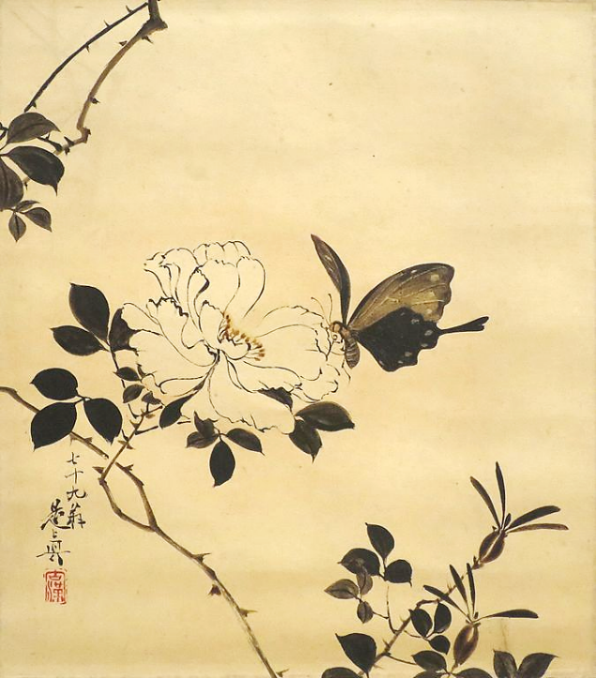
Butterfly and Wild Rose
Shibata Zeshin
Honolulu Museum of Art
Honolulu, HI

Slide 12
I am the first and I am the last;
Isaiah 44:6b

Slide 13
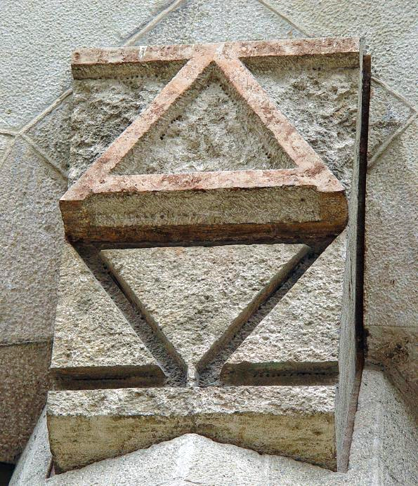
Alpha and Omega
Sagrada Familia Barcelona, Spain

Slide 14
Turn to me and be gracious to me; give your strength to your servant.
Psalm 86:16a

Slide 15
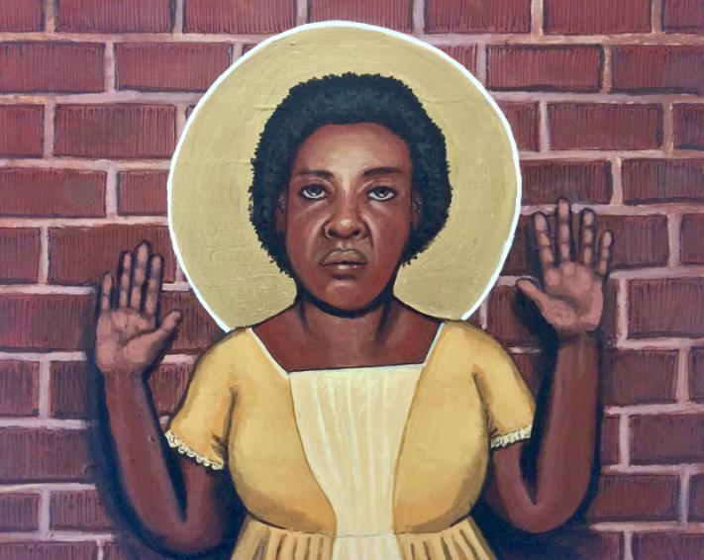
Fannie Lou Hamer, activist for women’s and civil rights -- Kelly Latimore

Slide 16
When we cry, "Abba! Father!" it is that very Spirit bearing witness with our spirit that we are children of God …
Romans 8:15c, 16

Slide 17
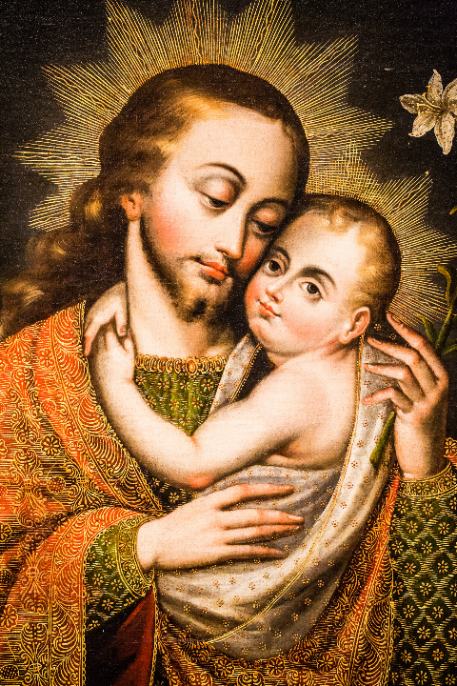
Joseph and the Christ Child
Denver Art Museum Denver, CO

Slide 18
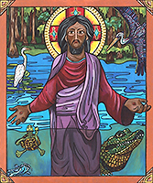
Jesus of the Bayou
Lauren Wright Pittman

Slide 19
"The kingdom of heaven may be compared to someone who sowed good seed in his field … "
Matthew 13:24b

Slide 20
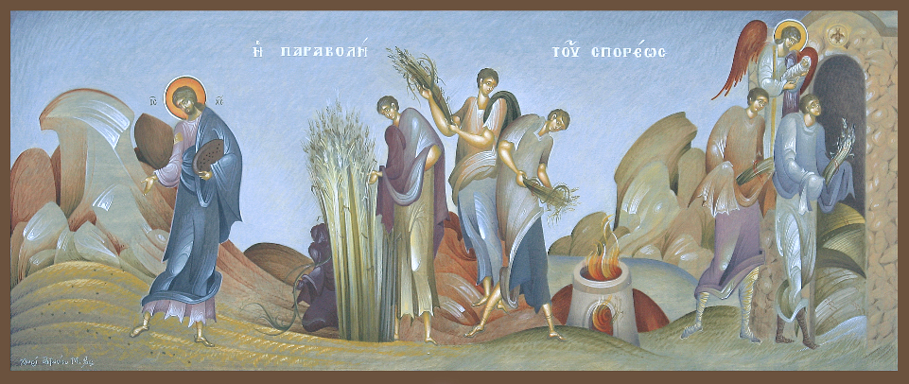
Parable of the Sower -- Greek Icon

Slide 21
"Then the righteous will shine like the sun in the kingdom of their Father. Let anyone with ears listen!"
Matthew 13:43

Slide 22
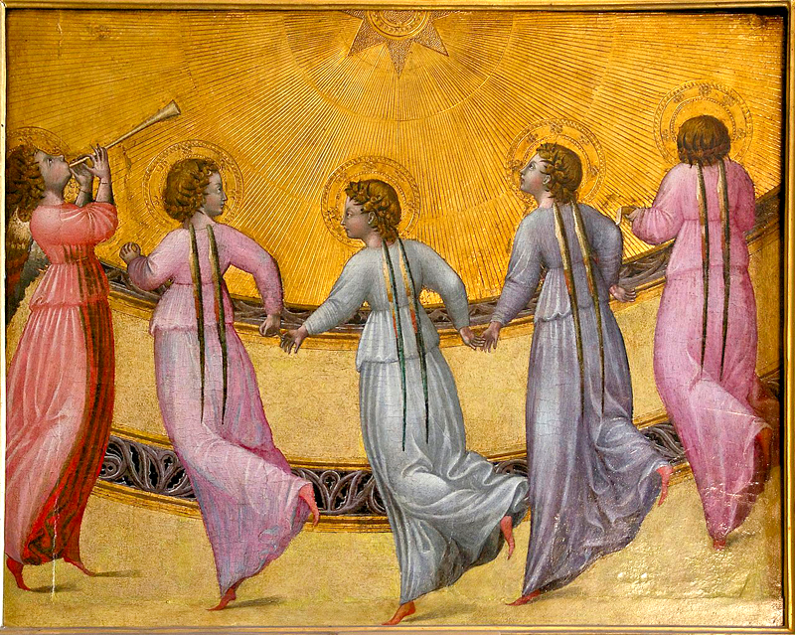
Angels Dancing -- Giovanni Paolo, Musée Condé, Chantilly, France

Slide 23
Credits
New Revised Standard Version Bible, copyright 1989, Division of Christian Education of the National Council of the Churches of Christ in the United States of America. Used by permission. All rights reserved.
https://www.flickr.com/photos/webcarnet/331459963
https://commons.wikimedia.org/wiki/File:Blake_jacobsladder.jpg
https://commons.wikimedia.org/wiki/File:Singing_Windows_stained_glass,_designed_by_J%26R_Lamb,_located_in_the_University_chapel_at_Tuskegee_University,_Tuskegee,_Alabama_LCCN2010637794.tif
https://commons.wikimedia.org/wiki/File:Diminish_and_Ascend,_Christchurch_Botanic_Gardens,_Christchurch.jpg
https://commons.wikimedia.org/wiki/File:%27Butterfly_and_Wild_Rose%27_by_Shibata_Zeshin,_1885,_Honolulu_Museum_of_Art,_4658.1.JPG
https://commons.wikimedia.org/wiki/File:AlphaOmega.jpg – Etan J. Tal
http://upload.wikimedia.org/wikipedia/commons/d/dd/Ralph_Hedley_The_Widow_1899.jpg
https://www.flickr.com/photos/thomashawk/10251241163/ - Thomas Hawk
https://commons.m.wikimedia.org/wiki/File:The_parable_of_the_sower.jpg
https://commons.m.wikimedia.org/wiki/File:Angels_dancing_sun_Giovanni_di_Paolo_Cond%C3%A9_Chantilly.jpg
Additional descriptions can be found at the Art in the Christian Tradition image library, a service of the Vanderbilt Divinity Library, http://diglib.library.vanderbilt.edu/. All images available via Creative Commons 3.0 License.

