Slide 1
Presentation of the Lord
Year A
Malachi 3:1-4 • Psalm 84 or Psalm 24:7-10
Hebrews 2:14-18 • Luke 2:22-40

Slide 2
…he will purify the descendants of Levi and refine them like gold and silver, until they present offerings to the LORD in righteousness.
Malachi 3:3

Slide 3
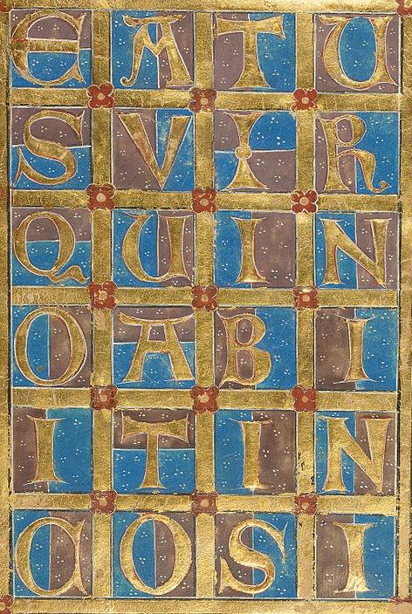
Text of Psalm 1
Gold and silver leaf
Getty Center, Los Angeles, CA

Slide 4
Even the sparrow finds a home, and the swallow a nest for herself…
Psalm 84:3a

Slide 5
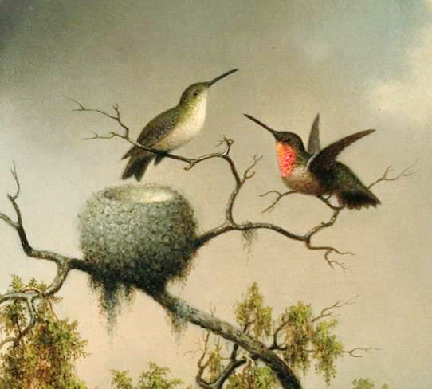
Hummingbirds with Nest -- Martin Heade, Museum of Fine Arts, Boston

Slide 6
…where she may lay her young, at your altars, O LORD of hosts, my King and my God.
Psalm 84:3b

Slide 7
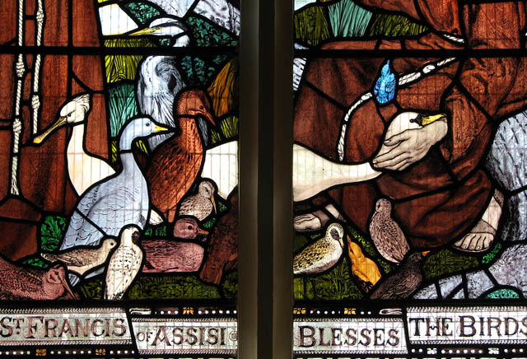
Blessing of the Birds -- Harry Mileham, St. Mary’s Church, Norfolk, England

Slide 8
Lift up your heads, O gates! and be lifted up, O ancient doors! that the King of glory may come in.
Psalm 24:7

Slide 9
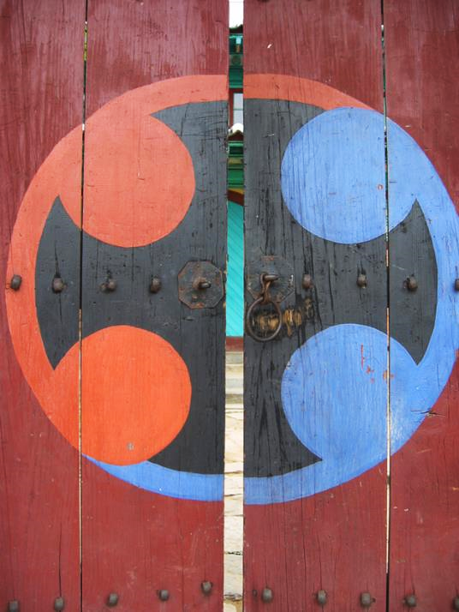
Front Gate
Ganghwa Anglican Church Ganghwa, Korea

Slide 10
Because he himself was tested by what he suffered, he is able to help those who are being tested.
Hebrews 2:18

Slide 11
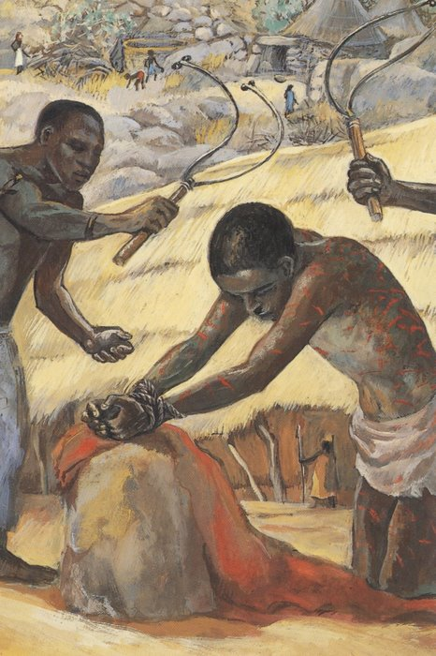
The Flagellation
JESUS MAFA, Cameroon

Slide 12
When the time came for their purification according to the law of Moses, they brought him up to Jerusalem to present him to the Lord…
Luke 2:22

Slide 13
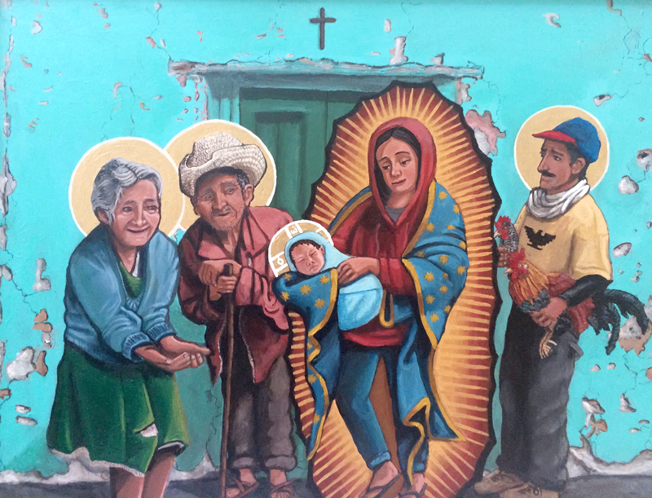
Presentation in the Temple -- Kelly Latimore, Longview, TX

Slide 14
and they offered a sacrifice according to what is stated in the law of the Lord, "a pair of turtledoves or two young pigeons."
Luke 2:24

Slide 15
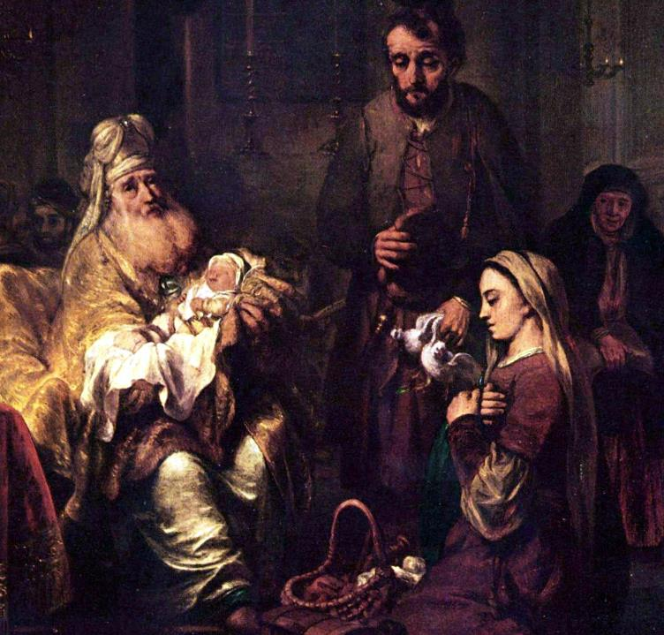
Presentation in the Temple
G. Van den Eeckhout
Museum of Fine Arts
Budapest, Hungary

Slide 16
Simeon took him in his arms and praised God, saying, "Master, now you are dismissing your servant in peace, according to your word;
Luke 2:28-29

Slide 17
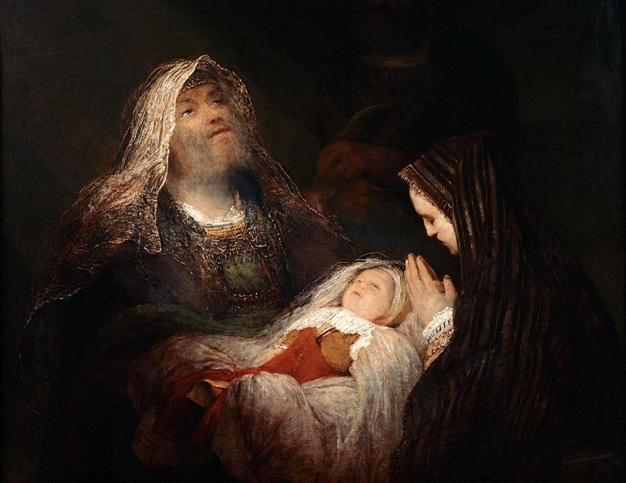
Simeon’s Song of Praise (Nunc Dimittis) -- Aert de Gelder, Mauritshuis, Hague, Netherlands

Slide 18
for my eyes have seen your salvation, which you have prepared in the presence of all peoples,
Luke 2:30-31

Slide 19
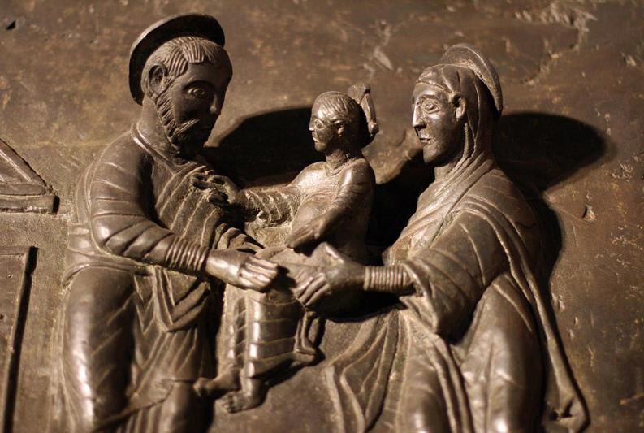
Presentation in the Temple -- Bernward’s Doors, Hildesheim Cathedral, Hildesheim, Germany

Slide 20
…a light for revelation to the Gentiles and for glory to your people Israel."
Luke 2:32

Slide 21
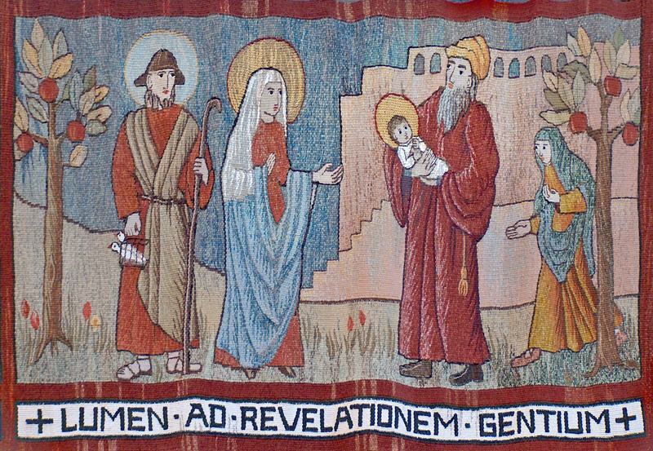
Presentation in the Temple -- Abbey of St. Walburga, Virginia Dale, CO

Slide 22
Then Simeon blessed them and said to his mother Mary, "This child is destined for the falling and the rising of many in Israel, and to be a sign that will be opposed…
Luke 2:34

Slide 23
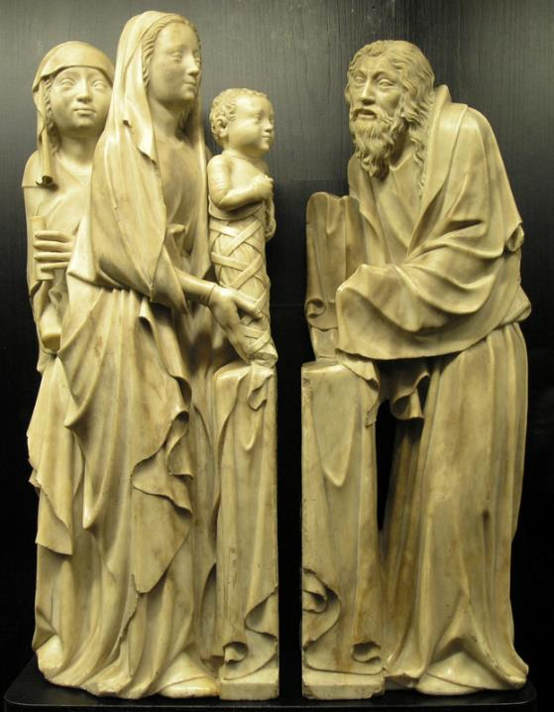
Presentation in the Temple
Musee National du Moyen Age Paris, France

Slide 24
so that the inner thoughts of many will be revealed--and a sword will pierce your own soul too."
Luke 2:35

Slide 25
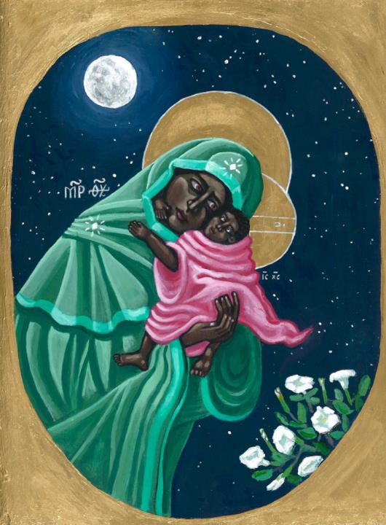
Mary:
Keep Watch
Kelly Latimore
St. Louis, MO

Slide 26
There was also a prophet, Anna the daughter of Phanuel, of the tribe of Asher. She was of a great age…
Luke 2:36a

Slide 27
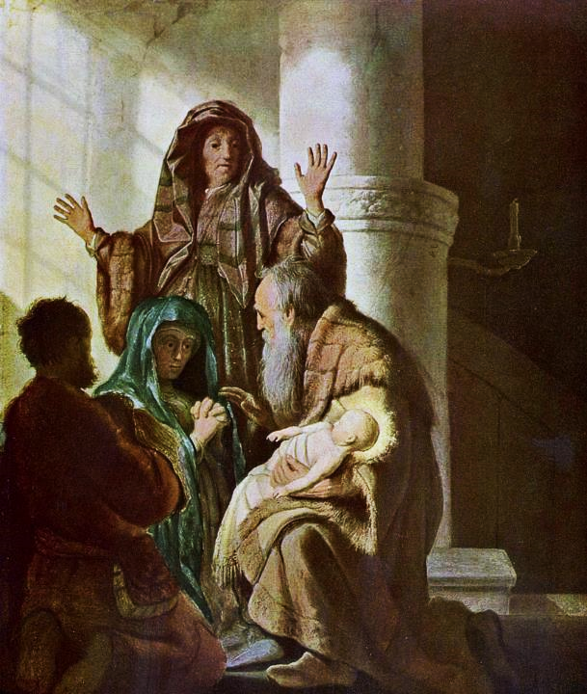
Anna and Simeon in the Temple
Rembrandt
Kunsthalle
Hamburg, Germany

Slide 28
She never left the temple but worshiped there with fasting and prayer night and day.
Luke 2:37b

Slide 29
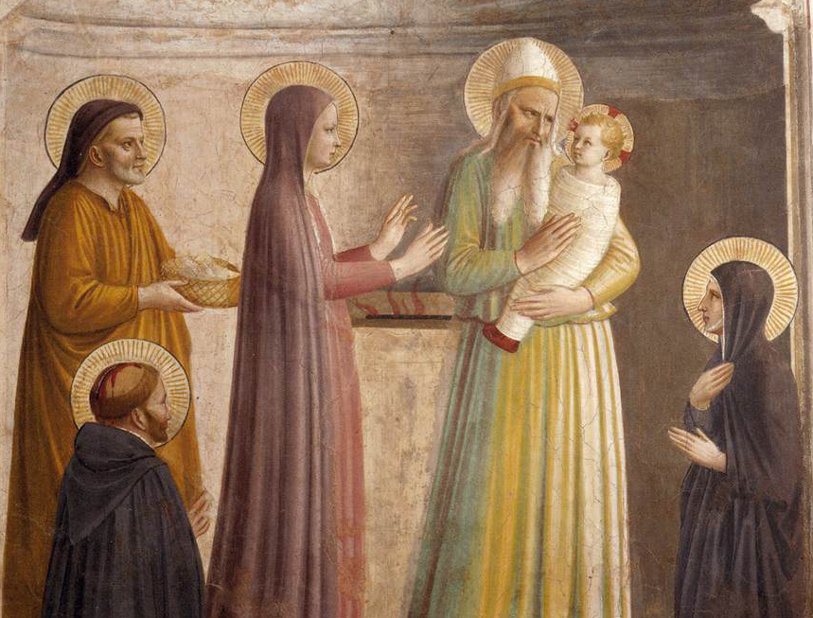
Presentation in the Temple -- Fra Angelico, Museum of San Marco, Florence, Italy

Slide 30
At that moment she came, and began to praise God and to speak about the child to all who were looking for the redemption of Jerusalem.
Luke 2:38

Slide 31
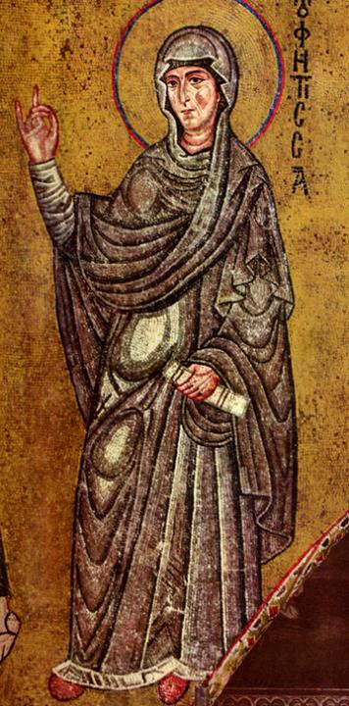
Anna, the Prophetess
Palatine Chapel
Palermo, Sicily

Slide 32
The child grew and became strong, filled with wisdom; and the favor of God was upon him.
Luke 2:40

Slide 33
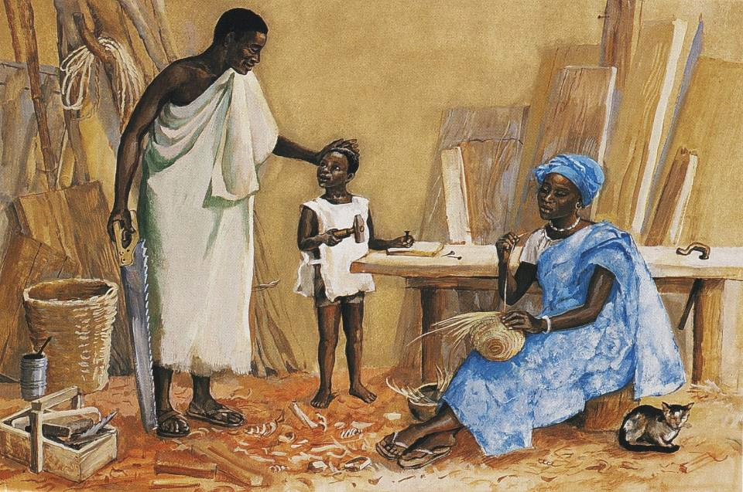
Jesus as a Child in Nazareth -- JESUS MAFA, Cameroon

Slide 34
Credits
New Revised Standard Version Bible, copyright 1989, Division of Christian Education of the National Council of the Churches of Christ in the United States of America. Used by permission. All rights reserved.
https://commons.wikimedia.org/wiki/File:Decorated_Incipit_Page_-_Google_Art_Project_(6850315).jpg
http://www.mfa.org/
https://commons.wikimedia.org/wiki/File:St_Mary%27s_church_-_stained_glass_detail_-_geograph.org.uk_-_1252096.jpg
http://www.flickr.com/photos/friarsbalsam/3377697557/
http://diglib.library.vanderbilt.edu/act-imagelink.pl?RC=48274
https://kellylatimoreicons.com/contact/
http://commons.wikimedia.org/wiki/File:Aert_de_Gelder_-_Het_loflied_van_Simeon.jpg
http://www.flickr.com/photos/sacred_destinations/3114703011/
http://www.flickr.com/photos/edithosb/204407845/
https://commons.wikimedia.org/wiki/File:CLUNY-Pr%C3%A9sentation_Bourgogne_1.JPG
https://kellylatimoreicons.com/contact/
https://commons.wikimedia.org/wiki/File:Rembrandt_Harmensz._van_Rijn_056.jpg
https://commons.wikimedia.org/wiki/File:Fra_Angelico_-_Presentation_of_Jesus_in_the_Temple_(Cell_10)_-_WGA00544.jpg
http://diglib.library.vanderbilt.edu/act-imagelink.pl?RC=46147
https://commons.wikimedia.org/wiki/File:Bathing_the_Christ_Child_and_The_Presentation_in_the_Temple_-_Google_Art_Project.jpg
http://www.librairie-emmanuel.fr
Additional descriptions can be found at the Art in the Christian Tradition image library, a service of the Vanderbilt Divinity Library, http://diglib.library.vanderbilt.edu/. All images available via Creative Commons 3.0 License.

