Slide 1
New Year’s Day
Year A
Ecclesiastes 3:1-13 • Psalm 8 • Revelation 21:1-6a • Matthew 25:31-46

Slide 2
For everything there is a season, and a time for every matter under heaven:
Ecclesiastes 3:1

Slide 3
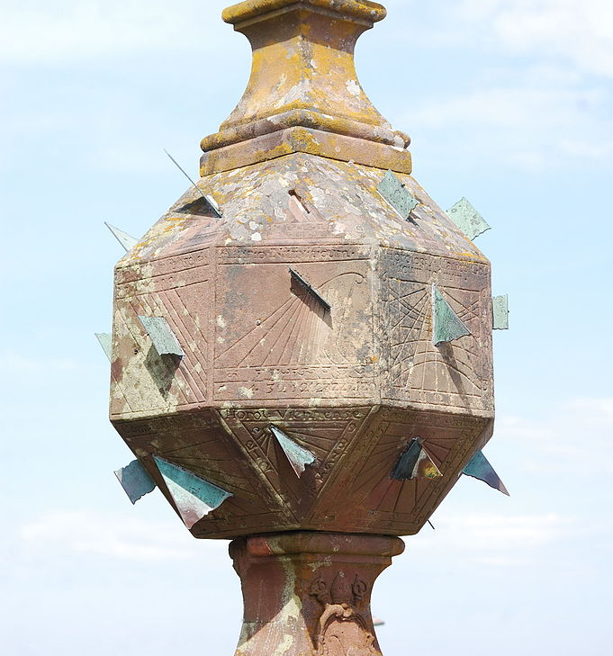
Vertical Sun Clock
Convent of Mont-Saint-Odile, Luxembourg

Slide 4
He has made everything suitable for its time; moreover he has put a sense of past and future into their minds…
Ecclesiastes 3:11

Slide 5
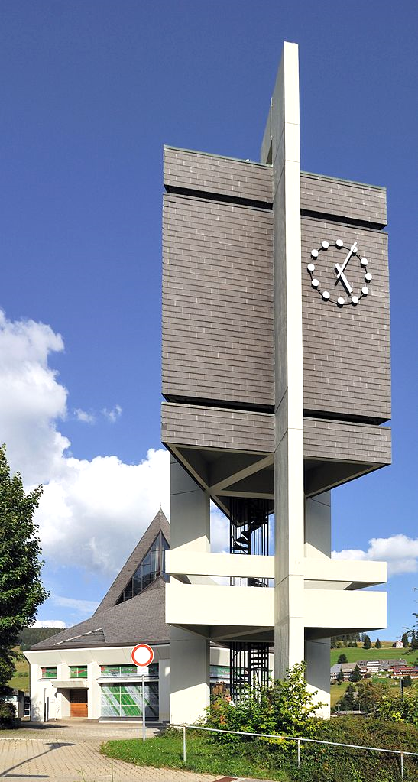
Bell Tower Clock
Church of St. James Son of Zebedee
Todtnauberg, Germany

Slide 6
I know that there is nothing better for them than to be happy and enjoy themselves as long as they live…
Ecclesiastes 3:12

Slide 7
Love and Happiness -- Ann from Detroit, photographer

Slide 8
When I look at your heavens, the work of your fingers, the moon and the stars that you have established…
Psalm 8:3

Slide 9
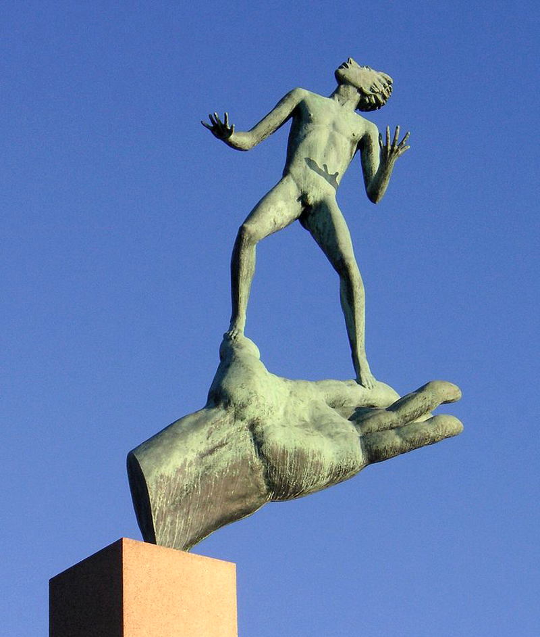
God’s Hand
Carl Milles Millesgarden Stockholm, Sweden

Slide 10
…what are human beings that you are mindful of them, mortals that you care for them?
Psalm 8:4

Slide 11
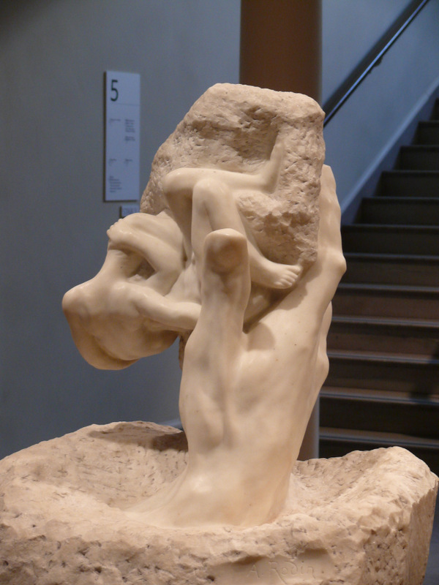
Hand of God
Auguste Rodin
Rhode Island School of Design Museum
Providence, RI

Slide 12
"It is done! I am the Alpha and the Omega, the beginning and the end.”
Revelation 21:6a

Slide 13
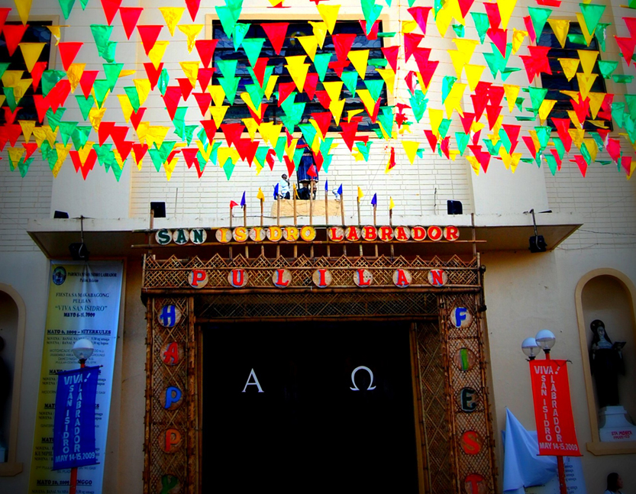
Alpha and Omega -- Church of San Isidro Labrador, Pulilan, Philippines

Slide 14
…for I was hungry and you gave me food, I was thirsty and you gave me something to drink, I was a stranger and you welcomed me…
Matthew 25:35

Slide 15
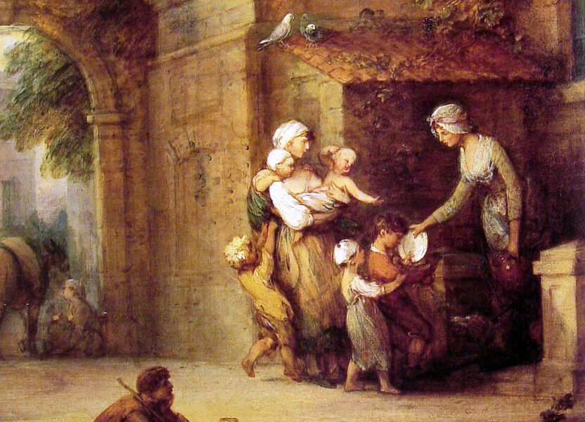
Charity Relieving Distress -- Thomas Gainsborough, Indianapolis Museum of Art

Slide 16
…I was naked and you gave me clothing, I was sick and you took care of me, I was in prison and you visited me.
Matthew 25:36

Slide 17
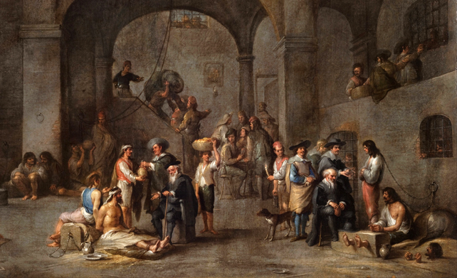
To Visit the Imprisoned -- Cornelis de Wael, Musei de Strada Nuova, Genoa, Italy

Slide 18
Credits
New Revised Standard Version Bible, copyright 1989, Division of Christian Education of the National Council of the Churches of Christ in the United States of America. Used by permission. All rights reserved.
https://commons.wikimedia.org/wiki/File:Sundial_of_Mont_Sainte-Odile.jpg
https://commons.wikimedia.org/wiki/File:Todtnau_-_St._Jakobus_der_%C3%84ltere3.jpg - Taxiarchos228
http://commons.wikimedia.org/wiki/File:Love_and_happiness.jpg
http://commons.wikimedia.org/wiki/File:Guds_hand_2007.jpg?uselang=enhands%20painting
http://commons.wikimedia.org/wiki/File:RISD_Rodin_Hand_of_God.JPG
http://www.flickr.com/photos/bigberto/3549919373/
http://commons.wikimedia.org/wiki/File:Charity_relieving_Distress.jpg
https://commons.wikimedia.org/wiki/File:Cornelis_De_Wael_-_To_Visit_the_Imprisoned_-_Google_Art_Project.jpg
Additional descriptions can be found at the Art in the Christian Tradition image library, a service of the Vanderbilt Divinity Library, http://diglib.library.vanderbilt.edu/. All images available via Creative Commons 3.0 License.

