Slide 1
Nativity of the Lord III
Year A
Isaiah 62:6-12
Psalm 97
Titus 3:4-7
Luke 2:(1-7), 8-20

Slide 2
How beautiful upon the mountains are the feet of the messenger who announces peace, who brings good news.
Isaiah 52:7

Slide 3
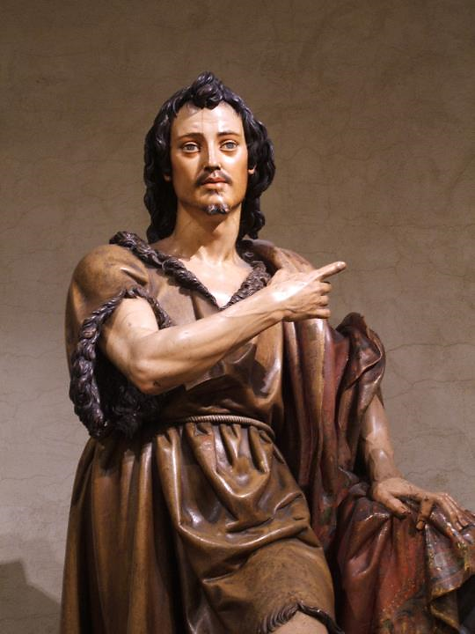
John the Baptist
Juan Martínez Montañés
Metropolitan Museum
New York

Slide 4
O sing to the LORD a new song,
for he has done marvelous things.
Psalm 98:1

Slide 5
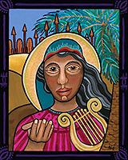
In Tune (the prophetess Deborah)
Lauren Wright Pittman

Slide 6
Make a joyful noise to the LORD,
all the earth; break forth into joyous song and sing praises.
Psalm 98:4

Slide 7
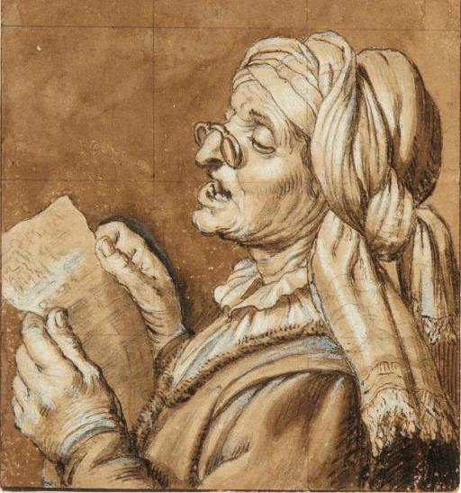
Old Woman Singing
Gerrit von Honthorst National Museum Warsaw, Poland

Slide 8
With trumpets and the sound
of the horn make a joyful noise…
Psalm 98:6

Slide 9
The Procession -- John August Swanson

Slide 10
Let the sea roar, and all that fills it;
the world and those who live in it.
Psalm 98:7

Slide 11
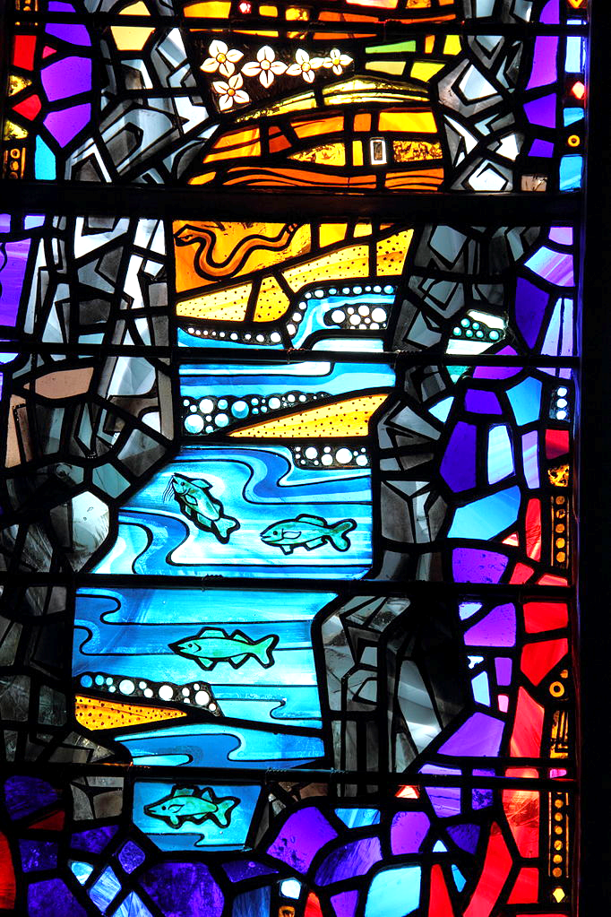
The Waters
R. and I. LeCompte
Washington National Cathedral

Slide 12
Let the floods clap their hands;
let the hills sing together for joy…
Psalm 98:8

Slide 13
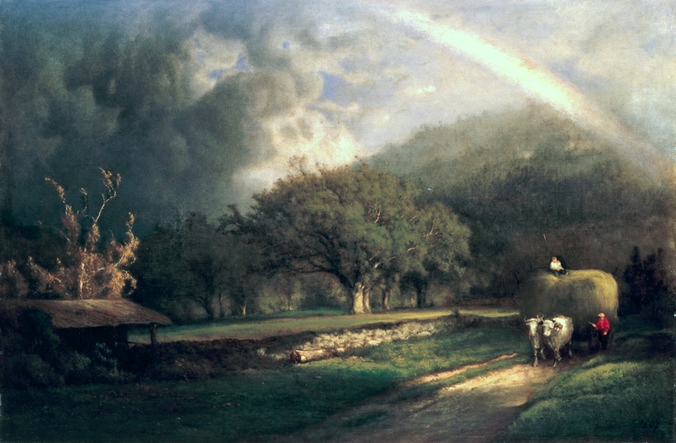
Rainbow in the Berkshire Hills -- George Inness, White House , Washington, DC

Slide 14
He will judge the world with righteousness, and the peoples with equity.
Psalm 98:9b

Slide 15
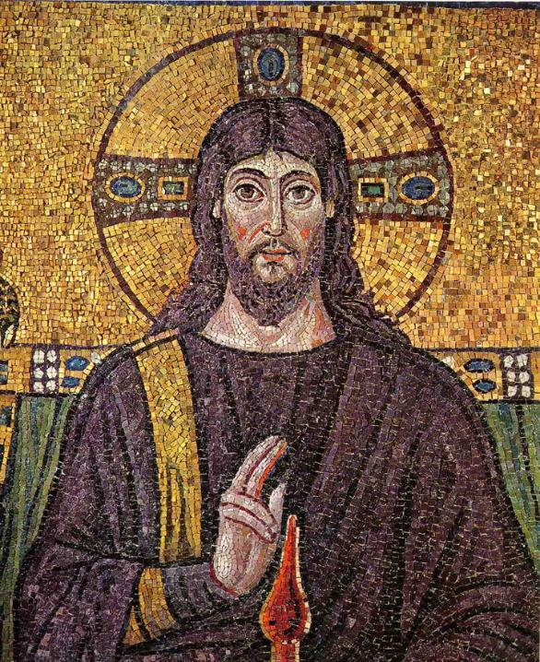
Christ Pantocrator
Mosaic
S. Apollinaire Nuovo Ravenna, Italy

Slide 16
Long ago God spoke to our ancestors in many and various ways by the prophets.
Hebrews 1:1

Slide 17
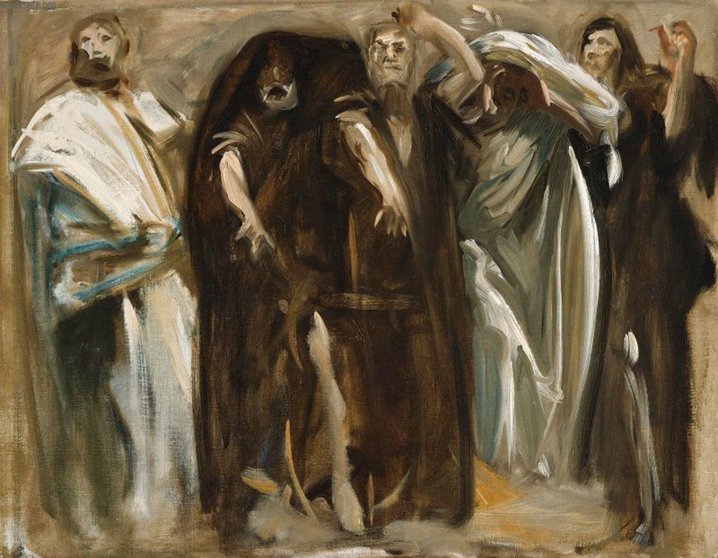
Study for Frieze of the Prophets, Boston Public Library -- Boston Museum of Fine Arts

Slide 18
You are my Son; today I have begotten you…
Hebrews 1:5b

Slide 19
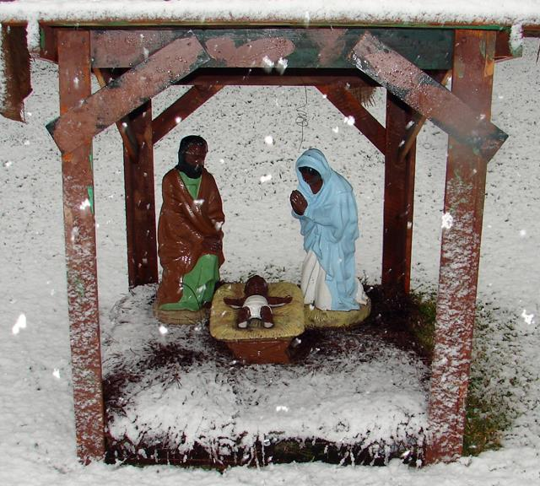
Nativity
Xavier Churchyard

Slide 20
In the beginning was the Word, and the Word was with God, and the Word was God.
John 1:1

Slide 21
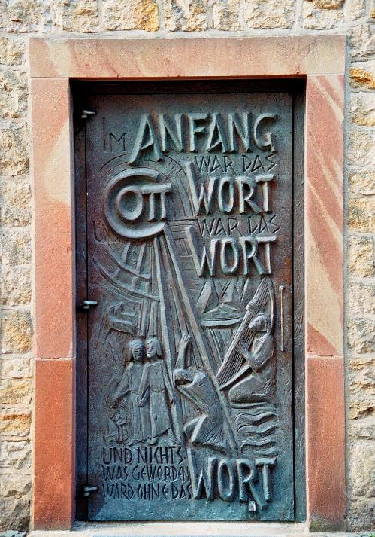
In the Beginning…
Josef Krautwald
St. Dionysius Church
Recke, Germany

Slide 22
There was a man sent from God, whose name was John. He came as a witness to testify to the light, so that all might believe through him…
John 1:6-7

Slide 23
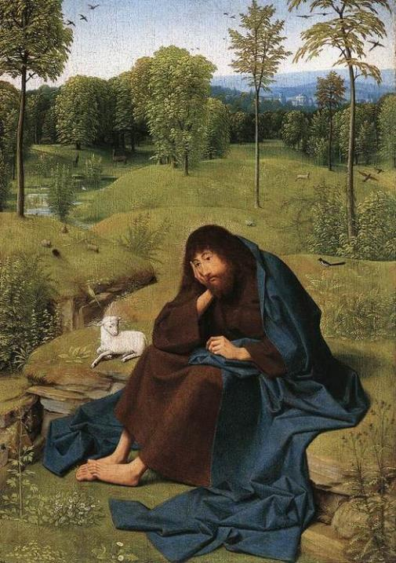
John the Baptist in the Wilderness
tot Sint Jans Geertgen Gemaldegalerie, Berlin

Slide 24
The true light, which enlightens everyone, was coming into the world.
John 1:9

Slide 25
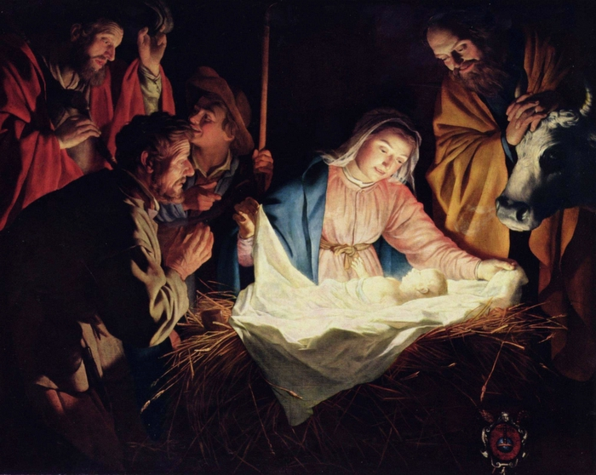
Adoration of the Shepherds -- Gerrit van Honthorst, Wallraf-Richartz-Museum, Cologne

Slide 26
And the Word became flesh and lived among us…
John 1:14

Slide 27
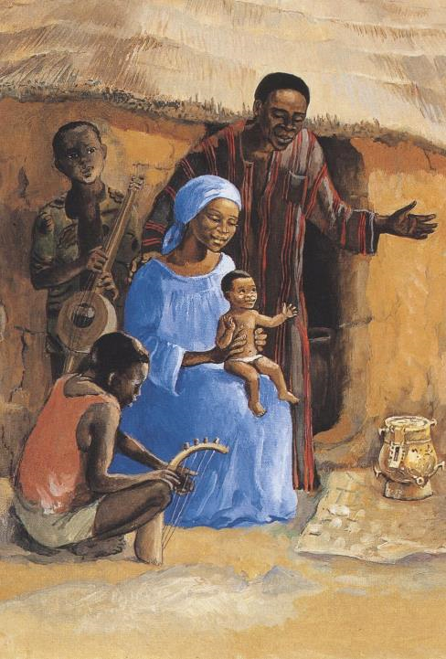
Jesus with his Family
JESUS MAFA
Cameroon

Slide 28
Credits
New Revised Standard Version Bible, copyright 1989, Division of Christian Education of the National Council of the Churches of Christ in the United States of America. Used by permission. All rights reserved.
https://commons.wikimedia.org/wiki/File:1376556356_9cae169c1f_o_San_Juan_Bautista.jpg
http://www.lewpstudio.com - copyright by Lauren Wright Pittman
http://commons.wikimedia.org/wiki/File:Honthorst_Old_woman_singing.jpg
Estate of John August Swanson, https://www.johnaugustswanson.com/
http://commons.wikimedia.org/wiki/File:Honningsv%C3%A5g_2013_06_09_2207_(10318844126).jpg
https://commons.wikimedia.org/wiki/File:Stained_glass_window_Washington_National_Cathedral_2012_06.JPG
https://commons.wikimedia.org/wiki/File:The_Rainbow_in_the_Berkshire_Hills_by_George_Inness,_1869.jpg
http://commons.wikimedia.org/wiki/File:Christus_Ravenna_Mosaic.jpg
http://www.flickr.com/photos/howieluvzus/3100071849/
http://www.flickr.com/photos/36229644@N06/4663154243 - Diane Brennan
https://commons.wikimedia.org/wiki/File:St_Dionysius_Hauptportal_Tuer_1.jpg
https://commons.wikimedia.org/wiki/File:Geertgen_tot_Sint_Jans_-_John_the_Baptist_in_the_Wilderness_-_WGA08515.jpg
http://www.yorckproject.de
http://www.librairie-emmanuel.fr
Additional descriptions can be found at the Art in the Christian Tradition image library, a service of the Vanderbilt Divinity Library, http://diglib.library.vanderbilt.edu/. All images available via Creative Commons 3.0 License.

