Slide 1
Liturgy of the Passion
Year A
Isaiah 50:4-9a
Psalm 31:9-16
Philippians 2:5-11
Matthew 26:14-27:66 or Matthew 27:11-54

Slide 2
I gave my back to those who struck me, and my cheeks to those who pulled out the beard; I did not hide my face from insult and spitting.
Isaiah 50:6

Slide 3
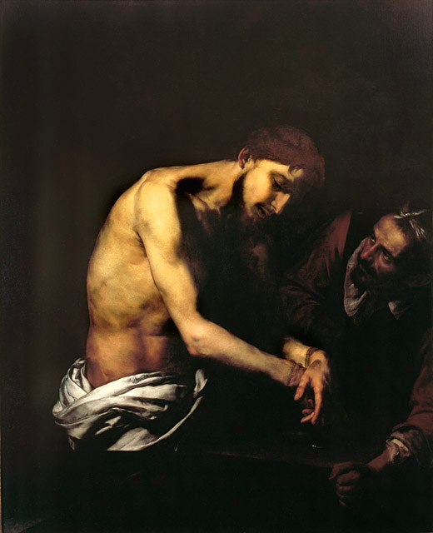
Flagellation of Christ
Jusepe de Ribera
Girolamini Gallery Naples, Italy

Slide 4
My times are in your hand; deliver me from the hand of my enemies and persecutors.
Psalm 31:15

Slide 5
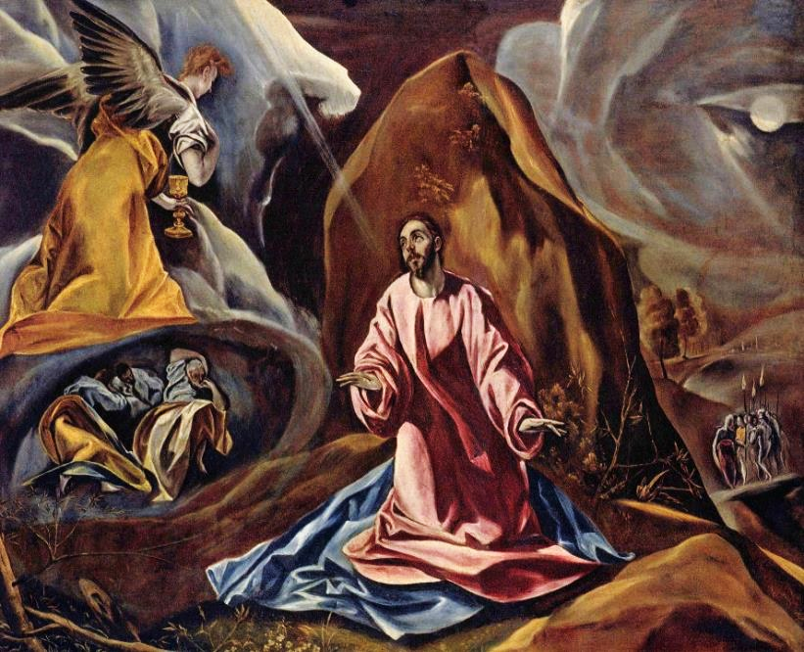
Christ on the Mount -- El Greco, National Gallery, London, England

Slide 6
he humbled himself and became obedient to the point of death-- even death on a cross.
Philippians 2:8

Slide 7
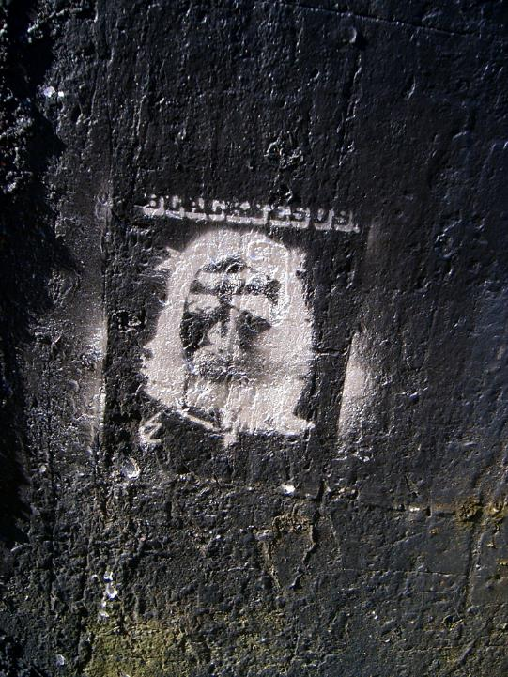
Black Jesus with Crown of Thorns
Roadside Mural
Wellington, New Zealand

Slide 8
While they were eating, Jesus took a loaf of bread, and after blessing it he broke it, gave it to the disciples, and said, "Take, eat; this is my body."
Matthew 26:26

Slide 9
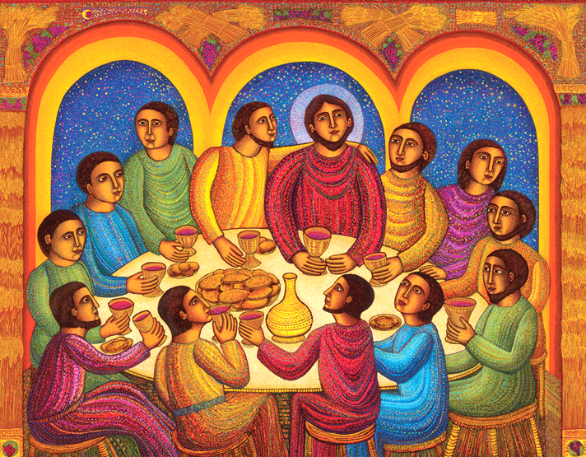
Last Supper -- John August Swanson, serigraph, 2009

Slide 10
"Friend, do what you are here to do." Then they came and laid hands on Jesus and arrested him.
Matthew 26:50bc

Slide 11
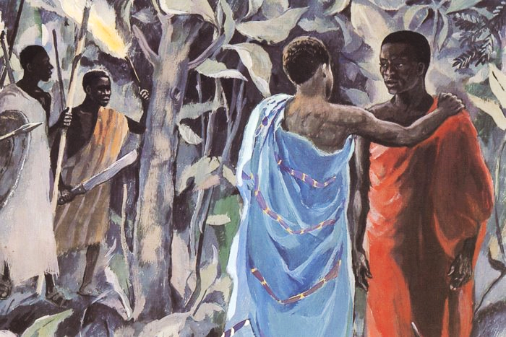
Kiss of Judas -- JESUS MAFA, Cameroon

Slide 12
Then the high priest said to him, “I put you under oath before the living God, tell us if you are the Messiah, the Son of God.“ Jesus said to him, "You have said so.
Matthew 26:63bc, 64a

Slide 13
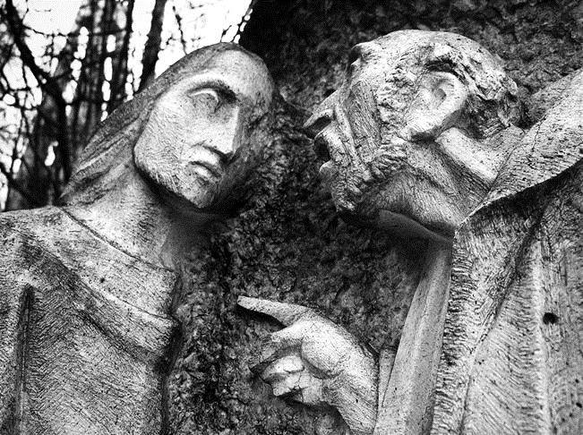
The Sanhedrin Examine Jesus -- Sanctuario di Lourdes Nevegal, Nevegal, Italy

Slide 14
Now Peter was sitting outside in the courtyard. A servant-girl came to him and said, “You also were with Jesus the Galilean.” But he denied it before all of them…
Matthew 26:69, 70a

Slide 15
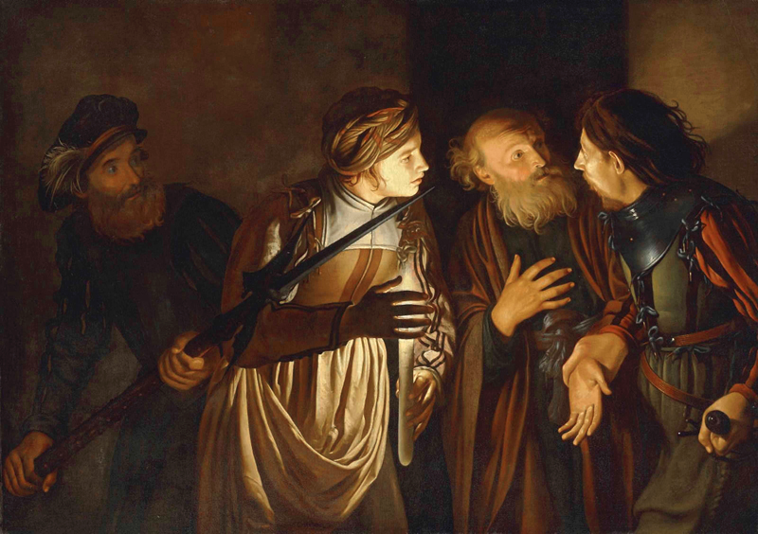
Peter’s Denial -- Adam de Coster, early 17th century

Slide 16
Then Pilate said to him, "Do you not hear how many accusations they make against you?” But he gave him no answer…so that the governor was greatly amazed.
Matthew 27:13-14

Slide 17
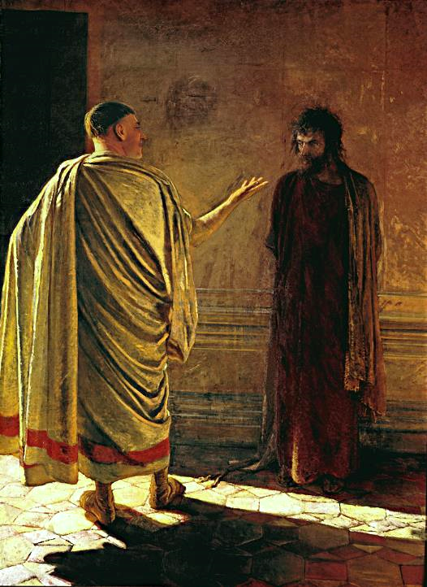
What is Truth?
Nicolai Ge
Tretyakov State Gallery
Moscow, Russia

Slide 18
…twisting some thorns into a crown, they put it on his head...and mocked him, saying, "Hail, King of the Jews!” Then they led him away to crucify him.
Matthew 27:29, 31a

Slide 19
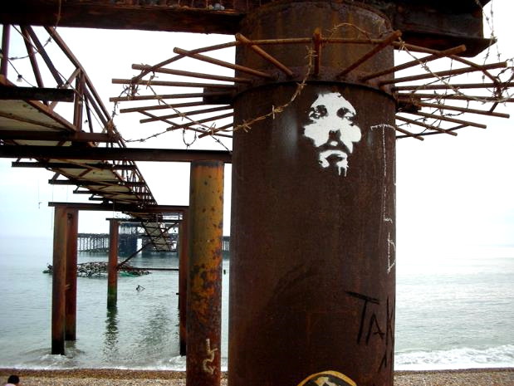
Crown of Thorns -- Easter 2007, West Pier, Brighton, England

Slide 20
Those who passed by derided him, shaking their heads and saying, “…If you are the Son of God, come down from the cross."
Matthew 27:39, 40ac

Slide 21
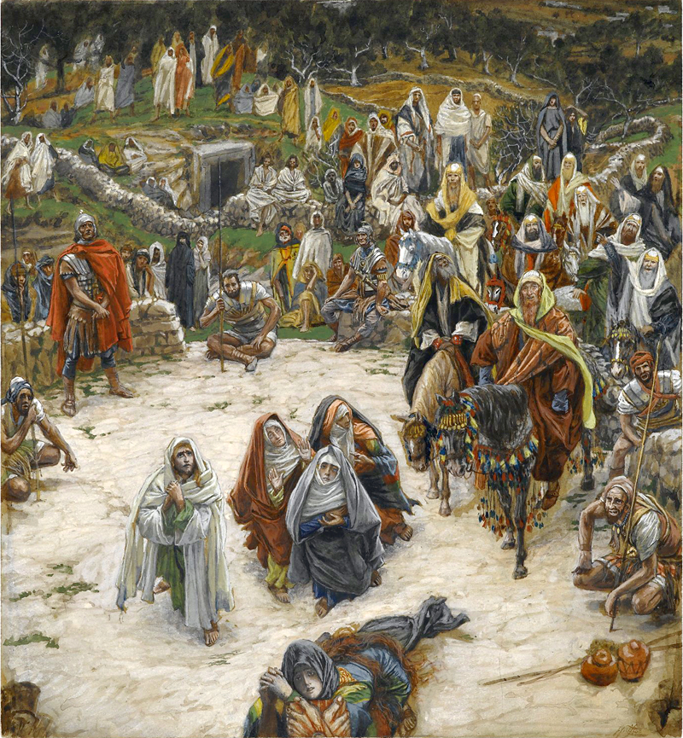
What Christ Saw from the Cross
James Tissot
Brooklyn Museum

Slide 22
And about three o'clock Jesus cried with a loud voice, "Eloi, Eloi, lema sabachthani?" that is, "My God, my God, why have you forsaken me?"
Matthew 27:46

Slide 23
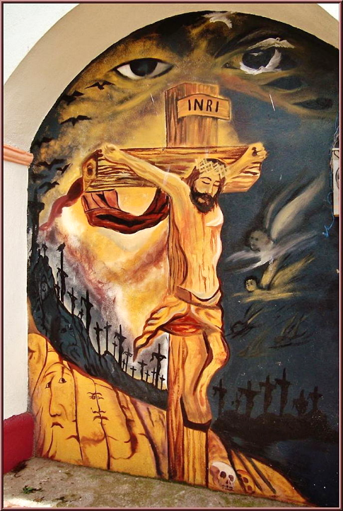
Crucifixion
Parish Church
Coatepec, Mexico

Slide 24
Then Jesus cried again with a loud voice and breathed his last.
Matthew 27:50

Slide 25
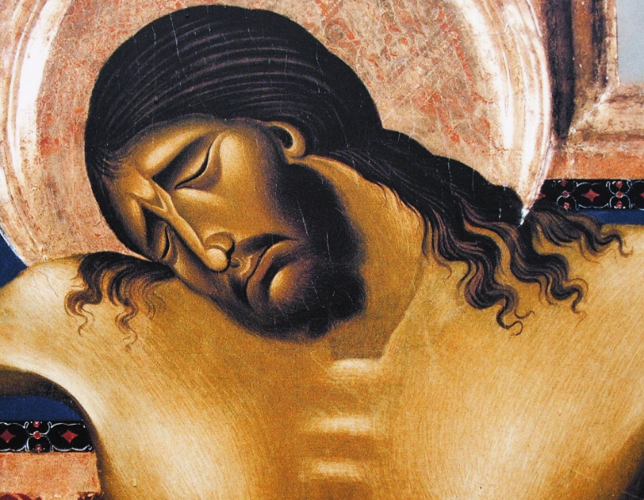
Crucifixion, detail -- Cimabue, Church of San Domenico, Arezzo, Italy

Slide 26
Many women were also there, looking on from a distance; they had followed Jesus from Galilee and had provided for him.
Matthew 27:55

Slide 27
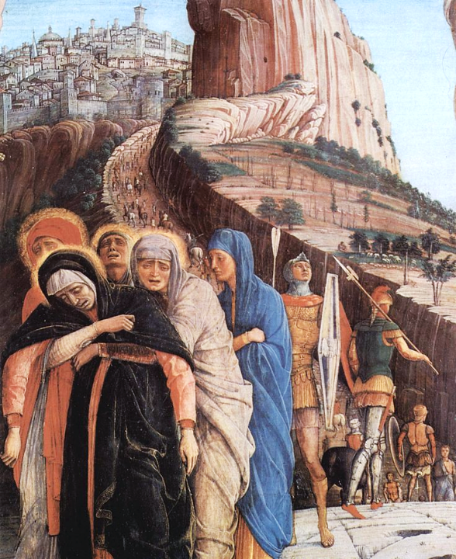
Crucifixion, detail
Andrea Mantegna
Basilica of San Zeno
Verona, Italy

Slide 28
Joseph took the body and wrapped it in a clean linen cloth and laid it in his own new tomb…
Matthew 27:59-60a

Slide 29
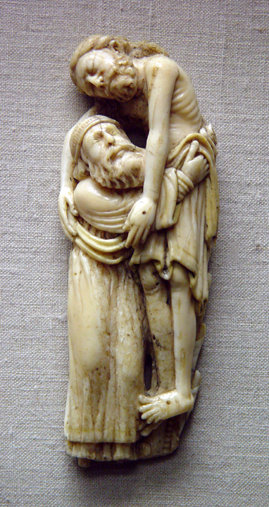
Joseph of Arimathea with the Body of Christ
Early 13th century
Victoria and Albert Museum
London, England

Slide 30
Credits
New Revised Standard Version Bible, copyright 1989, Division of Christian Education of the National Council of the Churches of Christ in the United States of America. Used by permission. All rights reserved.
https://commons.wikimedia.org/wiki/File:The_Flagellation_of_ChrisSpagnGirolamNaples.jpg
https://commons.wikimedia.org/wiki/File:El_Greco_019.jpg
http://www.flickr.com/photos/taniwha/5224693/
www.JohnAugustSwanson.com - copyright 2009 by John August Swanson
http://diglib.library.vanderbilt.edu/act-imagelink.pl?RC=48300
http://www.flickr.com/photos/brtsergio/2338170327
https://commons.wikimedia.org/wiki/File:Adam_de_Coster_-_The_Denial_of_Saint_Peter.jpg
https://commons.wikimedia.org/wiki/File:What_is_truth.jpg
http://www.flickr.com/photos/barkaway/471544128/
http://www.flickr.com/photos/gandalfspics/5312574176/
https://commons.wikimedia.org/wiki/File:Brooklyn_Museum_-_What_Our_Lord_Saw_from_the_Cross_(Ce_que_voyait_Notre-Seigneur_sur_la_Croix)_-_James_Tissot.jpg
https://commons.wikimedia.org/wiki/File:Parroquia_de_la_Asunci%C3%B3n_de_Mar%C3%ADa_(Coatepec_Harinas)_Estado_de_M%C3%A9xico,M%C3%A9xico.jpg
https://commons.wikimedia.org/wiki/File:Arezzo-Chiesa_di_san_Domenico-Crocifisso_di_Cimabue-closeup.jpg
Image courtesy of Patout Burns, Vanderbilt Divinity School
A service of the Vanderbilt Divinity Library, http://diglib.library.vanderbilt.edu/. All images available via Creative Commons 3.0 License.

