Slide 1
Liturgy of the Palms
Year A
Psalm 118:1-2, 19-29 Matthew 21:1-11

Slide 2
O give thanks to the LORD, for he is good; his steadfast love endures forever!
Psalm 118:1

Slide 3
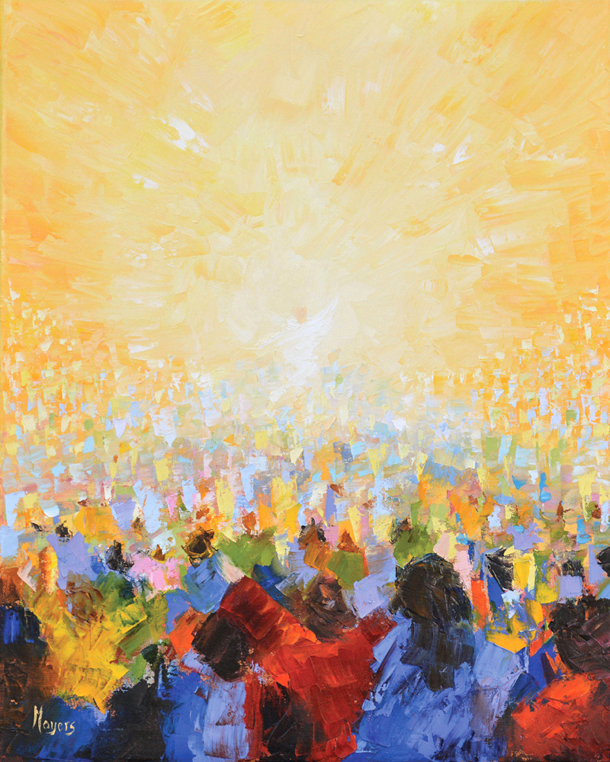
/
Hallelujah!
Mike Moyers
Nashville, TN

Slide 4
This is the gate of the LORD; the righteous shall enter through it.
Psalm 118:20

Slide 5
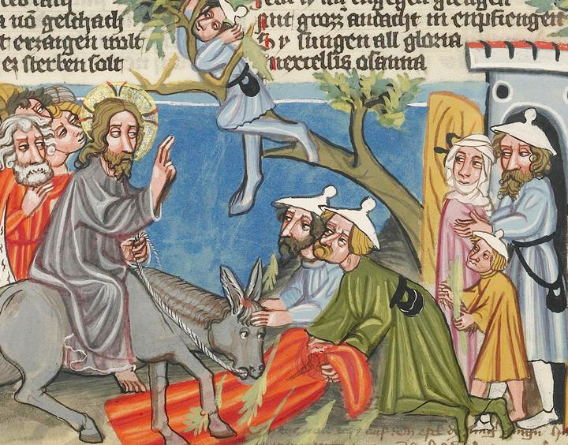
/
Entry into Jerusalem -- Manuscript illumination, c. 1400-1410, Getty Center, Los Angeles

Slide 6
The LORD is God, and he has given us light. Bind the festal procession with branches…
Psalm 118:27

Slide 7
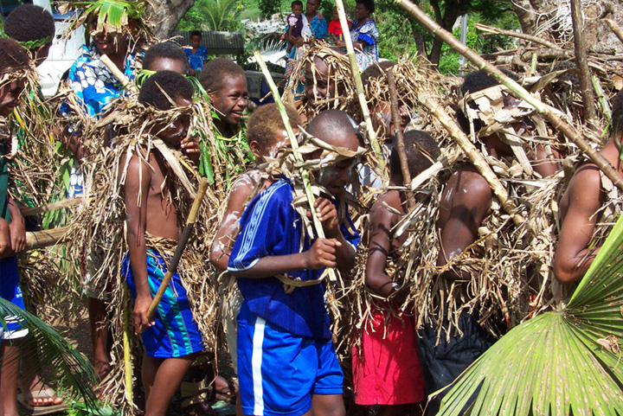
Palm Sunday Celebration Dance -- Youth of Pakarua Presbyterian Church, Port Vila, Vanuatu

Slide 8
When they had come near Jerusalem and had reached Bethphage, at the Mount of Olives, Jesus sent two disciples,
Matthew 21:1

Slide 9
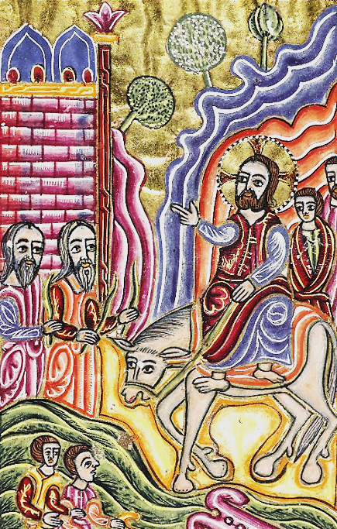
._d.13._Armenian_Gospels-0013-0.jpg
Entry into Jerusalem
Illuminated Armenian Gospels
Bodleian Library Oxford, England

Slide 10
saying to them, "Go into the village ahead of you, and immediately you will find a donkey tied, and a colt with her; untie them and bring them to me.
Matthew 21:2

Slide 11
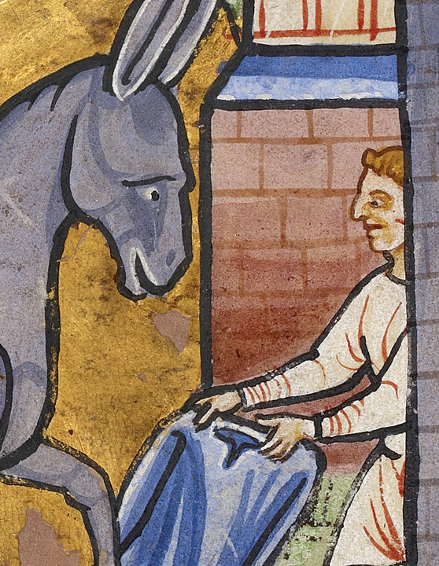
http://www.getty.edu/art/collection/objects/244431/unknown-maker-the-entry-into-jerusalem-english-illumination-about-1190-written-about-1490/
The Entry into Jerusalem, detail
Manuscript illumination, c. 1190
Getty Center
Los Angeles, CA

Slide 12
This took place to fulfill what had been spoken through the prophet, saying,
Matthew 21:4

Slide 13
"Tell the daughter of Zion, Look, your king is coming to you, humble, and mounted on a donkey, and on a colt, the foal of a donkey."
Matthew 21:5

Slide 14
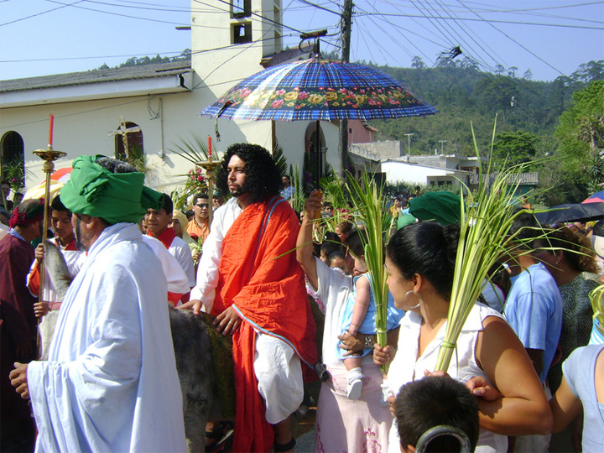
Palm Sunday Procession -- Church of San Martin, Tegucigalpa, Honduras

Slide 15
…they brought the donkey and the colt, and put their cloaks on them,
and he sat on them.
Matthew 21:7

Slide 16
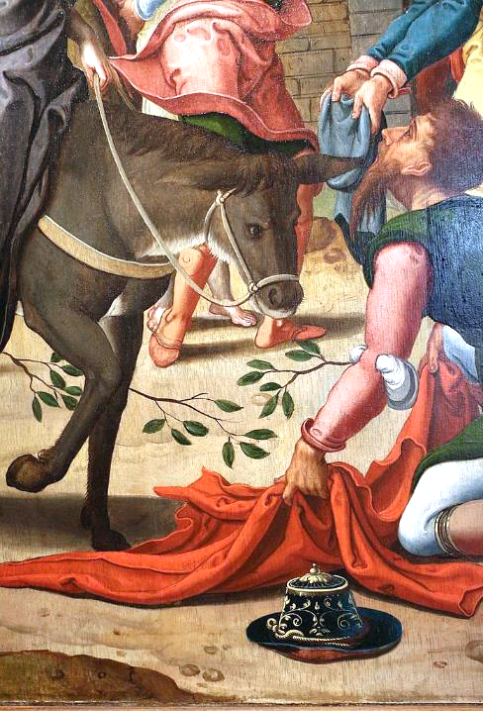
Entry into Jerusalm, detail
Pieter Coecks van Aelst
Bonnefantenmuseum
Maastricht, Netherlands

Slide 17
A very large crowd spread their cloaks on the road, and others cut branches from the trees and spread them on the road.
Matthew 21:8

Slide 18
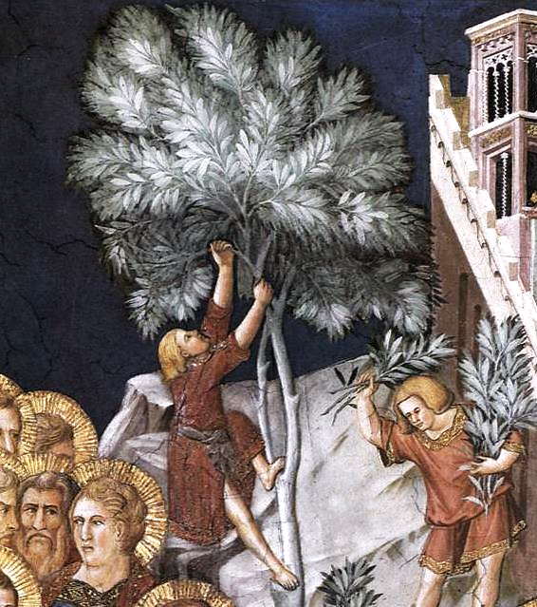
Entry into Jerusalem, detail -- Pietro Lorenzetti, Lower Church, San Francesco, Assisi

Slide 19
The crowds that went ahead of him and that followed were shouting, "Hosanna to the Son of David!
Matthew 21:9a

Slide 20
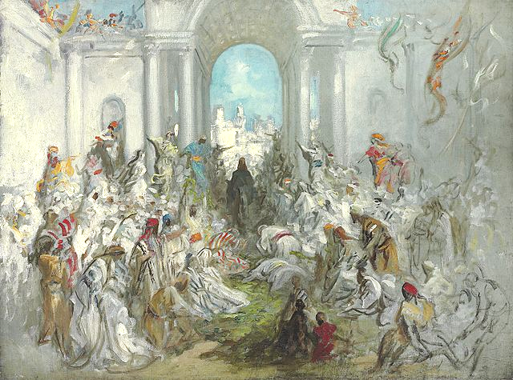
Christ’s Entry into Jerusalem -- Gustave Doré

Slide 21
Blessed is the one who comes
in the name of the Lord!
Matthew 21:9b

Slide 22
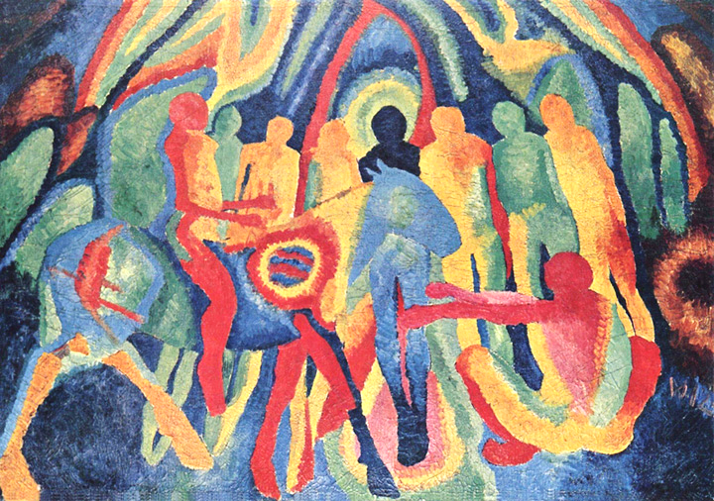
Entry into Jerusalem -- Wilhelm Morgner, Museum am Ostwall, Dortmund, Germany

Slide 23
Hosanna in the highest heaven!"
Matthew 21:9c

Slide 24
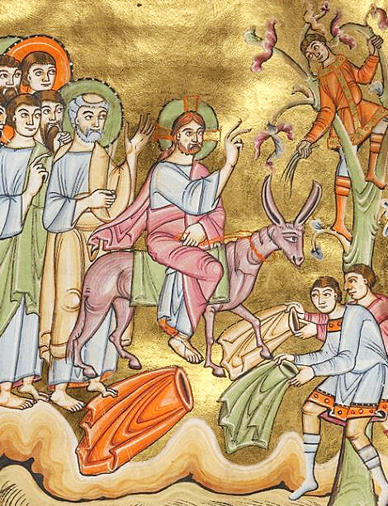
Entry into Jerusalem
Illuminated manuscript
c. 1030
Getty Center
Los Angeles, CA

Slide 25
When he entered Jerusalem, the whole city was in turmoil, asking, "Who is this?"?
Matthew 21:10

Slide 26
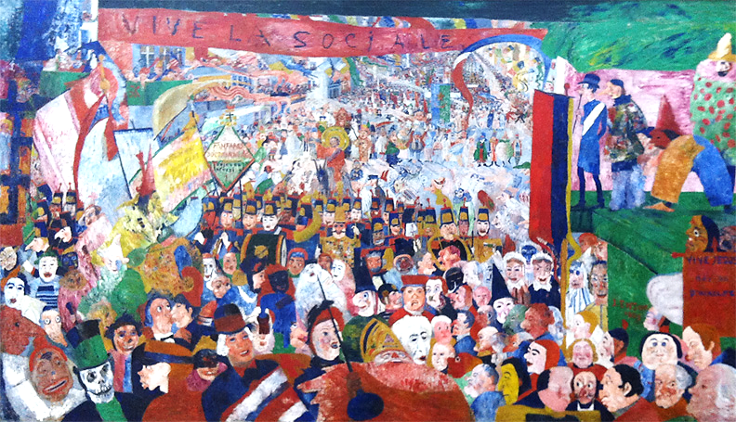
Christ’s Entry into Brussels -- James Ensor, Getty Museum, Los Angeles, CA

Slide 27
The crowds were saying, "This is the prophet Jesus from Nazareth in Galilee."
Matthew 21:11

Slide 28
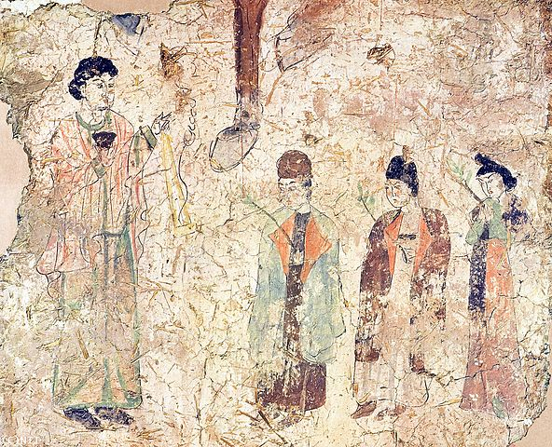
Palm Sunday -- Nestorian Temple, Khocho, China, 683-770 AD

Slide 29
Credits
New Revised Standard Version Bible, copyright 1989, Division of Christian Education of the National Council of the Churches of Christ in the United States of America. Used by permission. All rights reserved.
Mike Moyers, https://www.mikemoyersfineart.com/
http://www.getty.edu/art/collection/objects/2068/unknown-maker-the-entry-into-jerusalem-german-about-1400-1410
https://www.flickr.com/photos/yumievriwan/288750960/
https://commons.m.wikimedia.org/wiki/File:Bodleian_Library_MS._Arm
http://www.flickr.com/photos/johndonaghy/3415402416/
https://commons.m.wikimedia.org/wiki/File:Pieter_coecks_van_aelst,_entrata_a_gerusalemme,_1530-35_ca._03_asino.jpg
https://commons.m.wikimedia.org/wiki/File:Pietro_Lorenzetti_-_Entry_of_Christ_into_Jerusalem_(detail)_-_WGA13503.jpg#mw-jump-to-license
https://commons.m.wikimedia.org/wiki/File:Gustave_Dor%C3%A9_-_Christ%27s_Entry_into_Jerusalem.jpg
http://commons.wikimedia.org/wiki/File:Wilhelm_Morgner_001.jpg
https://commons.wikimedia.org/wiki/File:The_Entry_into_Jerusalem_-_Google_Art_Project_(6834070).jpg
https://www.flickr.com/photos/symo_26/7927523280 - Justin Symons
https://commons.m.wikimedia.org/wiki/File:Nestorian_Temple_-_Palm_Sunday.jpg
Additional descriptions can be found at the Art in the Christian Tradition image library, a service of the Vanderbilt Divinity Library, http://diglib.library.vanderbilt.edu/. All images available via Creative Commons 3.0 License.

