Slide 1
Fourth Sunday of Easter
Year A
Acts 2:42-47 • Psalm 23 • 1 Peter 2:19-25 • John 10:1-10

Slide 2
Day by day…, they broke bread at home and ate their food with glad and generous hearts.
Acts 2:46ac

Slide 3
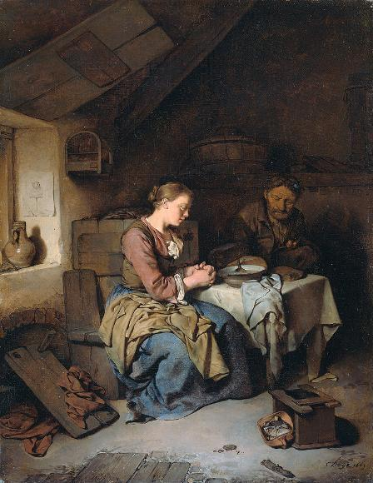
Saying Grace
Cornelis Bega Rijksmuseum Amsterdam

Slide 4
… he leads me beside still waters;
he restores my soul.
Psalm 23:2b, 3a

Slide 5
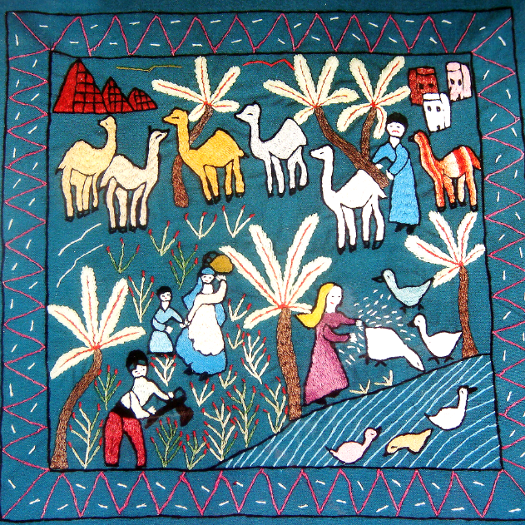
Daily Life -- Mottamadya Women's Association, Cairo, Egypt

Slide 6
When he was abused, he did not return abuse; when he suffered,
he did not threaten …
1 Peter 2:23a

Slide 7
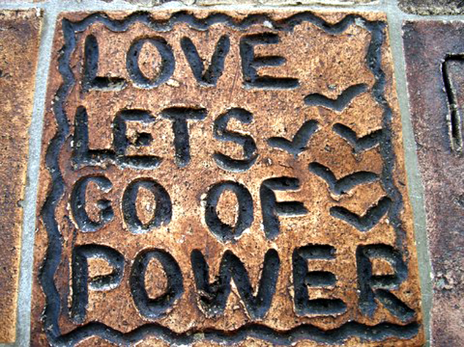
Tile from Peace Wall, Hamilton, New Zealand

Slide 8
“The one who enters by the gate
is the shepherd of the sheep.”
John 10:2

Slide 9
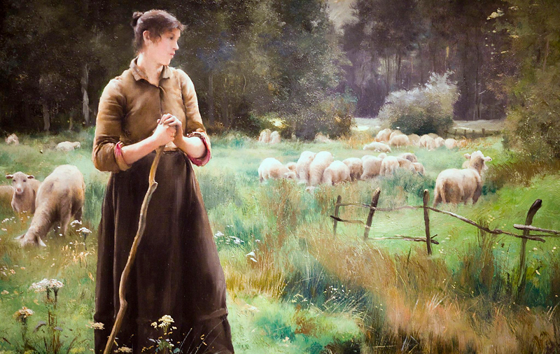
The Good Shepherd -- Julien Dupre, Legion of Honor Museum, San Francisco, CA

Slide 10
“… the sheep hear his voice. He calls his own sheep by name and leads them out.”
John 10:3b

Slide 11
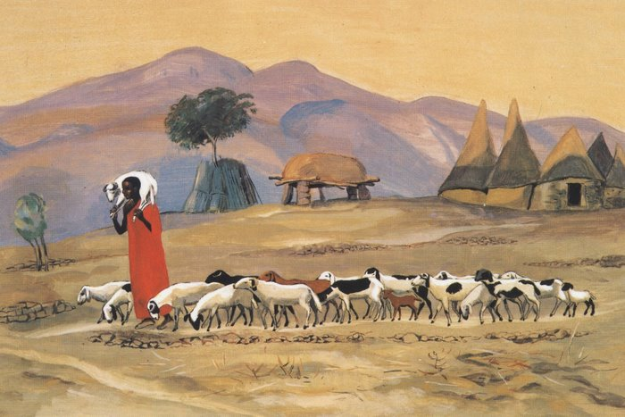
The Good Shepherd -- JESUS MAFA, Cameroon

Slide 12
“… he goes ahead of them, and the sheep follow him because they know his voice.”
John 10:4b

Slide 13
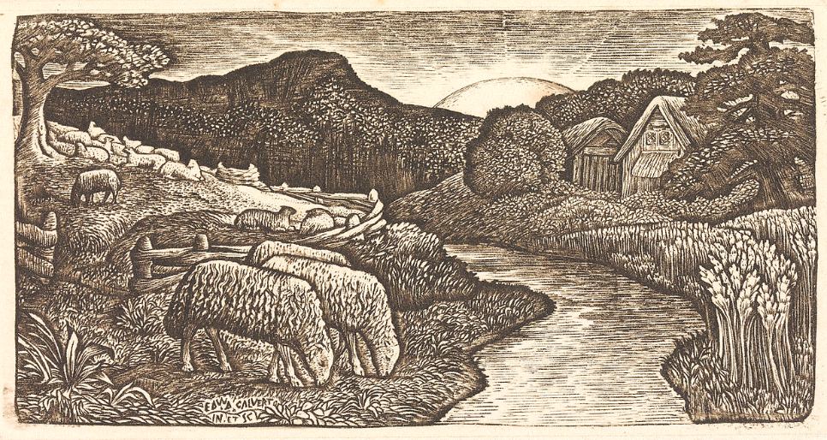
The Sheep of His Pasture -- Edward Calvert, Yale Center for British Art, New Haven, CT

Slide 14
“Very truly, I tell you, I am the gate for the sheep.”
John 10:7b

Slide 15
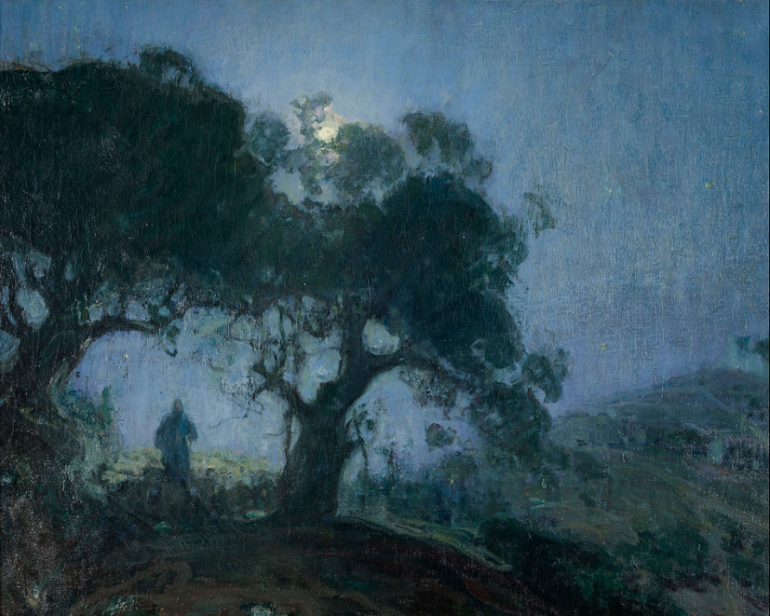
The Good Shepherd -- Henry Ossawa Tanner, Zimmerli Museum, Rutgers, NJ

Slide 16
“Whoever enters by me will be saved, and will come in and go out and find pasture.”
John 10:9b

Slide 17
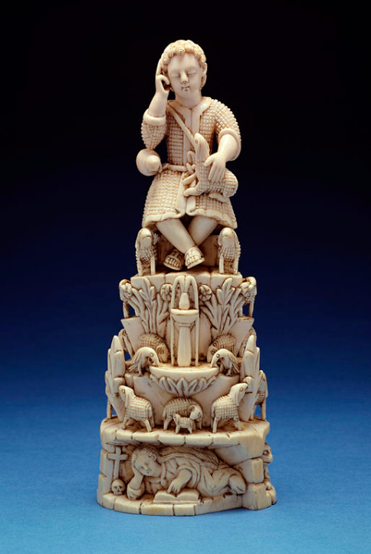
The Christ Child as Good Shepherd
Goa, India
Walters Art Museum, Baltimore, MD

Slide 18
“I came that they may have life, and have it abundantly."
John 10:10b

Slide 19
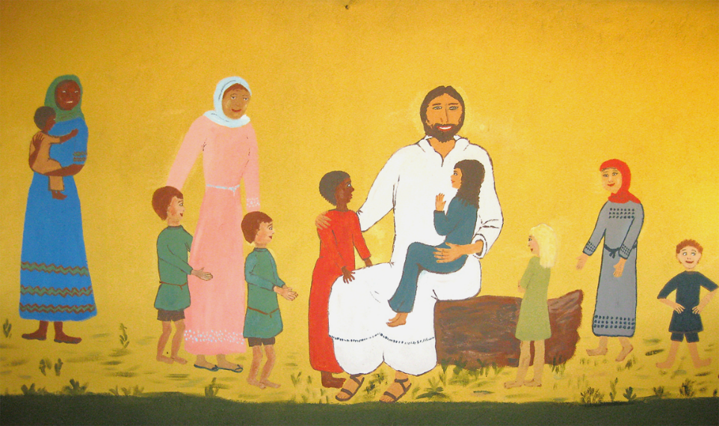
Jesus Welcomes All -- Church Mural, Sudan

Slide 20
Credits
New Revised Standard Version Bible, copyright 1989, Division of Christian Education of the National Council of the Churches of Christ in the United States of America. Used by permission. All rights reserved.
http://commons.wikimedia.org/wiki/File:BegaPrayer.jpg
https://www.flickr.com/photos/reisgekki/3056333088
http://www.flickr.com/photos/thomashawk/2202377733/
http://diglib.library.vanderbilt.edu/act-imagelink.pl?RC=48288
https://commons.wikimedia.org/wiki/File:Edward_Calvert_-_The_Sheep_of_His_Pasture_-_Google_Art_Project.jpg
https://commons.wikimedia.org/wiki/File:Henry_Ossawa_Tanner_-_The_Good_Shepherd_-_Google_Art_Project.jpg
https://commons.wikimedia.org/wiki/File:Indian_-_The_Christ_Child_as_Good_Shepherd_-_Walters_71324.jpg
https://www.flickr.com/photos/amyashcraft/13885591354/
Additional descriptions can be found at the Art in the Christian Tradition image library, a service of the Vanderbilt Divinity Library, http://diglib.library.vanderbilt.edu/. All images available via Creative Commons 3.0 License.

