Slide 1
Fourth Sunday in Lent
Year A
1 Samuel 16:1-13
Psalm 23
Ephesians 5:8-14
John 9:1-41

Slide 2
But the LORD said to Samuel, … the LORD does not see as mortals see;
they look on the outward appearance, but the LORD looks on the heart."
1 Samuel 16:7a, c

Slide 3
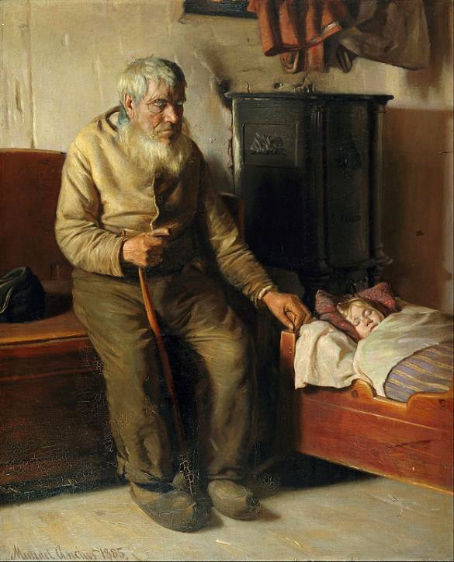
Blind Kristian Minding a Child
Michael Ancher
Hirschsprung Collection Copenhagen, Denmark

Slide 4
Even though I walk through the darkest valley, I fear no evil; for you are with me…
Psalm 23:4a

Slide 5
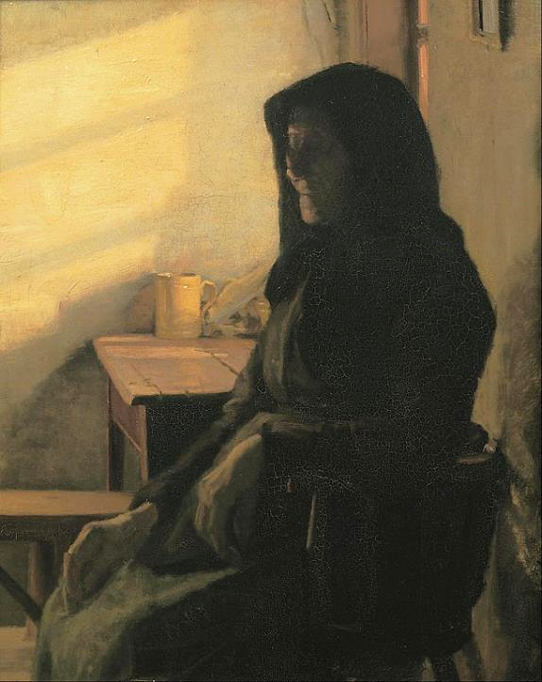
A Blind Woman in Her Room
Anna Ancher
Hirschsprung Collection Copenhagen, Denmark

Slide 6
For once you were darkness,
but now in the Lord you are light.
Live as children of light -
Ephesians 5:8

Slide 7
We Are the Children of Light
Wall Poster
Williamsburg, Brooklyn

Slide 8
As he walked along, he saw a man blind from birth.
John 9:1

Slide 9
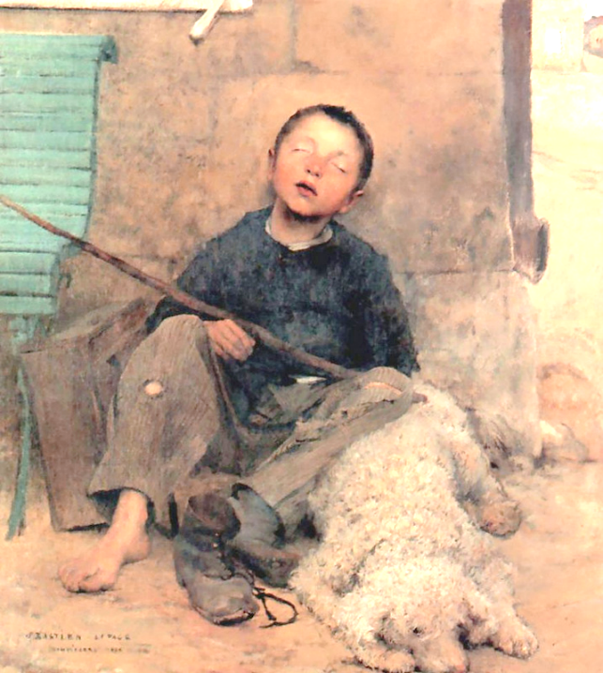
Blind Beggar
Jules Bastien-LePage
Musée des Beaux-Arts Tournai, France

Slide 10
“We must work the works of him who sent me while it is day…
As long as I am in the world,
I am the light of the world."
John 9:4a, 5

Slide 11
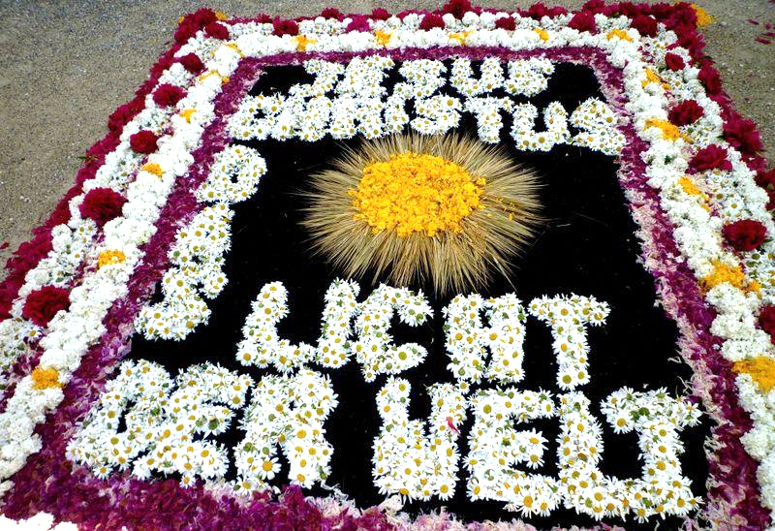
Jesus Christus das Licht der Welt -- Flower Festival, Aulendorf, Germany

Slide 12
he spat on the ground and made mud with the saliva and spread the mud on the man's eyes,
John 9:6b

Slide 13
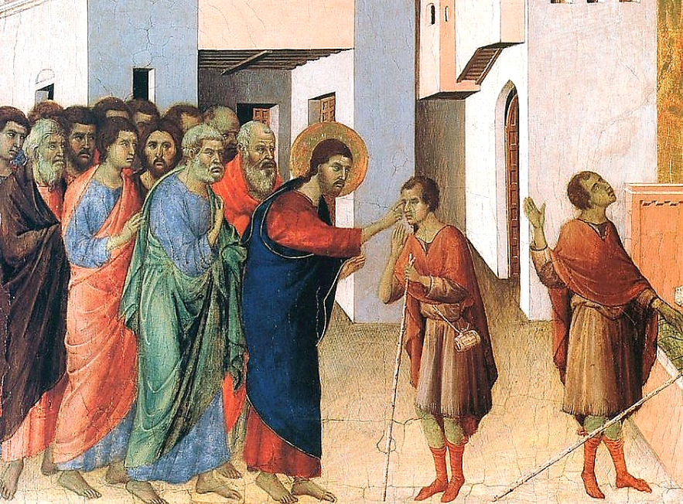
Healing of the Man Born Blind -- Duccio, National Gallery, London

Slide 14
saying to him, "Go, wash in the pool of Siloam" (which means Sent). Then he went and washed and came back able to see.
John 9:7

Slide 15
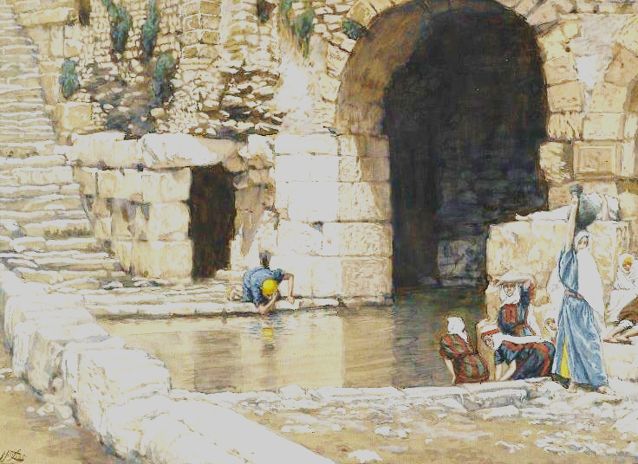
Blind Man Washes in the Pool of Siloam -- James Tissot, Brooklyn Museum, New York City

Slide 16
Now it was a sabbath day when Jesus made the mud and opened his eyes.
John 9:14

Slide 17
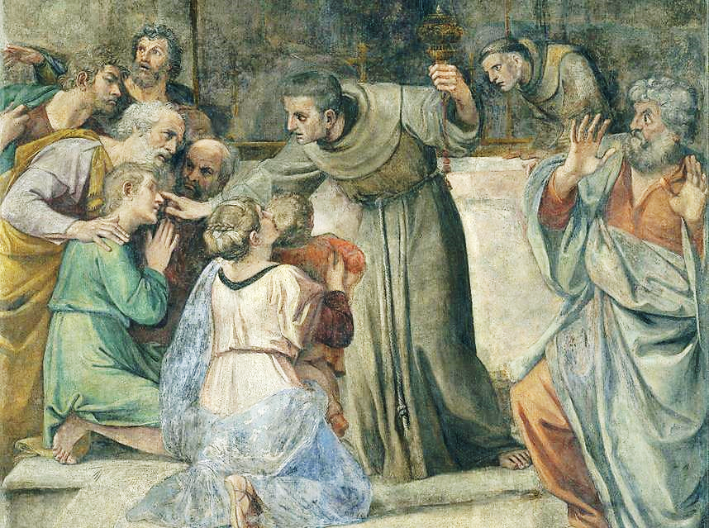
Healing the Man Born Blind -- A. Carraci, Museu Nacional d'Art de Catalunya, Barcelona

Slide 18
Some of the Pharisees said, "This man is not from God, for he does not observe the sabbath."
John 9:16

Slide 19
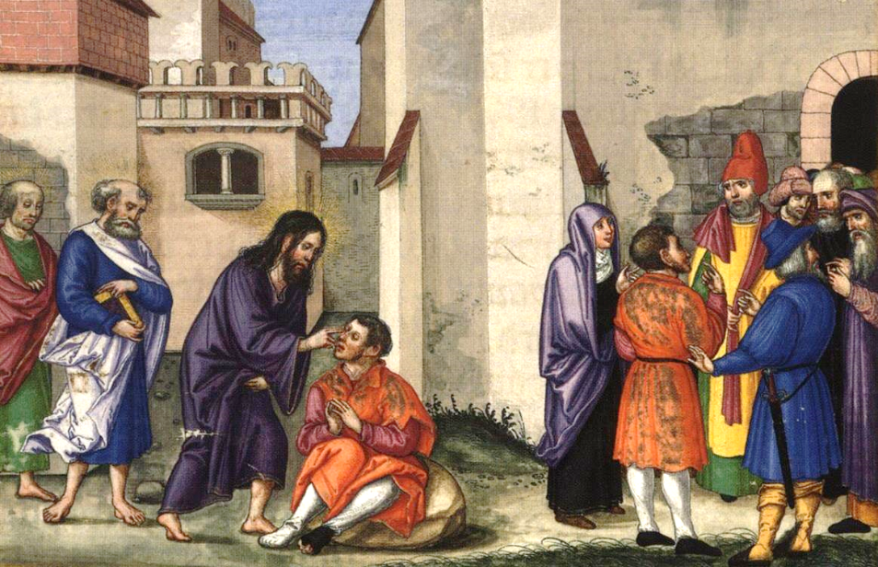
Healing of the Man Born Blind -- Matthias Gerung, Bayerische Staatsbibliothek, Munich

Slide 20
Jesus heard that they had driven him out, and when he found him, he said, "Do you believe in the Son of Man?"
John 9:35

Slide 21
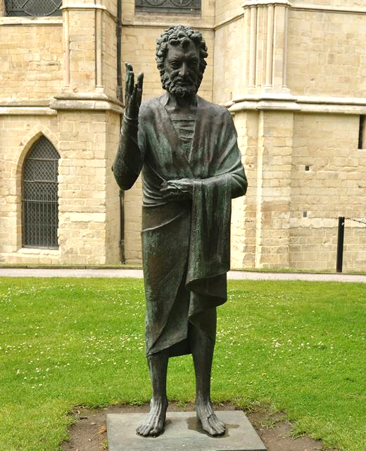
Son of Man
David McFall
Canterbury Cathedral Canterbury, England

Slide 22
Jesus said to him, "You have seen him, and the one speaking with you is he."
John 9:37

Slide 23
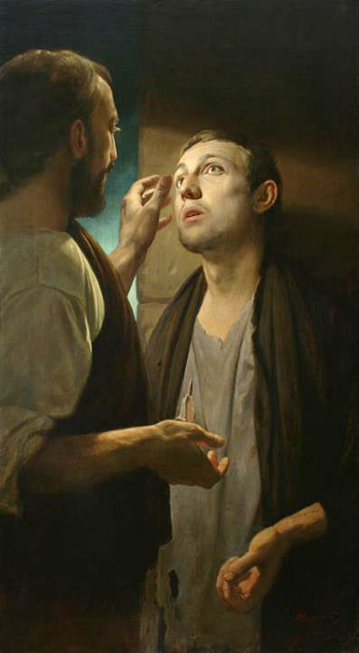
Christ and the Pauper
Andrey Mironov
Wikimedia

Slide 24
He said, "Lord, I believe." And he worshiped him.
John 9:38

Slide 25
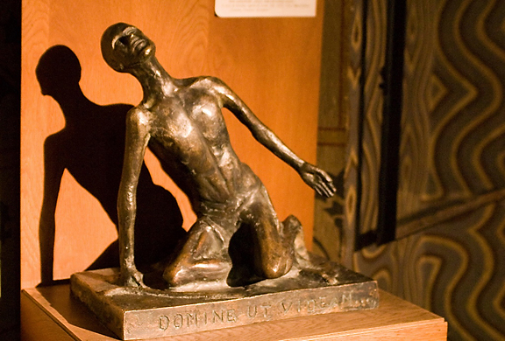
Christ Heals the Blind Man -- Matyas Church, Budapest, Hungary

Slide 26
Credits
New Revised Standard Version Bible, copyright 1989, Division of Christian Education of the National Council of the Churches of Christ in the United States of America. Used by permission. All rights reserved.
https://commons.wikimedia.org/wiki/File:Michael_Ancher_-_Blind_Kristian_minding_a_child_-_Google_Art_Project.jpg
https://commons.wikimedia.org/wiki/File:Anna_Ancher_-_A_blind_woman_in_her_room_-_Google_Art_Project.jpg
http://www.flickr.com/photos/lilomoony/6560430275/
http://commons.wikimedia.org/wiki/File:Jules_Bastien-Lepage_The_Blind_Beggar.jpg
http://commons.wikimedia.org/wiki/File:Aulendorf_-_Blumenteppich_zu_Fronleichnam.jpg
https://commons.wikimedia.org/wiki/File:Duccio_di_Buoninsegna_037.jpg
https://commons.wikimedia.org/wiki/File:Brooklyn_Museum_-_The_Blind_Man_Washes_in_the_Pool_of_Siloam_(Le_aveugle-n%C3%A9_se_lave_%C3%A0_la_piscine_de_Silo%C3%AB)_-_James_Tissot.jpg
https://commons.wikimedia.org/wiki/File:Annibale_Carracci_-_Healing_the_Man_Born_Blind_-_Google_Art_Project.jpg
https://commons.wikimedia.org/wiki/File:Ottheinrich_Folio126v_Jn9.jpg
https://commons.wikimedia.org/wiki/File:Canterbury_Cathedral_34.jpg - Nilfanion
https://commons.wikimedia.org/wiki/File:Christ_and_the_pauper.jpg
http://www.flickr.com/photos/stephenr/2296612588/
Additional descriptions can be found at the Art in the Christian Tradition image library, a service of the Vanderbilt Divinity Library, http://diglib.library.vanderbilt.edu/. All images available via Creative Commons 3.0 License.

