Slide 1
First Sunday in Lent
Year A
Genesis 2:15-17; 3:1-7 Psalm 32
Romans 5:12-19 Matthew 4:1-11

Slide 2
…of the tree of the knowledge of good and evil you shall not eat…
Genesis 2:17a

Slide 3
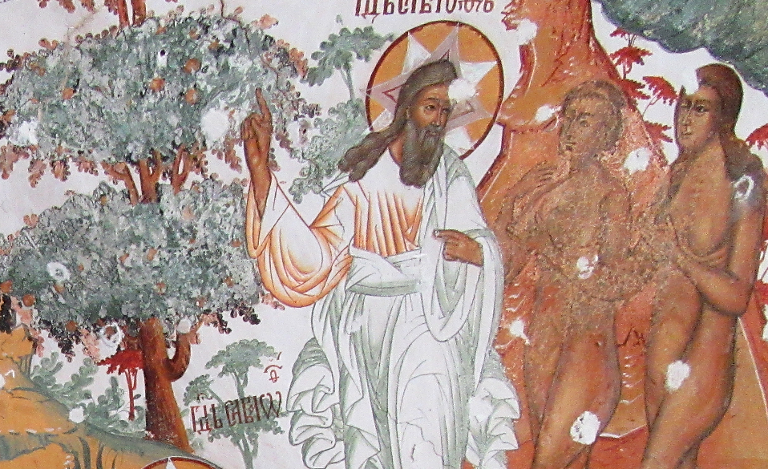
?
Heavenly Paradise, detail -- Cathedral of the Resurrection, Toutaiev, Russia

Slide 4
…she took of its fruit and ate;
and she also gave some to her husband, who was with her,
and he ate.
Genesis 3:6

Slide 5
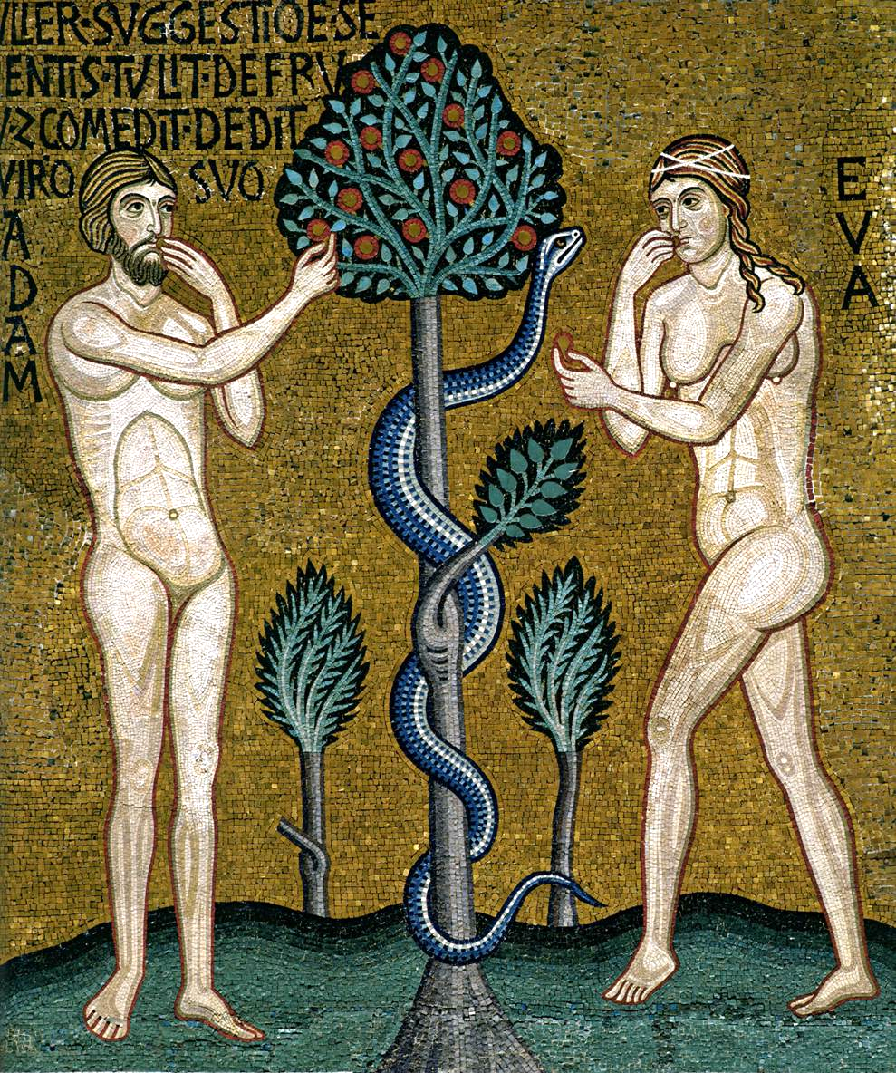
Temptation in the Garden -- Palatine Chapel, Palermo, Sicily

Slide 6
Then I acknowledged my sin to you… and you forgave the guilt of my sin.
Psalm 32:5a,c

Slide 7
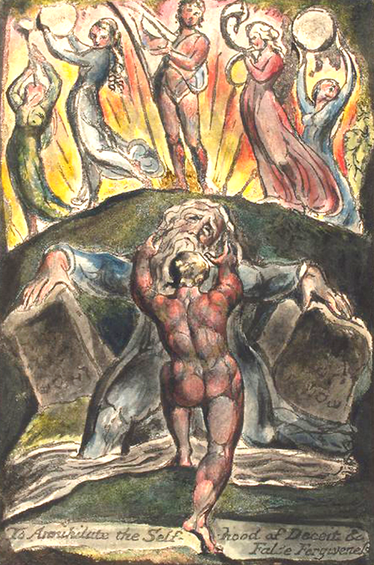
To Annihilate the Self-hood of Deceit and False Forgiveness
William Blake
New York Public Library
New York, NY

Slide 8
Be glad in the LORD and rejoice…
shout for joy, all you upright in heart.
Psalm 32:11

Slide 9
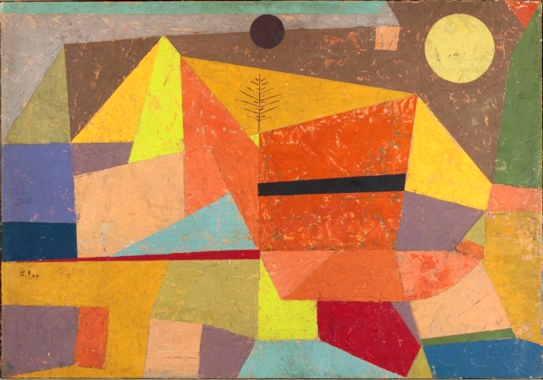
Joyful Mountain Landscape -- Paul Klee, Yale University Art Gallery, New Haven, CT

Slide 10
…receive the abundance of grace and the free gift of righteousness …through the one man, Jesus Christ.
Romans 5:17b

Slide 11
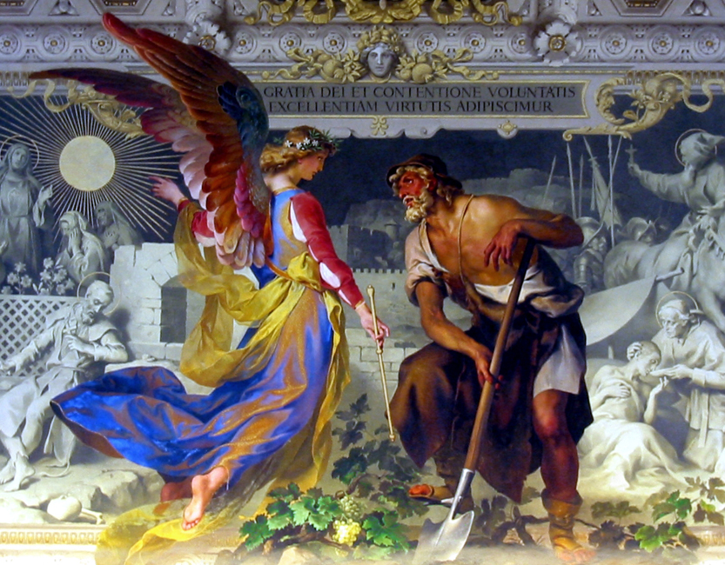
"With the grace of God and the effort of will, we obtain the excellence of virtue” -- Vatican Museum

Slide 12
The tempter came and said to him,
"If you are the Son of God,
command these stones to become loaves of bread."
Matthew 4:3

Slide 13
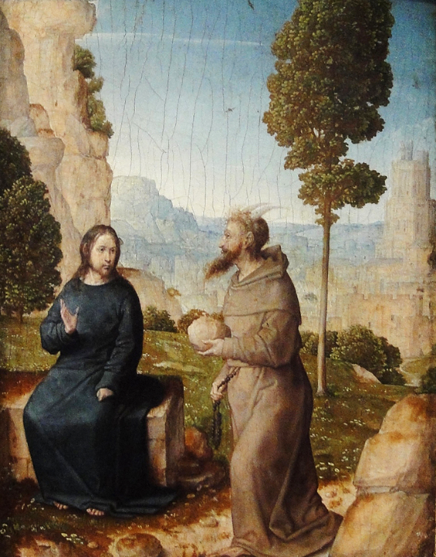
Jesus and the Tempter
National Gallery of Art
Washington, DC

Slide 14
But he answered, "It is written,
'One does not live by bread alone,
but by every word that comes from
the mouth of God.'"
Matthew 4:4

Slide 15
“In the beginning was the word…”
Grands Heures d’Anne de Bretagne
Jean Bourdichon
Bibliotheque Nationale, Paris, France

Slide 16
Then the devil took him to
the holy city and placed him
on the pinnacle of the temple,
…saying to him, "If you are the Son
of God, throw yourself down…”
Matthew 4:5-6

Slide 17
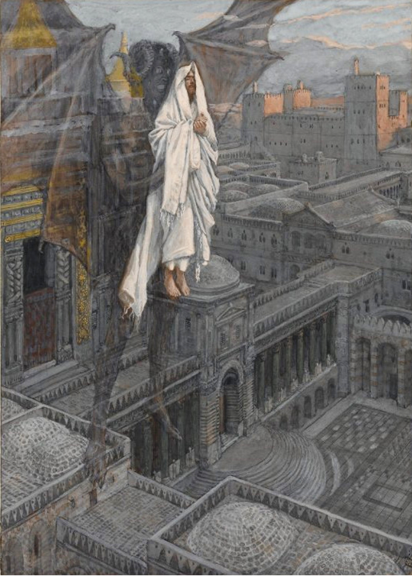
Jesus Carried Up to the Pinnacle of the Temple
James Tissot
Brooklyn Museum, New York, NY

Slide 18
Jesus said to him, "Again it is written, 'Do not put the Lord your God to the test.'"
Matthew 4:7

Slide 19
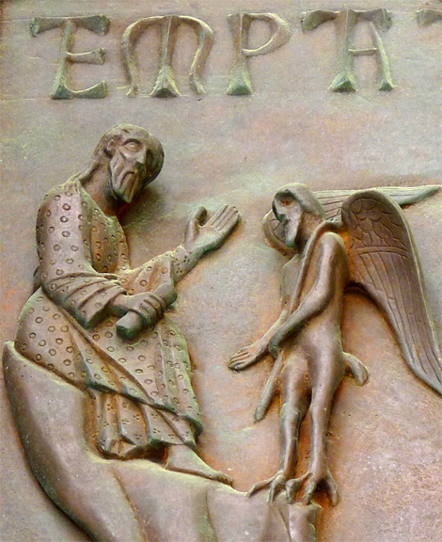
Temptation of Christ
South door, Duomo
Pisa, Italy

Slide 20
Again, the devil took him to a very
high mountain and he said to him,
"All these I will give you, if you will
fall down and worship me."
Matthew 4:8a, 9b

Slide 21
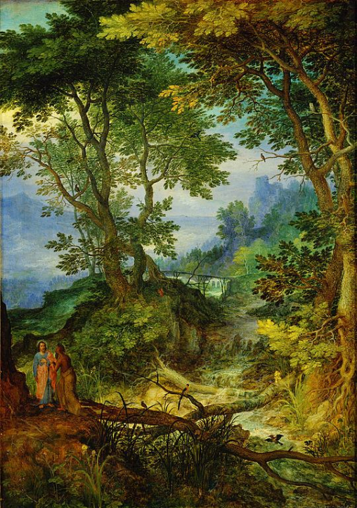
Mountain Landscape with the Temptation of Christ
Jan Brueghel the Elder
Kunsthistorisches Museum
Munich, Germany

Slide 22
Jesus said to him, "Away with you, Satan! for it is written,
'Worship the Lord your God,
and serve only him.'"
Matthew 4:10

Slide 23
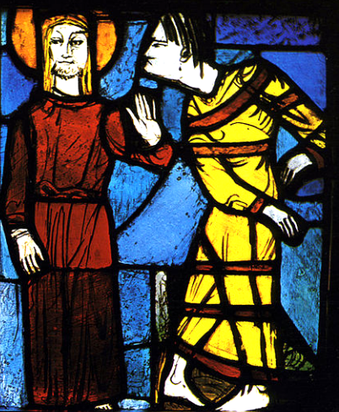
Temptation of Jesus, 1940
Josef Huber
Church of Sts. Peter and Paul Leonberg, Germany

Slide 24
Credits
New Revised Standard Version Bible, copyright 1989, Division of Christian Education of the National Council of the Churches of Christ in the United States of America. Used by permission. All rights reserved.
https://commons.wikimedia.org/wiki/File:Briton_Rivi%C3%A8re_-_The_Temptation_in_the_Wilderness.jpg
https://commons.wikimedia.org/wiki/File:Paradis_terrestre_;_fresque_de_la_cath%C3%A9drale_de_la_Resurrection_%C3%A0_Touta%C3%AFev_IMG_0496.jpg – Mortier.Daniel
CC BY-NC-ND 2.0
http://commons.wikimedia.org/wiki/File:To_annihilate_the_Self-hood_of_Deceit_and_Fals_Forgiveness_1804.jpg
http://commons.wikimedia.org/wiki/File:Heitere_Gebirgslandschaft_by_Paul_Klee_1929.jpeg
http://www.flickr.com/photos/mamjodh/2325880511/
http://www.flickr.com/photos/jimforest/4008865269/
https://commons.wikimedia.org/wiki/File:Evangile_Jean_Grandes_Heures_Anne_de_Bretagne.jpg
http://commons.wikimedia.org/wiki/File:Brooklyn_Museum_-_Jesus_Carried_up_to_a_Pinnacle_of_the_Temple_(J%C3%A9sus_port%C3%A9_sur_le_pinacle_du_Temple)_-_James_Tissot_-_overall.jpg
https://www.flickr.com/photos/damiavos/14427254824
https://commons.wikimedia.org/wiki/File:Jan_Brueghel_(I)_-_Mountain_Landscape_with_the_Temptation_of_Christ.jpg
https://commons.wikimedia.org/wiki/File:Versuchung_Jesu_1938-40.jpg – Adrix3000
Additional descriptions can be found at the Art in the Christian Tradition image library, a service of the Vanderbilt Divinity Library, http://diglib.library.vanderbilt.edu/. All images available via Creative Commons 3.0 License.

